Slide 1
Use of Self
Date

Slide 2
Breakout discussion 1
Share what you love about working as a peer.
After this discussion, you will be asked to introduce yourself to the other group members, and share your reflections from this discussion.
5

Slide 3
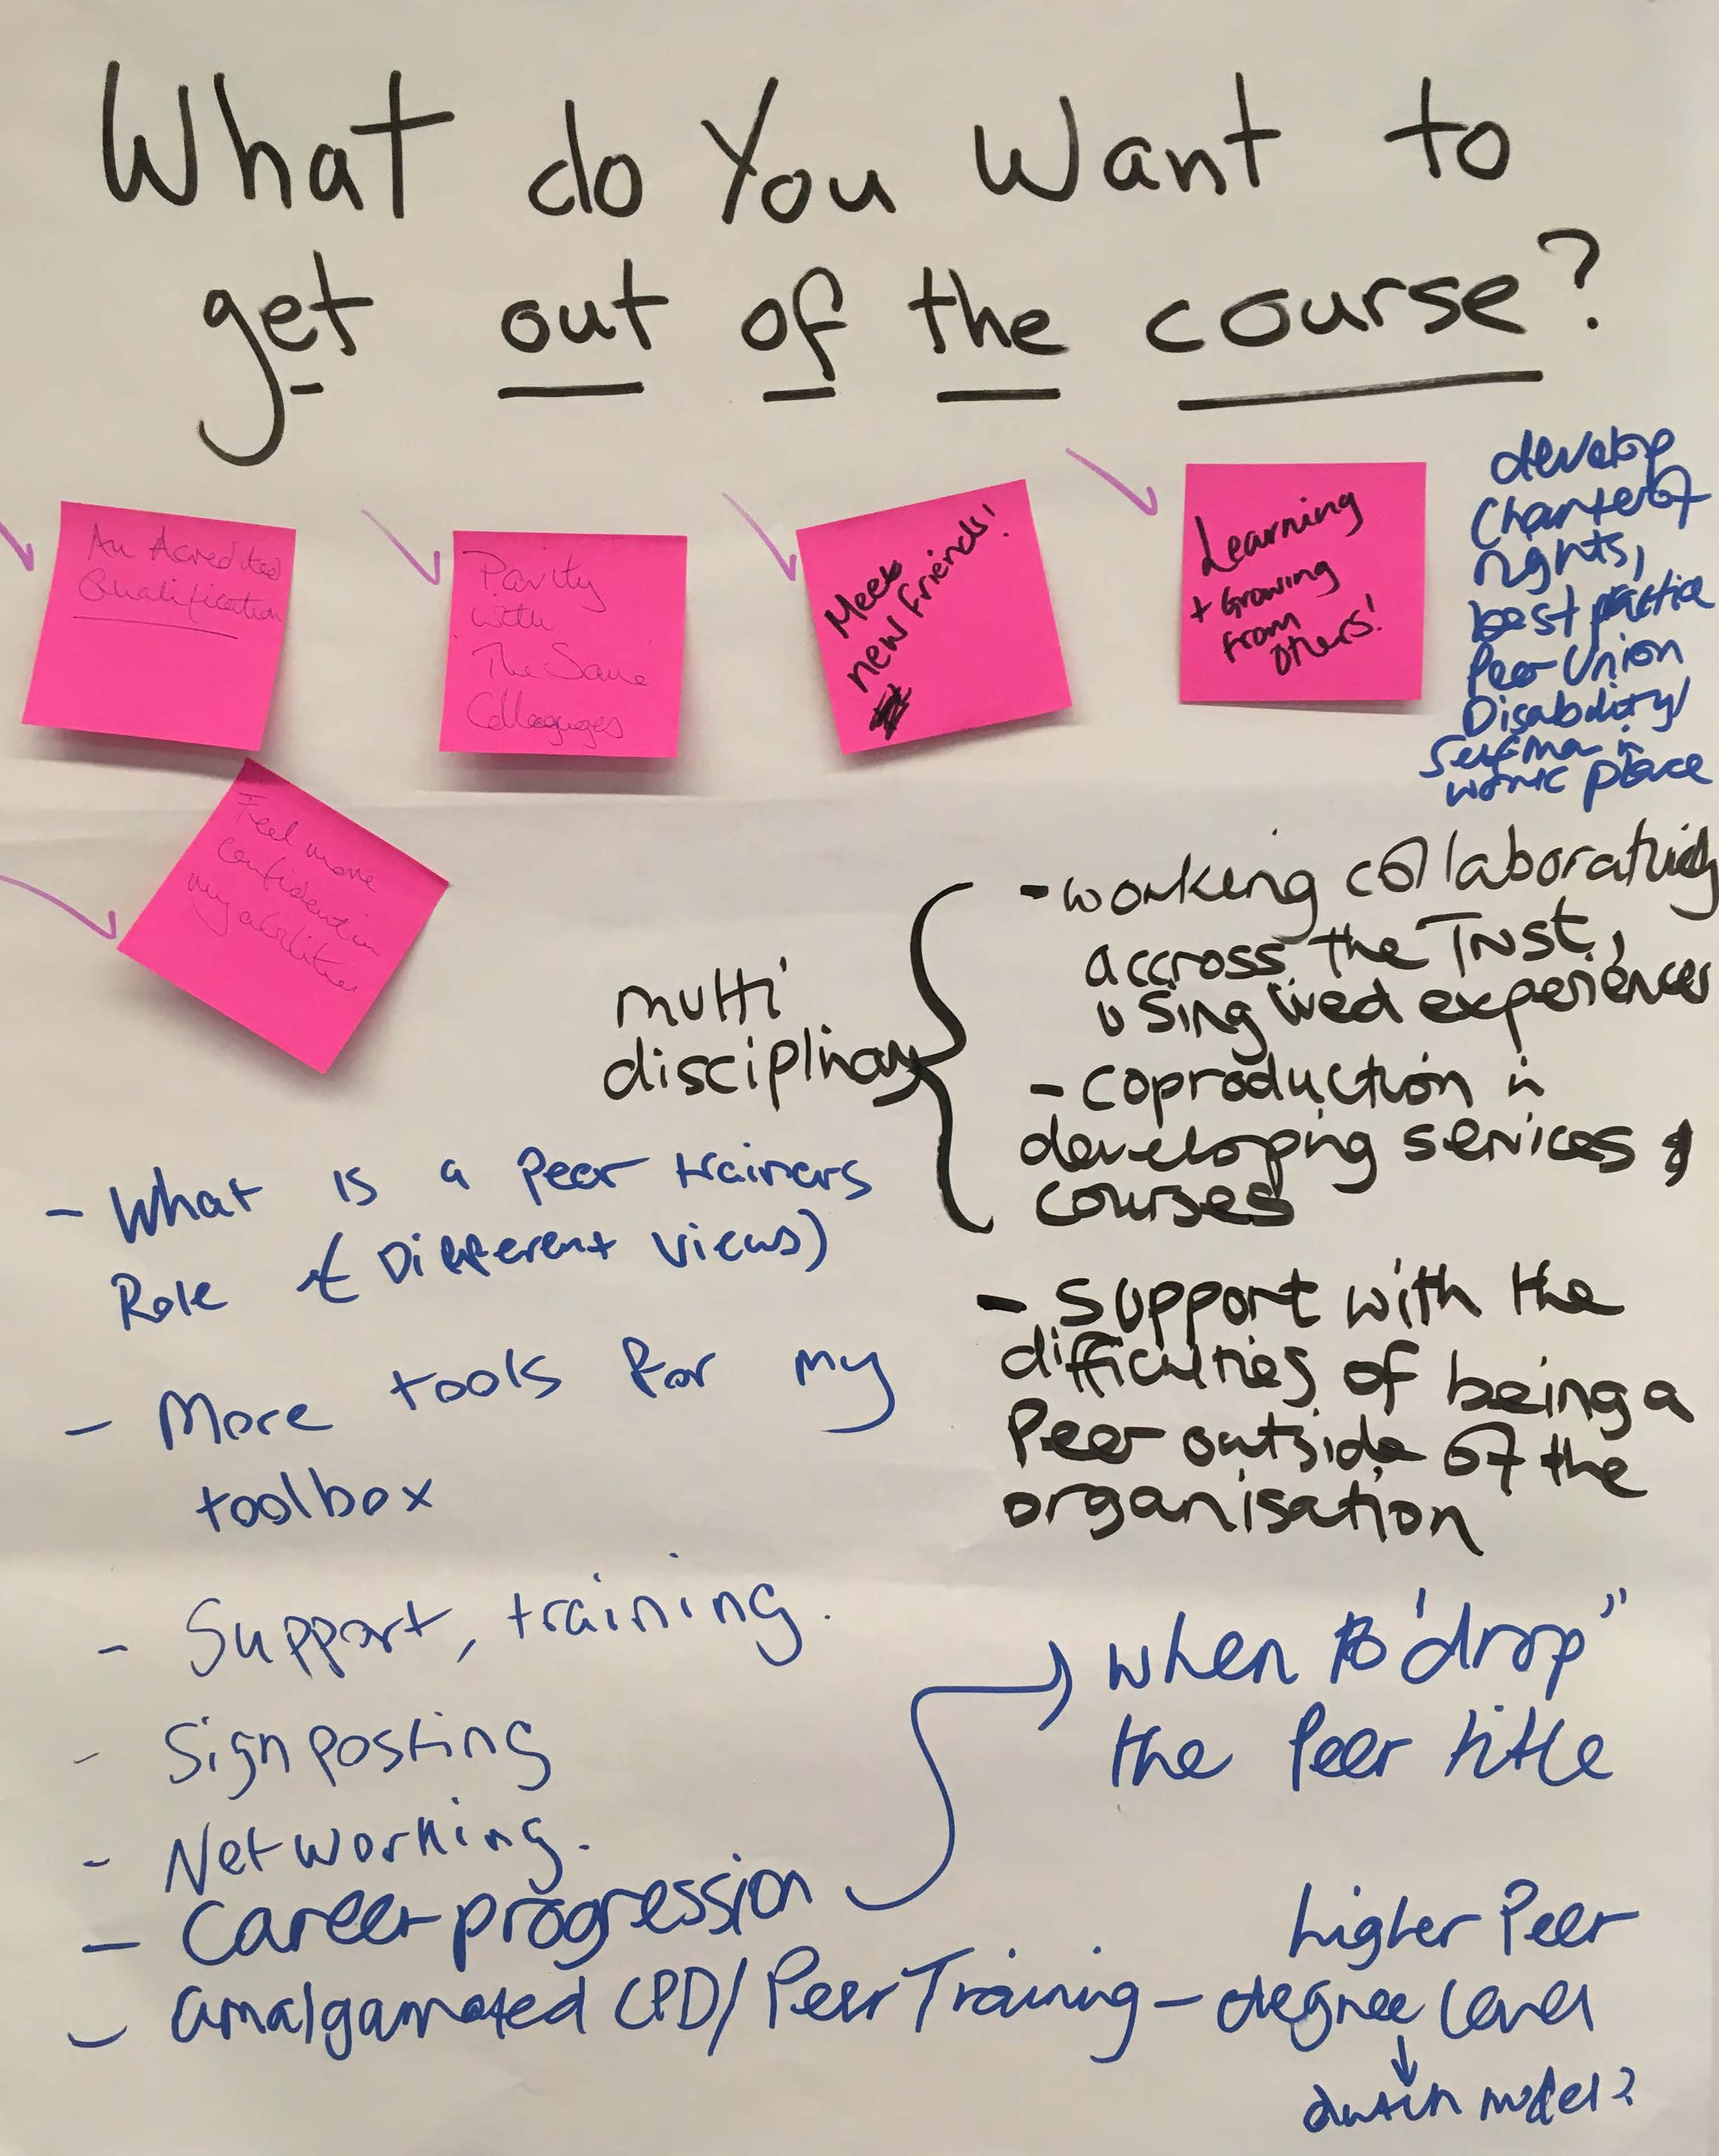
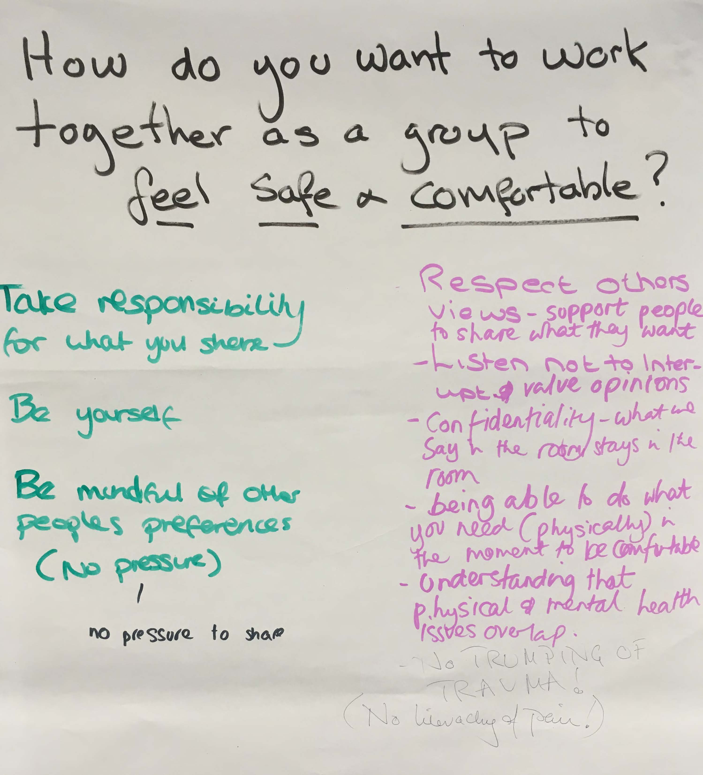
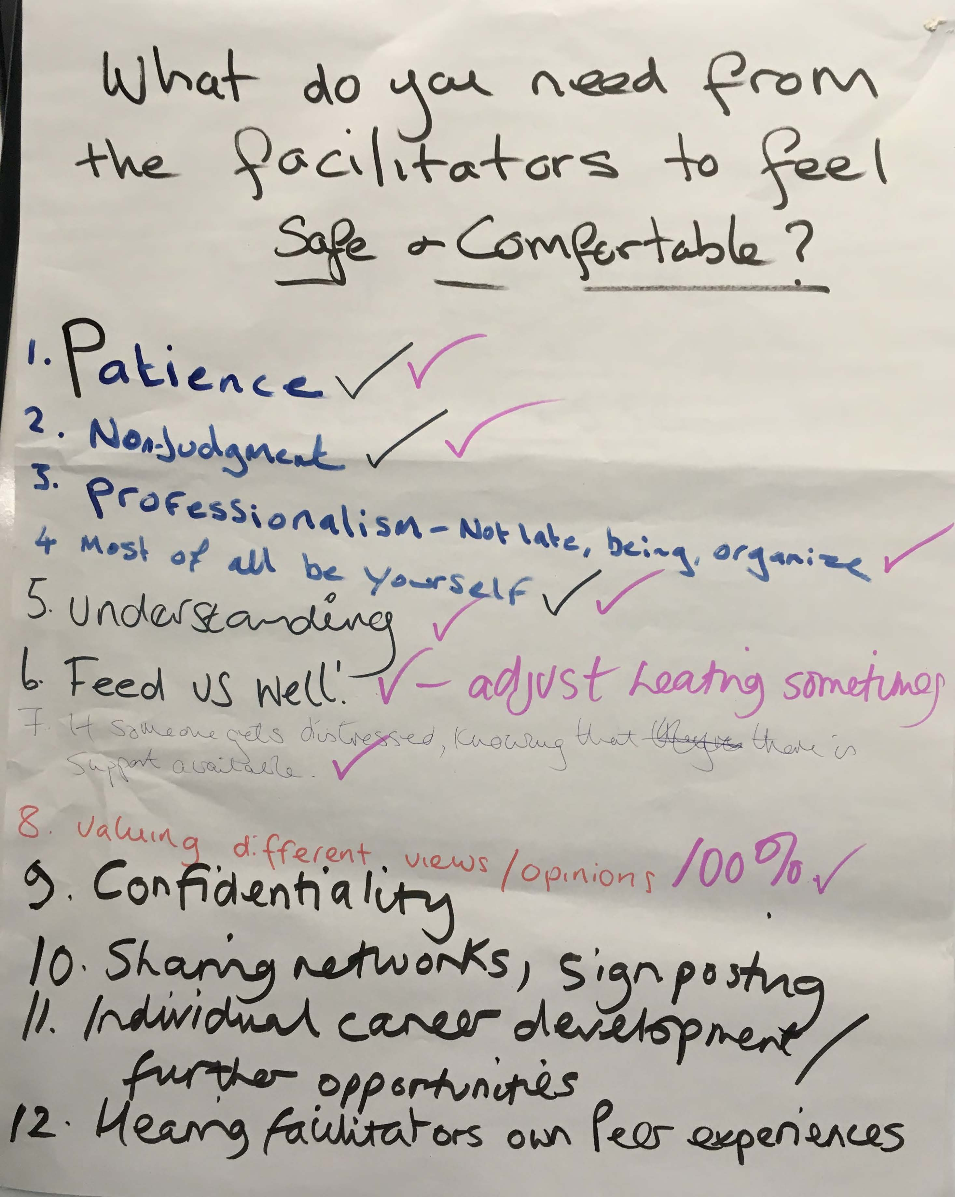
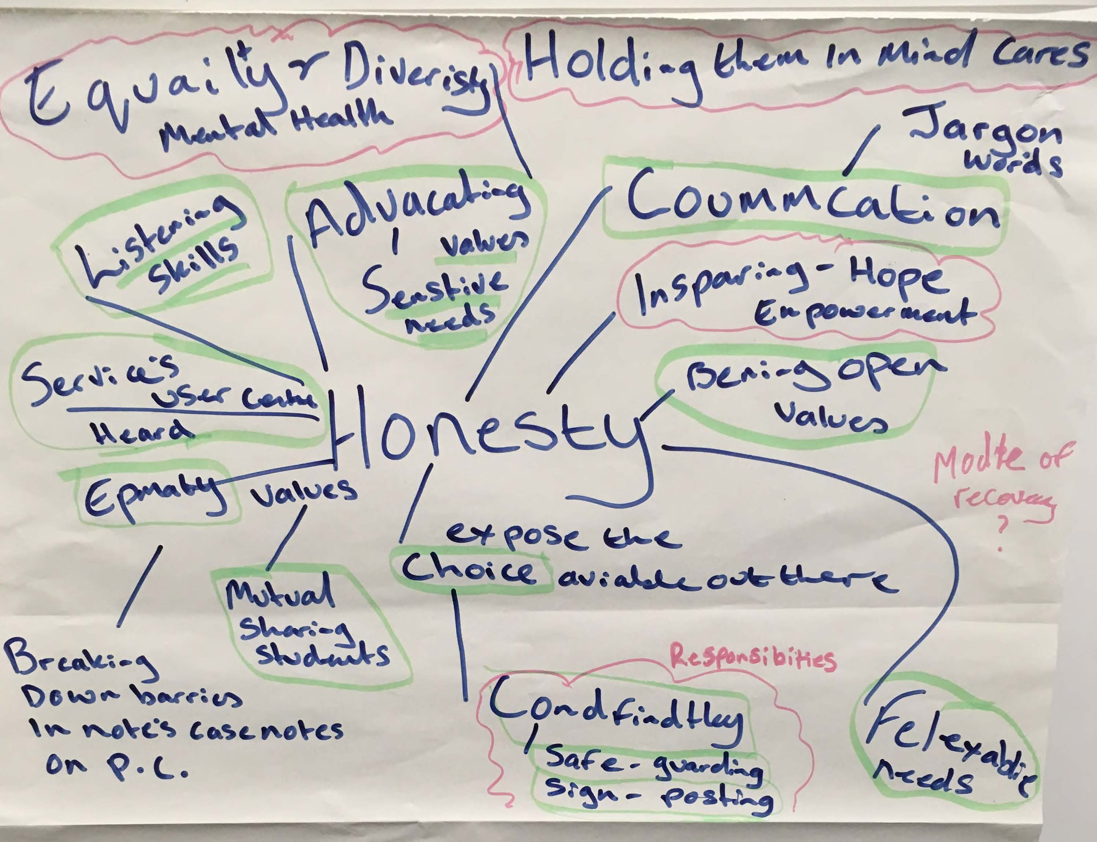
Session 1 outputs (example)

Slide 4
Breakout discussion 2
Discuss the ways of working that were developed in session 1.
Is there anything you would like to add in?
Is there anything you would like to remove/change?
You will be asked to feedback your reflections to the rest of the group.
5

Slide 5
Breakout discussion 3
The role of your buddy, a reminder:
Support you to identify goals for the training
Support you to manage your wellbeing
Help you plan how to apply your learning between sessions
Check in to see if you’re achieving your goals – and help problem solve
Check in during and between sessions
Discuss with your buddy:
Your hopes for today
Reflections on the last session (if you attended)
Progress with your Wellness Plan (if you have one)
This conversation is private – you won’t be asked to share the detail with the group.
20

Slide 6
Breakout discussion 4
What does Recovery mean to you?
Where does it come from?
Are there differences between organisational Recovery and personal Recovery ? If so, what are these differences?
You will be asked to feedback your reflections to the rest of the group.
10

Slide 7
Recovery in the bin - Principles
These principles were developed by a User Led group is for Psychiatric Survivors and Supporters who are fed up with the way co-opted ‘recovery’ is being used to discipline and control those who are trying to find a place in the world, to live as they wish, while trying to deal with the very real mental distress they encounter on a daily basis. We believe in human rights and social and economic justice!
The Recovery approach started with noble principles but has been co-opted by Neoliberal ideology and now mostly operates as cover for coercion, victim blaming, disability denial and removal of services.
The Recovery Star & Colleges focus on the individual which removes or obscures the social & political reality that affects a person’s wellbeing. The promotion of only normatively successful Recovery stories censors the truth and oppresses service users, peers, professionals, and academics.
Unrecovered is a valid self definition. We reject co-opted ‘Recovery’ that has been redefined, and taken over by market forces with humiliating treatment techniques and homogenising outcome measurements.
We want a robust ‘Social Model of Madness & Distress’ building upon the Social Model of Disability and Independent Living meaning support where needed and not perpetual pressure towards unattainable self sufficiency. Capitalism and inequality can be bad for your mental health!
We demand an immediate halt to the erosion of Social Security & Social Care and Healthcare. And the end to abusive assessment regimes (ESA, PIP, UC) which have caused thousands of deaths.
We oppose discrimination in all forms and demand social justice as part of a wider intersectional struggle Worldwide.
We call for a diversity of treatments and support that reflect the rich variation in our personal survivor narratives. A one size fits all services cannot successfully cope with the diversity of mental distress.
We demand that professionals work with service users to protect them from harmful government policy and to change such policies. We encourage whistleblowers and dissidents. Only following orders is never an excuse.
We should not have to justify our existence or right to a good quality of life with our story, our recovery or our usefulness to the economy. We reject employment as cure or objective all must aspire to.
We reserve the right to ridicule and satirise what we dislike rather than always respond with reasoned arguments which can get a bit boring and bad for our mental health.

Slide 8
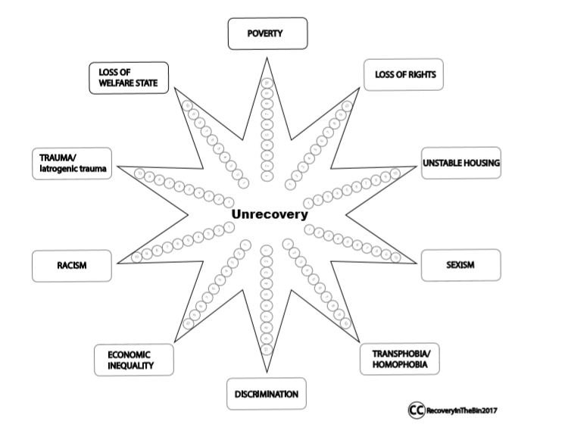
The Unrecovery Star

Slide 9
Breakout discussion 5
Recovery focused language recognise people’s strengths, skills and attributes. Read each of the statements below and think about how you might reword the statements in a way that does not discriminate, make assumptions or judgements about people.
Liz has a Personality Disorder which means she can struggle to make friends but she’s really nice once you get to know her.
Julie is recovering from an episode of psychosis, she needs a lot of support with her problems.
Stuart lacks insight into his mental illness, he’s refusing to take his medication.
Tom would find it helpful to talk to a peer support worker so that he can talk about his problems.
Jenny wont go to the group today she’s feeling very paranoid at the moment.
Aniita would like to start a college course but she’s not ready, she can become very loud and disruptive when with a group of people.
Jonah becomes very depressed when he doesn’t sleep well, he starts to drink and acts inappropriately towards others.
Ted won’t join a recovery group with you so please don’t get your hopes up.
Keisha hears voices, it is something she has to learn to manage for the rest of her life.
Vicky is amazing at music but when she becomes manic she has delusions about herself and others.
Sandeep has stopped being concordant with his medication, he will soon relapse and be back in hospital.
Rewrite each statement to make it more recovery focused. You will be asked to share your thoughts with the wider group.
10

Slide 10
Breakout discussion 6
What are the benefits of the use of self and lived experience in the peer support role?
What are the challenges of the use of self and lived experience in the peer support role?
Write a list for each to share with the rest of the group.
10

Slide 11
Breakout discussion 7 - GROUP 1
Paula has worked as a PSW for 2 years and is working in the same Trust that she had used when she was detained under the Mental Health Act as an inpatient. When initially applying for the role, there were some concerns from professional colleagues that this may be a conflict. This was resolved as it was agreed that Paula’s experiences gave her even more insight because she had the used the service.
As part of her role, Paula has started to support Ash, who has just been referred to the service. Ash mentions a psychiatrist on the team who has given Paula some concerns in the past. Ash says that he is really not happy with the doctor who was rude and gave him medication that he thought was not appropriate. Ash tells Paula that he really wants to see a different doctor.
On hearing this Paula’s first thought was she herself had similar issues with this doctor when she was using the service. She decides that it’s really important that she says something to Ash to validate his experiences. Paula explains that she also saw the same doctor when she was an inpatient and reassures Ash that this doctor has a bit of a reputation, so other people share his concerns. Paula decides to confide in Ash that she still doesn’t get on with the doctor, but now that she works here, she has to put up with it.
Ash seems really reassured to hear that it’s not just him who has an issue with the doctor and is very pleased when Paula offers to help him find a different doctor who is much more supportive.
Answer the following questions as a group:
What do you think is going on here?
What are the potential issues that this situation could cause?
How could Paula have applied her experience more constructively?
15

Slide 12
Breakout discussion 7 - GROUP 2
Mo is a PSW who helps to run a weekly wellbeing group, which Jada has been attending regularly. During a session, Mo notices that Jada seems a bit distracted, and asks her how she’s doing after the session. Jada tells Mo that she’s feeling really down as she’s just found out that her grandmother has terminal cancer and doesn’t have long to live. Jada says that she’s really close to her grandmother, she lives with her family and doesn’t know how she’ll cope if she loses her.
Mo tells Jada how sorry he is to hear her news, and they have a chat about Jada’s relationship with her grandmother. Jada shares some stories about growing up with her grandmother, and her happy memories of the things they did together when she was a child, like cooking traditional Jamaican meals for the whole family.
Mo is really touched to hear Jada’s stories – his dad was diagnosed with cancer a few months ago, so he can really relate to how Jada’s feeling. He wants to reassure Jada that the emotions she is experiencing are completely understandable, and to help her to feel less alone in her experience. He decides to tell her about his dad, and how it’s made him realise how precious life is. Jada seems really heartened to hear that Mo’s experiencing something similar, so Mo shares some of the things that he’s been doing with his dad to create some special memories. Jada explains that her grandmother is in hospital now and unconscious a lot of the time when she visits, which is really hard.
Mo asks Jada what support mechanisms she has in place to support her during this time. Jada says that she is able to talk to her mum and her sisters about how she’s feeling and they’re all supporting each other, but she’s really glad to have Mo to talk to as well.
Answer the following questions as a group:
What do you think is going on here?
What are the potential issues that this situation could cause?
How could Mo have applied his experience more constructively?
15

Slide 13
Breakout discussion 7 - GROUP 3
Angela has been working as a PSW in an NHS inpatient ward for around a year and is enjoying the role and challenges. She has a good relationship with the people who use the service, and due to her own experience of being detained under the Mental Health Act, she knows only too well what it is like.
Before this role she worked as an Independent Mental Health Advocate and is very passionate about individual rights. She has had some slightly tense interactions with other mental health professionals and can get quite frustrated with some of the heavy medication that people are being forced to take.
Angela is having a chat with Anthony, one of the regular users of the service. During the conversation, Anthony mentions that he’s having some issues with the side effects of his current medication. He says that he really hates these particular meds and asks Angela what she thinks he should do. Angela has experience of taking this particular type of medication and hated them herself. She believes that this is one of the types of medication that is overused on the ward. She feels very strongly that Anthony should have his experience validated so tells him that she used to take them and had similar negative side effects. She tells Anthony that she doesn’t think the ward should prescribe them as often as they do, and that people should stop taking them if the side effects get really bad.
Answer the following questions as a group:
What do you think is going on here?
What are the potential issues that this situation could cause?
How could Angela have applied her experience more constructively?
15

Slide 14
Breakout discussion 7 - GROUP 4
Marco works as a PSW for an IAPT service, and provides one-to-one coaching to a number of people including Yasmin, who he’s been working with for a few months. Yasmin struggles with confidence as she is new to the area and doesn’t have many friends locally.
In previous sessions, Yasmin has mentioned that she struggles to maintain her physical health. She has put on a lot of weight as a side-effect of her medication and doesn't think it helps that her family have a tradition of eating large meals together, which are often very high in fat. Yasmin's GP is worried about the impact that this is having on her blood pressure. Yasmin has identified fitness and weight loss as an important goal as part of her overall wellbeing and recovery, but has spoken to Marco about the challenges she has with motivation.
Today, Yasmin arrives looking very happy – she tells Marco that she’s joined a gym and found an exercise class that she used to love before she put on weight. She’s really pleased, but still feeling really nervous about her first class because she’s so out of shape. As she’s talking, Marco realises that he goes to the same gym, and has been to the same class himself. To help keep her motivated, Marco decides to tell her that he goes to that gym, reassuring her that it’s really friendly and that there are lots of people new to exercise in that class. Yasmin seems really pleased and relieved.
They chat a bit more about the gym and the class – Yasmin has been going to the Tuesday afternoon session. Marco explains that he has never been to that one as he works on Tuesdays, so he has to go to the evening sessions instead.
Answer the following questions as a group:
What do you think is going on here?
What are the potential issues that this situation could cause?
How could Marco have applied his experience more constructively?
15

Slide 15
Breakout discussion 8
Based on the discussion about the scenarios, come up with a list of tips and guidance to support effective self-disclosure.
You will be asked to share your list with the rest of the group.
10

Slide 16
Breakout discussion 9
Aspect of self-care | Strategies
Workplace or professional: This involves activities that help you to work consistently at the professional level expected of you. | E.g. Engage in regular supervision or consult with a more experienced colleague. Set up a peer-support group. Be strict with boundaries. Read professional journals and attend professional development programs.
Physical: Activities that help you to stay fit and healthy, and with enough energy to get through your work and personal commitments. | E.g. Develop a regular sleep routine. Aim for a healthy diet. Take lunch breaks. Go for a walk at lunchtime. Take your dog for a walk after work. Use your sick leave. Get some exercise before/after work regularly.
Psychological: Activities that help you to feel clear-headed and able to intellectually engage with the challenges that are found in your work and personal life. | E.g. Keep a reflective journal. Seek and engage in external supervision or regularly consult with a more experienced colleague. Engage with a non-work hobby. Turn off your email and work phone outside of work hours. Make time for relaxation. Make time to engage with positive friends and family.
Emotional: Allowing yourself to safely experience your full range of emotions. | E.g. Develop friendships that are supportive. Write three good things that you did each day. Play a sport and have a coffee together after training. Go to the movies or do something else you enjoy. Keep meeting with your parents' group or other social group. Talk to you friend about how you are coping with work and life demands.
Spiritual: This involves having a sense of perspective beyond the day-to-day of life. | E.g. Engage in reflective practices like meditation. Go for walks in nature. Go to church/mosque/temple if this is relevant for you. Do yoga. Reflect with a close friend for support.
Relationships: This is about maintaining healthy, supportive relationships outside of work. | E.g. Prioritise close relationships in your life e.g. with partners, family and children. Attend the special events of your family and friends. Arrive to work and leave on time every day.
Reflect on your wellness plans – what aspects of self-care might be helpful for you to add in?
You will not be asked to feed back the details of this discussion.
10

Slide 17
Breakout discussion 10
Discuss how you know if you’re stressed.
5

Slide 18
Sources of stress
5

Slide 19
Breakout discussion 11
Stress Container
Helpful coping strategies
Unhelpful coping strategies
What can I change or manage differently?
What can’t I change and need to accept?
Can anyone help me?
What are some of the useful ways that I use to try to cope?
What are some of my unhelpful ways that I try to cope?
What can I do to replace or minimise some of these less helpful strategies?
What support might I need to manage unhelpful strategies?
Discuss your answers to the questions above.
You will be asked to share some of your strategies with the group.
15

Slide 20
Weekly wellbeing check-up

Slide 21
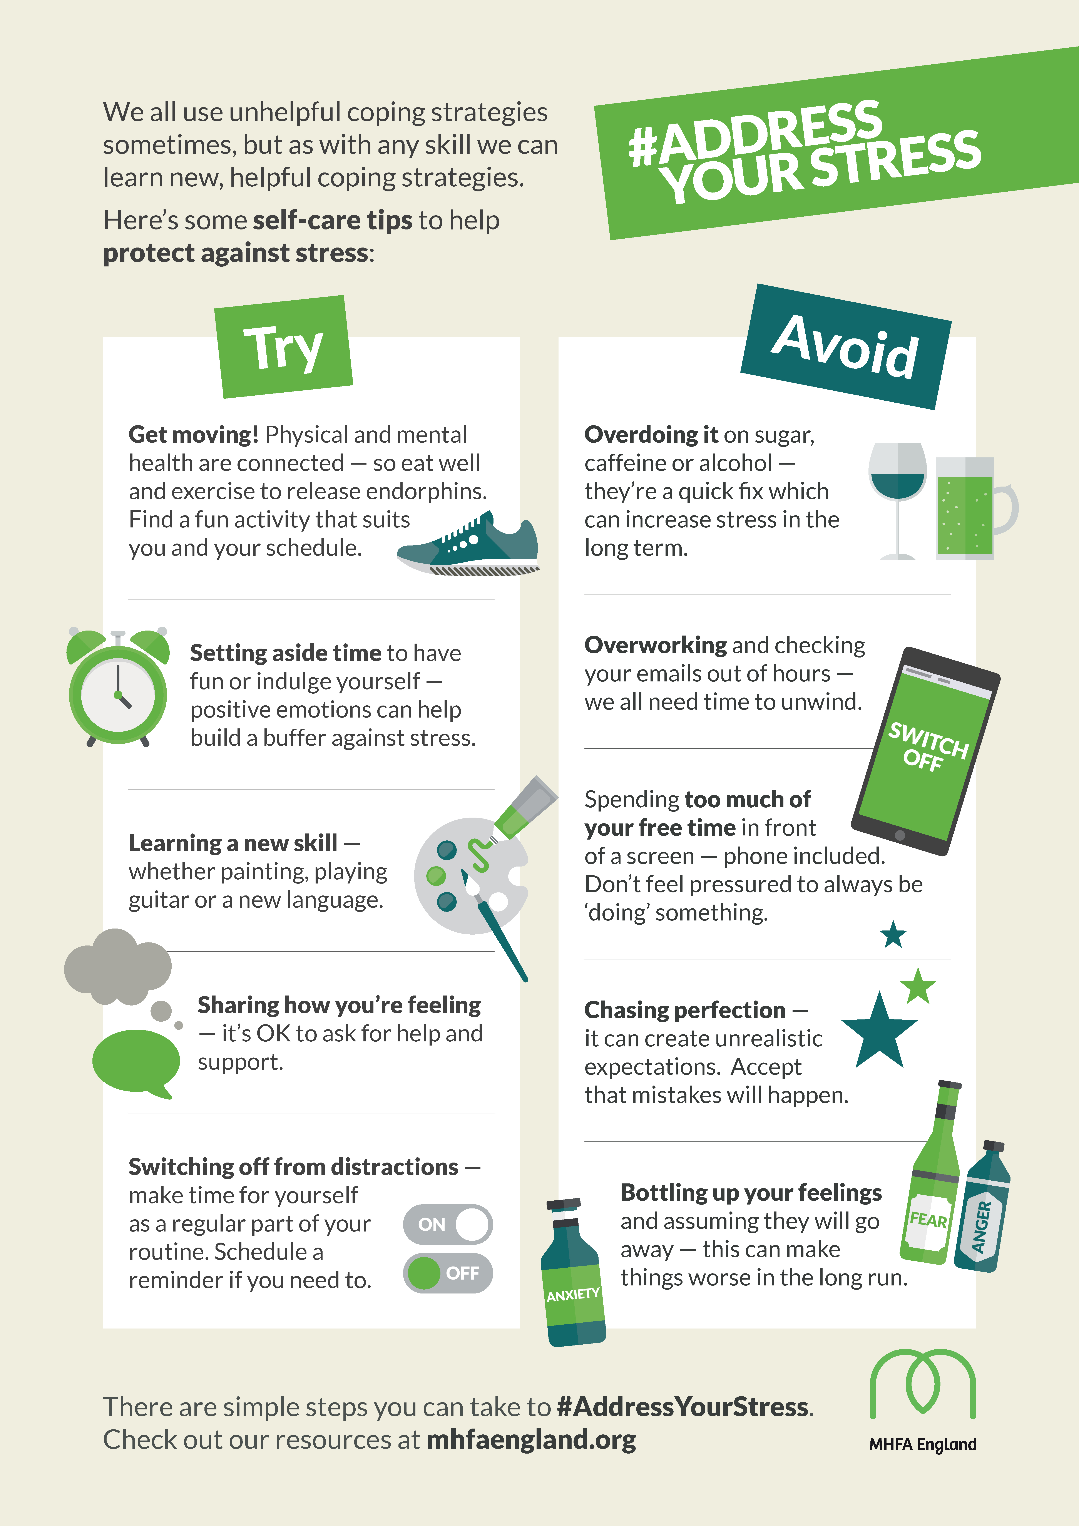
Coping strategies

Slide 22
Breakout discussion 12
Discuss with your buddy:
What has been most useful/interesting about today?
What will you take back to your role?
Consider situations where you can use recovery language day-to-day
You will be asked to share an example of where you might use recovery language with the rest of the group.
5

