Slide 1
Effective Relationships
Date

Slide 2
Breakout discussion 1
What parts of myself do I draw on in this training space?
What parts of myself do I draw on in my peer role? Are there some parts I draw on more than others? Why?
After this discussion you will be asked to share your reflections but you won’t have to share the detail if you’d rather not.

Slide 3
Breakout discussion 2
Who do you need to build relationships with in your role?
Focus on:
The work you do day-to-day
The support you might need to carry out your role effectively
Write down all the people (i.e. relationships) you will be interacting with for each.
Think about what interactions you will have because of that and the nature of the relationship.
You will be asked to feedback your lists to the rest of the group.

Slide 4
Breakout discussion 3
When did someone’s behaviour last really surprise you?​
What did they do?​
Why was it a surprise?​
How did you react?
After this discussion you will be asked to share your reflections but you won’t have to share the detail if you’d rather not.

Slide 5
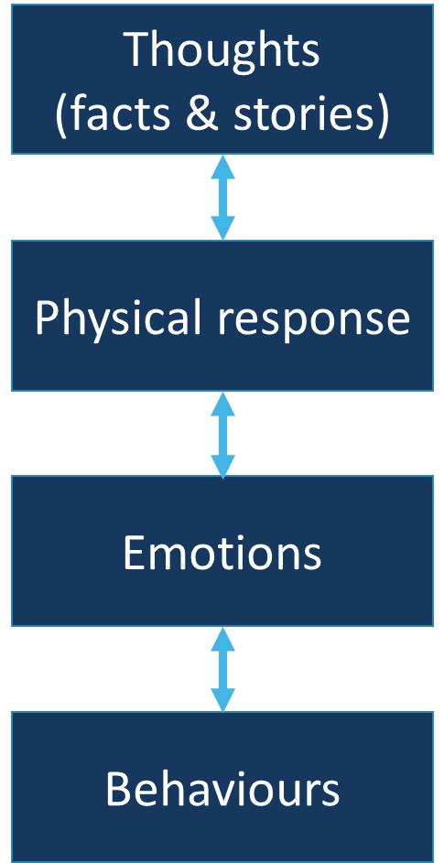
Breakout discussion 4
Talk through a challenging interaction you have each had with someone at work.
Try to identify
Your thoughts – separating out the facts and stories
Your physical and emotional response
Your behaviour as a result
After this discussion you will be asked to share your reflections but you won’t have to share the detail if you’d rather not.

Slide 6
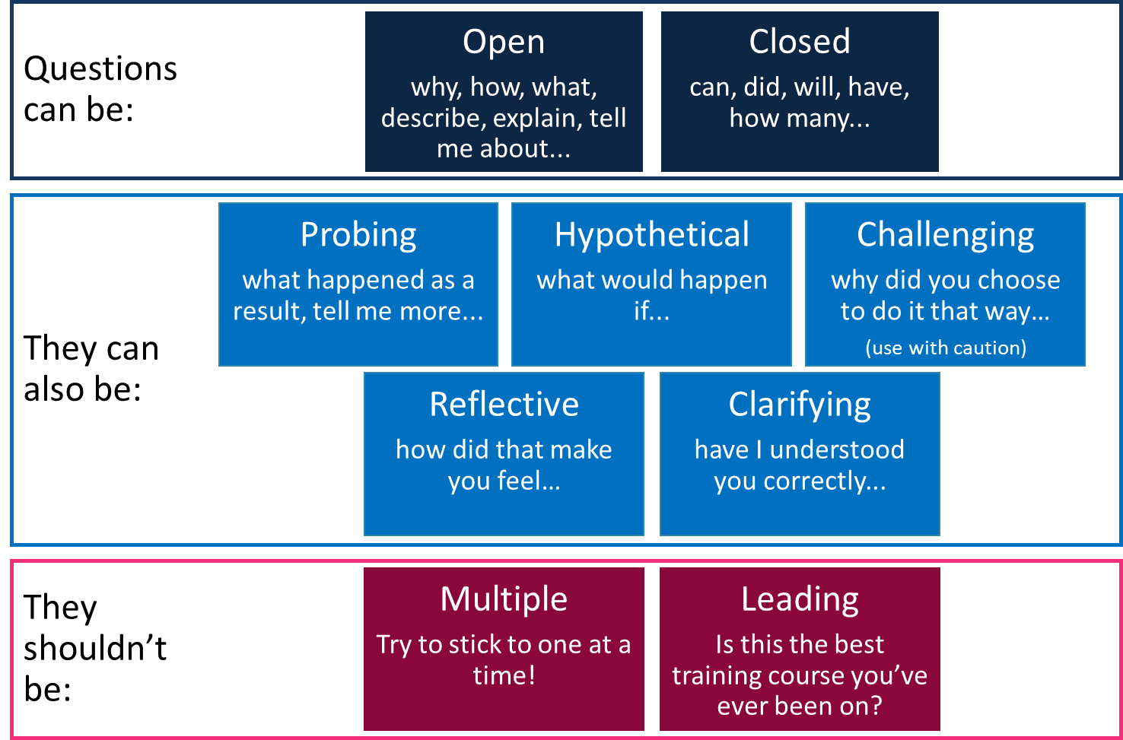
Types of question

Slide 7
Breakout discussion 5
Question Activity
Round 1
Person A: Use questions (see next page) to find out as much as you can about your partner’s ideal holiday
Person B: Answer only the question you’ve been asked (no bonus info!)
Person C: Observe and make a note of helpful/unhelpful questions
Round 2:
Person B asks the questions
Person C answers
Person A observes
Round 3:
Person C asks the questions
Person A answers
Person C observes
You will be asked to feedback which questions were most/least helpful in terms of finding out information.

Slide 8
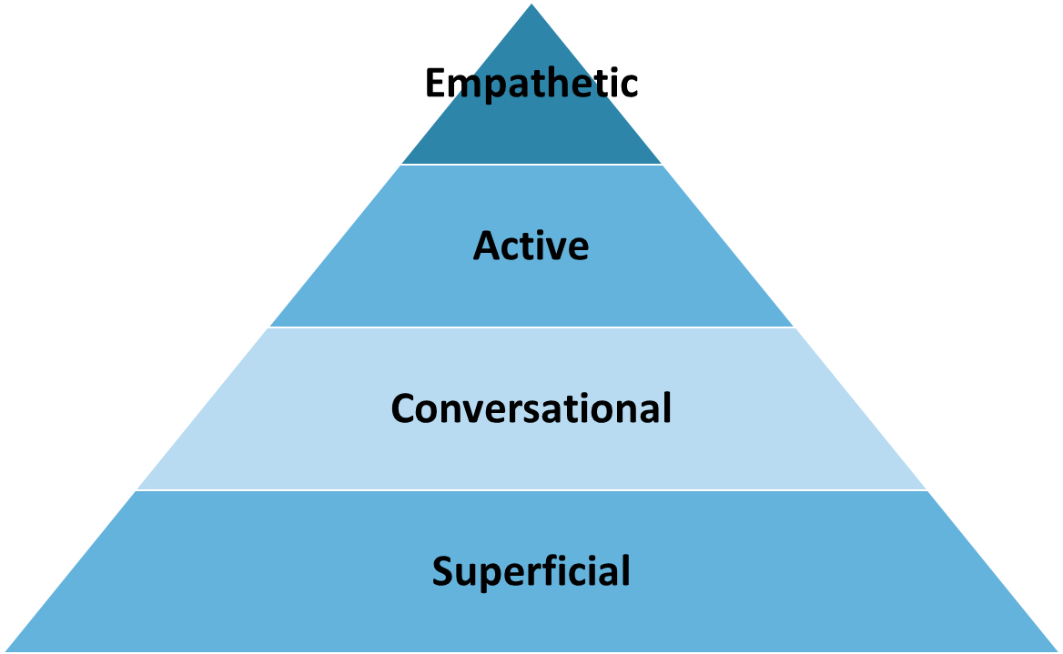
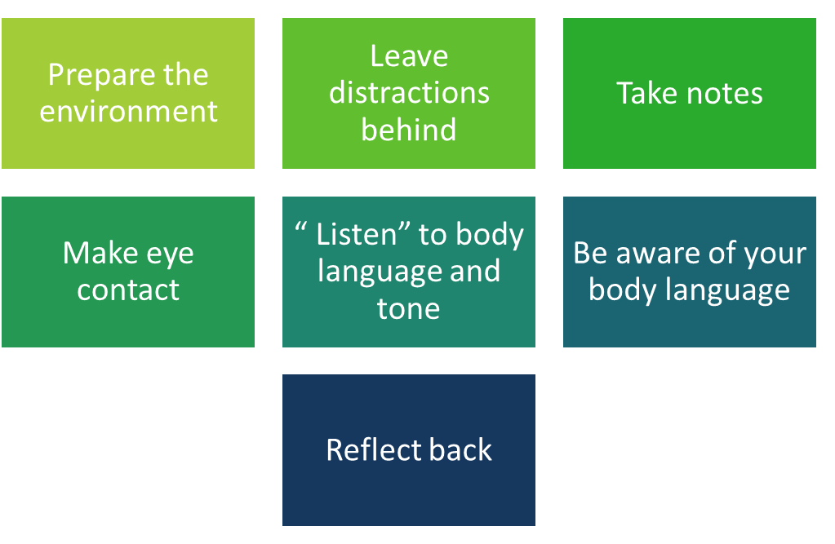
Listening levels and tips

Slide 9
Breakout discussion 6
Listening Activity
Round 1
Person A: Talks for 2 mins about what they did at the weekend
Person B: Listens without interrupting – raise your hand every time you are distracted (by a thought, a question you want to ask, something in your environment)
Person C: Observe the impact of the hand raising
Round 2:
Person B talks
Person C listens
Person A observes
Round 3:
Person C talks
Person A listens
Person C observes
You will be asked to feedback the impact of the hand raising.

Slide 10
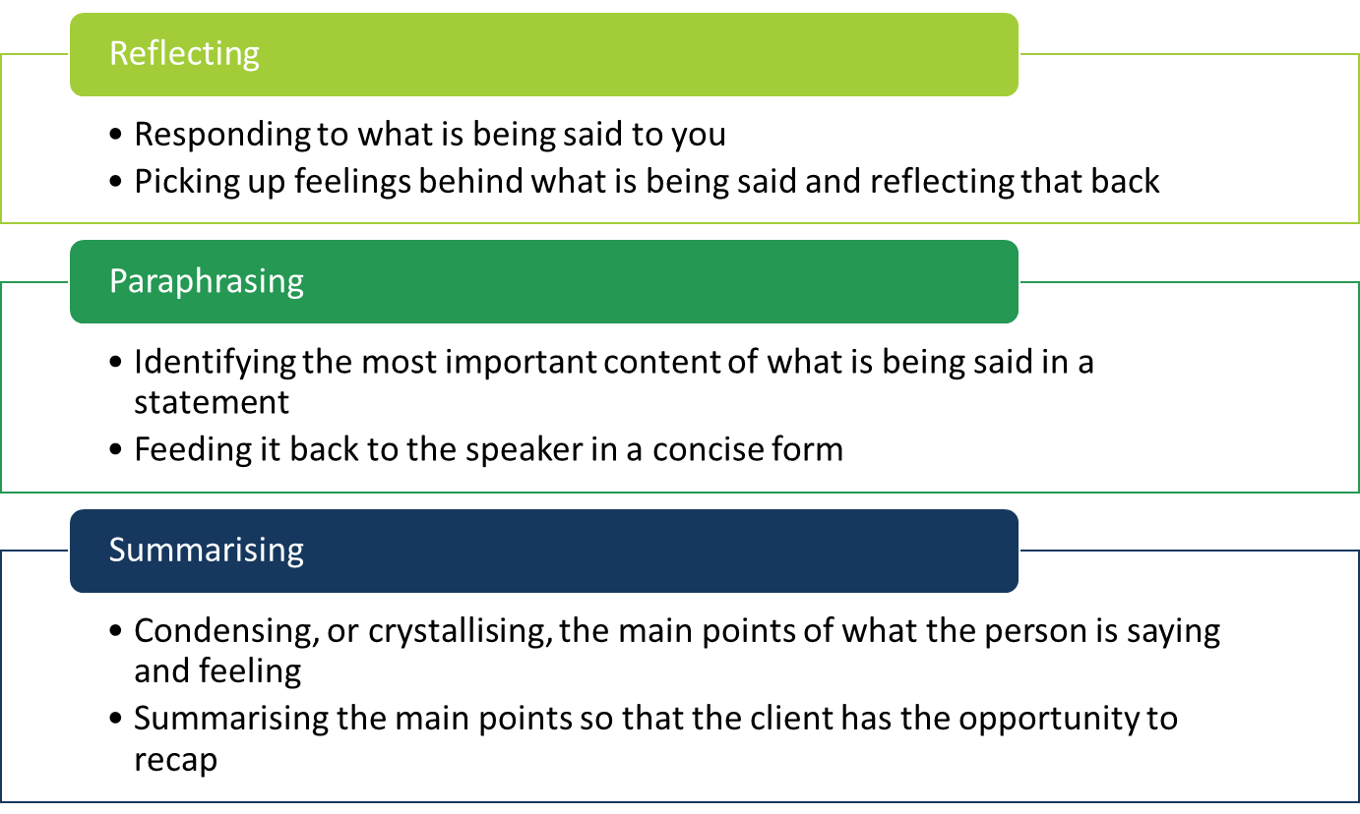
Reflecting, paraphrasing and summarising

Slide 11
Breakout discussion 7
Reflecting, Paraphrasing and Summarising Activity
Round 1
Person A: Reads out the ‘person A statements on the next page
Person B: Reflect back/paraphrase or summarise
Person C: Observes and makes a note of what’s successful/less successful
Round 2:
Person B reads the statements
Person C reflects/paraphrases/summarises
Person A observes
Round 3:
Person C reads the statements
Person A reflects/paraphrases/summarises
Person C observes
You will be asked to feedback what works well and any challenges.

Slide 12
Statements
Person A
“The walls are closing in around me”
“Everything I do seems to go wrong”
“I’m only staying in the relationship because of the children”
“I can see patterns every where, everything is inter-connected.”
Person B
“I can’t find a reason to get out of bed in the morning.”
“I really enjoy ironing in the garden.”
“People talk about me when I go out of the house.”
“I may go and see my mum next week.”
Person C
“I don’t trust them.”
“I am too scared to go out.”
“My anxiety has never been this bad, it’s never going to end.”
“I’ve stopped enjoying everything.

Slide 13
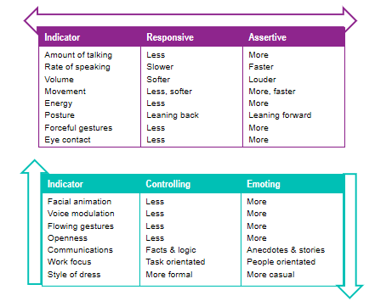
Breakout discussion 8
Have a 5-minute chat about your last holiday. From what we’ve discussed, try to guess where the other person sits on each dimension.

Slide 14
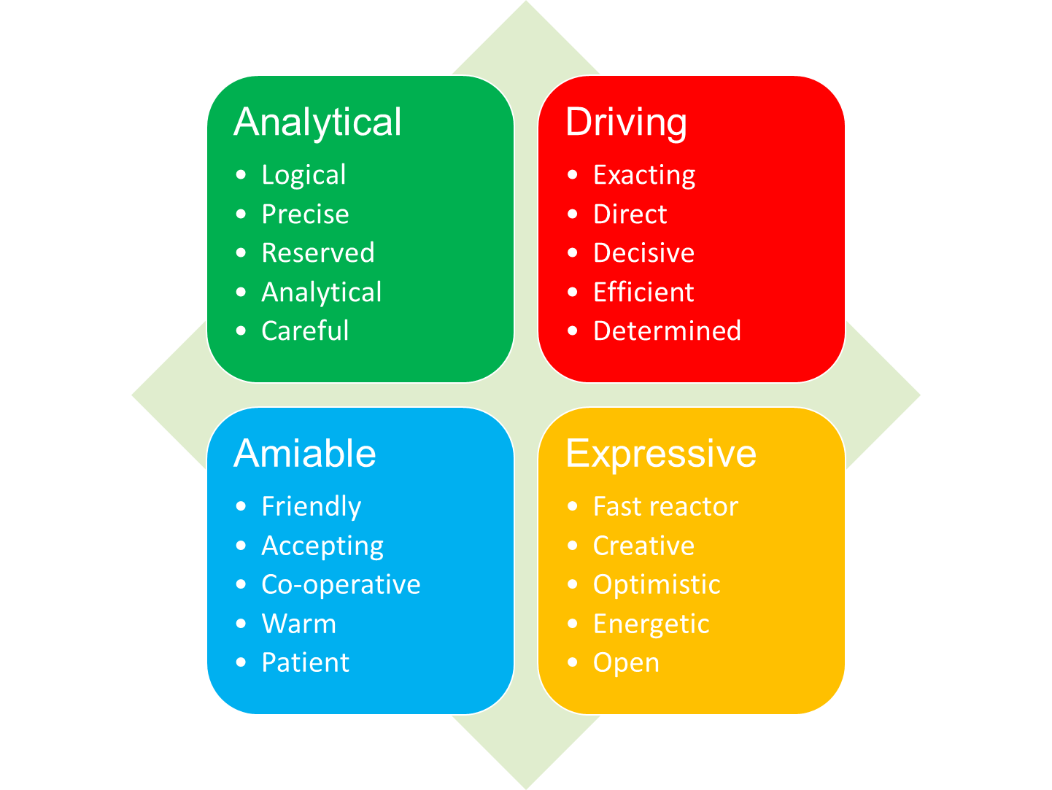
Communication Styles
The Social Style model was developed by the TRACOM® Group: http://www.tracomcorp.com/social-style-training/

Slide 15
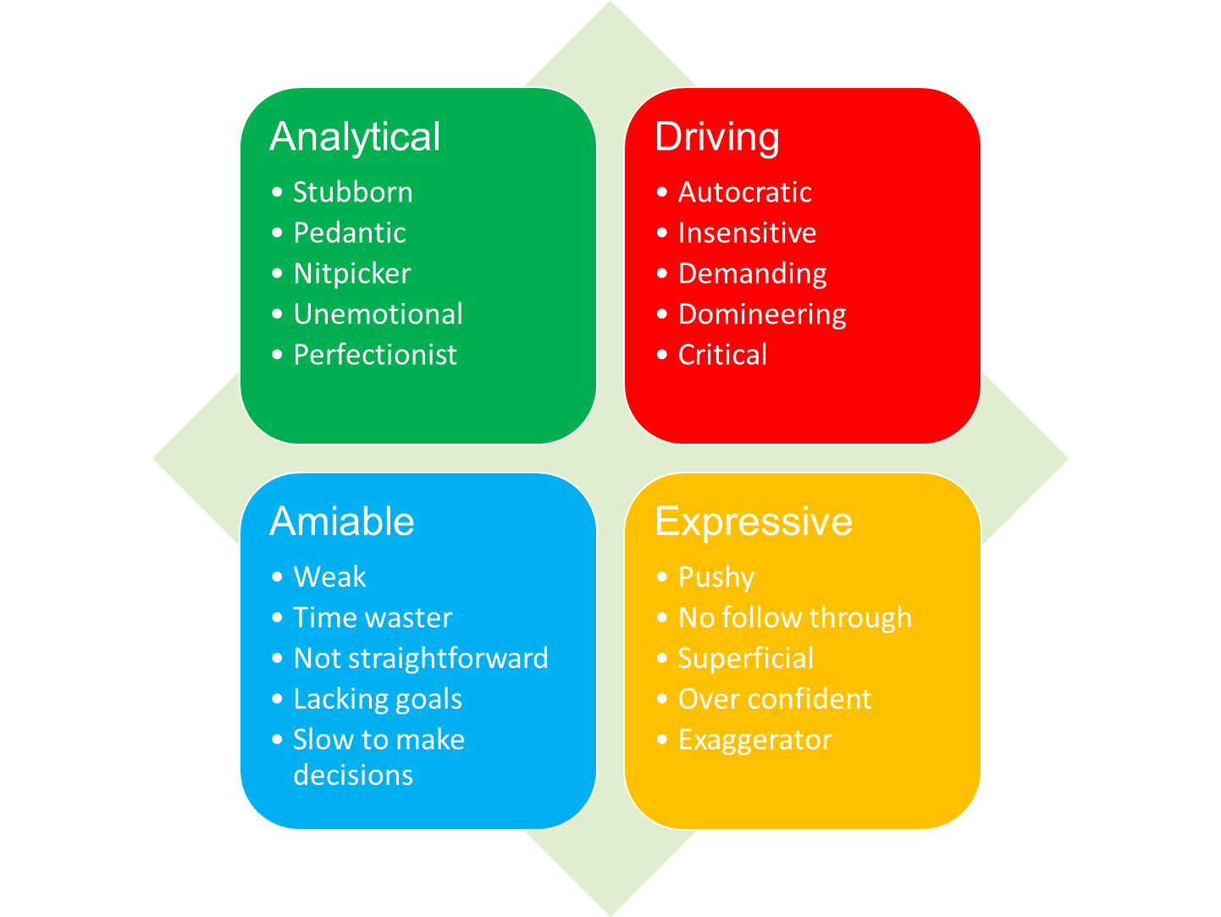
Breakout discussion 9
For your style discuss the following:
How might your style impact on others around you?
Have you experienced situations where someone else’s style has had a negative impact on you or vice versa?
What can others do to get the best out of people with your communication preference?
What can you do to minimise ‘behaviours to avoid’ (see below) when working with people with different preferences?
You will be asked to share your reflections with the group.

Slide 16
End of day 1 review
Share:
One thing I’ve learned
One thing I’ll take back to work
What I’ll do this evening to look after my wellbeing

Slide 17
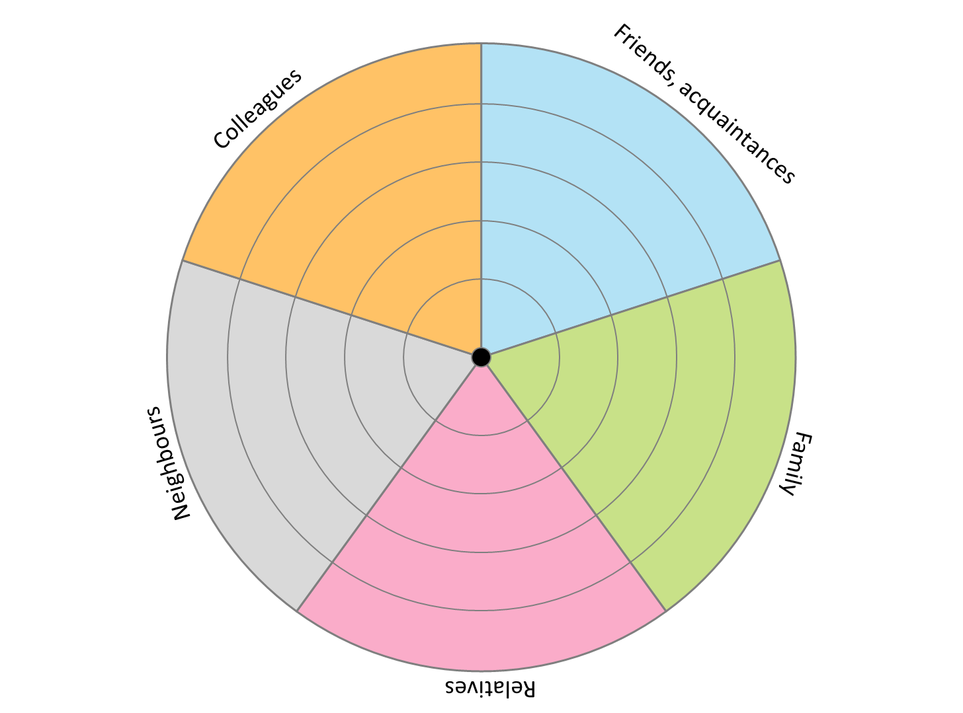
Breakout discussion 10
Complete social network map for each other and discuss:
What are the benefits of involving a person’s support network?
What are the challenges?
What is the peer role in working with an individual’s social network?
You will be asked to share your reflections on these questions, but not the detail of the plan.

Slide 18
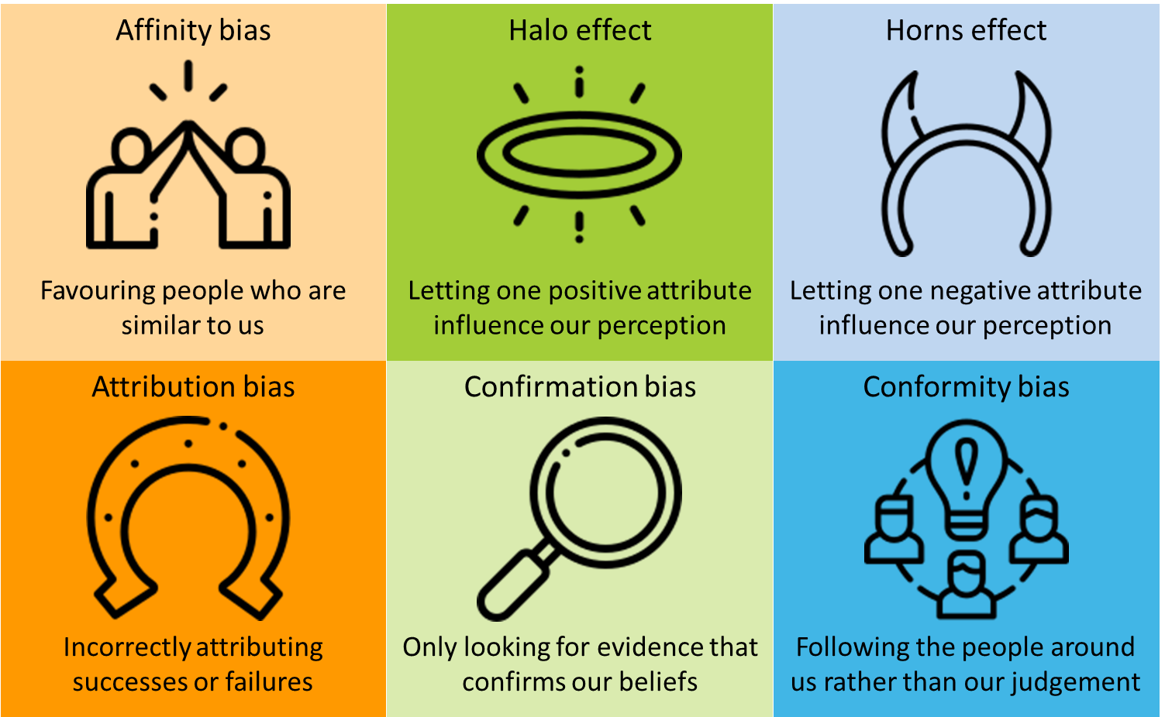
Unconscious bias
Icons made by Freepik from www.flaticon.com

Slide 19
Breakout discussion 11
Identify the type of bias in each scenario:
Reda strongly believes that yoga is incredibly beneficial for people’s mental health and wellbeing. When she meets people who do yoga regularly, she always asks them if they find that it helps their wellbeing. She doesn’t ask people who don’t seem interested in yoga.
Shanice works with a few clients and has built good rapport with them all. One particular client, Jacqui, grew up in the same part of London as Shanice and they have very similar backgrounds. Shanice tends to find that she spends longer with Jacqui than other people she works with, and is much more willing to help her out if she needs extra support.
When Nilesh meets with Ken for the first time, Ken arrives late and drops his bag as he enters the room, spilling the contents all over the floor. Nilesh doesn’t realise that Ken has had a stressful morning and makes a mental note that he must be quite scatty and disorganised.
Terry has been attending group coaching sessions for a while. At her first session she happened to arrive early and so offered to help the PSW, Sami, set up the room. Over the next few sessions, a number of people, including Terry, arrive late. When Terry comes in late, Sami usually waits for her to arrive before starting, but with the others he usually starts without them.
Omari has heard a few people in the team mention that Claude, one of the clients, is disinterested and is hard to engage in conversations about his care or treatment. Omari hasn’t worked with Claude before – when they meet Omari doesn’t make as much effort as he would usually as he assumes Claude won’t be interested.
A year ago, Jon worked for a mental health charity and met Sarah, who was a regular attendee at their day service. One day, Jon witnessed Sarah having an argument with another person at the day service – the argument escalated very quickly, and Sarah shouted and swore at other person. Last week Jon met Sarah again through his new PSW role. Jon is very professional with Sarah, but is less warm and friendly than he would be usually, and is a bit wary about spending time with her.
You will be asked to share your answers.

Slide 20
Breakout discussion 12
Choose one area of the Window of the World (see page 2) that you think might influence your unconscious biases.
You will be invited to share an example if you feel comfortable to.

Slide 21
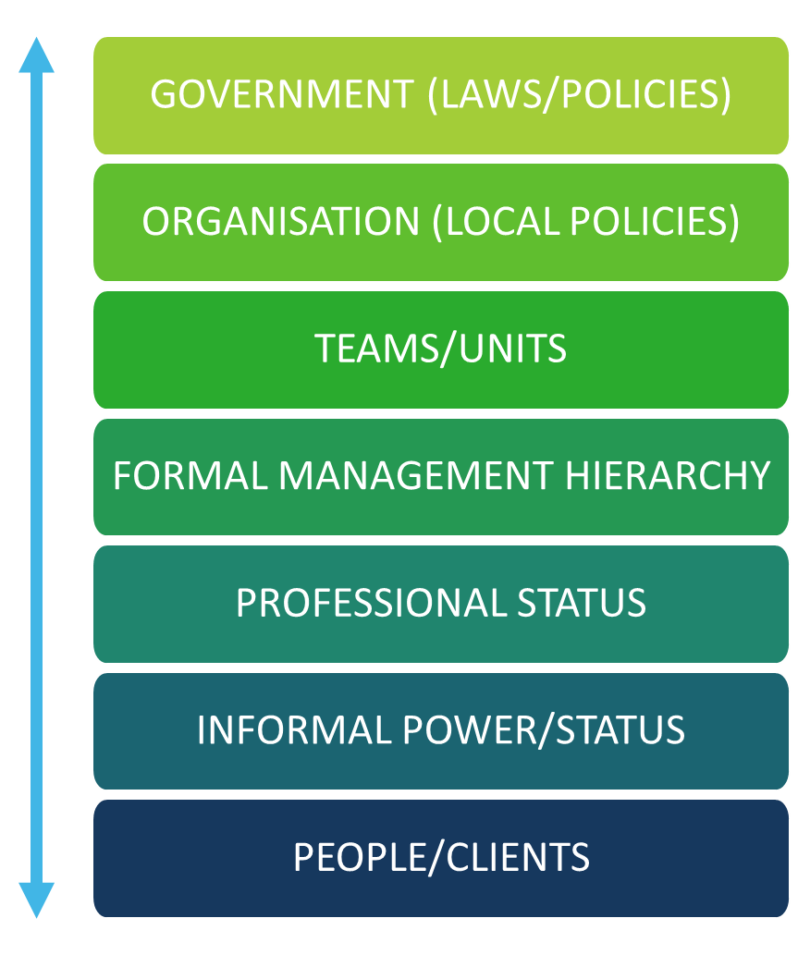
Power and hierarchy

Slide 22
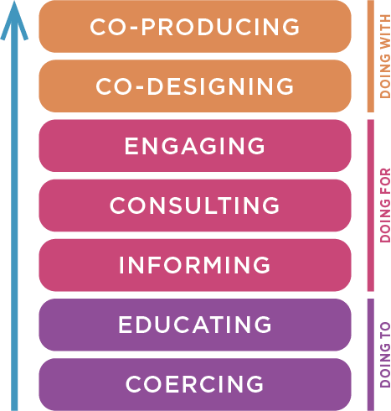
Addressing power imbalances

Slide 23
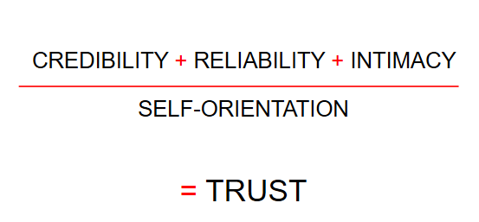
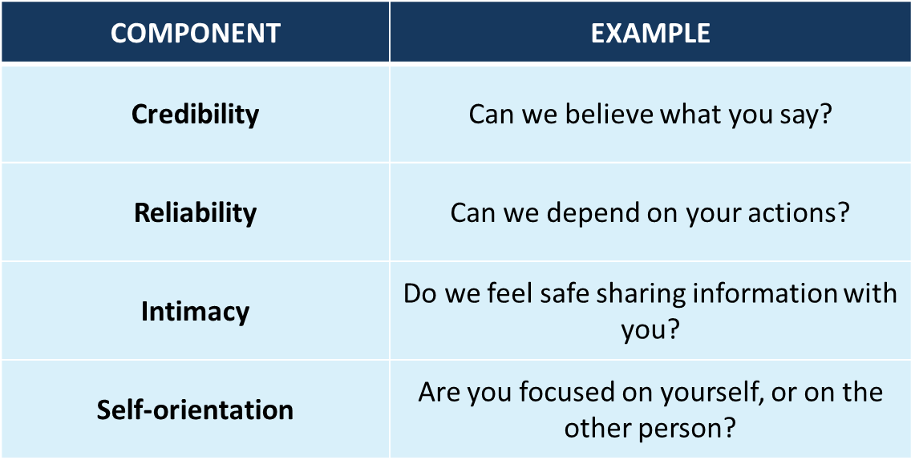
Breakout discussion 13
Plan an introduction of yourself and your role to a new client/person you’re supporting. Think about how you might demonstrate all components of the Trust Equation through your introduction.
You might be asked to share your introduction with the group.
Adapted from: The Trusted Advisor (Maister, Green and Galford, 2012) ​

Slide 24
Courageous Conversations
Withholding your views
Masking – understating or selectively showing our feelings – sarcasm, sugar coating, humour​
Avoiding – Steering away from sensitive conversations by keeping to safe, trivial ground​
Withdrawing – pulling out of the conversation entirely
Blocking their views
Controlling – forcing your view on others – cutting people off, overstating your point, speaking in absolutes (I’m sure that everyone here agrees that… the last time we tried that it was a complete disaster)​
Labelling – attaching a label to dismiss someone’s point (that’s very a very dated perspective)​
Verbal attack – belittling the person

Slide 25
Feedback framework
A | Ask – why am I giving feedback? What are the facts? What stories am I telling myself?
B | Outline the Behaviour – stick to the facts – ask them for their understanding of the facts
C | Tell them the Consequences of their behaviour – tell them how it’s impacting on you – but own your stories!
D | What do you suggest they should Do differently next time? What will you do differently?
E | Evaluate the conversation – did you withhold your views? Did you block theirs? If appropriate evaluate the behaviour change and give further feedback

Slide 26
Breakout discussion 14
Practice giving each other the feedback you have prepared. You may find it useful to roleplay the conversation, in which case the person receiving the feedback should be briefed on how to respond.
Round 1
Person A: Gives the feedback they’ve prepared
Person B: Receives the feedback
Person C: Observes and makes a note of what’s successful/less successful
Spend a couple of minutes helping person A refine the feedback.
Round 2:
Person B gives the feedback
Person C receives the feedback
Person A observes
Spend a couple of minutes helping person B refine the feedback.
Round 3:
Person C gives the feedback
Person A receives the feedback
Person C observes
Spend a couple of minutes helping person B refine the feedback.
You will be asked to feedback what works well and any challenges.

Slide 27
Buddy catch up
Share:
What I’ve learned
What I’ll take back to work
What support I might need
What I’ll do this evening to look after my wellbeing

