Slide 1
Effective Relationships
Trainer name (s)
Date

Slide 2
Timetable – Day 1
Time | Session overview
10.00am-10.30am | Welcome, housekeeping introductions and aims
10.30am-11.00am | Buddy catch up
11.00am-11.45am | Building your network ​
11.45am-12.45pm | Emotional intelligence
12.45pm-1.30pm | Lunch
1.30pm-2.45pm | Building empathy
2.45pm-3.45pm | Communication styles
3.45pm-4.00pm | Buddy catch up
4.00pm | Close
Timings allow for 2 x 10 min breaks in the morning, and 1 x 5 min break in the afternoon
NB. All timings are approximate and may change in response to the needs of the group
Notes:
The Introduction to Day 1 is purposefully a long section. This is to enable participants to get reacquainted with one another, and realign themselves to the work and what they agreed at the last session

Slide 3
Timetable – Day 2
Time | Session overview
10am-10.10am | Welcome and refresher
10.10am-10:55am | Working with families and supporters
10:55am –12:45pm | Barriers to relationship building
12:45pm-1.30pm | Lunch
1.30pm -3.30pm | Courageous conversations
3.30pm-3.40pm | Review of key learning
3.40pm-4:00pm | Buddy action planning and debrief
4pm | Close
Timings allow for 2 x 5 min breaks in the morning, and 1 x 10 min break in the afternoon
NB. All timings are approximate and may change in response to the needs of the group

Slide 4
Trainer notes: Housekeeping
Purpose: To make sure everyone knows the basics about the venue and the day
Materials: None
Instructions: Talk through the icons on slide 5:
Finish time
Tea/coffee breaks – what time breaks are planned and letting people know that you can stop for additional breaks if needed. Let people know where the break-out spaces are
Lunch – let people know that lunch is provided and at what time
Toilets – make sure everyone knows where they are
Fire – let them know if there are any planned fire tests and where the fire exits are
Phones – ask people to put their phones onto silent (or off if possible!)
Timings: 5 minutes

Slide 5
Housekeeping

Slide 6
Introductions

Slide 7
Trainer notes: Introductions
Purpose: For everyone to get reacquainted
Materials: None
Instructions: Split participants into groups of 3-4 and ask them to reintroduce themselves, and share something they have done since the last session to practice self care.
Debrief by asking everyone to reintroduce themselves to the rest of the room, and ask for some examples of self-care techniques they have found helpful
Timings: 5 mins in small groups, debrief 10 mins

Slide 8
Aims

Slide 9
Trainer notes: Aims
Purpose: To provide an overview of the background and aims of this module
Materials: None
Instructions:
Remind participants where we are in terms of programme overview (slide 10).
Talk through the aims of the session (slide 11), emphasise the importance for PSWs to build effective relationships in their role: a strong, communicative and honest relationship is fundamental to support meaningful, outcome-focused conversations with those they work with
Timings:
10 mins

Slide 10
Programme overview
You are here
Self-care and
self- management
Communication and interpersonal skills
Navigating the system
Supporting mental health
1. Working as a peer
2. Use of self
3. Effective relationships
4. Context and frameworks
5. Mental health
6. Supporting self-management
7. Working with other professionals
8. Supporting access to care
9. Working with groups

Slide 11
Aims for today
By the end of today you will have:
An understanding of how to build constructive relationships with people from a variety of backgrounds ​
A number of strategies to build rapport through soft skills
Developed insight and empathy for other’s positions and perspectives​
An understanding of how to engage an individual’s wider network to enhance the support offer they provide as a PSW​
An understanding of the concept of unconscious bias
Begun to recognise what the barriers to building effective relationships can be and how to identify and address these in practice ​

Slide 12
Trainer notes: Recap ways of working
Purpose: For people to remind themselves of what they wanted to get out of the training and how they wanted to work as a group
Materials: 3 flipcharts from session 1 around the room: “Aims for the course”, “Ways of working together”, “Working with the facilitators”
Instructions:
Talk through the outputs from session 1
Ask the groups to discuss any additions/changes they would like to make to these
NB. Keep the notes from this exercise for future sessions.
Timings:
5 mins

Slide 13
Ways of working
What do you want to get out of the course overall?
How do you want to work together as a group to feel safe and comfortable?
What do you need from the facilitators to feel safe and comfortable?
Review the flipchart outputs.

Slide 14
Buddy catch up

Slide 15
Trainer notes: Buddy catch up
Purpose: To give buddies a chance to catch up and plan their focus for the day
Materials: List with names of buddy pairs.
Instructions:
Explain that as today’s session focuses on building relationships, you’re going to start the session exploring how each of us has many different roles and voices, all which impact on how we relate to others.
Talk through the quotes on slide 15 and introduce the Window of the World model to explore the different elements that make up our frame of reference. Show the different roles on slide 18 as a simplified example of what this might look like in practice and explain that you are going to ask people to talk through the different parts of themselves, they are bringing to this training and their professional roles.
Check that everyone has a buddy (pair up anyone who doesn’t), and remind them of the role of the buddy (slide 19)
Activity: Ask people to discuss with their buddy the questions on slide 20
After the discussion, ask people to share back any thoughts or feelings they had about the exercise – let them know that they do not have to share the detail of their conversations.
Timings:
Introduction: 5 mins
Activity: 20 mins (10 minutes each)
Debrief: 5 mins

Slide 16
Self and others
“When we begin training, we embark on two simultaneous journeys; one outward into the professional world and the other inward, through the labyrinths of our own psyches…The more fearless we become in the exploration of our inner worlds, the greater our self-knowledge and our ability to help clients.” Cozolino (2004)
“All of our experiences leave a sign in our body, but only a minimal part of these ever become formulated into spoken narratives.” Hendy (2019).

Slide 17
Frame of reference: window on the world
The Frame of Reference (1975) is the term used by Jacqui and Aaron Schiff to refer to our individual filter on reality. They defined the term as:
"The structure of associated responses which provide the individual with an overall perceptual, conceptual, affective and action set which is used to define the self, other people and the world."

Slide 18
Father
Male
Teacher
Non-binary
Client
Colleague 1
Gay
Nigerian
Jewish
Mental health challenges
Chronic illness
Single parent
Colleague 2
Female
Partially sighted
Muslim
Instead of looking at one core self…the mind is voices speaking to each other; it is an ongoing process of dialogues.

Slide 19
Reminder: The role of your buddy
Support you to identify goals for the training
Support you to manage your wellbeing
Help you plan how to apply your learning between sessions
Check in to see if you’re achieving your goals – and help problem solve
Check in during and between sessions

Slide 20
Pairs Exercise
With your buddy, spend time discussing:
What parts of myself do I draw on in this training space?
What parts of myself do I draw on in my peer role? Are there some parts I draw on more than others? Why?

Slide 21
Building your network

Slide 22
Trainer notes: Who do you need to build relationships with as a PSW?​
Purpose: Reflect on the range of people PSWs will need to build relationships with.
Materials: Flipchart paper
Instructions: As you know, PSWs will be supporting individuals in their recovery journey. Highlight that within this, there will be multiple relationships they will need to build, manage and sustain. PSWs may be asked to be involved in a variety of services, with a range of different people with different needs.
Activity: Group attendees into 3-4.
‘Who do PSWs need to build relationships with?’ Have this question written on two flipchart pieces of paper per group. On one paper focus on the work they deliver, on the other focus on the support PSWs need (slide 23 also sets out the task).
Ask attendees to write down all the people (i.e. relationships) they will be interacting with for each. Encourage them to think about what interactions they will have because of that and the nature of the relationship.
Facilitator pointers:
The work they deliver focusing not just on the people they support but on the network of people they might need to engage with to be able to deliver that support. Support PSWs need: resources to develop themselves personally and professionally, skill development, confidence building. There will be some people who appear on both lists – encourage participants to think about how they might interact with the same people differently in different contexts. Talk through any challenges around specific individuals (e.g. when working with someone who knows you as a patient) – reassure people that this will be covered in more detail in Session 8.
Following the activity, each group to feedback the relationships. Facilitators to write up themes on flipchart.
Timings: Intro 5 mins, Group Activity: 20 minutes, Feedback: 10 minutes

Slide 23
Who do you need to build relationships with as a PSW?​
Focus on:
The work you do day-to-day
The support you might need
Write down all the people (i.e. relationships) you will be interacting with for each.
Think about what interactions you will have because of that and the nature of the relationship.

Slide 24
Emotional Intelligence

Slide 25
Trainer notes: Emotional Intelligence (1 of 2)
Purpose: To introduce the concept of Emotional Intelligence
Materials: None
Instructions: Module 2 discussed ‘self’, this module will focus on ‘others’. Before discussing others, we will talk a bit on why the two are fundamentally linked. Ask if people have heard of Emotional Intelligence and if they know what it means. Share the model and definition (slide 27) and talk briefly through each of the five dimensions. Explain that the top half focuses on self. Emotionally intelligent people tend to have a good self-awareness – they know their values, strengths and weaknesses, and can recognise and put strategies in place to help to manage their emotions. The bottom half focuses on others – using empathy to recognise how others are feeling, and social skills to interact with them successfully. At the centre is motivation – being motivated to learn and grow and build effective relationships with others. The elements are all inter-related – and we are all likely to be better at some than others.
Activity 1: Explain that a good example of how the self and other elements of the Emotional Intelligence model overlap is when we are faced with unexpected or surprising behaviour. When caught off guard we might find that we lose some of our self-awareness and self-management skills. Split the group into pairs to answer the questions about ‘someone else’s behaviour’ (slide 28). Explain how those reactions come from how we process the situation.
Debrief by asking people to share what they’re comfortable to share from their discussions. Emphasise that we are all caught off guard by people’s behaviour (positive or negative) at times – and this can often lead to unwanted or surprising reactions in ourselves.
Timings: Intro 10 mins, Activity: 10 minutes, Feedback: 10 minutes

Slide 26
Trainer notes: Emotional Intelligence (2 of 2)
Take participants through the model on slide 29 exploring behavioural reactions. Explain that this model draws on ideas from Cognitive Analytic Therapy and Cognitive Behavioural Therapy. The CAT model invites you to be the observer of your own life and to take part in what needs to change. The first thing that happens with any human encounter is our reaction to the other person. If we feel warm and happy, we are likely to feel accepted. Conversely, if we feel got at, criticised or humiliated we tend to feel hurt and misunderstood, we might respond by being angry and defensive or give up trying and get depressed and isolated. These reactions are in part due to the way we interpret the situation. The diagram shows how our thoughts aren’t just made up of facts – we also tell ourselves stories about the situation, based on previous experiences and assumptions. The stories often trigger a physiological as well as an emotional response, which have an impact on our behaviour.
Activity 2: Put people back into pairs and talk each other through a challenging interaction with someone at work: encourage them to identify the facts and stories, physical and emotional responses, and their behaviour as a result. Ask people to share their reflections with the rest of the group, prompting people to share how easy/difficult it is to separate out the facts from the stories. In order to build effective relationships, we must recognise the stories we are telling ourselves that might get in the way of the relationship.
Timings: Intro 10 mins, Activity: 10 minutes, Debrief: 10 minutes

Slide 27
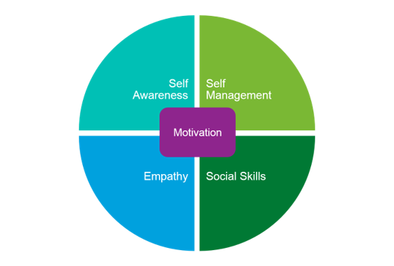
Emotional intelligence
“…the ability to understand and manage your own emotions, and those of the people around you.”

Slide 28
Someone else’s behaviour: discuss
When did someone’s behaviour last really surprise you?​
What did they do?​
Why was it a surprise?​
How did you react?

Slide 29
Person 1
Person 2
Thoughts
(facts & stories)
Thoughts
(facts & stories)
Physical response
Physical response
Emotions
Emotions
Behaviours
Behaviours

Slide 30
Building Empathy

Slide 31
Trainer notes: Building empathy (Part 1)
Purpose: To demonstrate and practice tools to build empathy with others, and highlight the importance of doing this in their role
Materials: None.
Instructions: Ask the group to share their understanding of the word empathy. Share Brene Brown video (on slide 34). Key points: the ability to understand and share the feelings and experiences of another. In other words, empathy is imagining yourself in someone else’s skin: feeling what they feel and seeing yourself and the world from their point of view. Emphasise the importance of building empathy in their role - without empathy, you might assume that someone else’s needs, boundaries, and experiences are the same as yours and as a result, you can make incorrect assumptions and may inadvertently negatively impact the relationship.
Explain that during this session we’re going to look at different tools to build empathy.
Part 1 Questioning: Explain how questions build empathy – if used well that can help you to gain insight on someone’s emotional reactions and experiences to provide a deeper understanding. Individuals are more likely to feel comfortable and supported when they feel understood. Slide 35 takes the attendees through the type of questions.
Group participants into 3s – ask them to take it in turns to practice their questioning skills using the exercise on slide 36. Their goal is to find out as much about each other’s ideal holiday in 3 mins by asking questions. The person answering the questions should only answer the question they’ve been asked. E.g. if you’re asked a yes/no question, answer only using yes or no – don’t elaborate. The observer in each round should make a note of which questions were most effective and which questions were not.
Debrief by asking the groups to feedback on the most/least effective questions.
Timings: Video and intro 10 mins, Activity: 10 minutes, Debrief: 5 minutes

Slide 32
Trainer notes: Building empathy (Part 2)
Part 2 Listening: Explain that another key part of building empathy is effective listening.
Show slide 37 and define gap listening “the time difference between your mental ability to interpret words and the speed at which they arrive to your brain; when we have a large listening gap we may daydream, doodle on paper, or allow our minds to wander”. We may also make incorrect assumptions.
Explain the different stages of gap listening (click through the animation on the slide): Listening starts with what information the sender communicates based on their mental model. The information the recipient receives will inevitably have gaps in because of distractions and interruptions. The receiver also has their own mental model of the world, and they use this to fill the gaps – this means that the information received will also have assumptions and stories which impact on how the receiver responds.
Show slide 38 with the listening levels – superficial listening (pretending to listen) is to be avoided. Conversational listening (listening to respond) is fine for chats with friends but less effective in a professional context. The goal is to achieve a blend of active listening – listening to understand, while putting your own thoughts and beliefs to one side – and empathetic listening – really feeling what the other person is going through. In a PSW role, it is important to be able to move between the two fluidly to be connected and in the moment when needed, but to step back and maintain objectivity if necessary.
Put the group back into 3s and explain the task on slide 39. The person listening should not speak or respond in any way but raise their hand every time they are distracted. The observer should make a note of the impact of the distractions.
Debrief by asking the groups how it felt. Share the top tips on slide 40
Timings: Intro 10 mins, Activity: 10 minutes, Debrief: 5 minutes

Slide 33
Trainer notes: Building empathy (Part 3)
Part 3 Reflecting back: Take participants through the reflecting back slides (slides 41 and 42). Explain how the ‘Reflecting’ process will encourage the service user to discuss her/his feelings further. By ‘Paraphrasing’, the service user knows that they are being listened to and will be encouraged to talk further. This process also helps the service user clarify what the problem is. Note that ‘Summarising’ is different to using paraphrasing as a summary usually covers a longer time period than a paraphrase. Mention they can also be useful for bringing a session to a close, by drawing together the main threads of the discussion, as well as beginning a subsequent session if appropriate.
Back into groups of 3 – Ask them to have a go at summarising the statements on slide 43.
Debrief by asking people to share some examples and any challenges they faced.
Timings: Intro 10 mins, Activity: 10 minutes, Debrief: 5 minutes

Slide 35
Questioning
Questions can be:
Open
why, how, what, describe, explain, tell me about...
Closed
can, did, will, have, how many...
They can also be:
Probing
what happened as a result, tell me more...
Hypothetical
what would happen if...
Challenging
why did you choose to do it that way…
(use with caution)
Reflective
how did that make you feel…
Clarifying
have I understood you correctly...
They shouldn’t be:
Multiple
Try to stick to one at a time!
Leading
Is this the best training course you’ve ever been on?

Slide 36
Question activity
Round 1
Person A: Use questions to find out as much as you can about your partner’s ideal holiday
Person B: Answer only the question you’ve been asked (no bonus info!)
Person C: Observe and make a note of helpful/unhelpful questions
Round 2:
Person B asks the questions
Person C answers
Person A observes
Round 3:
Person C asks the questions
Person A answers
Person C observes

Slide 37
Gap listening
Mental model of sender
Mental model of receiver
Mental model of receiver
Data Transmitted
ASSUMPTIONS
Data Received
Icons made by Eucalyp from www.flaticon.com

Slide 38
Listening levels
Empathetic
Active
Superficial
Conversational

Slide 39
Listening activity
Round 1
Person A: Talks for 2 mins about what they did at the weekend
Person B: Listens without interrupting – raise your hand every time you are distracted (by a thought, a question you want to ask, something in your environment)
Person C: Observe the impact of the hand raising
Round 2:
Person B talks
Person C listens
Person A observes
Round 3:
Person C talks
Person A listens
Person C observes

Slide 40
Listening tips
Prepare the environment
Leave distractions behind
Take notes
Make eye contact
“ Listen” to body language and tone
Reflect back
Be aware of your body language

Slide 41
Reflecting, paraphrasing and summarising
Reflecting
Paraphrasing
Responding not just to what is being said to you, but how it is said
Picking up feelings behind what is being said and reflecting that back
Identifying the most important content from what is being said
Feeding it back to the speaker in a concise form
Summarising
Condensing, or crystallising, the main points of what the person is saying and feeling at the end of a conversation, or before moving on to a new topic
Summarising the main points so that the client has the opportunity to recap
Likely to include both reflecting back and paraphrasing
Helpful for reviewing, taking stock, and starting the process of focusing and prioritising ‘scattered’ thoughts and feelings

Slide 42
Example
I am getting so wound up by everyone at the moment. I want to talk about going to college, but everyone’s just fixating on what could go wrong. My mum basically told me I can’t do it because I’m too mental, and my psychiatrist just keeps banging on about my medication – even though I’ve told her I hate it and don’t want to take it any more. It’s like I’m just a walking talking diagnosis and everyone has just forgotten that I’m a person.
Reflecting:
It sounds like you’re feeling really frustrated and let down by the people around you.
Paraphrasing:
It sounds like you’re not getting the encouragement you were hoping for to go to college. You want people to focus on you, not your diagnosis and medication. It also sounds like you might want a review of your medication. Is that right?

Slide 43
Reflecting, Paraphrasing, Summarising Exercise
I feel really stuck – it feels like everything is going wrong. Everything was going well and then my relationship started to go downhill. I keep telling myself to stay positive but if it wasn’t for the children, I think I would leave. No matter how hard I try, I keep hitting dead ends, and I don’t know where to turn any more. I feel like such a failure.
Reflecting:
Paraphrasing:
I’m feeling really low at the moment. Everything feels like such an effort – getting up in the morning and having a shower feels like a mammoth task. When I do manage to get up I feel like I’m walking around with a heavy weight on my shoulders. I was supposed to see my mum last week, but I cancelled again – she’s probably really upset with me. It feels like this is just my life now, it’s never going to get any better.
Reflecting:
Paraphrasing:

Slide 44
Communication styles

Slide 45
Trainer notes: Communication styles (part 1)
Purpose: Understanding the influence of communication styles to build rapport and empathy
Materials: Social Style grid handout
Building rapport: Ask participants to discuss what rapport is and why it’s important in their role.
Following group discussion, show slides 49-50, stating building rapport is a process and can be developed through multiple channels. Go through the communication iceberg explaining how the majority of what we communicate to others is understood without a single word being spoken. You pick up most of your understanding of what is being communicated to you, or what the other person is trying not to communicate to you, through body language, voice and tone, and is underpinned by their thoughts and feelings. We communicate and express our feelings, attitudes, beliefs and values not through what we say but how we say it. These messages are made clear by such things as our facial expressions or our eye contact or lack of it. We therefore need to build rapport and show empathy through all these channels – not just through what we say.
Explain how we’re looking at the Social Styles model (developed by David Merrill and Roger Reid in 1960s) to help you understand the people around you and knowing how to get the best from people with each preference. This model covers all the different communication channels, so is a good starting point to help you think about how you can build rapport with people effectively.
Show the Social Styles diagram (slide 51) and explain how you will go through each part in turn.

Slide 46
Communication styles (part 2)
The two dimensions: Explain that the model you’ve just shown is made up of two dimensions.
Assertiveness styles range from ‘asking’ behaviours to ‘telling’ behaviours, while our responsiveness varies from ’emoting’, or displaying our feelings, to ‘controlling’ our emotions. Depending on where you are on the dimensions, you will prefer a social style. As with other models, we each have our preferences, but can display all the styles from time to time.
Introduce the first dimension (slide 51) and explain each briefly. Assertive people like to take the lead in more assertive ways, speaking directly and frankly. Others respond to input from others, sharing their own ideas to build upon others’ views.
Introduce the next dimension (slide 54). Some people like to express themselves outwardly in social settings, whilst others prefer to maintain composure and control.
Talk through the ‘identifying a social style’ handout on slide 55– explain that these are not set-in stone, but generally you will lean one way or the other.
Activity In pairs, have a 5-minute conversation about your last holiday. From what we’ve discussed, try and guess where the other person sits on each dimension. Tell them it’s just for fun!
Debrief by asking people to share how easy/hard it was to decide where people sat.
Timings: Intro to communication channels and the 2 dimensions: 10 mins. Activity: 5 mins. Debrief: 5 mins

Slide 47
Communication styles (part 3)
Talk through the scoring from the questionnaire, explaining that where you are on each dimension means you are likely to have a preference for one of 4 social styles. Talk through the scoring from the questionnaires – remind people that this is not an in-depth personality test and will only give an indication of preference. Ask people if their self-assessment matched what their colleagues said in the last exercise.
Highest score column 1: Driving
Highest score column 2: Expressive
Highest score column 3: Amiable
Highest score column 4: Analytical
Talk through the definition of each style on slide 57, explaining that these are some of the characteristics of each style. Check in with people to see if this resonates.
Explain that sometimes, our personal preference can have a negative impact on other people – particularly when they have the opposite preference to us. Talk through the next slide – behaviours to avoid – emphasising that this isn’t necessarily how they are behaving, but how other people might interpret their communication style – particularly in stressful situations.
Then explain: what’s the importance? Explain how Social Styles is closely related to Emotional Intelligence. It is all about how the four styles manifest in the real world, to meet other people’s needs –. The Social Styles model has power in helping you understand their behaviours and those of other people around them. And by adapting your style, the model allows you to get the best from any situation.

Slide 48
Communication styles (part 4)
Activity: Ask people if they are willing to share their results with the rest of the group (if not randomly split the group into 4). Split the group into four groups according to their communication preference.
Ask them to work through the questions on slide 59, thinking about how they can work effectively with people with different communication preferences, and how others can get the best out of them. Emphasise that the intention here isn’t to ‘pigeonhole’ them into a particular style or group. But to encourage them to think about what it means to flex their style to match others, using the Social Styles model as a starting point.
Debrief by asking each group to share their insights so that the other groups can add to their reflections about effective ways of working with other styles.
Finish by sharing the tips on slide 60
Timings: Introduction to the four styles: 15 mins. Activity: 15 mins. Debrief: 10 mins

Slide 49
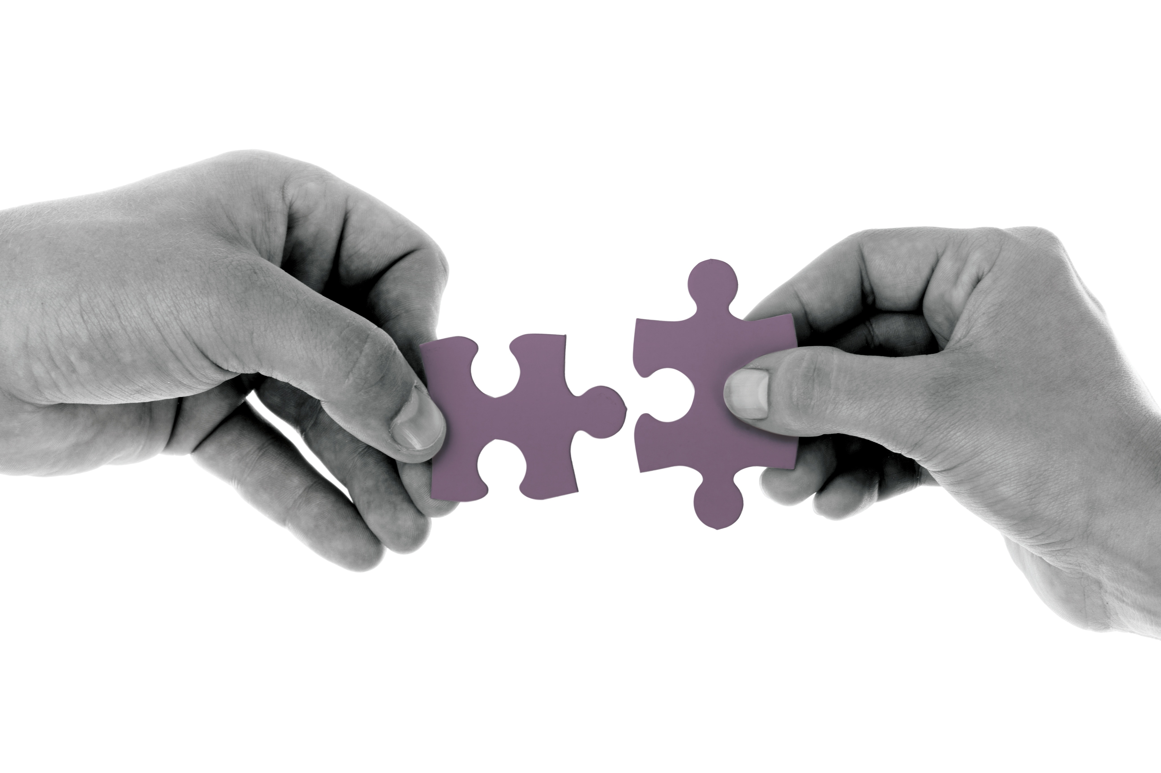
What is rapport?
‘A process of trust & responsiveness’

Slide 50
Rapport channels: communication iceberg
7% of how we communicate is through what we say
Words
Body language Voice
Thoughts-conscious Feelings-unconscious
The remaining 93% is communicated through how we say it

Slide 51
Social styles
Analytical
Driving
Amiable
Expressive
Controlling
Responsive
Assertive
Emoting
The Social Style model was developed by the TRACOM® Group: http://www.tracomcorp.com/social-style-training/

Slide 52
Social styles
Controlling
Are you more of an ‘ask’ or a ‘tell’ person?
Responsive
Assertive
Emoting
The Social Style model was developed by the TRACOM® Group: http://www.tracomcorp.com/social-style-training/

Slide 53
Social styles
Analytical
Driving
Amiable
Expressive
Controlling
Responsive
Assertive
Emoting
The Social Style model was developed by the TRACOM® Group: http://www.tracomcorp.com/social-style-training/

Slide 54
Social styles
Controlling
Do you prefer to show or control your emotions?
Responsive
Assertive
Emoting
The Social Style model was developed by the TRACOM® Group: http://www.tracomcorp.com/social-style-training/

Slide 55
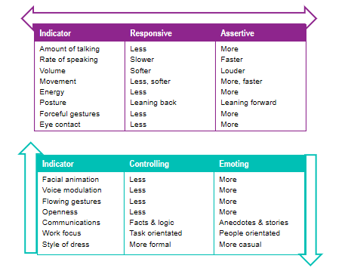
Identifying a Social Style
The Social Style model was developed by the TRACOM® Group: http://www.tracomcorp.com/social-style-training/

Slide 56
Questionnaires
Highest score in column 4: Analytical
Highest score in column 1: Driving
Highest score in column 3: Amiable
Highest score in column 2: Expressive
Controlling
Responsive
Assertive
Emoting
The Social Style model was developed by the TRACOM® Group: http://www.tracomcorp.com/social-style-training/

Slide 57
Social styles
Analytical
Driving
Amiable
Expressive
Logical
Reserved
Careful
Analytical
Precise
Fast reactor
Optimistic
Open
Creative
Energetic
Exacting
Friendly
Co-operative
Patient
Accepting
Warm
Direct
Decisive
Efficient
Determined
Controlling
Responsive
Assertive
Emoting
The Social Style model was developed by the TRACOM® Group: http://www.tracomcorp.com/social-style-training/

Slide 58
Behaviours to avoid
Analytical
Driving
Amiable
Expressive
Stubborn
Pushy
Weak
Superficial
Exaggerator
No follow through
Over confident
Nitpicker
Perfectionist
Pedantic
Unemotional
Not straightforward
Slow to make decisions
Time waster
Lacking goals
Autocratic
Insensitive
Demanding
Domineering
Critical
Controlling
Responsive
Assertive
Emoting
The Social Style model was developed by the TRACOM® Group: http://www.tracomcorp.com/social-style-training/

Slide 59
Communication styles - reflection
How might your style impact on others around you?
Have you experienced situations where someone else’s style has had a negative impact on you or vice versa?
What can others do to get the best out of people with your communication preference?
What can you do to minimise ‘behaviours to avoid’ when working with people with different preferences?

Slide 60
Working with other styles
Controlling
Analytical
Driving
Amiable
Expressive
Take your time
Communicate clearly
Don’t pressure for answers
Respect their processes
Ask for their feedback
Give them space
Respect their time
Stick to the facts
Follow through on promises
Show your competence
Earn their trust
Let them have some control
Approach conflict carefully
Get to know them
Consider their perspectives
Draw out their opinions
Handle issues privately
Be courteous
Laugh with them
Listen to their opinions
Think big picture
Recognise their contributions
Lighten up
Form a friendship
Responsive
Assertive
Emoting
The Social Style model was developed by the TRACOM® Group: http://www.tracomcorp.com/social-style-training/

Slide 61
Wrap up
Purpose: To reflect on what has been covered during the first day
Materials:
Building rapport: Talk through slide 62. Ask people to talk through with their buddy.
Timings: 10 mins

Slide 62
Discuss in buddy pairs:
One thing I’ve learned
One thing I’ll take back to work
What I’ll do this evening to look after my wellbeing

Slide 63
Effective Relationships
Day 2

Slide 64
Check in & recap on housekeeping
Make sure everyone remembers the housekeeping details -
Finish time
Tea/coffee breaks – what time breaks are planned and letting people know that you can stop for additional breaks if needed. Let people know where the break-out spaces are
Lunch – let people know that lunch is provided and at what time
Toilets – make sure everyone knows where they are
Fire – let them know if there are any planned fire tests and where the fire exits are
Phones – ask people to put their phones onto silent (or off if possible!)
Check in purpose: To provide an opportunity to share any questions or reflections that have emerged overnight before introducing more content
Materials:
Building rapport: Talk through slide 65. Ask people to share their thoughts or questions.
Timings: 10 mins

Slide 65
Day 2
Having digested overnight:
Any questions?
Any reflections?
Any concerns?

Slide 66
Effective relationships with families and supporters

Slide 67
Trainer notes: working with families and carers 1/2
Purpose: To reflect on the importance of considering a person’s wider network when building relationships with an individual
Materials: Social network map handout
Instructions: Ask the group why it is important to build effective relationships with a person’s family or support network. Give the group a few minutes to discuss their thoughts.
Introduce the triangle of care on slide 69 and ask if anyone has heard of it before. On slide 70 there is an overview of what the triangle of care is in more detail. Explain that the triangle of care encourages effective relationships between staff members, service users, and their carers, which supports recovery and well-being. Talk through the six standards highlighting the fact that it is important that staff, including peers, are aware of carers and that they are considered when working with an individual. Slide 70 shows why this is so important. Only 55% of service users who took part in this survey felt that their family member or someone close someone close to them was involved as much as they would’ve liked in their care. This had an impact on how they rated their experience of mental health services. So we can see from these two slides that awareness of, and effective working with, carers and family members is an important part of the role of anyone working in mental health.
On slide 72 there are a couple of quotes that also reinforce the importance of thinking beyond the individual you are working with. The first quote highlights the fact that effective dialogue exists between people, not within an individual. The second quote stresses the importance of an individual‘s relationships as a way to create new ways of seeing, thinking and doing.
At the beginning of day one, we looked at a diagram which showed how we each have different windows of the world based on our experiences and how we define ourselves. The diagram on slide 73 shows how, in fact, we don’t just exist as a set individual characteristics, but that all our individual senses of self can relate to and interact with other people’s. This diagram shows how one person’s relationships with four other people can all interact with each other. In this example they are all parents, they have a variety of different roles, and a variety of challenges that they experience. Understanding how all these experiences, characteristics and roles interact across the people in someone’s network is critical to get a full understanding of the complex interplay of individuals and relationships.
Timings: 20 mins

Slide 68
Working with families and carers 2/2
Explain that a useful tool to help you understand somebody’s social network, and therefore how you can work with it and support them to connect with it effectively is the social network map on slide 74.
A peer wanting to use this approach with an individual would help them to map out the various people in their social network according to how close or far away they are from the individual. Show the example on slide 74. Explain that in this example a peer might start a conversation about those people closest to this individual, for example their daughter and their sister. This conversation might include how those individuals might be involved in the persons care or support. It can also be a good way to start to explore some of the more distant relationships and how they might impact on how the individual feels about themselves. For example, the pair might ask the individual whether it is an aspiration to build closer relationships with those people further away from the centre, or indeed to build new relationships where there are gaps, such as with neighbours.
Activity: Split the group into pairs and ask them to complete a social network map for their partner.
Debrief by asking them how they found the exercise and if they have any questions.
Timings: Intro to network map: 5 mins, activity 10 mins, debrief, 10 mins.

Slide 69
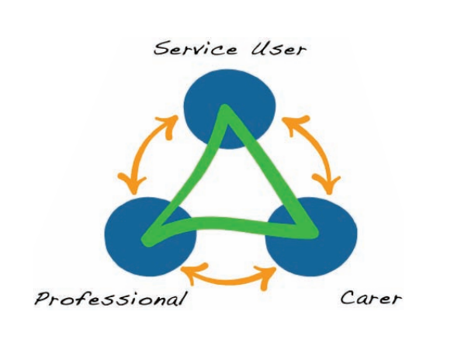
What is the Triangle of Care?
A therapeutic alliance between service user, staff member and carer that promotes safety, supports recovery and sustains wellbeing – launched as a national initiative in 2010 by the Carers Trust.
Consists of six standards:
Carers and their essential role are identified at first contact or as soon as possible thereafter
Staff are carer aware and trained in carer engagement strategies
Policy and practice regarding confidentiality and sharing information are in place
Defined posts responsible for carers are in place
A carer introduction to the service and staff is available
A range of carer support services is available.
Notes:
https://www.nsft.nhs.uk/Get-involved/Pages/Triangle-of-care.aspx

Slide 70
Why is it important to build effective relationships with a person’s family/support network?

Slide 71
Last National CQC Community MH Service User Survey*
Poor Involvement…
“I was involved as much as I wanted to be in agreeing my care” | 57%
“A family member or someone close to me was involved as much as I would like” | 55%
…leads to poor agreement
“I definitely agreed with someone in NHS MH services on what care I’ll receive” | 43%
“Mental health services understand what is important in my life” | 42%
“Mental health services help me with what is important” | 41%
“mental health services help me feel hopeful about what is important” | 38%
*16,400 SU respondents from 51 MH Trusts
56 mental health care providers in England only 32 are members of the Triangle of Care

Slide 72
Peer / Family Work
Dialogue has been described as the art of thinking together - meaning it develops, not within any one person’s head alone, but rather, in the interpersonal space’ between people. Seikkula & Arnkil 2006.
In peer support we “are taught to listen for how and why each of us has learned to make sense of our experiences, and then use the relationship to create new ways of seeing, thinking, and doing.”

Slide 73
Colleague 1
Colleague 2
Client
Partner
Father
Single parent
Non-binary
Pan-sexual
Doctor
Peer Worker
Teacher
Engineer
Chronic illness
Partially sighted
Mental health challenges
Carer
Atheist
Muslim
Jewish
Jewish

Slide 74
Social network map
Colleagues
Friends, acquaintances
ME
Neighbours
Family
Relatives

Slide 75
Social network map example
Colleagues
Friends, acquaintances
Jamila
Mo
Harpreet
ME
Daughter
Neighbours
Sister
Family
Mum
Wife
Relatives

Slide 76
Pairs exercise
Complete social network map for each other and discuss:
What are the benefits of involving a person’s support network?
What are the challenges?
What is the peer role in working with an individual’s social network?

Slide 77
Social network map handout
Colleagues
Friends, acquaintances
ME
Neighbours
Family
Relatives

Slide 78
Barriers to relationship building

Slide 79
Trainer notes: Barriers to relationship building (part 1)
Purpose: To explore what may hinder building trust in relationships, looking at our biases and what is vital to build trust.
Materials: Window on the World sheet
Instructions: We’ve covered how to build empathy and meaningfully connect with someone, let’s talk now about how this can be hindered. Explain ‘unconscious bias’ – when we make quick judgements about people and situations without us realising.
Show the illusions on slides 83 & 84 and ask people what they can see. Explain that our brains are bombarded with so much information that they use short-cuts to maintain processing speed, they put things into boxes to try to make sense of them. However, in trying to be quick and efficient, our brains make mistakes – this is why we see the optical illusions on the screen. Even if we know that the first image isn’t moving, and the circles are the same size, it’s very hard to “unsee” the illusion.
Our brains make the same mistakes when categorising people; we regularly and quickly sort people into groups based on stereotypes, the cultural environment around us and our personal experiences. We do this because when we meet someone, the information available to us is overwhelming and we can’t process it fast enough. It is useful as it provides us with a script for what to expect from others, but the danger is that it can then guide how we behave on the assumption that the individual conforms to the stereotype or group we’ve put them in. The challenge is that the categories we unconsciously use to sort people are not always logical, fair or at times even legal.
This unconscious sorting is very fast – it usually happens about 250 milliseconds before our conscious processes engage. It’s important to note that this is a common process. It’s not the behaviour of ‘bad’ or racist or sexist people, but of everyone, including you and I.
Talk through the types of unconscious bias on slide 84 – explain that there are more than on this list but these are some of the more common types.
Activity: Split participants into groups and ask them to work through the ‘bias quiz’, guessing which type of bias is demonstrated in each example. Debrief with the right answers and a discussion about the scenarios
Timings: Intro 15 mins, activity: 10 mins, debrief 5 mins

Slide 80
Barriers to relationship building (part 2)
Window on the World: Explain that a huge part of the context behind our unconscious biases is our individual frame of reference – we started to look at that in the buddy exercise yesterday. Explain that we’re now going to revisit that in the context of bias
Activity: In pairs, choose one area of the Window of the World that you think might influence your unconscious biases. Facilitators to share a personal example first. E.g. if you are over 40 you might assume that everyone in their 20s is really tech-savvy and not give them help when they need it.
Debrief by asking people if they’re comfortable to share some of their examples.
Timings: Intro 5 mins, activity: 10 mins, debrief 5 mins

Slide 81
Barriers to relationship building part 3
Power and hierarchy: Ask people what role power and hierarchy has in building effective relationships. Facilitate a discussion, pulling out the fact that perceptions of power and hierarchy are potentially as important as actual power imbalances. Having a lanyard and a job title can create a power imbalance even if you, as a peer, don’t feel that you have higher ‘status’ than the people you support.
Talk through the roles on slide 89, emphasising that each person/role/organisation on this diagram is likely to have different status (real and perceived) and varying levels of formal/informal power. Invite people to feedback on this diagram and where they feel they sit.
Ask participants what they think they can do to break down perceptions of power imbalances – recognising that it won’t always be possible. Explain that one thing to do is to think about how they engage people effectively. Show the co-production diagram on slide 90. Explain that this is a way to turn power on its head, giving people to power to co-produce their own experience rather than feeling ‘done to’ by the system.
Timings: Intro 10 mins, group discussion, 10 mins

Slide 82
Barriers to relationship building part 4
Ask participants ‘why is trust important in your role?’. Group discussion, write answers on flipchart. Then ask, ‘how do you know when you haven’t built trust?’ Explain how we use trust to: interpret what people say​; decide if we feel comfortable sharing information​; decide whether we feel other people have our interests at heart​. Refer to the flipchart answers and emphasise how trust with those we work helps make the relationship a successful one.
Without trust it is very hard to build effective relationships – and it is very hard (but not impossible) to rebuild it once it’s lost. The Trust Equation (From The Trusted Advisor (Maister, Green and Galford, 2012)) is a useful framework to think about what makes someone trustworthy.
The Trust Equation: The Trust Equation in basic terms says that trust equals reliability plus credibility plus intimacy, divided self-orientation. What this means is that there are three key factors at the top of the equation can increase trust, but that they can be undermined by the fourth factor – self-orientation. To build trust, you need high credibility, reliability and intimacy and low self-orientation.
Trust Components: Go through each trust component (slide 92). Credibility means people can trust what you say – your words ring true and are backed by experience/knowledge. Reliability has to do with actions – you deliver what you promise. Intimacy refers to safety or security with someone – you create a safe and comfortable space to share. Low self-orientation is about focus – you are focused on them, not on yourself.
Activity: In pairs, ask people to think about how they might introduce themselves and their role to a new client/person they’re supporting. How can you demonstrate the components of the Trust Equation in this introduction.
Debrief by asking people to share some examples.
Timings: Intro 10 mins, activity: 20 mins, debrief 10 mins

Slide 83
Are the circles moving?

Slide 84
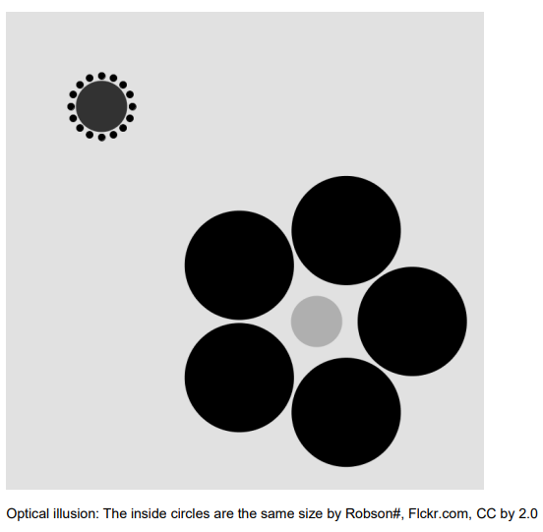
Are the inner circles the same size?

Slide 85
Affinity bias
Halo effect
Horns effect
Favouring people who are similar to us
Letting one positive attribute influence our perception
Letting one negative attribute influence our perception
Attribution bias
Confirmation bias
Conformity bias
Incorrectly attributing successes or failures
Only looking for evidence that confirms our beliefs
Following the people around us rather than our judgement
Icons made by Freepik from www.flaticon.com

Slide 86
Bias quiz handout
For each of the scenarios below, can you spot the bias at play?
Reda strongly believes that yoga is incredibly beneficial for people’s mental health and wellbeing. When she meets people who do yoga regularly, she always asks them if they find that it helps their wellbeing. She doesn’t ask people who don’t seem interested in yoga.
Shanice works with a few clients and has built good rapport with them all. One particular client, Jacqui, grew up in the same part of London as Shanice and they have very similar backgrounds. Shanice tends to find that she spends longer with Jacqui than other people she works with and is much more willing to help her out if she needs extra support.
When Nilesh meets with Ken for the first time, Ken arrives late and drops his bag as he enters the room, spilling the contents all over the floor. Nilesh doesn’t realise that Ken has had a stressful morning and makes a mental note that he must be quite scatty and disorganised.
Terry has been attending group coaching sessions for a while. At her first session she happened to arrive early and so offered to help the PSW, Sami, set up the room. Over the next few sessions, several people, including Terry, arrive late. When Terry comes in late, Sami usually waits for her to arrive before starting, but with the others he usually starts without them.
Omari has heard a few people in the team mention that Claude, one of the clients, is disinterested and is hard to engage in conversations about his care or treatment. Omari hasn’t worked with Claude before – when they meet Omari doesn’t make as much effort as he would usually as he assumes Claude won’t be interested.
A year ago, Jon worked for a mental health charity and met Sarah, who was a regular attendee at their day service. One day, Jon witnessed Sarah having an argument with another person at the day service – the argument escalated very quickly, and Sarah shouted and swore at other person. Last week Jon met Sarah again through his new PSW role. Jon is very professional with Sarah but is less warm and friendly than he would be usually and is a bit wary about spending time with her.

Slide 87
Bias quiz - answers
Confirmation bias
Affinity bias
Attribution bias
Halo effect
Conformity bias
Horns effect

Slide 88
Frame of reference: window on the world
The Frame of Reference (1975) is the term used by Jacqui and Aaron Schiff to refer to our individual filter on reality. They defined the term as:
"The structure of associated responses which provide the individual with an overall perceptual, conceptual, affective and action set which is used to define the self, other people and the world."

Slide 89
GOVERNMENT (LAWS/POLICIES)
ORGANISATION (LOCAL POLICIES)
TEAMS/UNITS
FORMAL MANAGEMENT HIERARCHY
PROFESSIONAL STATUS
INFORMAL POWER/STATUS
PEOPLE/CLIENTS

Slide 90
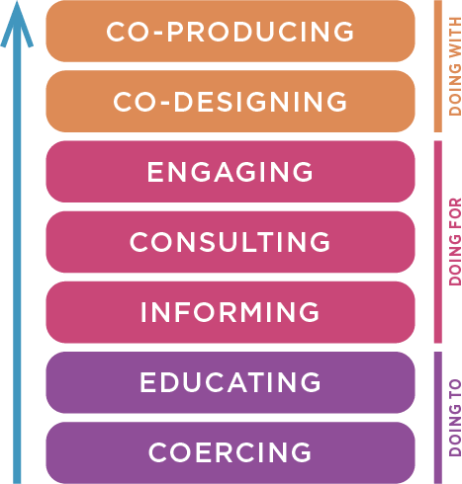

Slide 91
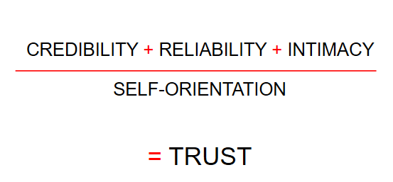
The Trust Equation
Adapted from: The Trusted Advisor (Maister, Green and Galford, 2012) ​

Slide 92
Trust components
COMPONENT | EXAMPLE
Credibility | Can we believe what you say?
Reliability | Can we depend on your actions?
Intimacy | Do we feel safe sharing information with you?
Self-orientation | Are you focused on yourself, or on the other person?
Adapted from: The Trusted Advisor (Maister, Green and Galford, 2012) ​

Slide 93
Courageous conversations

Slide 94
Trainer notes: Courageous conversations (1 of 3)
Purpose: Identify how best to create effective dialogue with other people
Materials: Flipchart paper
Instructions:
Part 1: Link back to the Cause & Effect diagram, building on it with slides 97 – 99 to emphasise that both people in a two-person dialogue will have facts-stories-emotions-behaviour. In order to have effective dialogue, the facts and stories need to be aligned. Everyone needs to be on the same page with sharing facts and having access to all the relevant information and testing stories. Facilitators to undertake a scenario to the group taking it in turns to read out the statements below (replace facilitator A/B with names):
Facilitator A: I asked Facilitator B for help with putting together some slides for a training session. I provided her with a full brief. A day before the deadline I asked Facilitator B for a progress update. Facilitator B said she hadn’t started it yet, but it would probably be done on time. I decided to take the piece of work back and completed the slides myself. I was pretty angry and disappointed that Facilitator B didn’t prioritise the task and I’ve decided I’ll ask someone else for help next time. I don’t think I’ll speak to Facilitator B about this issue – even though I’m angry, it doesn’t feel like it’s worth it.
Facilitator B: I felt really undermined and angry that the work was taken off me, and I feel like Facilitator A doesn’t trust me with simple tasks. I’ll probably avoid social contact with Facilitator A for a while. I probably won’t talk to Facilitator A about the slides again – I don’t want to make things any worse.
Facilitator A: What I didn’t share with Facilitator B is the fact that I am under a huge amount of pressure at the moment – I had the training deadline, and this piece of work is a small but an important part of a bigger programme. I’m pretty sure that Facilitator B knows all this as there have been lots of conversations about it. ​
Facilitator B: What I haven’t shared with Facilitator A is that I am working on multiple projects with competing timelines. I didn’t think to check how important this task was – I’ve been pretty busy and Facilitator A is usually pretty relaxed about deadlines, so I assumed it was ok to leave it to the last minute. I made a judgement call that these particular slides were less important than a major deadline on another project – I was pretty confident I’d fit it all in, and I didn’t really feel that this was a big deal until Facilitator A took the work away from me.​
Debrief: This sort of misunderstanding is pretty common and in itself not catastrophic! The task got done and the training was delivered well. But by not having a conversation afterwards to explore what happened, and where the misunderstanding came from, there’s a risk that the relationship breaks down, and neither of us learns about how to manage similar situations in the future
Timings: 15 minutes

Slide 95
Trainer notes: Courageous conversations (2 of 3)
Part 2:
Ask the group ‘What does effective dialogue look like in the PSW role?’ write up their answers, using the questions below as prompts:
‘When have you had effective dialogue as a PSW with others?’
‘What made it effective?’
‘What difficult conversations might you need to have as a PSW?’
Then ask participants ‘what prevents dialogue?’ as a group. Write answers on flipchart paper at the front of the room. In a group discussion, ask participants how their answers on ‘what prevents dialogue’ could impact on the relationship with those they support?
Explain that the main barrier to effective dialogue is when people stop themselves, or are stopped by others from contributing to the conversation and the shared understanding we discussed previously.
Then go through slide 100 on ‘what prevents dialogue?’:
Withholding your views
Masking – understating or selectively showing our feelings – sarcasm, sugar coating, humour​
Avoiding – Steering away from sensitive conversations by keeping to safe, trivial ground​
Withdrawing – pulling out of the conversation entirely
Blocking their views
Controlling – forcing your view on others – cutting people off, overstating your point, speaking in absolutes (I’m sure that everyone here agrees that… the last time we tried that it was a complete disaster)​
Labelling – attaching a label to dismiss someone’s point (that’s very a very dated perspective)​
Verbal attack – belittling the person
Timings: 20 mins

Slide 96
Trainer notes: Courageous conversations (3 of 3)
Ask people what they have done in situations when they are faced with the reactions on the slide. Explain that one of the key things is having the confidence to give helpful, constructive feedback to move the conversation forward.
Part 3: Then, describe the Feedback Framework (slide 103). Explain that A and E happen before and after the conversation - they are prompts to help you to prepare to have an effective conversation (A), and to reflect on how it went afterwards (E). Facilitators to demonstrate the approach to each other in front of the group by giving feedback to one another – focus on ‘I’ statements. Take it in turns to provide feedback to one another based on the scenario you talked through earlier in the session using the ‘BCD’ components of the model. As you give the feedback point to the part of the BCD you are talking through.
E.g. Facilitator 1: When we were preparing the slides and I asked you for a progress update, you said that you hadn’t started, and they would probably be done on time (behaviour). This task was very important for me, and I interpreted your response as a sign that you hadn’t prioritised it. I felt disappointed about this and concerned that it wouldn’t be done on time (consequences). Next time, it would be helpful if you could check in with me sooner on progress and give me a more definitive answer about when work might be completed (do) Ask participants how it felt to hear feedback being giving in that way.
Activity
Ask participants to spend a couple of minutes reflecting individually about a piece of feedback they either need to give, or wish they’d given to someone in the past. These should be work related, ideally (but not necessarily) in the PSW role. Check that everyone has an example to use.
Ask them to then spend 10 mins individually planning how they might structure the feedback using the framework provided (tell them they can ignore the ‘evaluate’ section for now). After 10 mins, check that everyone has their feedback written up, and then split them into groups of 3 to practice giving the feedback. Encourage them to role play as much as possible: i.e. that other participant is the real-life person they want to feed back to. They might find it helpful to ask the recipient of the feedback to react as the real person might. The third person should observe. Once the feedback has been given, they can spend 5 mins refining the feedback before the next person has a go. Repeat for the third person.
Debrief to ask people to share their learning and reflections from the activity.
Timings: Intro: 5 minutes, Individual prep: 12 min, Practice: 30 mins, Debrief: 10 mins

Slide 97
The situation
Person 1
Person 2
Thoughts
(facts & stories)
Thoughts
(facts & stories)
Physical response
Physical response
Emotions
Emotions
Behaviours
Behaviours

Slide 98
The situation
Gaps in information received
Person 1
Person 2
Thoughts
(facts & stories)
Thoughts
(facts & stories)
Physical response
Physical response
Emotions
Emotions
Behaviours
Behaviours

Slide 99
The situation
Dialogue builds a shared understanding
Person 1
Person 2
Thoughts
(facts & stories)
Thoughts
(facts & stories)
Physical response
Physical response
Emotions
Emotions
Behaviours
Behaviours

Slide 100
What prevents dialogue?
Withholding your views
Blocking their views

Slide 101
What prevents dialogue?
Withholding your views
Masking
Avoiding
Withdrawing
Blocking their views
Notes:
Masking – understating or selectively showing our feelings – sarcasm, sugar coating, humour
Avoiding – Steering away from sensitive conversations by keeping to safe, trivial ground
Withdrawing – pulling out of the conversation entirely

Slide 102
What prevents dialogue?
Withholding your views
Masking
Avoiding
Withdrawing
Blocking their views
Controlling
Labelling
Verbally attacking
Notes:
Controlling – forcing your view on others – cutting people off, overstating your point, speaking in absolutes (I’m sure that everyone here agrees that… the last time we tried that it was a complete disaster)
Labelling – attaching a label to dismiss someone’s point (that’s very a very dated perspective)
Attacking – belittling the person

Slide 103
The Feedback Framework
A | Ask – why am I giving feedback? What are the facts? What stories am I telling myself?
B | Outline the Behaviour – stick to the facts – ask them for their understanding of the facts
C | Tell them the Consequences of their behaviour – tell them how it’s impacting on you – but own your stories!
D | What do you suggest they should Do differently next time? What will you do differently?
E | Evaluate the conversation – did you withhold your views? Did you block theirs? If appropriate evaluate the behaviour change and give further feedback

Slide 104
Shared action planning with buddies

Slide 105
Trainer notes: Action planning
Purpose: To recap on the learning and reflect on next steps
Materials:
Instructions:
Talk through the visual recap of the key learning from the past two days on slides 106 and 107. Invite people to ask any questions, as you go through the models and theories, if anything is still unclear or if they have any outstanding questions. Break people into their buddy pairs and ask them to discuss their questions on slide 108. Debrief by asking people to share any final thoughts on anything that you've covered during the training , or anything that hasn't been covered that they would like to discuss. Finish by showing the suggested work from home on slide 109 suggesting that, if participants have time and would find it helpful, they should identify an opportunity to apply one of the tools from the day with someone they feel comfortable with, for example a colleague, friend or family member.
Timings:
Recap: 10 mins
Buddy discussion: 15 mins
Debrief: 5 mins

Slide 106
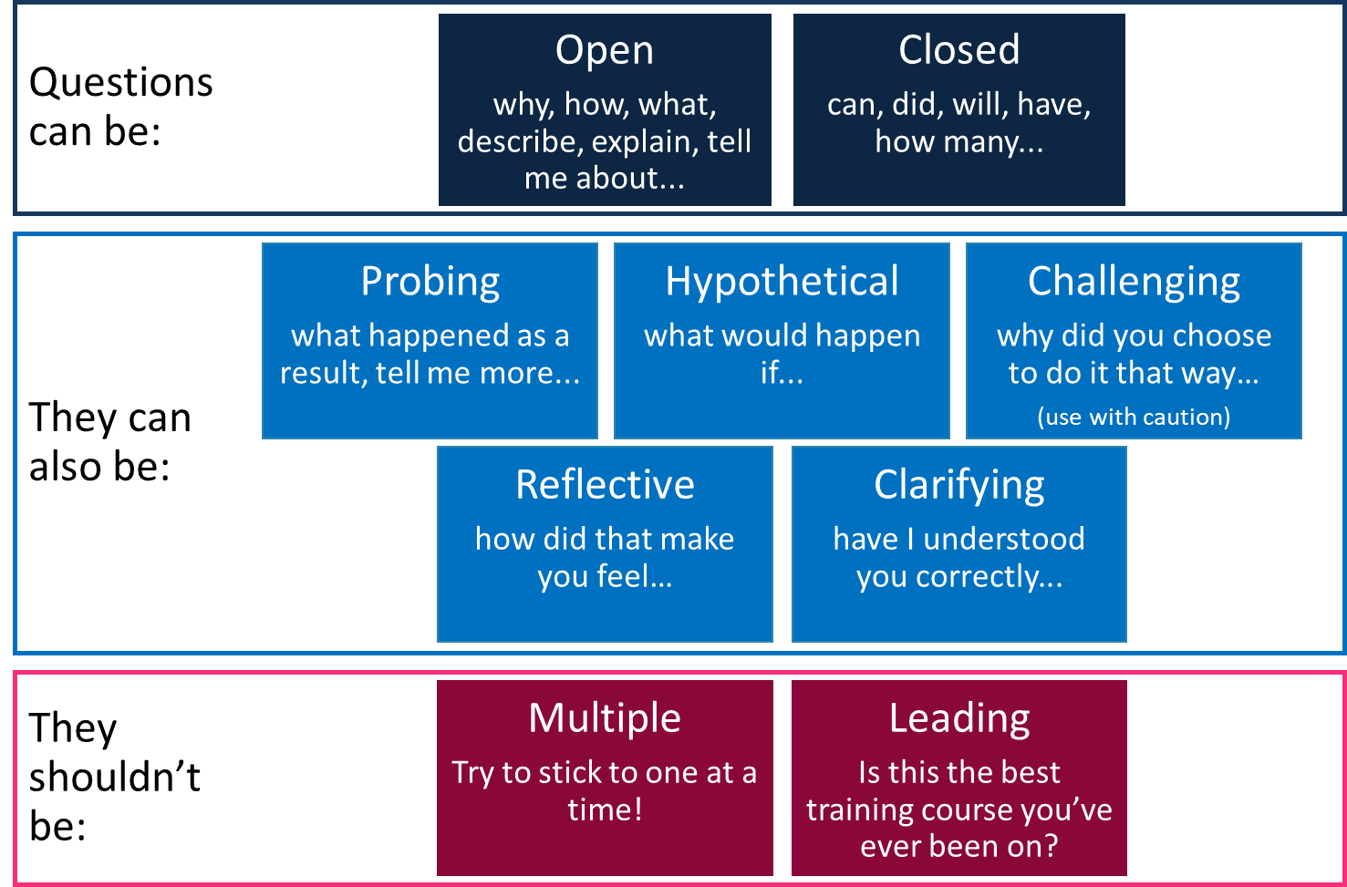
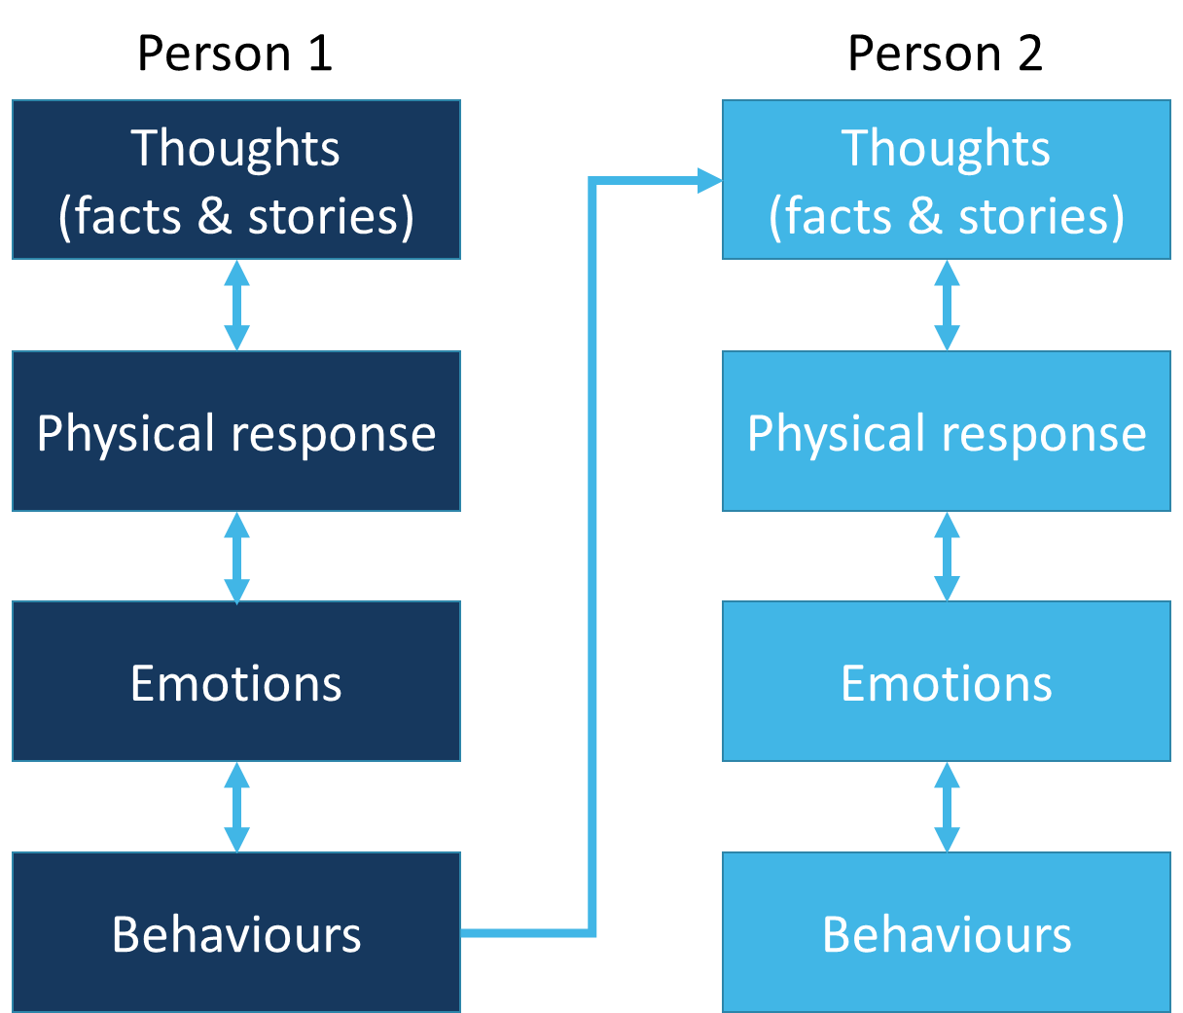
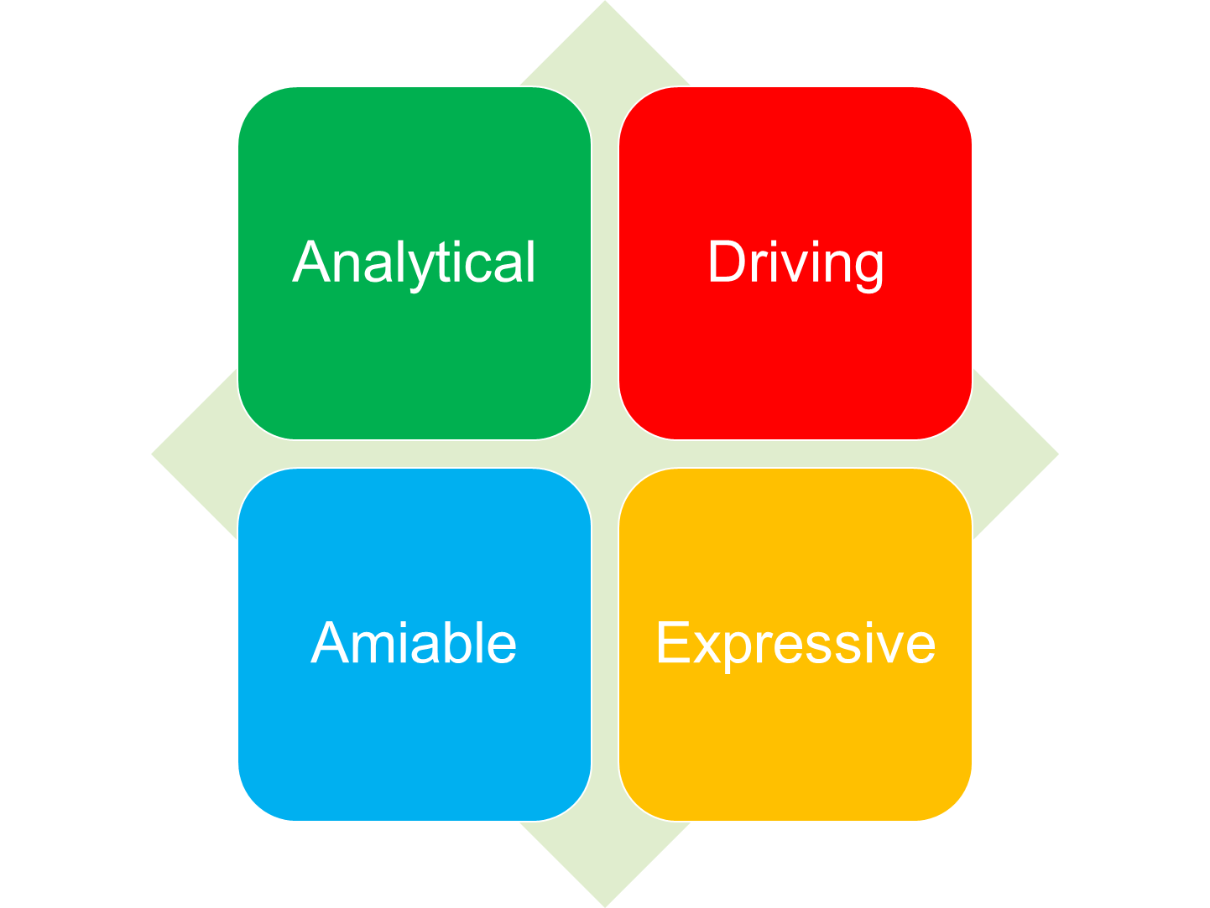
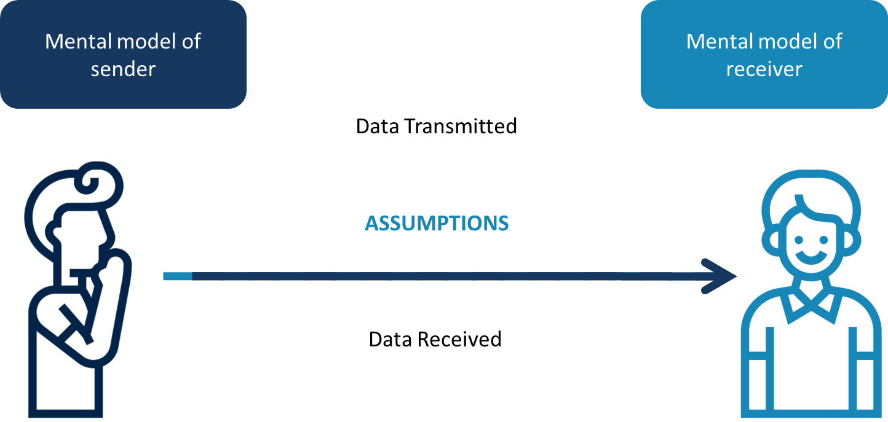
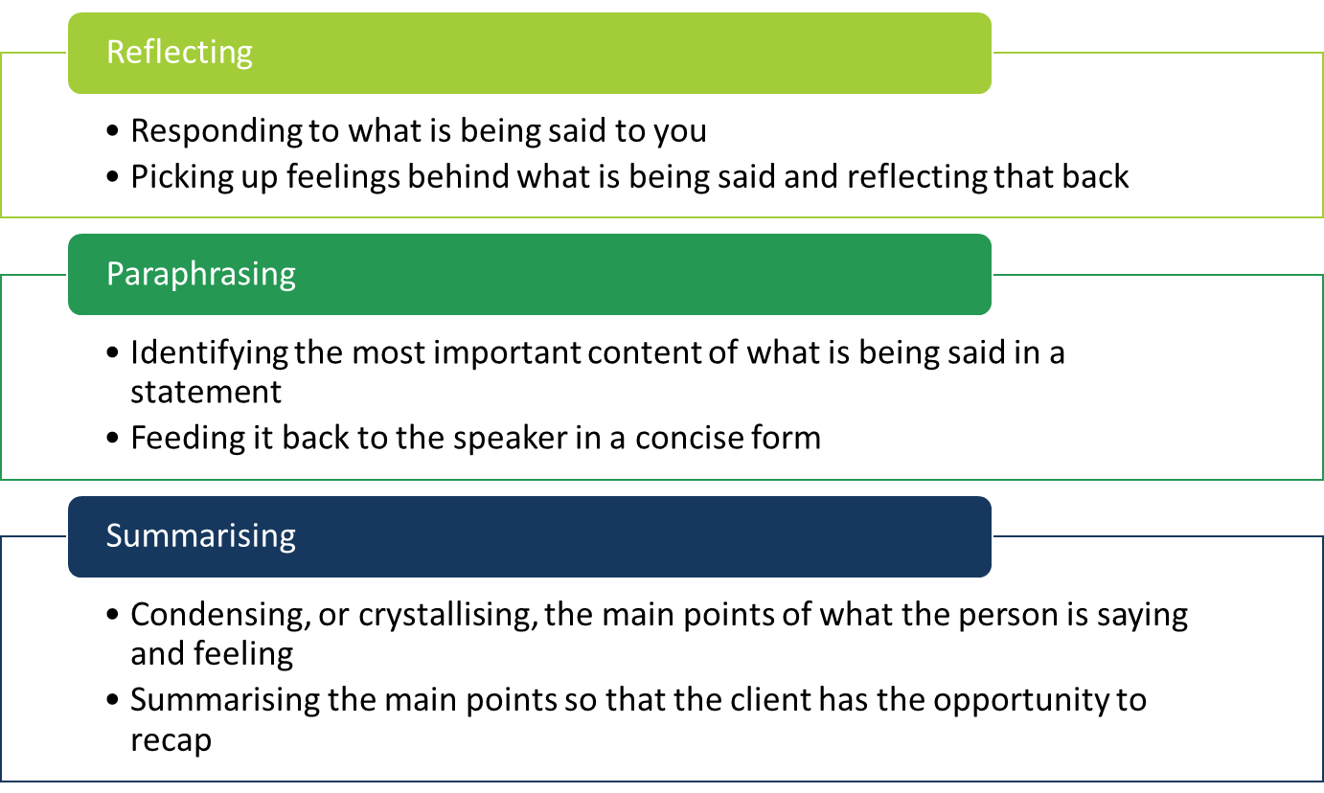
Recap: Day 1…
Icons made by Eucalyp from www.flaticon.com

Slide 107
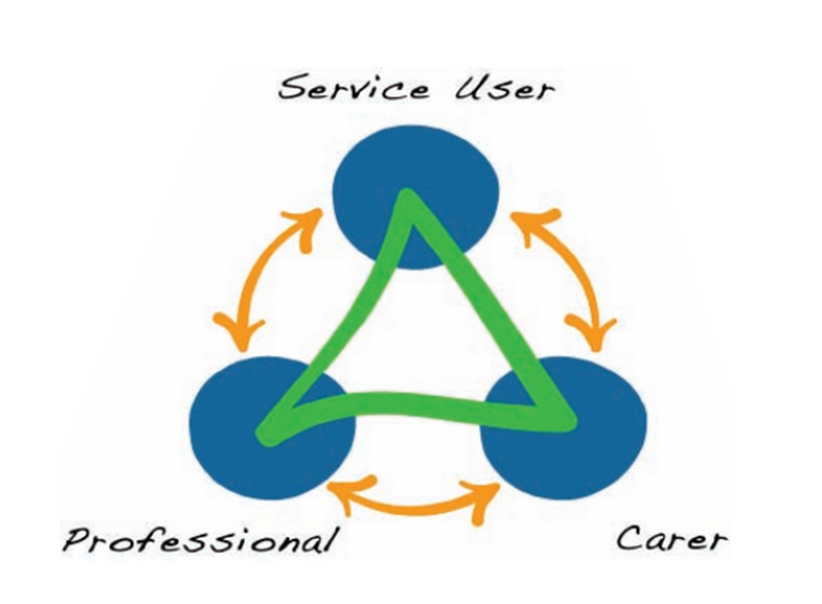
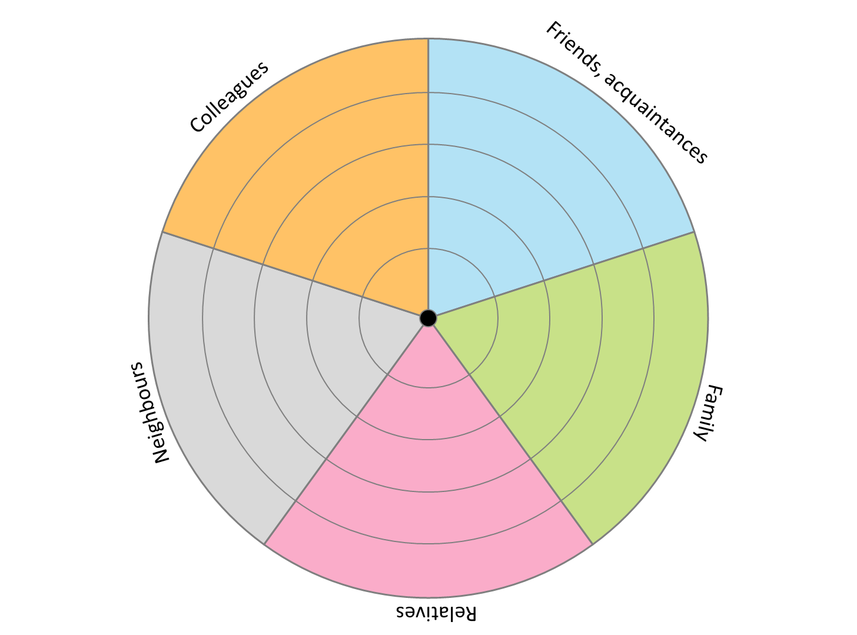
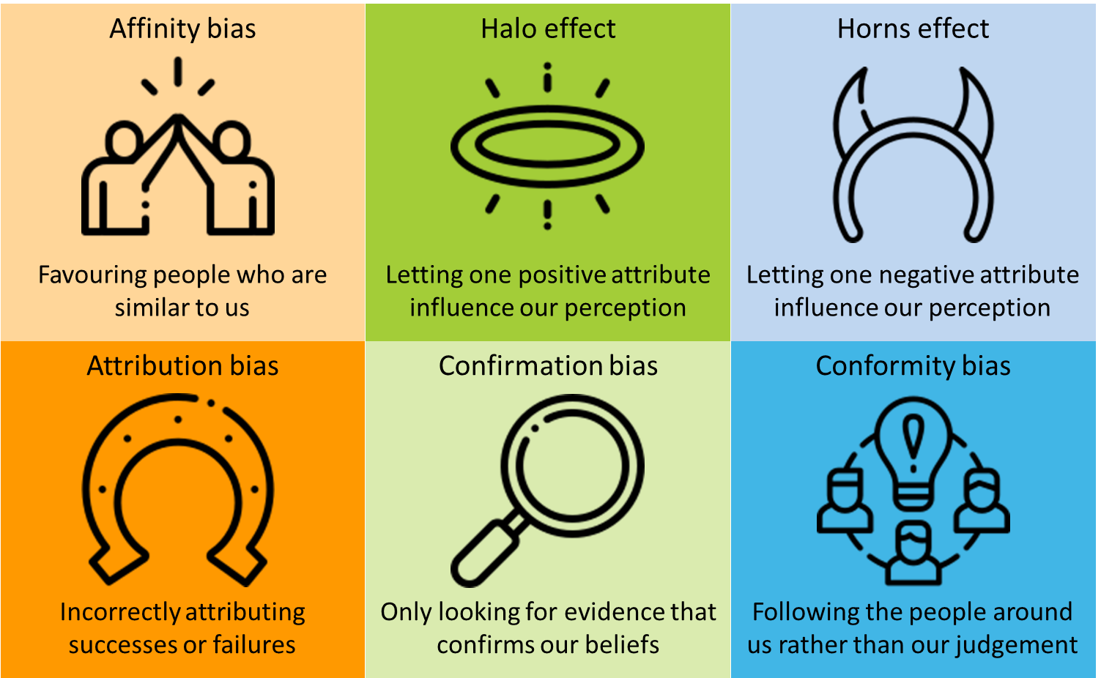
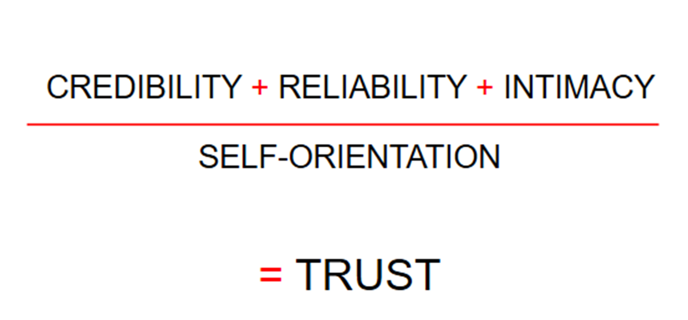
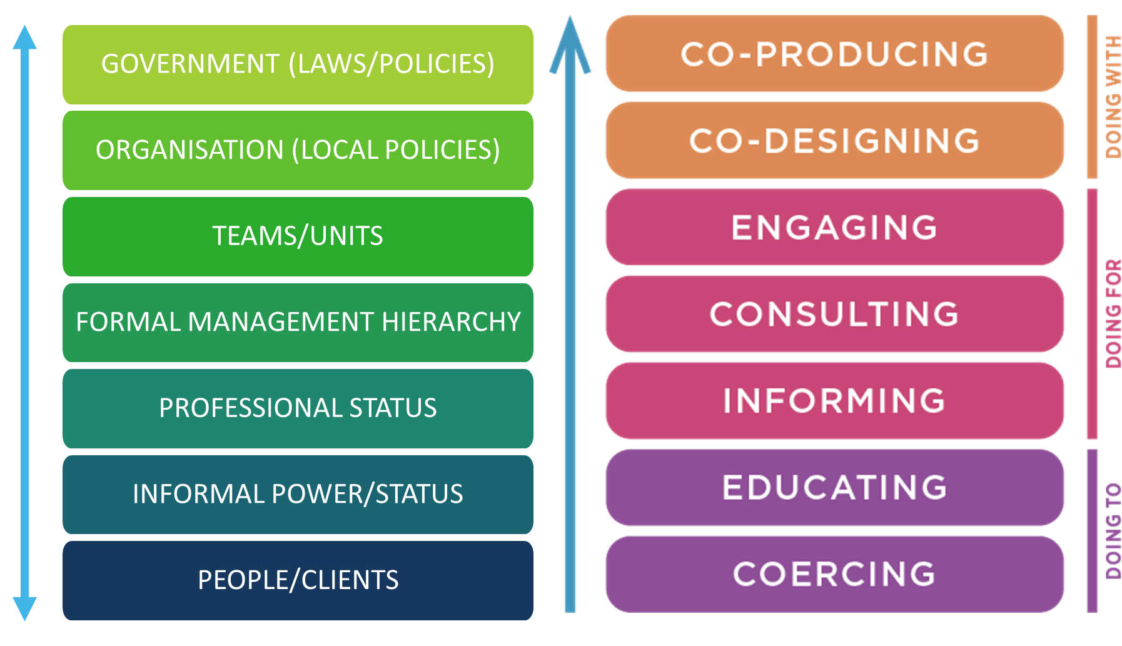
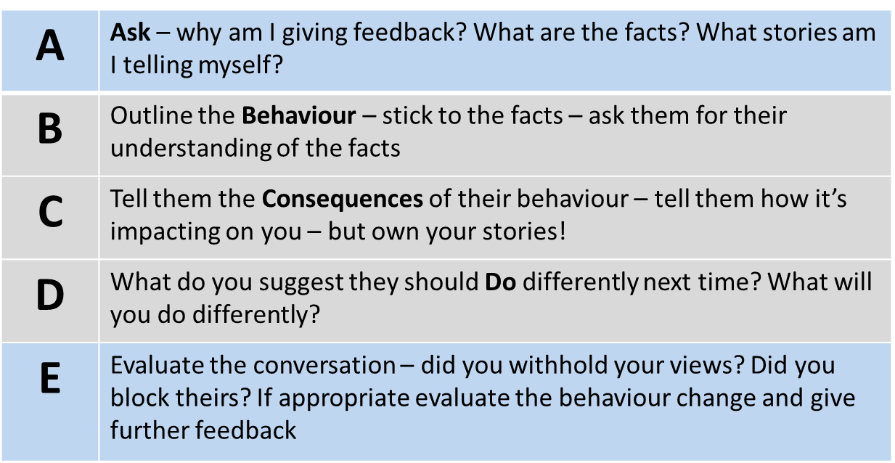
Recap: Day 2…
Icons made by Eucalyp from www.flaticon.com

Slide 108
Discuss in buddy pairs:
What I’ve learned
What I’ll take back to work
What support I might need
What I’ll do this evening to look after my wellbeing

Slide 109
Before the next session: If you have time, and would find it helpful, practice using one of the tools from this session with a friend or colleague.

