Slide 1
Context and Frameworks
Date

Slide 2
Trigger warning
This pack, and the training session itself, includes scenarios (pages 14-15) and discussions that relate to self-harm and suicide.
Please let one of the facilitators know if you would prefer not to take part in these discussions. We will let you know before we start these conversations.

Slide 3
Breakout discussion 1 – Warm up
Thinking about the next 2 days’ training:
Share 1 thing each you’re looking forward to
Share 1 thing each you’re worried about
Make 1 commitment each to support the rest of the group
After this discussion you will be asked to introduce yourself to the group and share your commitment.
If there is anything you are worried about that you would like to share with one of the facilitators, please use the chat function when we return to the main room.
In the ‘To’ drop-down box, select one of the facilitators’ names (Natasha or Steph) to send a private message.

Slide 4
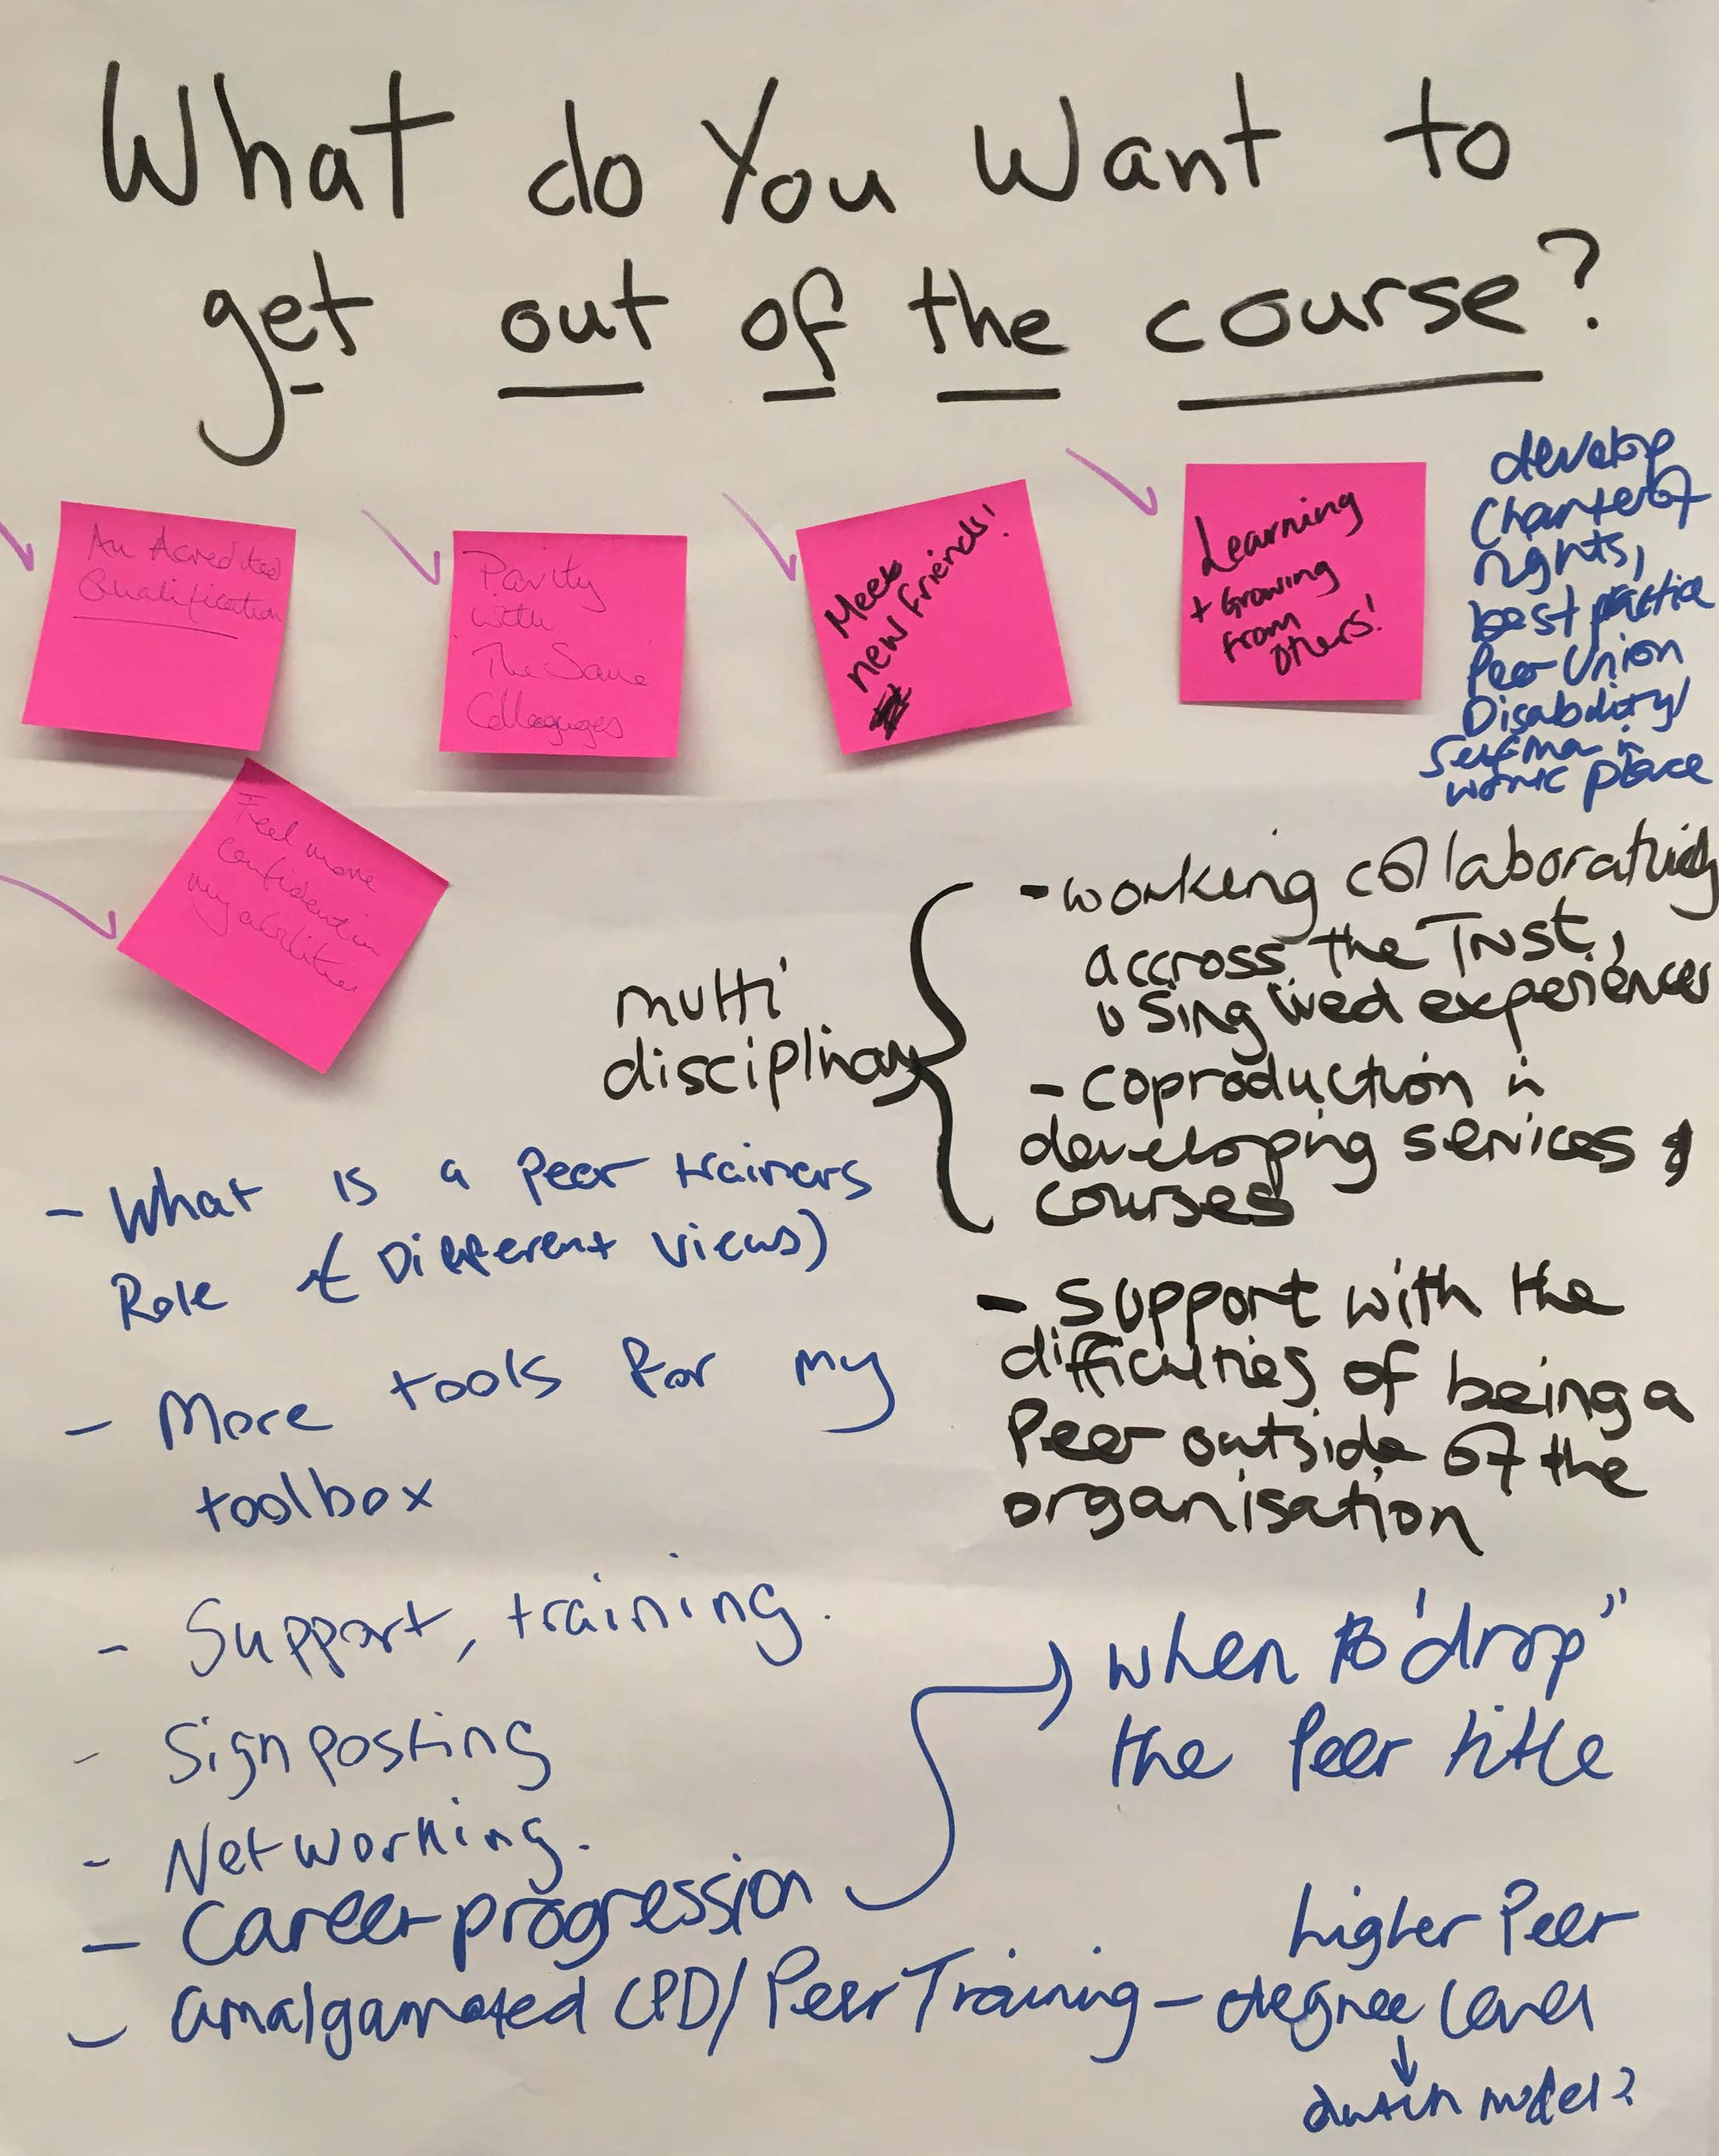
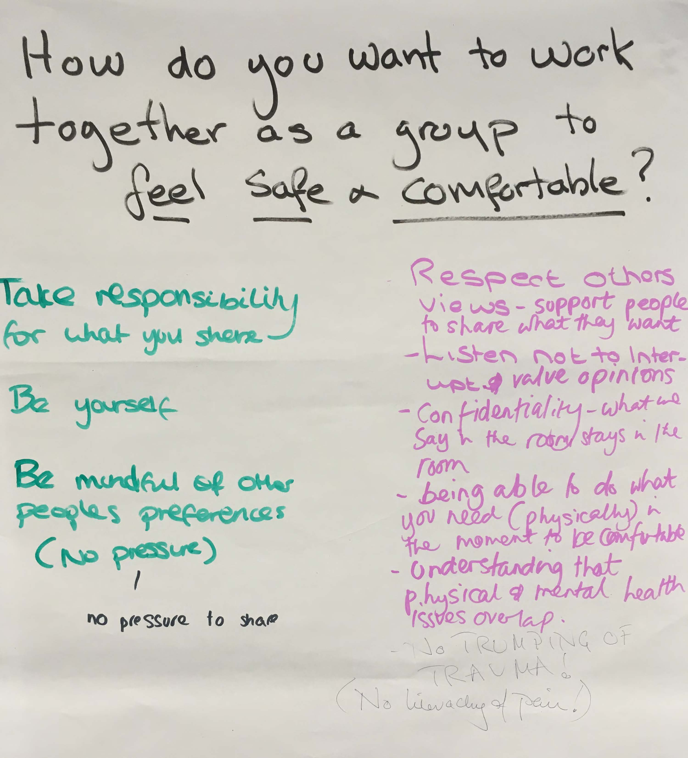
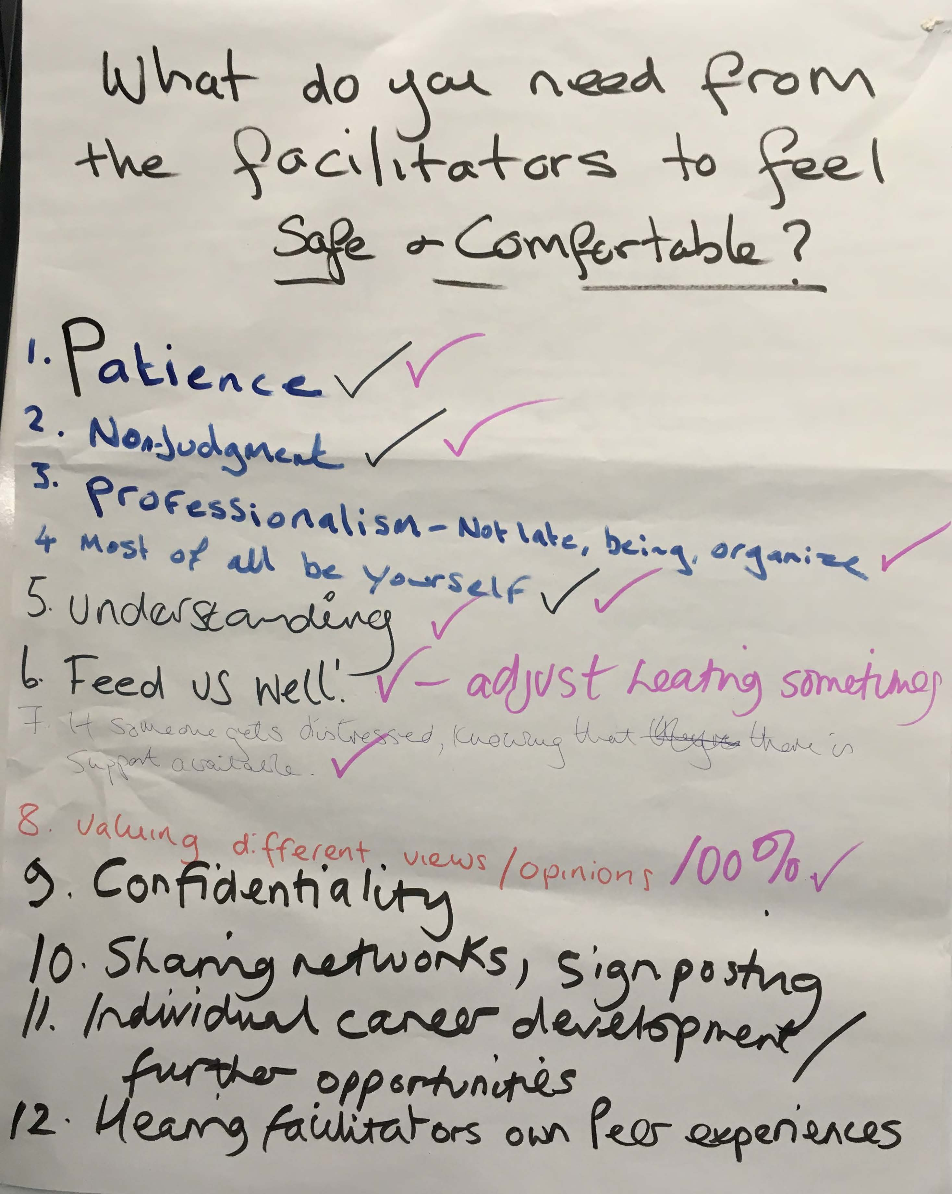
Ways of working (example)

Slide 5
Breakout discussion 2 – Buddy catch up
Share with your buddy
What you want to get out of today’s session
Reflections on the last session
Any action you’ve taken to put the tools from the last session into practice
After this discussion you will be asked to share your thoughts but you won’t have to share the detail if you’d rather not.

Slide 6
Breakout discussion 3 – Using frameworks
What are the benefits and challenges of using these frameworks?
Please nominate a spokesperson for your group who should take notes and feedback to the wider group.

Slide 7
Breakout discussion 4 – Information Sharing Scenario 1
Sami has been working with Zach for some time, and receives a phone call from Giovanna, Zach’s wife. Giovanna shared that Zach had started drinking again as well as taking medication. Giovanna said that she didn’t want Zach to know she had called because he would be angry with her and she couldn’t cope with any more upset.
Sami asked how much Zack was drinking, Giovanna said between 7-10 pints every other night. Sami asked how the family was managing at the moment. Giovanna said that the children were keeping themselves to themselves and spending a lot of time in their rooms now they were teenagers. Giovanna said she was trying to stay out of the house as much as possible because Zach verbally attacked her when she was at home. Giovanna said she was really struggling.
Giovanna asked what the outcome of Zach’s last outpatient appointment was because he had not wanted her to be there. Sami checked on the patient record and noted that Zach had withdrawn consent for staff to communicate details of care to his wife. Sami explained to Giovanna that due to patient confidentiality he was not able to share the details of the appointment. Giovanna became distressed at this point and told Sami that she was very worried about Zach, and that being excluded from the conversation was having a very negative impact on her wellbeing. She pleads with Sami to give her at least a high-level overview of what’s been discussed.
Questions:
What boundaries does this raise for the peer role?
Explore conflicts between what feels ‘right’ vs following organisational policies/procedures?
When/how should Sami involve others?
What impact may this have on Sami?
Where/how could he find out more information?
Please nominate a spokesperson for your group who should take notes and feedback to the wider group.

Slide 8
Breakout discussion 4 – Information Sharing Scenario 2
Rubina is 17 years old and lives at home with her mother and older sister. Rubina is experiencing verbal and physical abuse from her older sister. Rubina is being supported by peer support workers to access therapy outside of the home because she can’t speak in the home due to fear of repercussions. The peer support worker has a discussion with her mother regarding the verbal and physical abuse. The mother denies that there is a problem at home.
The team are facing challenges to get the right support for Rubina away from the family home and how to connect with the mother.
Questions:
What boundaries does this raise for the peer role?
Explore conflicts between what feels ‘right’ vs following organisational policies/procedures?
When/how should the peer worker involve others?
What impact may this have on them?
Where/how could they find out more information?
Please nominate a spokesperson for your group who should take notes and feedback to the wider group.

Slide 9
Information sharing
“Where there are safeguarding concerns staff have a duty to share information. It is important to remember that in most serious case reviews, lack of information sharing can be a significant contributor when things go wrong. Information should be shared with consent wherever possible”
NHS England, Safeguarding Adults Guide
https://www.england.nhs.uk/wp-content/uploads/2017/02/adult-pocket-guide.pdf

Slide 10
Breakout discussion 5 – Safeguarding Scenario 1
Asyma received a phone call from Sara, a pregnant woman who lived with her husband and two young children. Sara asked Asyma if she could meet in a local park rather than at the home address for their next meeting tomorrow. Jenny agreed and confirmed the date and time.
When Asyma arrived at the park, she saw Sara sitting on a bench with two men sitting either side of her. Sara introduced the men as her older and younger brothers. Sara said that had left the family home two days ago and was now staying with her younger brother and family. Sara explained that she had picked up her husband’s bag left open on the floor out of reach of their toddler and had spotted medications for HIV. Sara went on to explain that she had opened mail addressed to her husband which contained needles. Sara said she had taken the packet to show her family who were deeply concerned that her husband was taking drugs and may have contracted HIV.
Sara also said that she had become fearful in the home due to verbal attacks from her husband resulting in her fleeing the family home.
Asyma asked if she could speak with Sara alone. Asyma asked Sara how the relationship was with her younger brother. Asyma remembered that Sara had shared her younger brother in particular was quite controlling and had applied pressure to Sara to leave her husband on several occasions with a view to the family organising another arranged marriage.
Sara said that family members were starting to put pressure on her to divorce her husband and remarry, believing that the marriage was a mistake. Asyma gave Sara the telephone numbers to Women’s Aid and the Women’s Refuge Centre to contact for support. Sara said that she didn’t want to take the children to a refuge and was worried about being pregnant there. She felt it was better to stay with her family even though family relationships were difficult.
Questions:
What boundaries does this raise for the peer role?
When/how should Asyma involve others?
Where/how would Asyma find information she needs?
What impact might this situation have on Asyma?
Where could Asyma access support?
Where could Jenny access support?
Please nominate a spokesperson for your group who should take notes and feedback to the wider group.

Slide 11
Breakout discussion 5 – Safeguarding Scenario 2
Ella visited Bola, a man in his 80s. Early on in the visit Ella picked up that Bola seemed agitated and looked anxious. Ella asked if Bola was okay. Bola said that he was okay. Ella asked if Bola was worried about anything, Bola said that he wasn’t sure how to pay his bills this month.
Knowing Bola had a guaranteed amount coming in every month, Ella asked if anything had changed with Bola's finances, Bola went quiet. Ella asked if Bola's benefits had stopped. Bola said something had happened with a family member, but he didn’t want to get them into trouble. Ella reflected back that she was worried that Bola was not usually this quiet and was concerned for him.
Bola disclosed that a family member had asked to borrow money to buy food for her children. Bola said he couldn’t deny loaning money to feed children even if it meant he was short himself. Ella asked if this happened a lot, Bola said yes, every month. Ella asked if it was just food money or if there were other things Bola was being asked to cover as well. Bola said he was also asked to cover some of their rent each month. Ella asked how much of the rent Bola covered, he said £250.
Ella checked with Bola what date this had started from, Bola said for the past 6 months. Ella asked if the family member had paid the money back on the agreed date. Bola said yes, she paid the rent money back but then asked to borrow next month’s rent 2 weeks later. Ella asked if Bola could afford to loan this money each money, Bola said yes but only if it was paid back in the same month. Bola said that his son-in-law did not always pay back the money on time which meant he was unable to pay his own bills, and this was causing him a lot of worry and had stopped sleeping at night.
Ella asked if Bola felt able to say no when asked to loan money. Bola said that he did, but if he didn’t pay give his son-in-law the money, he wouldn’t get to see his grandchildren. Bola said he felt he had to loan them the money. Bola also said that if he didn’t, he received over 100 text messages a day asking for the money.
Ella thanked Bola for sharing with her this information, Ella asked Bola for the family members name. Bola said that he was worried that if he disclosed the name things may be taken out of his hands and was worried that if anything was reported about this his son-in-law would immediately stop contact with his grandchildren.
Questions:
What boundaries does this raise for the peer role?
Explore conflicts between what feels ‘right’ vs following organisational policies/procedures?
When/how should Ella involve others?
Where/how could she find out more information?
Please nominate a spokesperson for your group who should take notes and feedback to the wider group.

Slide 12
Safeguarding
‘Safeguarding adults means protecting a person’s right to live in safety, free from abuse and neglect’
According to NHS England safeguarding is everybody’s responsibility. Within the Care Act 2014 six key principles underpin all adult safeguarding work:
Empowerment – Personalisation and the presumption of person-led decisions and informed consent. “I am asked what I want as the outcomes from the safeguarding process and these directly inform what happens.” Continued over... Your Responsibilities
Prevention – It is better to take action before harm occurs. “I receive clear and simple information about what abuse is, how to recognise the signs and what I can do to seek help.”
Proportionality – Proportionate and least intrusive response appropriate to the risk presented. “I am sure that the professionals will work for my best interests, as I see them and they will only get involved as much as I require.”
Protection – Support and representation for those in greatest need. “I get help and support to report abuse. I get help to take part in the safeguarding process to the extent to which I want and to which I am able.”
Partnership – Local solutions through services working with their communities. Communities have a part to play in preventing, detecting and reporting neglect and abuse. “I know that staff treat any personal and sensitive information in confidence, only sharing what is helpful and necessary. I am confident that professionals will work together to get the best result for me.”
Accountability – Accountability and transparency in delivering safeguarding. “I understand the role of everyone involved in my life.”
https://www.england.nhs.uk/wp-content/uploads/2017/02/adult-pocket-guide.pdf

Slide 13
Safeguarding
The person who raises a safeguarding concern within their own agency should follow their own policy and procedures
This concern may result from something that you have seen, been told or heard
You should usually discuss any safeguarding issues with your manager or safeguarding lead in the first instance to determine whether a safeguarding referral should be made. If you are asked to make the referral, you should receive the support for you to feel confident to be able to do this.
If, having spoken to your line manager/safeguarding lead you feel a safeguarding referral should be made and they do not, you can escalate this further.
Any assessment should be holistic and should thoroughly consider the person’s emotional, social, psychological and physical presentation, as well as any identified clinical need.
Categories of abuse:
Physical abuse
Sexual abuse
Psychological abuse
Modern slavery
Financial or marital abuse
Neglect and acts of omission
Self – neglect
Domestic violence
Discriminatory abuse
Organisational abuse
https://www.england.nhs.uk/wp-content/uploads/2017/02/adult-pocket-guide.pdf

Slide 14
Breakout discussion 6 – Suicide & Self harm Scenario 1
Imani a 34-year-old female was discharged from the acute mental health unit over 3 months ago. She is now having support from the MH community team including Steve, a peer support worker, who had used the same unit 3 years ago. Amani had a history of suicide ideation and of self-harm, generally by cutting but this had been reduced by harm minimisation techniques she had developed while under the care of the centre.
As part of the multi-disciplinary team, Steve’s role was to check in with her on a regular basis and support her with developing her networks , being mindful about any relapses as there was still a high risk of her starting to become obsessed with ending her life. Steve himself was a survivor of attempted suicide and so he very much felt an affinity to the situation.
While on one visit to her supported accommodation, he saw signs of self-harm, including blood on the sofa and a knife. As he thought they had now a good connection, he was open and frank about what he saw. Amani denied anything had happened and reacted strongly to this question, in that she told Steve to leave.
Questions:
Was Steve’s response to this situation appropriate?
If Steve left, are there any legal implications?
Would Steve need to contact anyone for support?
Is there any signposting that Steve could manage?
What is the impact on Steve?
Please nominate a spokesperson for your group who should take notes and feedback to the wider group.

Slide 15
Breakout discussion 6 – Suicide & Self harm Scenario 2
Keisha was a PSW working in a newly formed women only service for survivors of domestic violence and had been a PSW for 2 years and enjoying the work. She had a keen interest in sex-based services for women, again due to her own lived experience. When a lady called Sarah arrived at the centre, Keisha was assigned to her for support. Sarah was a pre op trans-woman and had been a victim of violence with her former partner.
This was a new situation for Sarah, who was keen to understand the specific issues trans women face. She had found out that trans people have a very high rate of suicide and self-harm in proportion to the general population and so was very keen to understand the issues.
While the centre had a policy of accepting trans women , Keisha felt they did not understand the needs of Sarah and was concerned that other women within the centre were also not happy about having a trans women in ‘their’ space. On speaking to Sarah for the first time she did mention a previous suicide attempt and discrimination from her former colleagues.
Q. How do you think Keisha is feeling?
Q. Are there any legal issues with this situation?
Q. How is this situation affecting other staff members?
Q. What options does Keisha have to support Sarah?
Please nominate a spokesperson for your group who should take notes and feedback to the wider group.

Slide 16
Self harm
Definition of self-harm:
Any act of non-fatal self-poisoning or self-injury carried out by a person, irrespective of their motivation. This commonly involves self-poisoning with medication or self-injury by cutting. Self-harm is not used to refer to harm arising from overeating, body piercing, body tattooing, excessive consumption of alcohol or recreational drugs, starvation arising from anorexia nervosa or accidental harm to oneself.
National Institute for Health and Care Excellence (NICE)
Self harm and transitions in care
Transitions in care may represent periods of risk for people who self-harm and/or are suicidal. For a person who is being supported in the community or the wider public by individuals or an organisation that is not healthcare focused, this may happen when a professional refers them to a statutory health service for further support, care and treatment. Given that discontinuation of care can often happen during transitions, a person can be lost within the system unless transitions are anticipated and well-planned.
https://www.ucl.ac.uk/pals/sites/pals/files/self-harm_and_suicide_prevention_competence_framework_-_adults_and_older_adults_8th_oct_18.pdf
Self harm key information
Self-harm is not a mental health condition, it is a behaviour
It isn’t attention seeking, as it is often done secretively
The UK has one of the highest self-harm rates in Europe (1–3)
It is not about suicidal behaviour, it is about seeking control or feeling
The focus shouldn’t be on stopping self-harm but increasing wellbeing
Mental Health First Aid

Slide 17
Breakout discussion 7 - Supervision
Supervision is understood differently in different settings. Here, it is defined as an activity that gives peer support workers the opportunity to review and reflect on their work with a senior peer support worker/person with lived experience, line manager/clinician, or within group peer supervision. This includes talking about areas which they might experience as difficult or distressing. This definition distinguishes supervision from line management or case management.
Thinking about your experiences of supervision, discuss what the following:
What are the benefits of supervision?
What are some of the challenges?
What could you do at the beginning of a relationship with a new supervisor ?
What could you do before, during and after each supervision meeting?
Please nominate a spokesperson for your group who should take notes and feedback to the wider group.

Slide 18
Making the most of supervision
When working with a new supervisor:
If you have a choice of supervisor, think carefully about who would be best placed to fulfil that role – based on your needs, experience and aspirations
Make sure you have an understanding of the local policy around supervision – and what is in and out of scope for the relationship
Ask to have an introductory conversation with your supervisor to discuss your preferred working style, values, and any support needs you might have
Make sure that you and the supervisor have a clear shared understanding of your role and expectations
Ask them to share their expectations of the relationship, and how you can get the most out of them
Discuss how you’ll work together, including frequency, duration and preferred setting for meetings
Before each meeting:
Reflect on successes, achievements and progress in your work since your last meeting
Consider any specific situations or challenges you would like to discuss or questions you would like to ask
Consider anything you would like to share or discuss about your wellbeing
Think about any feedback you would like to give (remember ABCDE!) or receive
Reflect on any unhelpful ‘stories’ you might be bringing to the conversation about the supervisor or yourself, that might prevent you from engaging fully in the conversation
During each meeting:
Start by outlining the key points you want to share at a high level to agree up front what you will cover
Take notes or another record of key points
Talk through the points you have prepared – make sure there is clarity on both sides about any actions agreed or decisions made
Try to bring your authentic self to the conversation – being open and honest will help you to have a more helpful discussion
After each meeting:
Take some time out to reflect on how the conversation went – what you have learned and what you will do as a result
Share any notes you have made – particularly any actions or decisions

Slide 19
Breakout discussion 7 – Supervision Scenario 1
Rasheed had been a PSW for 5 years in several settings and thought of himself as a senior practitioner who had a great deal of experience in the role. He was reflective around his own needs when performing the role, but also confident that not much phased him.
His line manager Malik was psychologist within the secure unit and he felt didn’t really get Rasheed or the role and didn’t always make time for him when it came it to the official supervision sessions. He was a little despondent as Rasheed himself was a trained supervisor and had a team of 3 junior PSW’s that he was supervising anyway.
After a serious incident on the ward with one of the people Rasheed was supporting around medication and so called ‘noncompliance’ Rasheed was called in outside his regular supervision for a debrief by Malik. Rasheed felt that this was unnecessary as the outcome of Rasheed's involvement with the client turned out to be positive avoiding any use of seclusion or coercion.
Q. Is Rasheed approaching this correctly?
Q. Are there any issues with his supervisor?
Q. Reflect on why Rasheed needs supervision in this situation?
Please nominate a spokesperson for your group who should take notes and feedback to the wider group.

Slide 20
Breakout discussion 7 – Supervision Scenario 2
It was 2 months after Jasmine had gained her PSW qualification and was successful in gaining a PSW role within a local NHS trust within the ‘Personality Disorder’ community team at a band 3. After 2 months of her induction phase, she was enjoying the challenge and had very much liked being with the other 4 PSW’s within the team. This was the first time she had worked for the NHS and was finding the system a challenge with a lot of paperwork and red tape.
She had previous only had group supervision and so when she had the more formal regular sessions with her line manager, who was a peer specialist at band 5, this was a new experience. She had 4 people who she was supporting and in general things were going ok. One of her clients was struggling, Jazmine had advised them to make what she thought was a useful choice.
On the first supervision session with her line manager this had come up and Jazmine was taken aback when they said a complaint had been made. Jazmine became upset and had to leave the session as she felt it was wrong and was very frustrated by it.
Questions:
How was Jazmine feeling and what is the impact?
Are there any organisational issues apparent here?
What could happen to make this situation easier for Jazmine?
Please nominate a spokesperson for your group who should take notes and feedback to the wider group.

