Slide 1
Working with other professionals
Date

Slide 2
Breakout discussion 1 – Warm up
If you were interviewing someone for a peer role, what ONE question would you want to ask them?
(You’re only allowed one per group!)
After this discussion you will be asked to introduce yourself to the group and share your question.

Slide 3
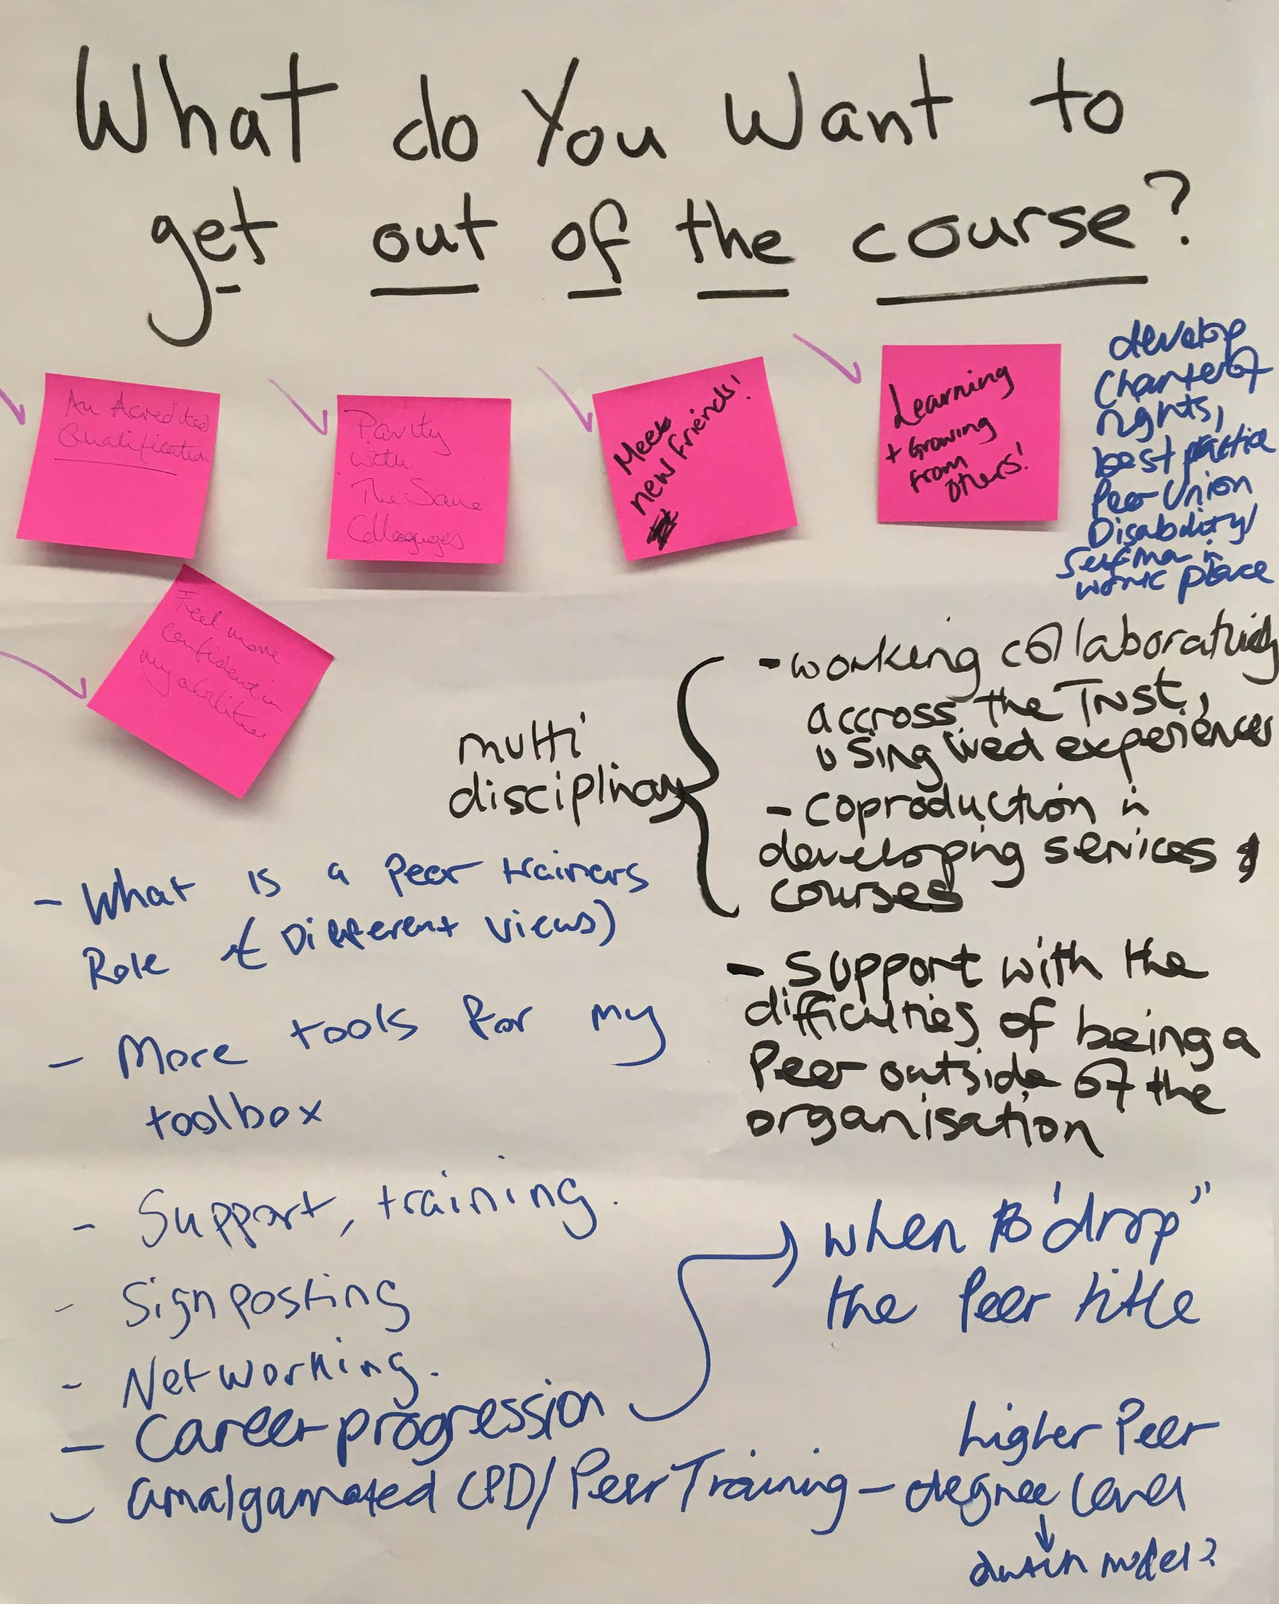
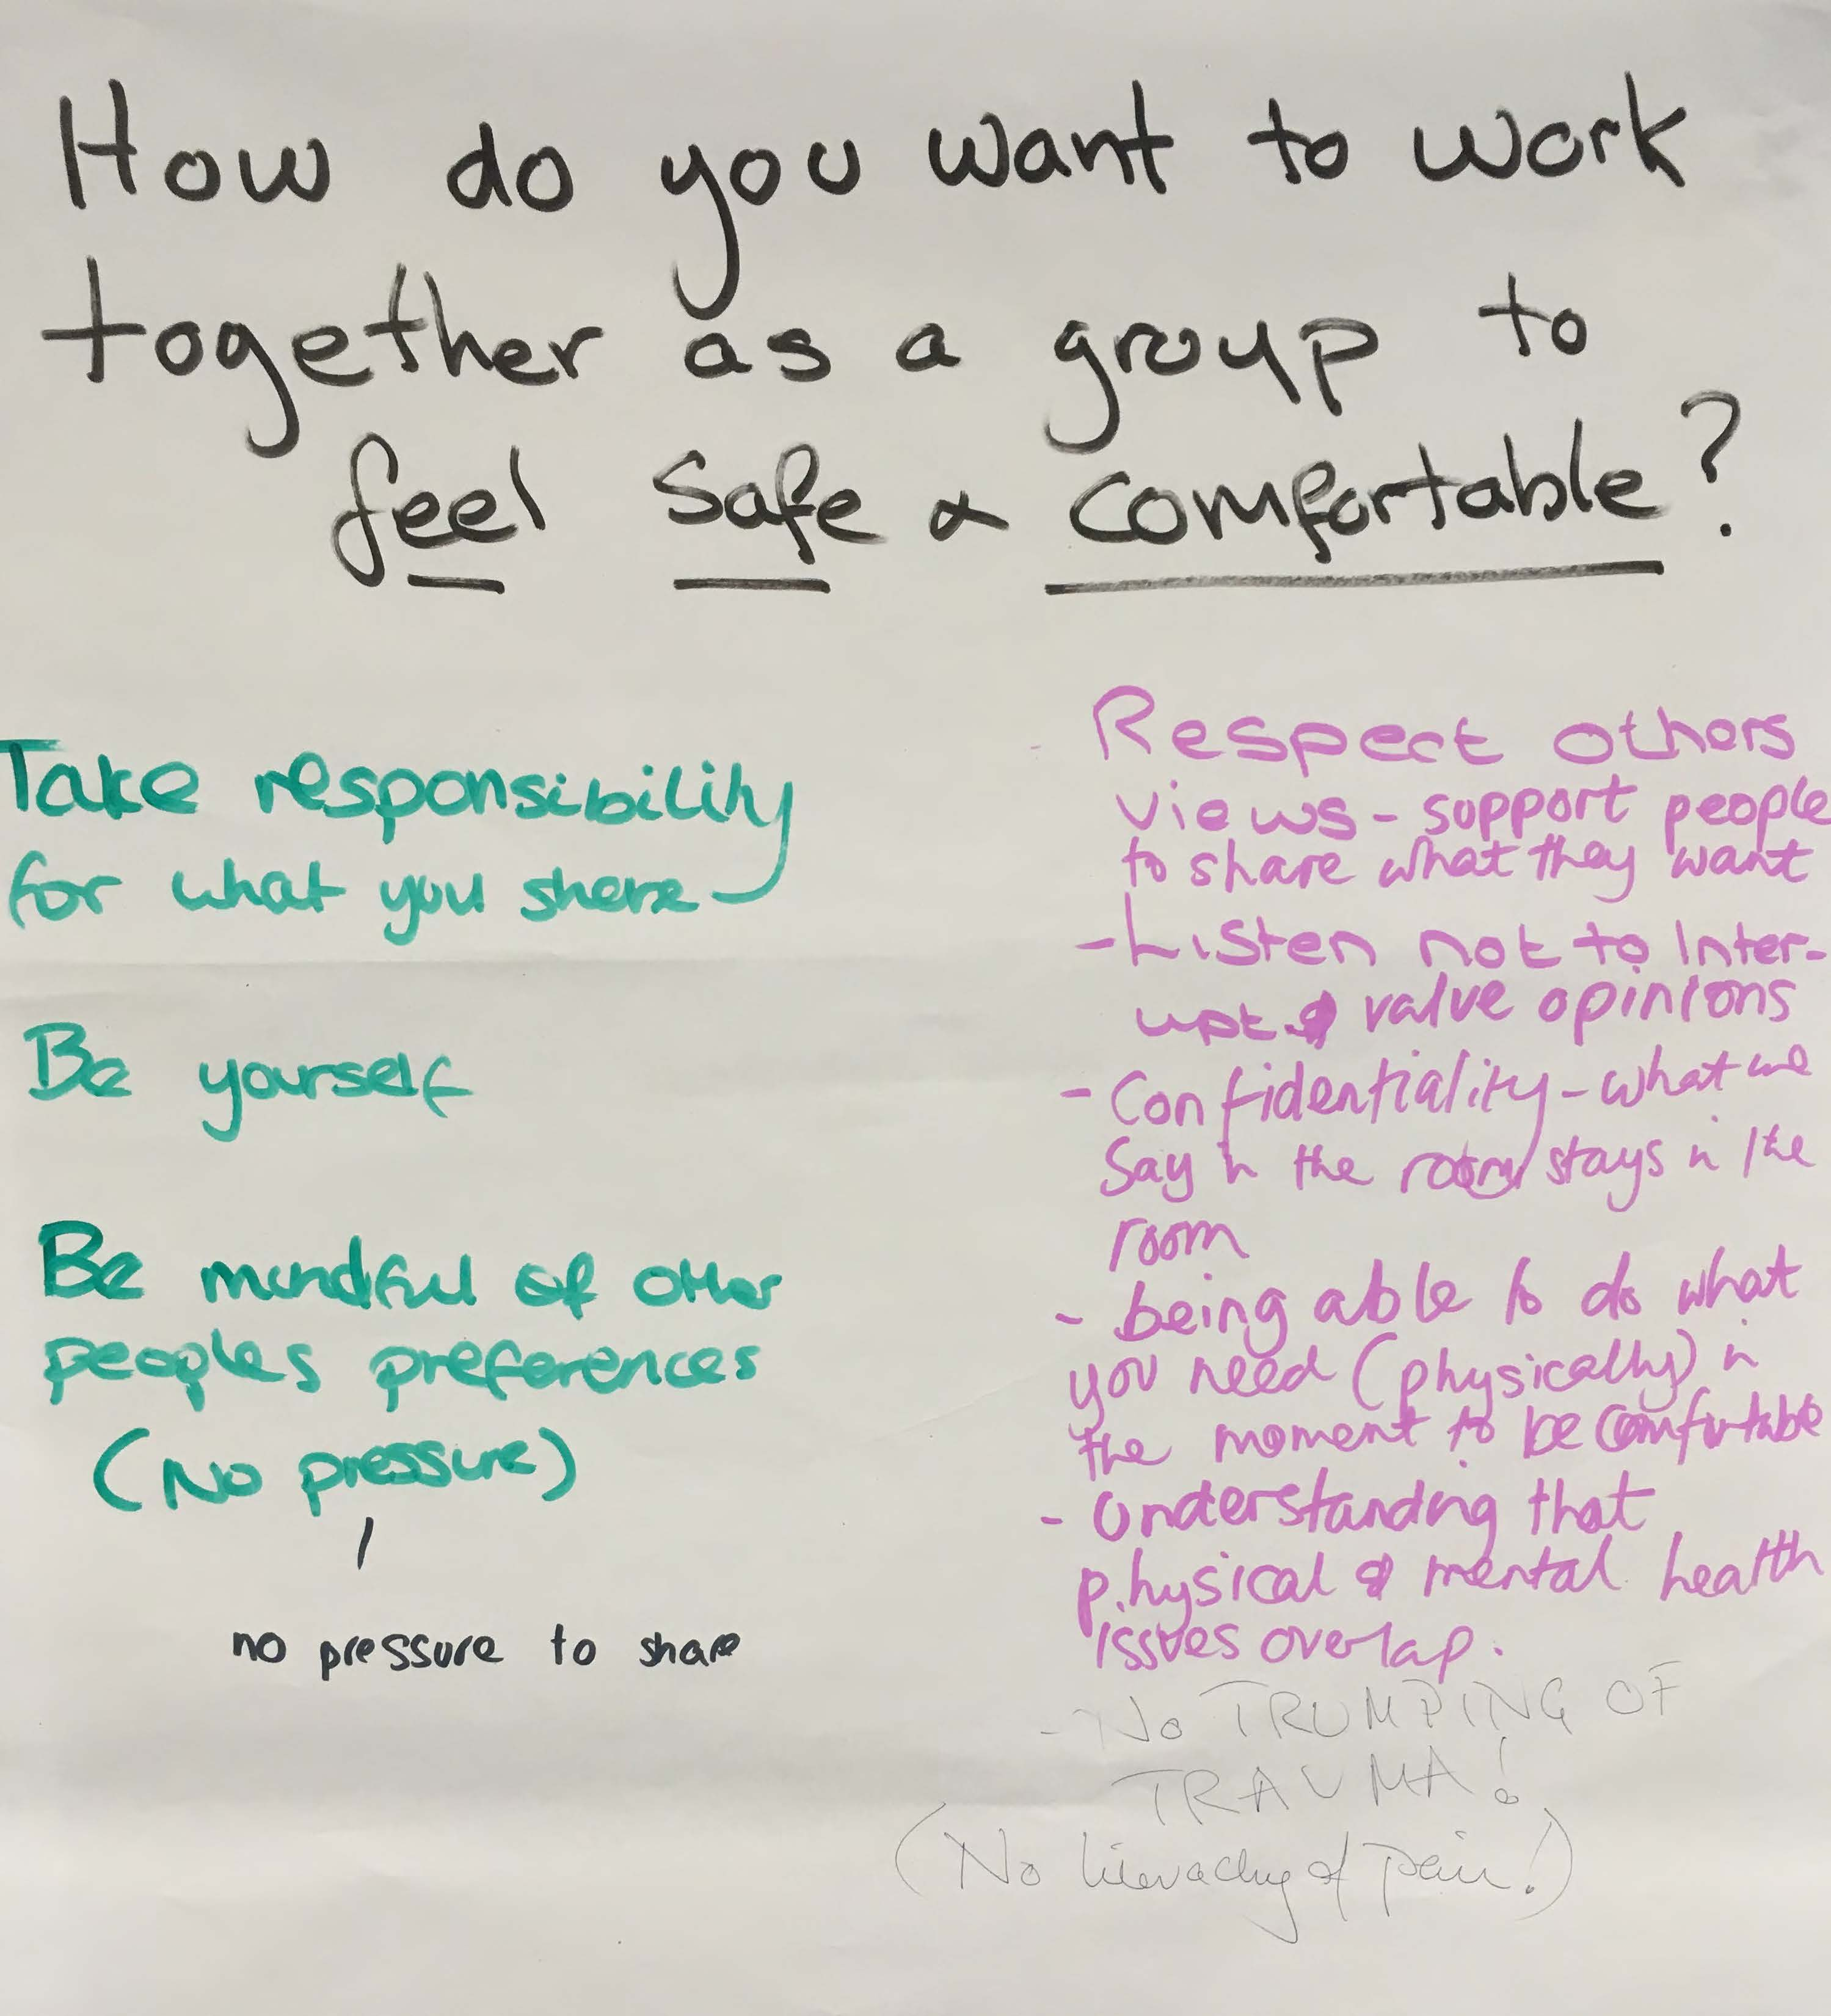
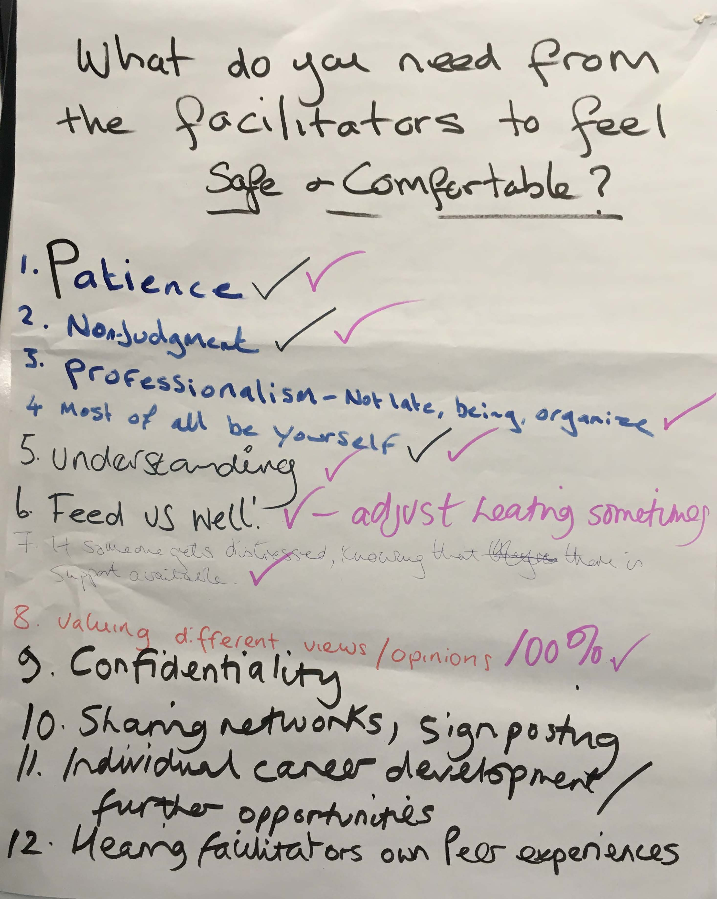
Ways of working (example)

Slide 4
Breakout discussion 2 – Buddy catch up
Share with your buddy
Reflections on the last session and any action you’ve taken to work on language and supporting people to share their stories.
Hopes for today
After this discussion you will be asked to share your thoughts but you won’t have to share the detail if you’d rather not.

Slide 5
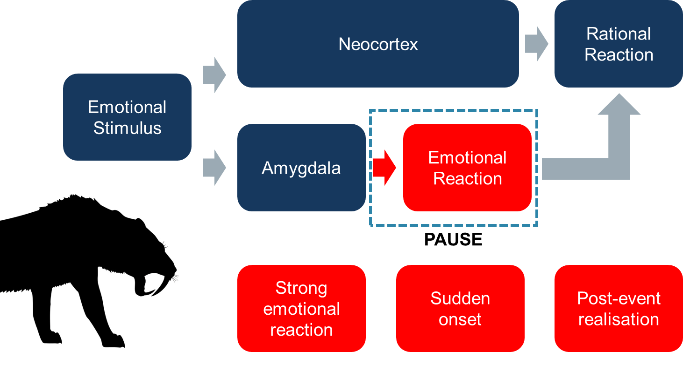
Working better together
Adapted from: Emotional Intelligence: Why It Can Matter More Than IQ (Daniel Goleman, 2009)
The key here isn’t to try to stop the amygdala response – it’s how our brains are wired! Nor is it saying that emotional reactions are wrong – they are what make us human (e.g. it’s what makes us laugh spontaneously to a joke)! But it’s about trying to slow the emotional reaction down long enough to assess whether it’s appropriate to the stimulus and the situation. We are suggesting you PAUSE the reaction, rather than stopping it completely, so you can consider the most effective way to channel the emotion to get a good result.

Slide 6
Breakout discussion 3 – Amygdala hijacks
Discuss in pairs:
What situations in your role have caused a strong or unhelpful emotional reaction?
What practical steps could you put in place to help slow the emotional reaction?
You will be asked to share some of your strategies with the wider group.

Slide 7
Breakout discussion 4 – Spheres of control
Work challenges | (please tick)
 | Within my control | Within my influence | Outside of my control/influence

Slide 8
Breakout discussion 5 - Assertiveness
Discuss:
What does being assertive at work look like?
When have you been assertive at work?
You will be asked to share your reflections with the group.

Slide 9
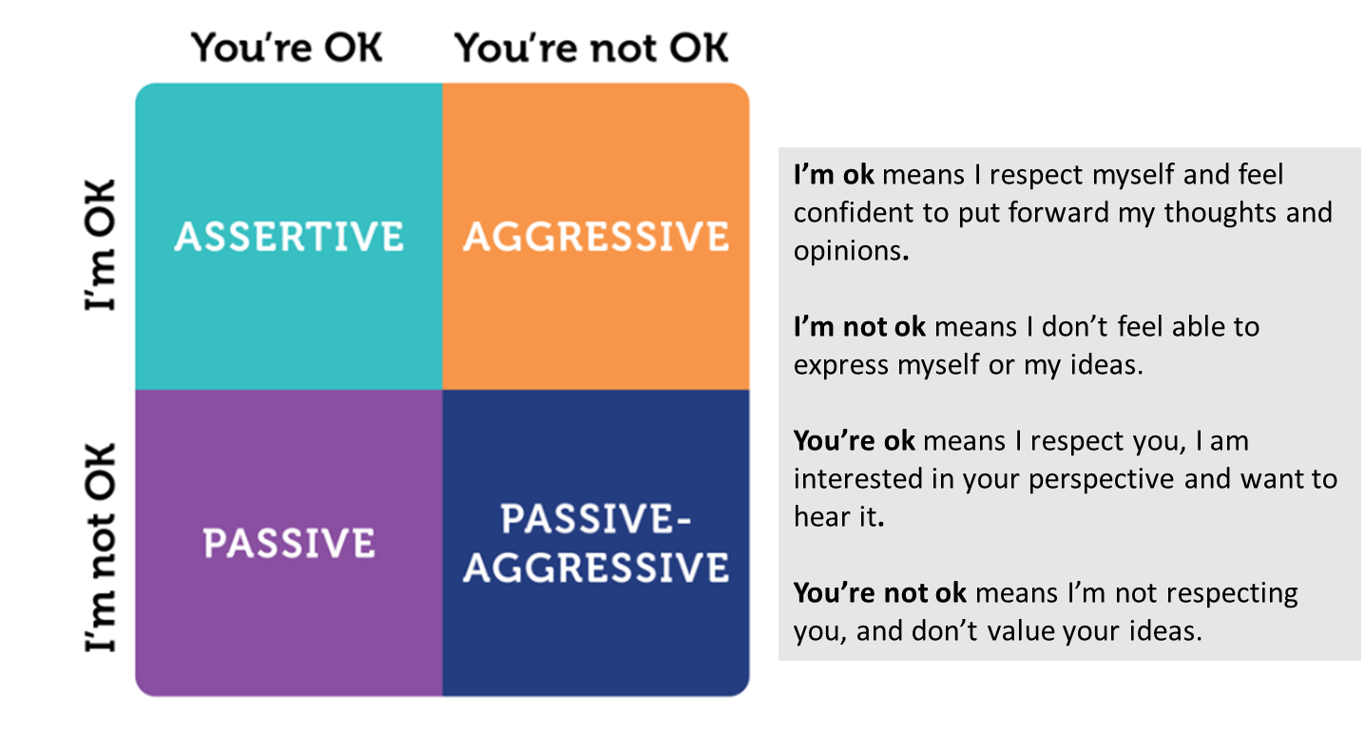
I’m OK/you’re OK
https://www.managementcentre.co.uk/insights/assertiveness-at-work-explained/

Slide 10
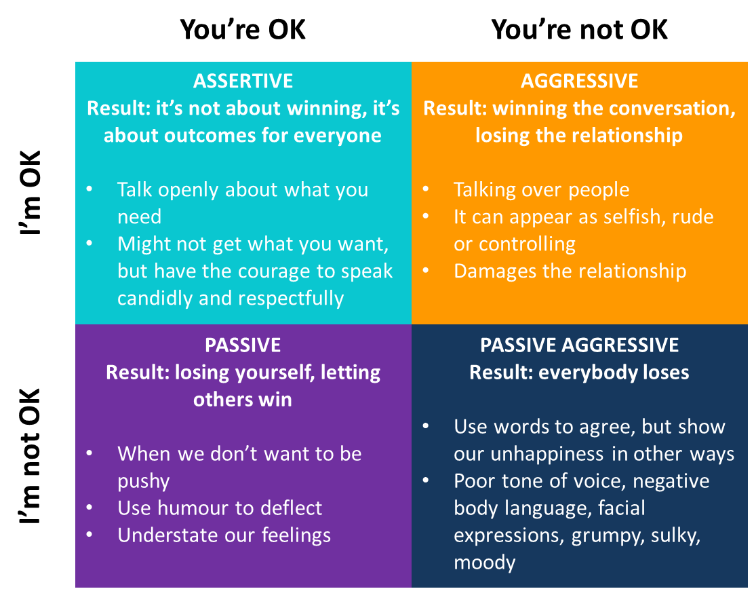
The four styles in detail

Slide 11
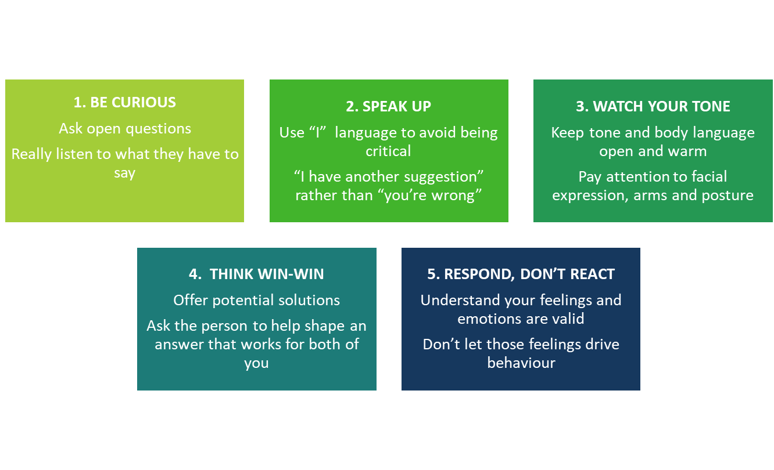
Breakout discussion 6 – Assertiveness next steps
Which of these tips or steps would be most valuable for you? How might you apply them?

Slide 12
Breakout discussion 7 – True or false?
Conflict is bad and should be avoided
Team members misunderstanding one another causes conflict
All conflict can be resolved to everyone’s satisfaction

Slide 13
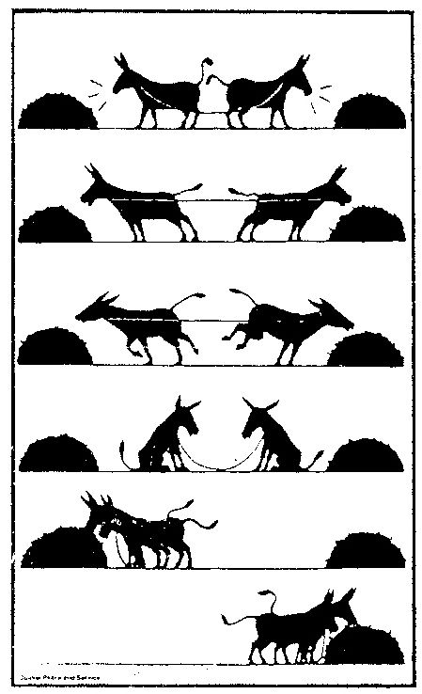
Conflict vs. collaboration

Slide 14
Breakout discussion 8 – Collaboration
Why is collaboration important in your role?
You will be asked to share your thoughts with the group.

Slide 15
Breakout 9 – The XY Game: Win as much as you can
Group Response | If you chose X | If you chose Y
4 Ys |  | Lose £100
3 Ys 1 X | Lose £300 | Gain £100
2 Ys 2 Xs | Lose £200 | Gain £200
1 Y 3 Xs | Lose £100 | Gain £300
4 Xs | Gain £100
 | Round | Your choice (X or Y) | Payoff | Balance
 | 1
 | 2
 | 3
 | 4
Bonus round (payoff x 3) | 5
 | 6
 | 7
Bonus round (payoff x 5) | 8
 | 9
Bonus round (payoff x 10) | 10

Slide 16
Breakout discussion 10 – Group review
How did other groups’ behaviour impact on your choices?
How does this activity relate to collaboration/competition in real life?
You will be asked to share your reflections with the group.

Slide 17
Breakout discussion 11 – Buddy catch up
Discuss a relationship at work that would benefit from more assertive/collaborative behaviour.
Discuss how you might apply the learning from today to improve the relationship.

