Slide 1

Supporting self management
Trainer (s)
Date

Slide 2
Timetable
Time | Session overview
10am-10.35am | Welcome and housekeeping
 | Buddy catch up
10.35am-11.05am | Introduction to change cycle: Apply it to self
11:05am-11.20am | Break
11.20am-11.50am | Precontemplation Identifying when people are at this stage Tools and techniques to support them
11.50am-12.50pm | Contemplation & Preparation Identifying when people are at this stage Tools and techniques to support them
12.50pm-1.50pm | Lunch
1.50pm-2.50pm | Action & maintenance Identifying when people are at this stage Tools and techniques to support them
2.50pm-3.00pm | Break
3.00pm-3.30pm | Relapse Identifying when people are at this stage Tools and techniques to support them
3.30pm-4.00pm | Buddies and action planning
4.00pm | Close
All timings are approximate and may change in response to the needs of the group

Slide 3
Trainer notes: Housekeeping
Purpose: To make sure everyone knows the basics about the venue and the day
Materials: None
Instructions: Talk through the icons on slide 4:
Finish time
Tea/coffee breaks – what time breaks are planned and letting people know that you can stop for additional breaks if needed. Let people know where the break-out spaces are
Lunch – let people know that lunch is provided and at what time
Toilets – make sure everyone knows where they are
Fire – let them know if there are any planned fire tests and where the fire exits are
Phones – ask people to put their phones onto silent (or off if possible!)
Timings: 5 minutes

Slide 4






Housekeeping

Slide 5
Trainer notes: Recap ways of working
Purpose: For people to remind themselves of what they wanted to get out of the training and how they wanted to work as a group
Materials: 3 flipcharts from session 1 around the room: “Aims for the course”, “Ways of working together”, “Working with the facilitators”
Instructions:
Talk through the outputs from session 1
Ask the groups to discuss any additions/changes they would like to make to these
Keep the notes from this exercise for future sessions.
Timings:
5 mins

Slide 6

Ways of working
What do you want to get out of the course overall?
How do you want to work together as a group to feel safe and comfortable?
What do you need from the facilitators to feel safe and comfortable?
Recap flipchart outputs.

Slide 7
Aims

Slide 8
Trainer notes: Aims
Purpose: To provide an overview of day
Materials: None
Instructions:
Remind people where we are in terms of the programme overview (slide 9) before talking about the aims for todays session (slide 10)
Timings:
5 mins

Slide 9
Session overview
You are here
Self-care and
self- management
Communication and interpersonal skills
Navigating the system
Supporting mental health
1. Working as a peer
2. Use of self
3. Effective relationships
4. Context and frameworks
5. Mental health
6. Supporting self-management
7. Working with other professionals
8. Supporting access to care
9. Working with groups

Slide 10
Aims for today
By the end of today you will leave with:
An understanding of the change cycle and how this might impact on an individual’s progress
Insight into each of the stages in the cycle, and what support someone might need at each
Tools, techniques and approaches to support people to self-manage effectively, wherever they are on their journey

Slide 11
Buddy catch up

Slide 12
Trainer notes: Buddy catch up
Purpose: To give buddies a chance to catch up and plan their focus for the day
Materials: Handout – Support Plan template (completed in last session), outputs from ‘getting to know you session’
List with names of buddy pairs.
Instructions:
Part 1: Ask people to find their buddies and a space to talk. Encourage the full usage of the room, or to find a spot outside of the room, if they would prefer.
Part 2: Ask people to discuss with their buddy; what they are hoping to get from the day, their reflections from the last session and how they got on with applying the assertiveness techniques from last time.
Timings:
Part 1: 1 minute
Part 2: 20 mins (10 minutes each)

Slide 13

Reminder: The role of your buddy
Support you to identify goals for the training
Support you to manage your wellbeing
Help you plan how to apply your learning between sessions
Check in to see if you’re achieving your goals – and help problem solve
Check in during and between sessions

Slide 14

Buddy catch up
Spend 20 minutes discussing with your buddy, your:
Hopes for today
Reflections on the last session
Progress with having assertive conversations

Slide 15
The change cycle

Slide 16
Trainer notes: The change cycle
Purpose: To introduce people to the change cycle, and to provide a chance for them to reflect on it from a personal perspective
Materials:
Instructions: Ask if anyone has heard of the change cycle. Show the cycle on slide 17 and explain that it is a model of change that was originally developed to support health-related behaviour change (although it can be applied to other types of change as well). The model suggests that there are a number of stages that we go through when making change. These stages are not fixed, and everyone will experience change differently, but it is a useful frame to think about what people might experience when trying to make changes – whether that’s reducing unhelpful or unhealthy behaviours (e.g. smoking) or introducing new, helpful behaviours/activities (e.g. starting a new hobby). Talk through the stages of the model:
Precontemplation – at this stage the person is not considering doing anything different – they might not think there is anything that needs to change, or they might not think change is possible
Contemplation – they are now willing to consider change is possible, but have not yet decided to change
Preparation – they have decided to change, and they are ready to think about what that looks like
Action – the person has begun to take steps to change
Maintenance – the person is successfully maintaining the change for a sustained period of time
Relapse – The person falls back to their old behaviour
Show the example slide to show a very basic thought process of someone going through each stage.
Activity: In pairs or small groups, discuss the questions on slide 19. Debrief by asking people if they were able to apply the model to their example. People do not need to share their personal examples unless they want to.
Timings:
Intro to model: 10 mins, Activity: 10 mins, Debrief: 10 mins
Activity: 10 mins, Debrief 10 mins

Slide 17

Change cycle
Pre-contemplation
Not considering change
Relapse
Back to old behaviours
Contemplation
Change is possible
Maintenance
Change is maintained
Upward spiral:
Learn from relapse
Preparation
Planning the change
Action
Taking steps to change
Adapted from Prochaska & DiClemente’s Transtheoretical Model of Change (1997)

Slide 18
Change cycle
Pre-contemplation
I am not interested in socialising
Relapse
I had a bad experience – I’m not going again
Contemplation
Maybe being isolated is affecting my mood
Maintenance
I’m attending regular online socials
Upward spiral:
Learn from each relapse
Preparation
I’m researching online social groups
Action
I’ve attended an online cooking class

Slide 19
Activity
Think about a change you have made (e.g. a lifestyle or habit change)
Go through each stage and reflect on what it was like at each stage, and what helped you to move forward

Slide 20
Pre-contemplation

Slide 21
Trainer notes: pre-contemplation
Purpose: To reflect on what a PSW can do to support people at this stage
Instructions: Show the cycle on slide 22 to remind people where we are on the cycle.
Activity: Get people into small groups to reflect on the questions on slide 23. Talk through the different types of pre-contemplation on slide 24 and ask people if they resonate.
Debrief the activity by asking the group what someone might need from a PSW when they’re at this stage – write their thoughts up on the board. If necessary, prompt or add in suggestions:
The aim is to get people comfortable to talk to you about the possibility for change
Focus on building trust - they might feel quite vulnerable talking about it – contracting and being clear about confidentiality is key
Lots of listening
Explain that throughout the day you will be introducing, and reintroducing tools for participants to add to their toolkits – not all of these will be applicable to every individual or every situation. Show the tools on slide 26 , explaining that these are all tools that participants have seen before. At the centre is a reminder of the importance of enabling people to tell their own stories in their own words. This is particularly important at the precontemplation stage, where we want to avoid imposing our beliefs about if/how/what an individual should change. Storytelling is supported by gentle questions full, active listening, and reflecting back what you're hearing to the individual.
Check in with the group to make sure they are happy and familiar with all these concepts.
Timings: Activity: 10 mins, Debrief: 10 mins, Tools: 10 mins

Slide 22
Change cycle
Pre-contemplation
Not considering change
Relapse
Back to old behaviours
Contemplation
Change is possible
Maintenance
Change is maintained
Upward spiral:
Learn from relapse
Preparation
Planning the change
Action
Taking steps to change
Adapted from Prochaska & DiClemente’s Transtheoretical Model of Change (1997)

Slide 23
What is it like?
Think back to your change – what was it like to be at this stage
What did it feel like?
What did it look like?
How would you identify if someone else was at this stage?

Slide 24
Types of pre-contemplation
Reluctance
I don’t want to think about change.
Rebellion
You can’t tell me what to do.
Resignation
Change feels impossible.
Rationalisation
This is not a problem for me because of XYZ.
Notes:
Reluctant precontemplators are those who through lack of knowledge or inertia do not want to consider change. The impact of the problem has not become fully conscious.
Rebellious precontemplators have a heavy investment in drinking and in making their own decisions. They are resistant to being told what to do.
Resigned precontemplators have given up hope about the possibility of change and seem overwhelmed by the problem. Many have made many attempts to quit or control their drinking.
Rationalising precontemplators have all the answers; they have plenty of reasons why drinking is not a problem, or why drinking is a problem for others but not for them.

Slide 25
The role of the PSW

Slide 26




Pre-contemplation toolkit
Reflecting back
Gentle questioning
Supported storytelling
Active listening
Icons made by Freepik from www.flaticon.com

Slide 27
Contemplation & preparation

Slide 28
Trainer notes: Contemplation & preparation 1/2
Purpose: To reflect on what a PSW can do to support people at these stages
Instructions: Show the cycle on slide 30 to remind people where we are on the cycle. Explain that we’re going to look at contemplation and preparation together as the tools are similar.
Activity: Get people into small groups to reflect on the questions on slide 31. Debrief by asking the group what someone might need from a PSW when they’re at this stage – write their thoughts up on the board. If necessary prompt or add in suggestions:
Starting to explore areas for support/change
Developing a flexible, realistic, shared plan
Considering what you want to put into place as support mechanisms. E.g. coming off medication
Talk through the tools on slide 33, highlighting that each one has a different purpose depending on where the individual is on their journey. Community mapping , and person mapping are great visual ways for people to think about how they can access support in their networks and community. Online tools such as mood juice can help individuals find new and creative ways to achieve their goals. Wellness plans and advanced directives can help people to reflect on the tools techniques and support they might have access to and how they might communicate their needs to others when they are facing challenges.
Show the mood juice screen shot and ask if anyone has used it or other similar websites? Invite them to share if they have. Explain that sites like mood juice are a great starting point for a conversation with someone who might be open to starting a change journey, but might be unsure of where to start. As a peer you can support them to explore the different areas and see if anything jumps out as something they might want to think about in more detail.

Slide 29
Contemplation and preparation 2/2
Community and person mapping are a mixture of techniques such as mind mapping, service mapping and support mapping that keeps the person at the centre and is genuinely co-produced and an organic document that people can change and use as part of their overall support plan. Show examples on slides 35 and 36. People can use these to identify resources, sources of support, and potential blockers to their planned change. Using the Red, Amber and Green ratings for added visual effect, the following meanings are:
Red – something /service etc is NOT happing at all and is a block
Amber – something that is potentially happing or been worked on
Green – service /support area is active and is helpful
Demonstration – facilitators to complete a person/community map on the board as a demonstration of how it can be used with another person. One facilitator to guide the other through creating a map of their own community
Another useful tool for exploration is the wellness plans we covered in module 1. Explain that these are a great way to consider things that will help to keep them well on their journey, as well as triggers and warning signs that things might not be going so well. They can also use these plans to capture the resources and sources of support explored through the previous tools.
Finally advance statements, advance decisions and Long Lasting Power of Attorney are tools worth exploring before someone starts to make any major changes. Show definitions on slide 37. The reason why this is so important, is to make sure their wishes are followed should they become too unwell to make decisions for themselves. An advanced decision and Lasting Power of Attorney essentially means that professionals can’t just ‘do what they want’, they have to take into account a person’s wishes and involve their nominated person, which is usually a family member.
Since a person can make a statement/decision or complete a LPA when they have capacity peers are in a good place to make people aware that these things exist and sign post them or support them to put their wishes down.
Examples of advance statement and direction are in the handouts. Invite and questions or reflections.
Timings: Activity: 10 mins, Debrief: 10 mins
Introduction to tools and demonstration: 20 mins
Overview of advanced statements etc: 20 mins

Slide 30
Change cycle
Pre-contemplation
Not considering change
Relapse
Back to old behaviours
Contemplation
Change is possible
Maintenance
Change is maintained
Upward spiral:
Learn from relapse
Preparation
Planning the change
Action
Taking steps to change
Adapted from Prochaska & DiClemente’s Transtheoretical Model of Change (1997)

Slide 31
What is it like?
Think back to your change – what was it like to be at these stages
What did it feel like?
What did it look like?
How would you identify if someone else was at these stages?

Slide 32
The role of the PSW

Slide 33
Contemplation and preparation toolkit
Tool | Uses
Online tools, e.g. mood juice | To explore areas of focus and ideas and online sources of support
Person/community mapping | To support an individual to identify resources and sources of support in the networks/communities
Wellness plans | To identify areas of focus and support mechanisms
Advanced directives, advanced statements and lasting power of attorney | To ensure there is a plan in place in case of issues or setbacks

Slide 34
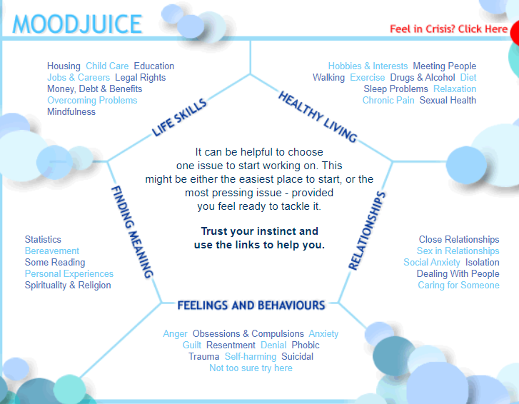

Slide 35
From: The Community Mental Health Framework for Adults and Older Adults: Support, Care and Treatment: NCCMH
Notes:
Ref The Community Mental Health Framework for Adults and Older Adults: Support, Care and Treatment NCCMH

Slide 36
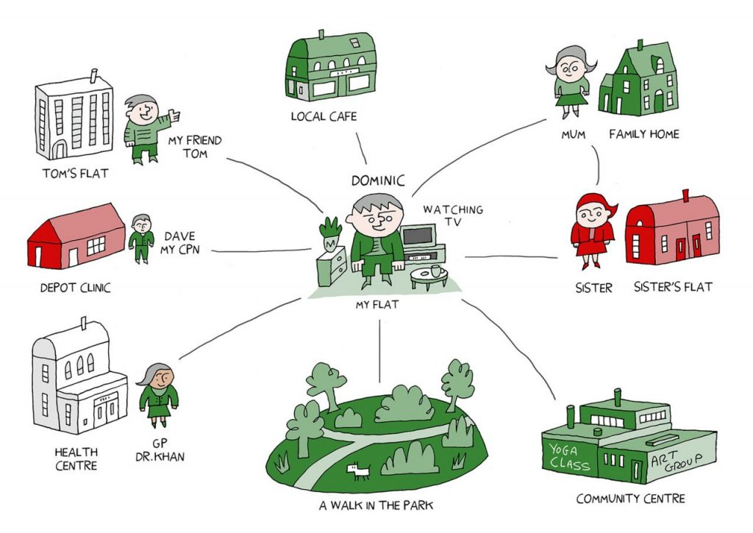

Slide 37
Advance Statements, Directives and Lasting Power of Attorney
An advance statement is not legally binding but under the Mental Capacity Act medical professionals are required to make practical efforts to follow your wishes. An advanced statement can reflect your views, beliefs and values that can help people make decisions that will affect you. You can write one yourself or use a template, you can also ask your GP, consultant, nurse or peer to support you to write it.
An advance decision, also known as an advance directive, is legally binding and usually relates to a specific treatment that you do not want in the future when you may not have the mental capacity to make the decision for yourself at that time. You have to be 18 years or older and have capacity to make an advance decision.
A Lasting Power of Attorney can make decisions about your treatment in the event you do not have the capacity to do so for yourself. If you have also made an Advanced decision, your LPA will not be able to override this, unless the advanced decision is not deemed appropriate. There are two types:
  A Property and Financial Affairs LPA allows a nominated person to handle your bank accounts, investments, bills and property.
  A Health and Welfare LPA covers decisions about your health and care.
https://www.nhs.uk/conditions/end-of-life-care/advance-statement/
https://www.mind.org.uk/information-support/legal-rights/mental-capacity-act-2005/advance-decisions/
https://www.mind.org.uk/information-support/legal-rights/mental-capacity-act-2005/lasting-power-of-attorney-lpa/

Slide 38
Advanced statement example
Name: Anita García Date of Birth: 01/04/1970 Address: 37 Cambridge Road DY7 8TP
I Anita García have been detained under the Mental Health Act 3 times to date. Whenever I am detained I tell mental health professionals not to tell my son and daughter information about my medication and care. But I want my son and daughter to know what medication I am taking and what care I am being given. I also want them to be involved with planning my care on discharge. Even though I will tell professionals that I don’t want this to happen. When I become unwell I believe that my son, daughter and other loves ones are plotting against me. Don’t tell me that you have told them my information. It will cause me distress. Don’t give me medication through injection. I have always been scared of injections and this adds to my distress. If I will not accept oral medication on its own, put it into my food. I have a good appetite even when I am unwell.
This will help me to build trust with staff and hopefully help me to get better quicker. I also have an advance decision to refuse electroconvulsive therapy (ECT). I have told my son and daughter that I have made an advance statement and advance decision and given them each a copy.
I have also made my GP aware and given them a copy.
I have added their contact details below.
GP: Doctor Bansal Address: Roper Way Surgery, DY7 4BJ Contact number: 0121 478 1365
Daughter: Gina García Address: 37 Cambridge Road, DY7 8TP Contact number: 07984731244
Son: Carlos García Address: 52 Birdcage way, CM4 3LY Contact number: 07845123457
Signed: Anita García
Printed name: Anita García
Today’s date: 15th February 2017

Slide 39
Advance decision/advance directive
I am making an advanced decision to be used in the event I lack capacity to make decisions about my treatment, even if my life is at risk. I have discussed this at length with my GP.
Name: Sandeep Begum
Date of Birth: 01/04/1985
Address: 21 Derby Road DE6 6TR
I do not wish to receive ECT even if my life is at risk.
Signed: Sandeep Begum
Date: 15th July 2010
Witness: Dr Fox (GP)
Date: 15th July 2010
My GP has a copy of my Advance decision:
GP: Dr Lammy, Parkside Medical Practice
Address: 1 The Centre, Derby, DE1 2AP

Slide 40
Action & maintenance

Slide 41
Trainer notes: Action & maintenance
Purpose: To reflect on what a PSW can do to support people at these stages
Materials:
Instructions: Show the cycle on slide 43 to remind people where we are on the cycle. Explain that we’re going to look at action and maintenance together as the tools are similar.
Activity 1: Get people into small groups to reflect on the questions on slide 44. Debrief by asking people to share their reflections.
Ask the group what someone might need from a PSW when they’re at this stage – write their thoughts up on the board. If necessary, prompt or add in suggestions:
Supported action
Encouraging people to reflect on their progress, achievements and any setbacks
Keeping motivation up into maintenance
Talk through the ORID framework on slide 46 – explain that this is a great tool to structure questions to help people to learn from an experience. You don’t have to stick to the order of the questions, but it’s a useful checklist to support reflection. Talk through the example on slide 47.
Activity 2: Get people into pairs to take it in turns to try out the ORID framework to support their partner to review a recent experience. This could be something at work, or something in their personal lives.
Timings: Activity 1: 10 mins, Debrief: 10 mins, Activity 2: 10 mins

Slide 42
Action and maintenance 2/2
Explain that another key role for PSW is to support the individual to maintain motivation while they are maintaining their knew activity or skill. A useful model for motivation that was developed by Daniel Pink in his book Drive. Daniel Pink talks about three key factors in maintaining motivation: autonomy, mastery, and purpose.
Autonomy is a human desire to be self directed when carrying out any activities. We prefer to be able to set our own direction , and have control over what we do and when. When working with individuals who are trying to maintain a change, it is useful to help them to identify areas where they can have greater autonomy or freedom over their actions , or two recognise where they have autonomy already.
Mastery is about how we are motivated when we feel that we are getting better at the things that we are doing. To support people to maintain motivation, it is useful to help them to recognise where they are gaining new skills , or building on existing ones. This might include soft skills , such as the ability to overcome challenges as well as practical skills .
Purpose is the desire to do something that has meaning and is important. It is very difficult to be motivated when you don't feel strongly connected to the purpose of what you're doing. It is important to help people to identify why they are making a change and how this will benefit either them as individuals or the issues that are important to them. People will always struggle to maintain motivation if they feel that they are pursuing a goal to serve somebody else’s purpose other than their own.
Activity 3: Divide the group into pairs and ask them to reflect on the questions on slide 48. In their pairs they should think about a situation where they would like to be more motivated. They should support their partner to consider how they could apply the principles of autonomy, mastery, and/or purpose to increase their motivation.
Debrief by asking people to share their thoughts on the activity
Timings: Introduction to motivation, 10 mins
Activity 3: 10 mins, debrief: 10 mins

Slide 43
Change cycle
Pre-contemplation
Not considering change
Relapse
Back to old behaviours
Contemplation
Change is possible
Maintenance
Change is maintained
Upward spiral:
Learn from relapse
Preparation
Planning the change
Action
Taking steps to change
Adapted from Prochaska & DiClemente’s Transtheoretical Model of Change (1997)

Slide 44
What is it like?
Think back to your change – what was it like to be at these stages
What did it feel like?
What did it look like?
How would you identify if someone else was here?

Slide 45
The role of the PSW

Slide 46




Reviewing actions - ORID
Objective
O
Reflective
R
Interpretive
I
Decision
D
What happened?
Focusing on the facts
How did you feel?
Focusing on emotions
Why?
Making connections
What will you do next?
Agreeing action
Adapted from: The Art of Focused Conversation by Brian Stanfield

Slide 47
ORID example
O: Describe your first run to me – what happened?
I went out at about 9:00am. It was cold and quiet on the streets, and it had just started raining. I went to the local park, but there were loads of children there so I went back out onto the road. I had planned to run for 20 minutes, but I only managed to do about 5 minutes of running, and about 15 minutes walking.
R: How do you feel about how that run went?
I feel pretty good about it I guess, it was good that I managed to get out after so long. I'm a bit disappointed that I didn't manage to run for longer than 5 minutes, and I was very anxious that the children might laugh at me because I'm so out of shape.
I: What have you learned from the experience?
I think I've realised but it's going to take me a while to get back to running as far as I used to, and I need to be realistic about the process. I've also realised but I'm feeling a lot more insecure about myself than I thought.
D: And what will you do next time?
I think I’ll set a lower target for myself next time, and plan a route that doesn’t take me through the park.
Nilesh has recently started to try to improve his physical wellbeing by starting to go running again. He meets with a PSW to review progress:

Slide 48
Practice
Support your partner to review a recent experience using the ORID framework.
Identify a recent experience you are comfortable to share (e.g. something new you’ve tried at work or at home)
Your partner then asks you ORID questions to reflect on the experience
Swap if you have time

Slide 49
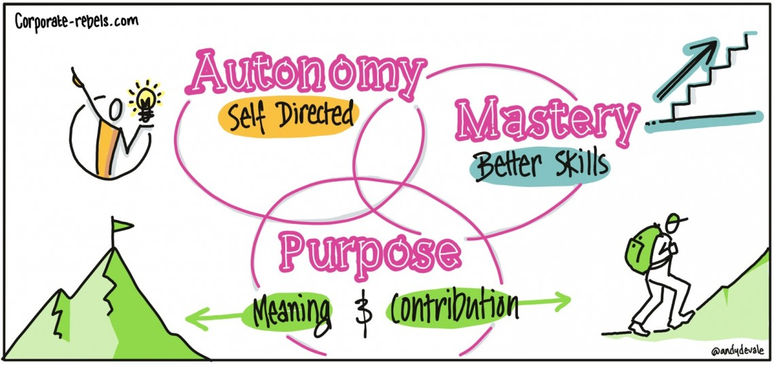
Motivation
Strengths based?
Autonomy, Mastery, Purpose – using coaching questions to support this?

Slide 50
Motivation example
Olu has recently joined a slimming club to lose weight. She is doing really well, and has lost 7lbs, but has mentioned to her PSW that time motivation is wavering, and she's had a couple of instances recently where she ended up eating takeaways and feeling very guilty about it afterwards. Her PSW works with her to consider her motivation to continue on the diet plan.
Olu mentions that she finds the food plans really restrictive, and she is missing the Nigerian food that she used to cook and enjoy. They discuss whether Olu would feel confident to try to find ways to adapt the food she likes to eat to the fit with slimming club approach, rather than feeling restricted by the food the slimming club suggests that she eats. Olu loves cooking and so decides to try to adapt the recipes to work with the plan.
Mastery
Purpose
Autonomy
They then talk about what Olu is learning through the slimming club. Olu is unsure at first, but following some gentle questioning she starts to realise how much she has actually learned about nutrition. She decides that it would be a great idea to try to find out even more about how the slimming plan works so that she can use this knowledge to broaden her meal choices.
The PSW asks Olu why she started the diet. Olu mentions the fact that her GP told her but she was obese and therefore needed to lose weight. They have a chat about whether there are other reasons why she might like to lose weight, and Olu shares that she’s worried if she doesn't lose weight, she won’t be around to see her grandchildren grow up. She decides to stick photos of her grandchildren in her food diary to remind herself why this is so important to her.

Slide 51
Motivation - practice
Identify an area in your life where you would like to be more motivated, and share this with your partner
Support your partner to identify strategies to increase their sense of autonomy, mastery, and/ or purpose.

Slide 52
Relapse

Slide 53
Trainer notes: Relapse
Purpose: To reflect on what a PSW can do to support people at this stage
Materials:
Instructions: Show the cycle on slide 55 to remind people where we are on the cycle.
Activity: Get people into small groups to reflect on the questions on slide 56. Debrief by asking people to share their reflections.
Ask the group what someone might need from a PSW when they’re at this stage – write their thoughts up on the board. If necessary, prompt or add in suggestions:
Providing reassurance & empathy
Supporting the individual to reflect on reasons behind their relapse
Validating their frustration or other emotions
Reconnecting to purpose for the change
Stress the importance of holding the space for people without judgement or pressure when somebody has relapsed to old behaviours. Regardless of the scale or importance of the change, people can feel a range of complex emotions if they feel that they have failed to achieve their goals.
Explain that when working with somebody who has relapsed to old behaviours, it is important to support them with empathy, drawing on the key skills and principles that are the essence of the PSW role. Show the peer support charter that we shared in session 1 on slide 57 highlighting some of the key skills that are needed during relapse. In particular: solidarity, empathy, trust and commonality are all skills that can be drawn upon during moments where an individual might be feeling particularly vulnerable or disappointed. Invite people to discuss how they might apply these skills at this stage of the change cycle.

Slide 54
Relapse 2/2
It is also useful to have a tool kit of self-help tools and grounding techniques that you can support people to use when they are facing challenges. Show the overview of the different types of resources on slide 59 and signpost to the list of resources in the handout. Ask if anyone has a particular favourite that they use. Invite them to share their favourites in the chat if they have any that they use regularly.
At this stage, it is important to remember that the PSW’s goal isn’t to immediately push someone to make another change attempt. Helping an individual to process what’s happened (using tools like ORID, and the tools from the pre-contemplation stage) can be enough until someone is ready to move round the cycle again to contemplation.
Relapse is a point where someone might be particularly vulnerable, so it is really important to recognise the limits of the PSW role, and the importance of appropriate signposting to services and sources of support that are designed specifically to support people in a crisis. Show the list on slide 61 and again asked people to share any others that they are aware of that are helpful.
Explain that you are going to finish this session with an opportunity to go through a mindfulness technique together – square breathing. Invite everyone to use their finger to trace the shape of a square in front of them, keeping their eyes on the finger. As they follow the first side of the square invite them to breathe in for four seconds. On the next side of the square hold your breath for four seconds. On the third side breathe out for four seconds and on the final side hold again for four seconds. Repeat this three or four times. Ask people how they are feeling after that exercise.
Timings: Activity: 10 mins, debrief: 10 mins, Overview of tools: 8 mins, Breathing exercise: 2 mins

Slide 55
Change cycle
Pre-contemplation
Not considering change
Relapse
Back to old behaviours
Contemplation
Change is possible
Maintenance
Change is maintained
Upward spiral:
Learn from relapse
Preparation
Planning the change
Action
Taking steps to change
Adapted from Prochaska & DiClemente’s Transtheoretical Model of Change (1997)

Slide 56
What is it like?
Think back to your change – what was it like to be at this stage
What did it feel like?
What did it look like?
How would you identify if someone else was at this stage?

Slide 57
The role of the PSW

Slide 58
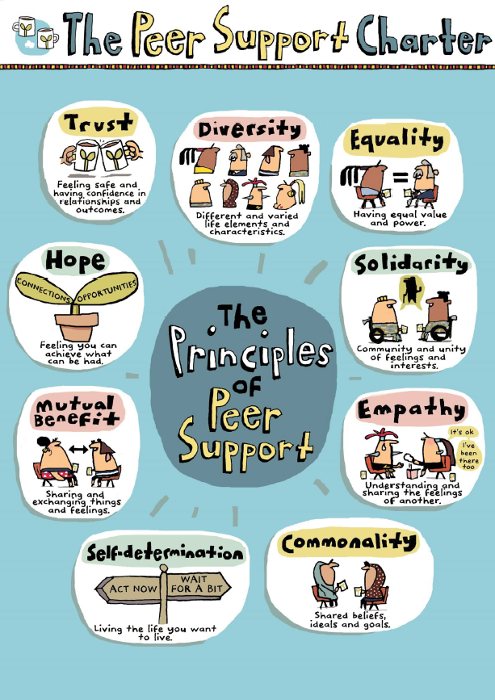

Slide 59




Downloadable resources
Online courses
Mindfulness & Grounding Techniques
Audio/
video guides
Apps
Icons made by Freepik from https://www.flaticon.com

Slide 60
Handout – mindfulness and grounding resources
Apps
http://www.sleepfulnessapp.com/how-it-works/
Velindre mindfulness app FREE
Headspace
Courses
https://www.breathworks-mindfulness.org.uk/
https://www.bemindfulonline.com/
Downloadable resources FREE
https://www.lscft.nhs.uk/media/Site%20Images/Perinatal/Covid-19/Grounding%20Cards.pdf
https://www.guysandstthomas.nhs.uk/resources/patient-information/rheumatology/mindfulness-web.pdf
Audio/video guides FREE
https://www.youtube.com/watch?v=wfDTp2GogaQ&app=desktop
http://www.bangor.ac.uk/mindfulness/audio/index.php.en
https://www.mind.org.uk/need-urgent-help/what-can-i-do-to-help-myself-cope/relaxing-and-calming-exercises/
http://franticworld.com/free-meditations-from-mindfulness/

Slide 61
Additional help and support
24 hour support
Call the Samaritans: 116 123
Text SHOUT to 85258
Other helplines
Under 19s can call Childline: 0800 1111 7.30am -3.30am
Call the SANE helpline: 0300 304 7000 4:30pm - 10:30pm
Call the Mind helpline: 0300 123 3393 9am - 6pm Monday-Friday

Slide 62

Square breathing
inhale 2… 3… 4…
hold 2… 3… 4…
hold 2… 3… 4…
exhale 2… 3… 4…

Slide 63
Shared action planning with buddies

Slide 64
Buddy catch up
Identify a situation in work where it might be helpful to support someone’s change journey.
How might you apply some of the learning from today?

Slide 66

Before the next session:
If you have time, and would find it helpful, practice using one of the tools covered today

