Slide 1
Working with groups
Date

Slide 2
Breakout discussion 1 – Buddy catch up
Share with your buddy
What you want to get out of today’s session
Reflections on the last session
Any action you’ve taken to apply the thinking from the last session about supporting people through transitions
After this discussion you will be asked to share your thoughts but you won’t have to share the detail if you’d rather not.

Slide 3
Reflection - feedback
For each person in your group, write down a word or short sentence to describe something you appreciate or value about them. Consider all of the interactions you’ve had with them over the duration of the course.
Person 1:
Name:
Positive feedback:
Person 2:
Name:
Positive feedback:
Person 3:
Name:
Positive feedback:
Person 4:
Name:
Positive feedback:
Person 5:
Name:
Positive feedback:

Slide 4
Breakout discussion 2 - feedback
Decide who is going to receive feedback first in your group.
All other members of the group give that person their positive feedback.
Resist the temptation to disagree with the feedback you are given, if you’re not sure what to say just say thank you!
Repeat the process for each member of the group so that everybody has a chance to hear their positive feedback.
You won’t have to share the feedback you’ve been given, but you will be asked to share any thoughts or feelings you have after the exercise.

Slide 5

The purpose of icebreakers
Icebreakers can be used to:
Help people get to know each other
Get people chatting
Boost energy
Introduce topical theme
Build trust and safety
Have fun!
What’s your favourite icebreaker?

Slide 6
Breakout discussion 3 – the role of the facilitator
What types of groups might you facilitate as a peer?
What skills are needed when facilitating groups?
You’ll be asked to share your responses to these questions with the rest of the group.

Slide 7
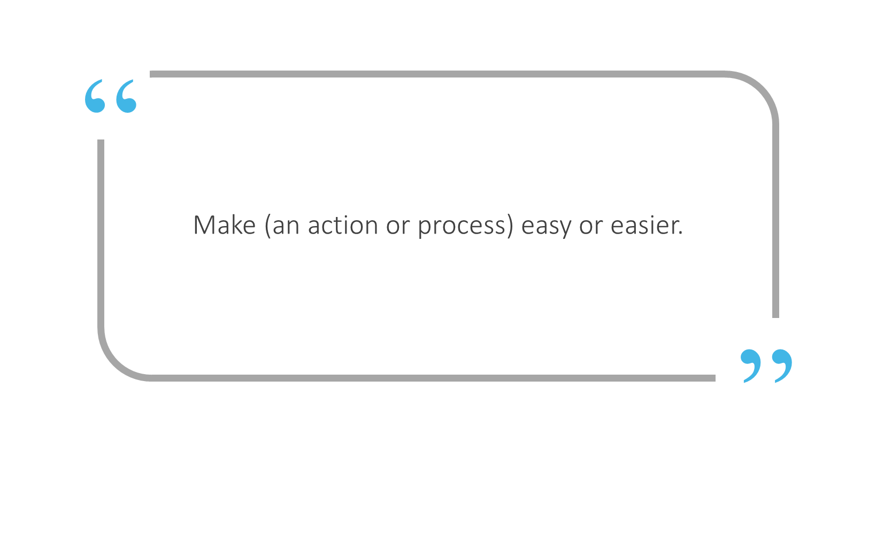
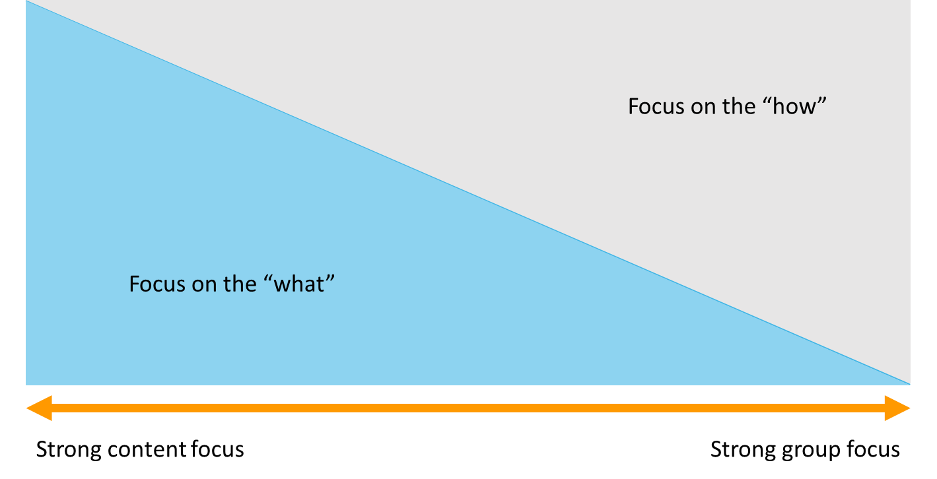
The role of the facilitator
Oxford dictionaries

Slide 8
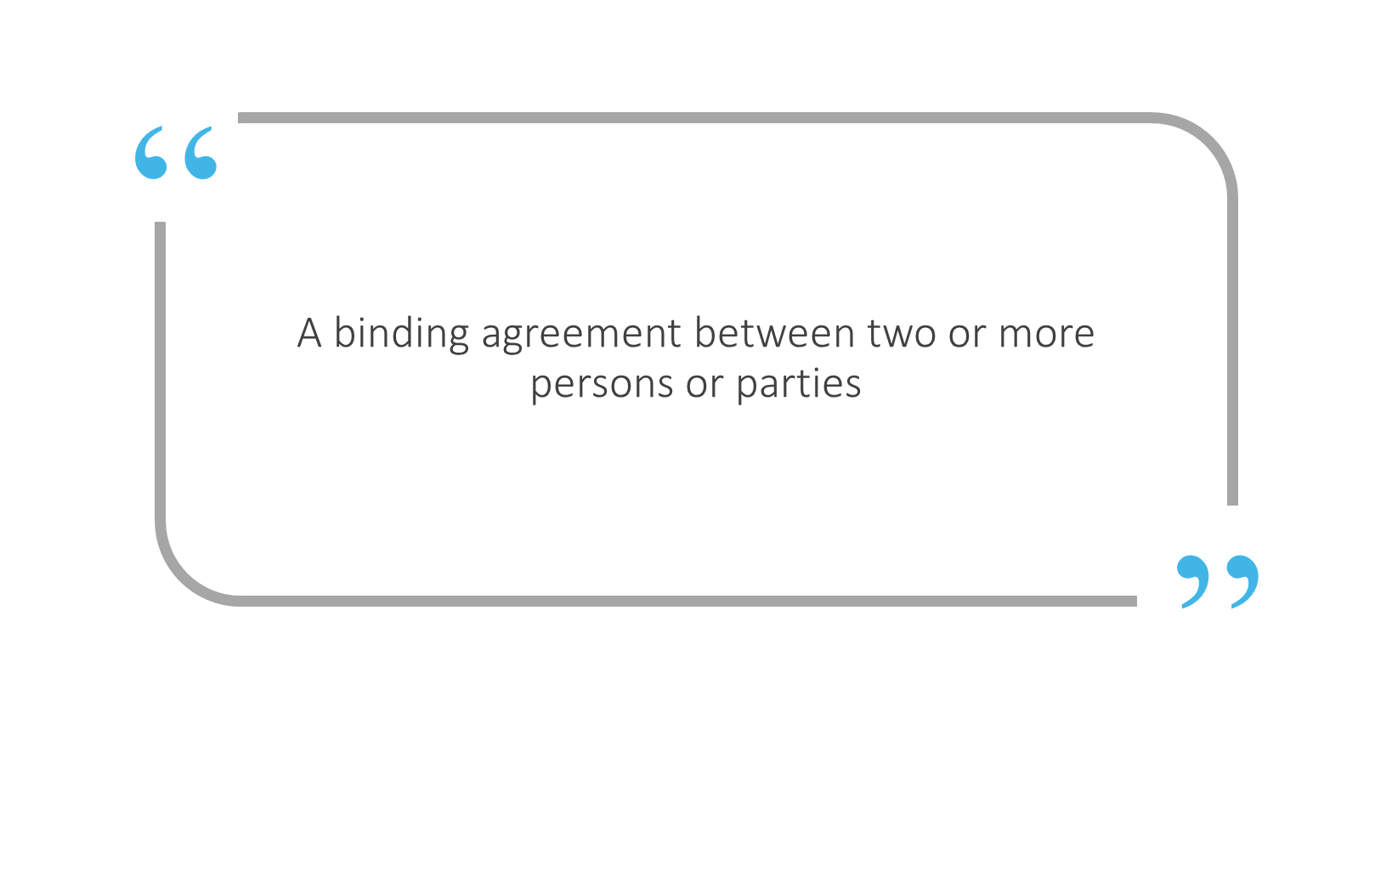

Contracting
Merriam-Webster
What forms part of your group contract?
Joining instructions
Pre-course materials
Room set up
Greeting and introductions
Session aims
Ground rules and housekeeping
How the facilitator engages with the group
How the group engages with each other
Icons made by Freepik www.flaticon.com

Slide 9
Breakout discussion 4 – our contract
What contracting has happened around today’s session so far?
How has that made you feel about the day?
Why?
What might you learn from this to apply to how you contract with groups?
You will be asked to share your reflections from this discussion with the rest of the group.

Slide 10
Breakout discussion 5 – group dynamics
What examples of challenging behaviour have you seen when working in or with a group? This might be your experiences as a facilitator or as a group member.
You will be asked to share some of your examples with the group.

Slide 11

Challenging behaviour
Non-participation or withdrawal
Monopolising
Conflict
Distractions
You will be asked to consider one or two of the types of behaviour listed above. For the behaviours you’ve been asked to consider, answer the following questions:
Why might someone behave like this?
What’s the impact on the group?
What strategies should the facilitator use to respond it?

Slide 12

Top tips
Agree clear ways of working at the beginning, clarifying expectations around participation
Recognise that it might take people time to warm up and get settled into the group
Invest time in building trust between group members and with you as the facilitator
Provide opportunities for people to speak to you separately if there are challenges that are distracting the group
Provide plenty of opportunities for people to speak – but don’t pressure people to share if they don’t feel comfortable

Slide 13


Breakout discussion 6 – Course review
Review the pictures over the following pages, and have a discussion in your group about what you remember about the pictures themselves (i.e. the model or theory represented) or about that module more generally.
Remember, this is just for fun! You will be asked to share your memories, stories and anecdotes from the modules, but this isn’t a test. Feel free to refer back to your materials from the previous modules if you need a little memory jog!

Slide 14
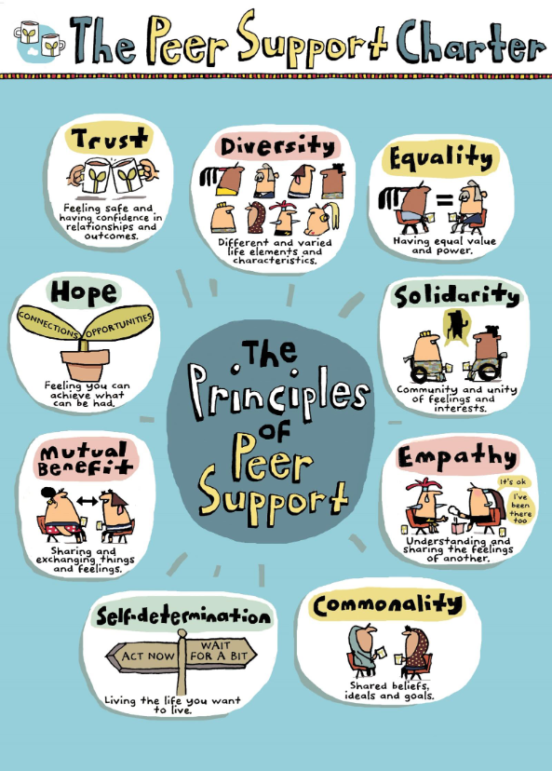


What do you remember about these pictures?
What do you remember about this day?

Slide 15
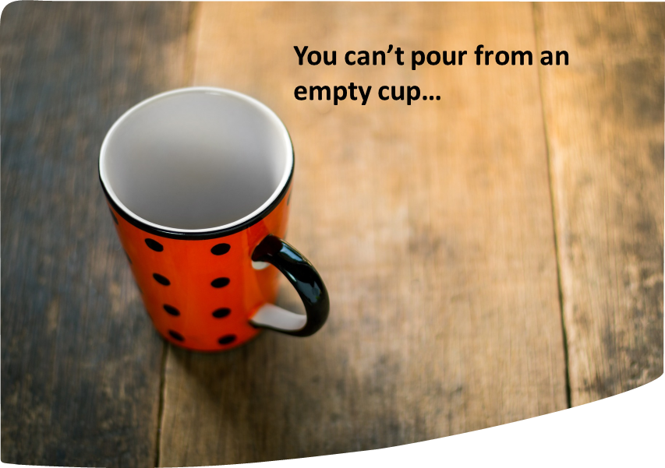
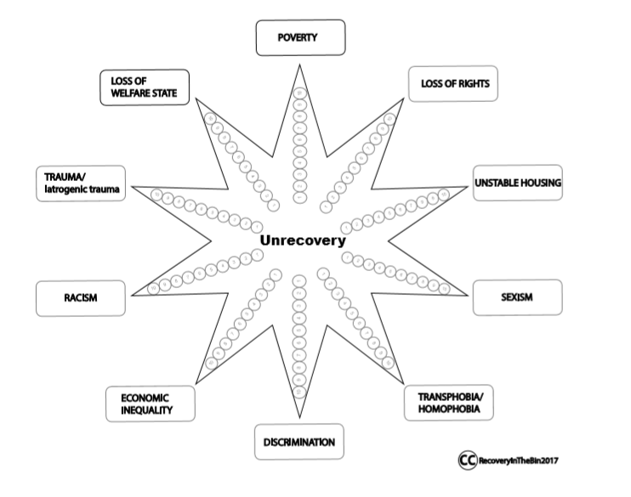
What do you remember about these pictures?
What do you remember about this day?

Slide 16
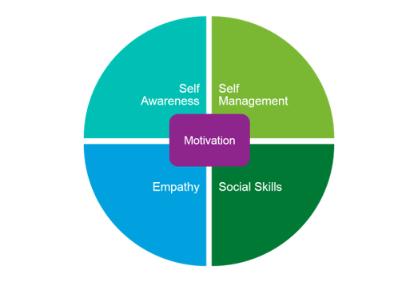
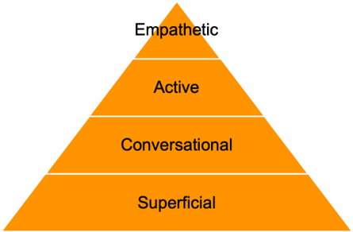
What do you remember about these pictures?
What do you remember about this day?
“…the ability to understand and manage your own emotions, and those of the people around you.”

Slide 17


What do you remember about these pictures?
What do you remember about this day?

Slide 18
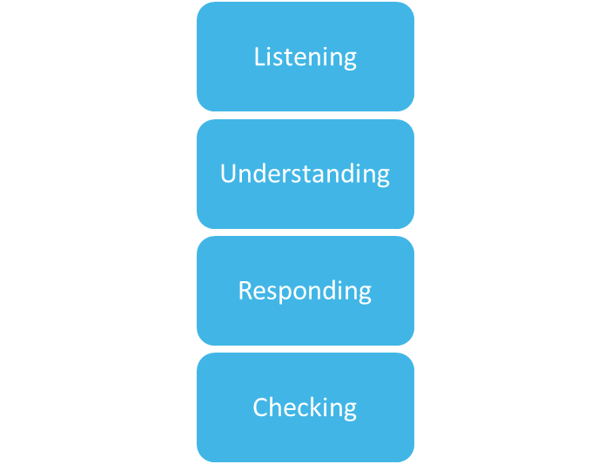
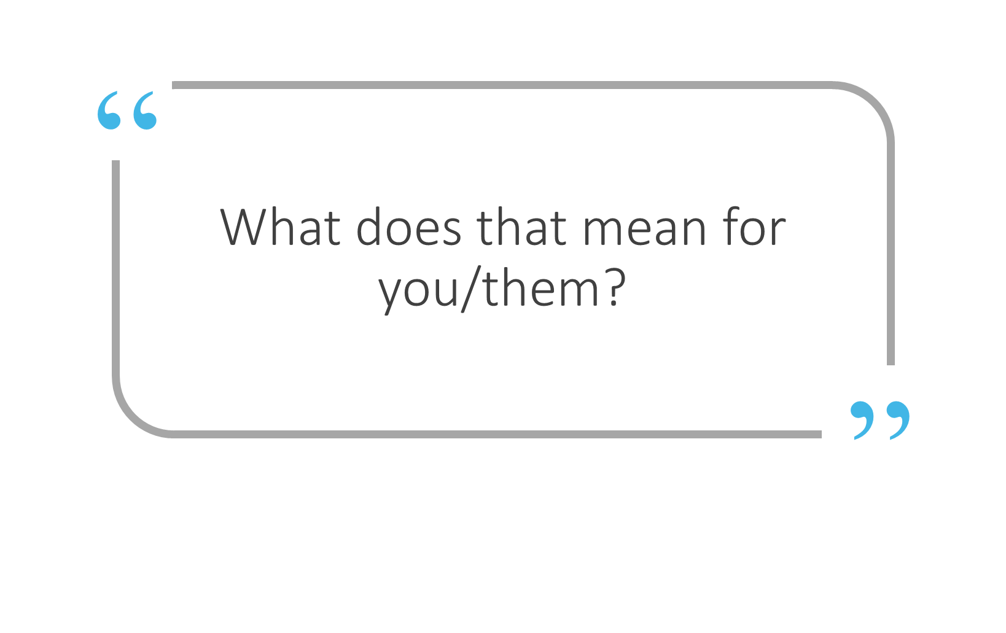
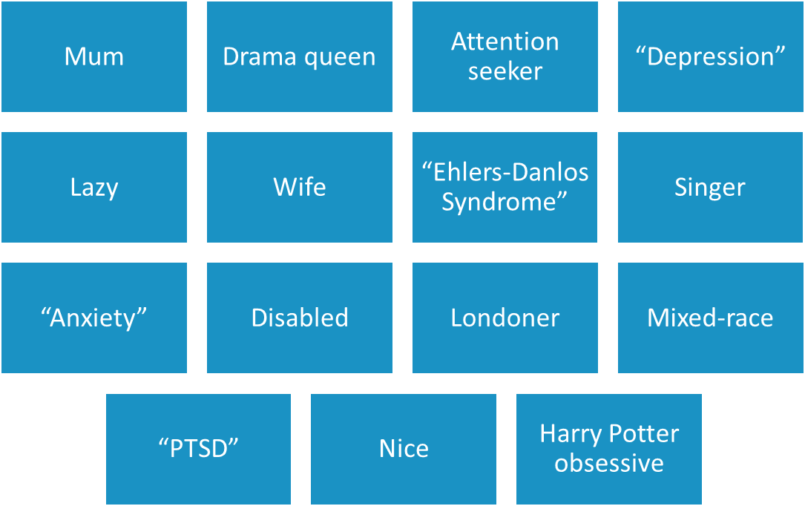
What do you remember about these pictures?
What do you remember about this day?

Slide 19
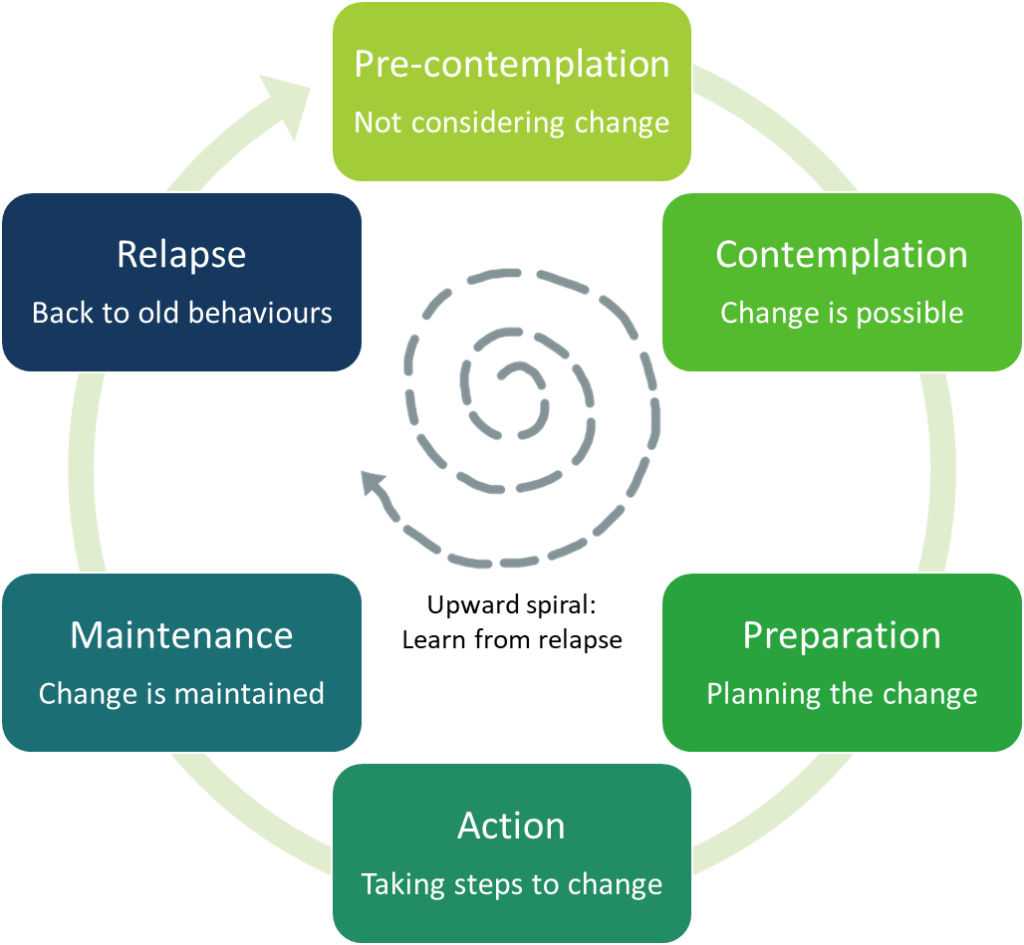
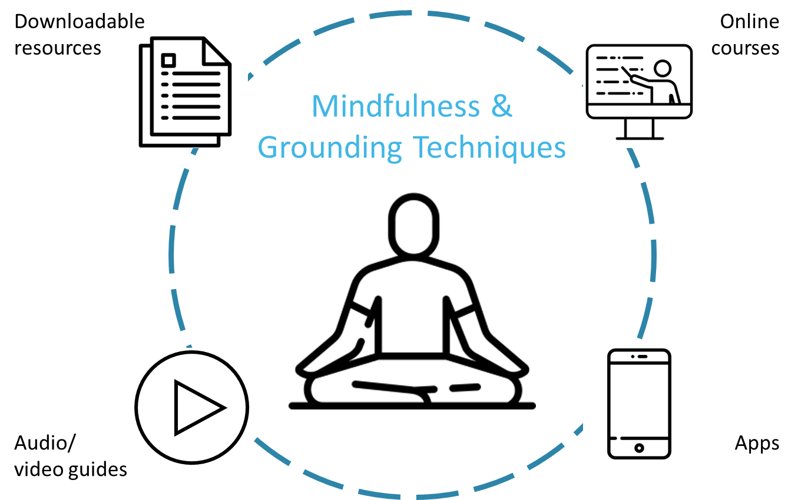
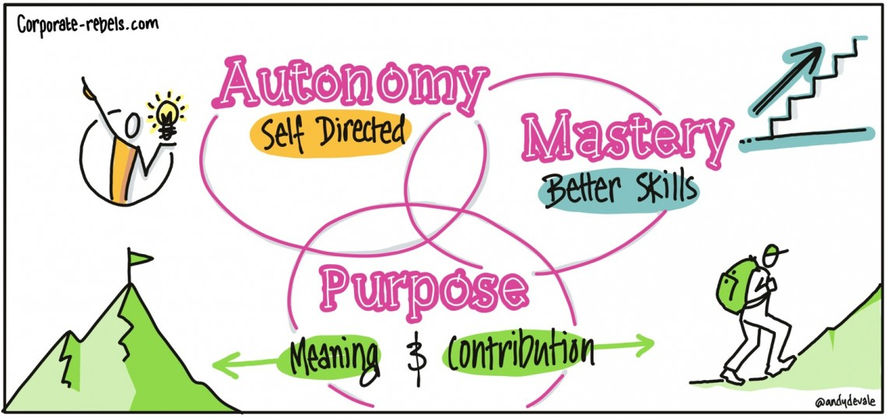
What do you remember about these pictures?
What do you remember about this day?

Slide 20
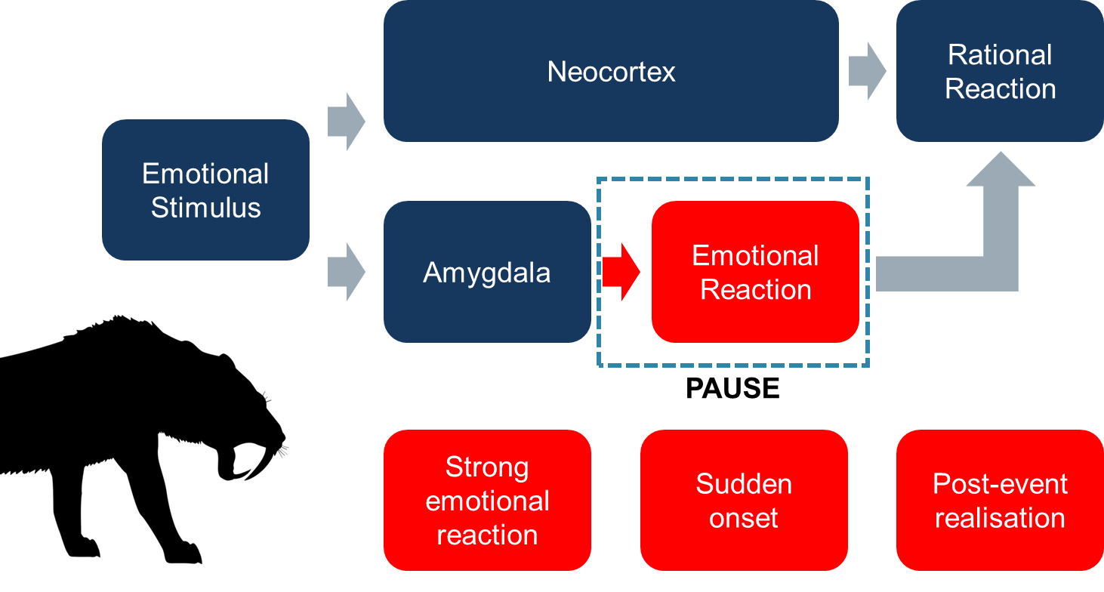
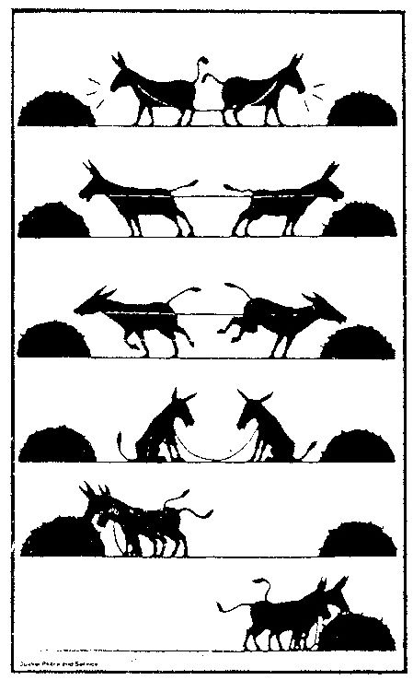
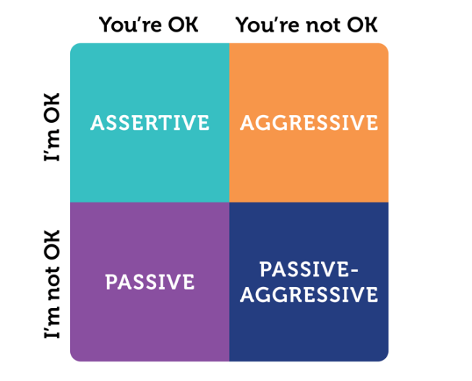
What do you remember about these pictures?
What do you remember about this day?

Slide 21
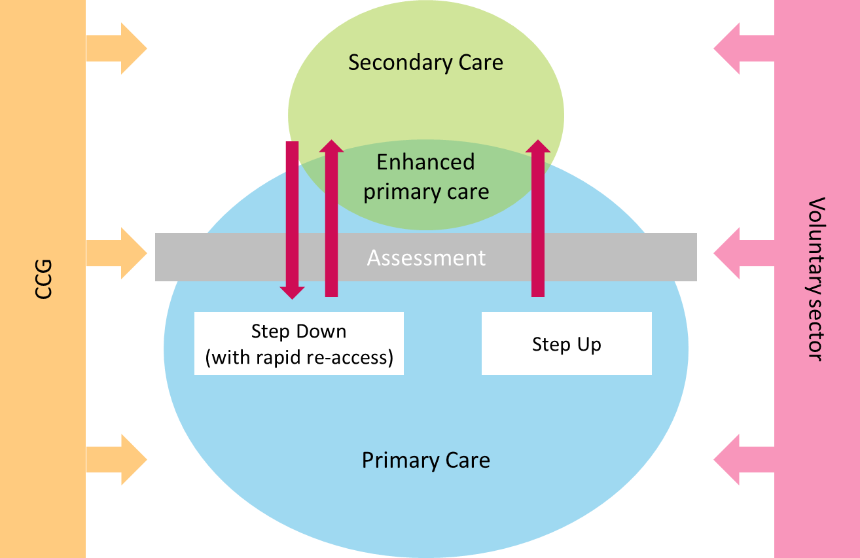
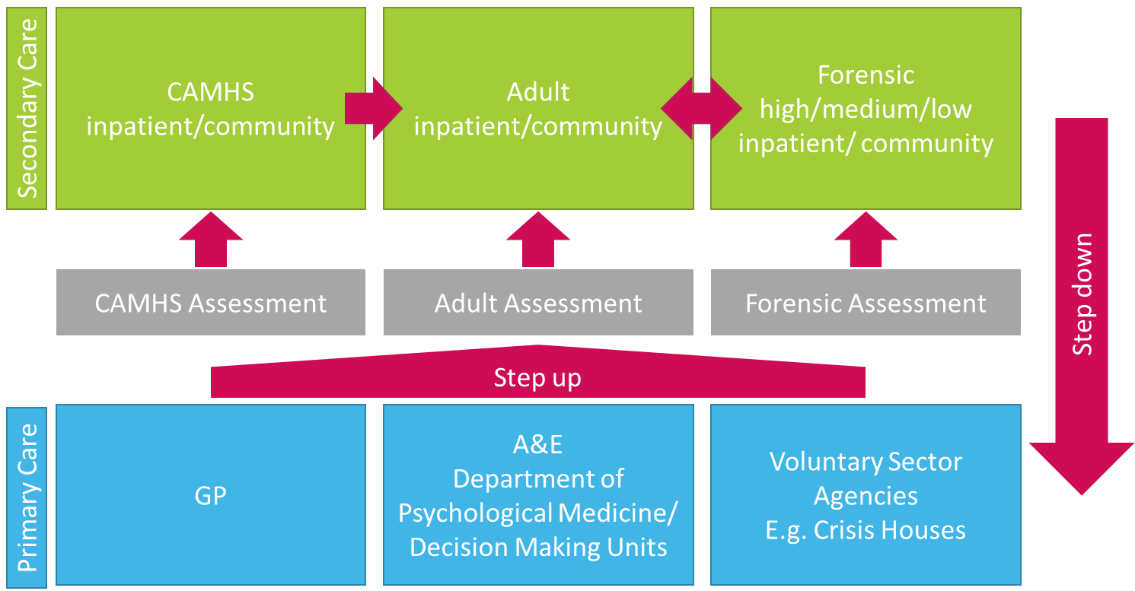
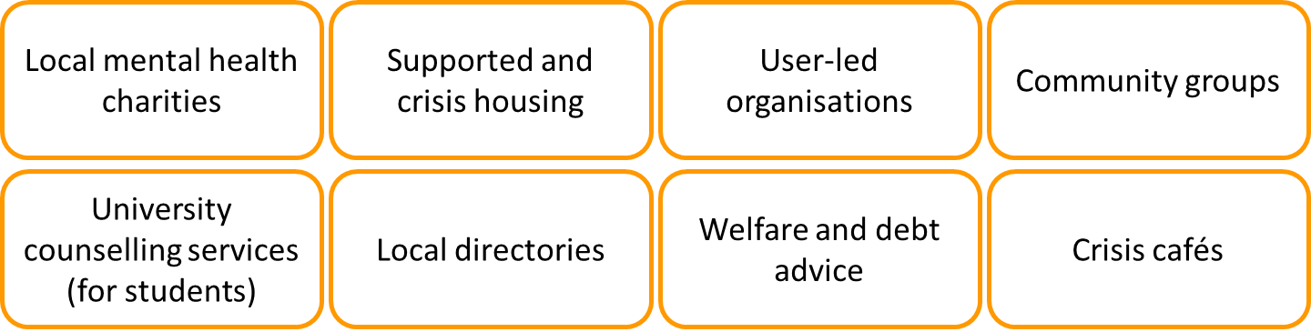
What do you remember about these pictures?
What do you remember about this day?

Slide 22
Action planning
What have I learned?
Consider the whole course from each of these perspectives
What will I do?
Think about what, when, and what support you might need
For myself?
For my work with clients?
For my relationships with colleagues?

Slide 23
Breakout discussion 7 – Buddy catch up
Share your action plan with your buddy.
Talk through any potential challenges or barriers to achieving your goals
Identify one key action that you would like to be held accountable for. Discuss how you might hold yourself to account for this action, and what your buddy might be able to do to support you.

Slide 24
Thank you!
Thank you so much for all of your hard work, energy and commitment to these sessions. We couldn’t have done it without you!

