Slide 1

Working with groups
Trainer name
Date

Slide 2
Timetable
Time | Session overview
10.00-10.15am | Welcome and housekeeping
10.15-10.35am | Buddy catch up
10.35-11.10am | Icebreakers
11.10-11.20am | Break
11.20-12.00pm | The role of the facilitator
12.00-12.45pm | Contracting
12.45-1.30pm | Lunch
1.30-2.30pm | Group dynamics
2.30-2.45pm | Break
2.45-3.35pm | Course review
3.35-4.00pm | Buddies and action planning 30 min
4.00 | Close

Slide 3
Trainer notes: About today
Purpose: To make sure everyone knows the basics about the venue and the day
Materials: None
Instructions: Talk through the icons on slide 4:
Finish time
Tea/coffee breaks – what time breaks are planned and letting people know that you can stop for additional breaks if needed. Let people know where the break-out spaces are
Lunch – let people know that lunch is provided and at what time
Toilets – make sure everyone knows where they are
Fire – let them know if there are any planned fire tests and where the fire exits are
Phones – ask people to put their phones onto silent (or off if possible!)
Timings: 5 mins

Slide 4






Housekeeping

Slide 5
Aims

Slide 6
Trainer notes: Aims
Purpose: To provide an overview of day
Materials: None
Instructions:
Remind people where we are in terms of the programme overview (slide 7) before talking about the aims for todays session (slide 8)
Timings:
5 mins

Slide 7
Programme overview
You are here
Self-care and
self- management
Communication and interpersonal skills
Navigating the system
Supporting mental health
1. Working as a peer
2. Use of self
3. Effective relationships
4. Context and frameworks
5. Mental health
6. Supporting self-management
7. Working with other professionals
8. Supporting access to care
9. Working with groups

Slide 8
Aims for today
By the end of today you will leave with:
An understanding of the role of the peer when working with groups
Ideas and strategies to create a safe environment through your contract with a group
An understanding of the use of icebreakers
Strategies to deal with challenging group dynamics
An action plan based on your work over the duration of the course

Slide 9
Trainer notes: Recap ways of working
Purpose: For people to remind themselves of what they wanted to get out of the training and how they wanted to work as a group
Materials: 3 flipcharts from session 1 around the room: “Aims for the course”, “Ways of working together”, “Working with the facilitators”
Instructions:
Talk through the outputs from session 1
Ask the groups to discuss any additions/changes they would like to make to these
Timings:
5 mins

Slide 10
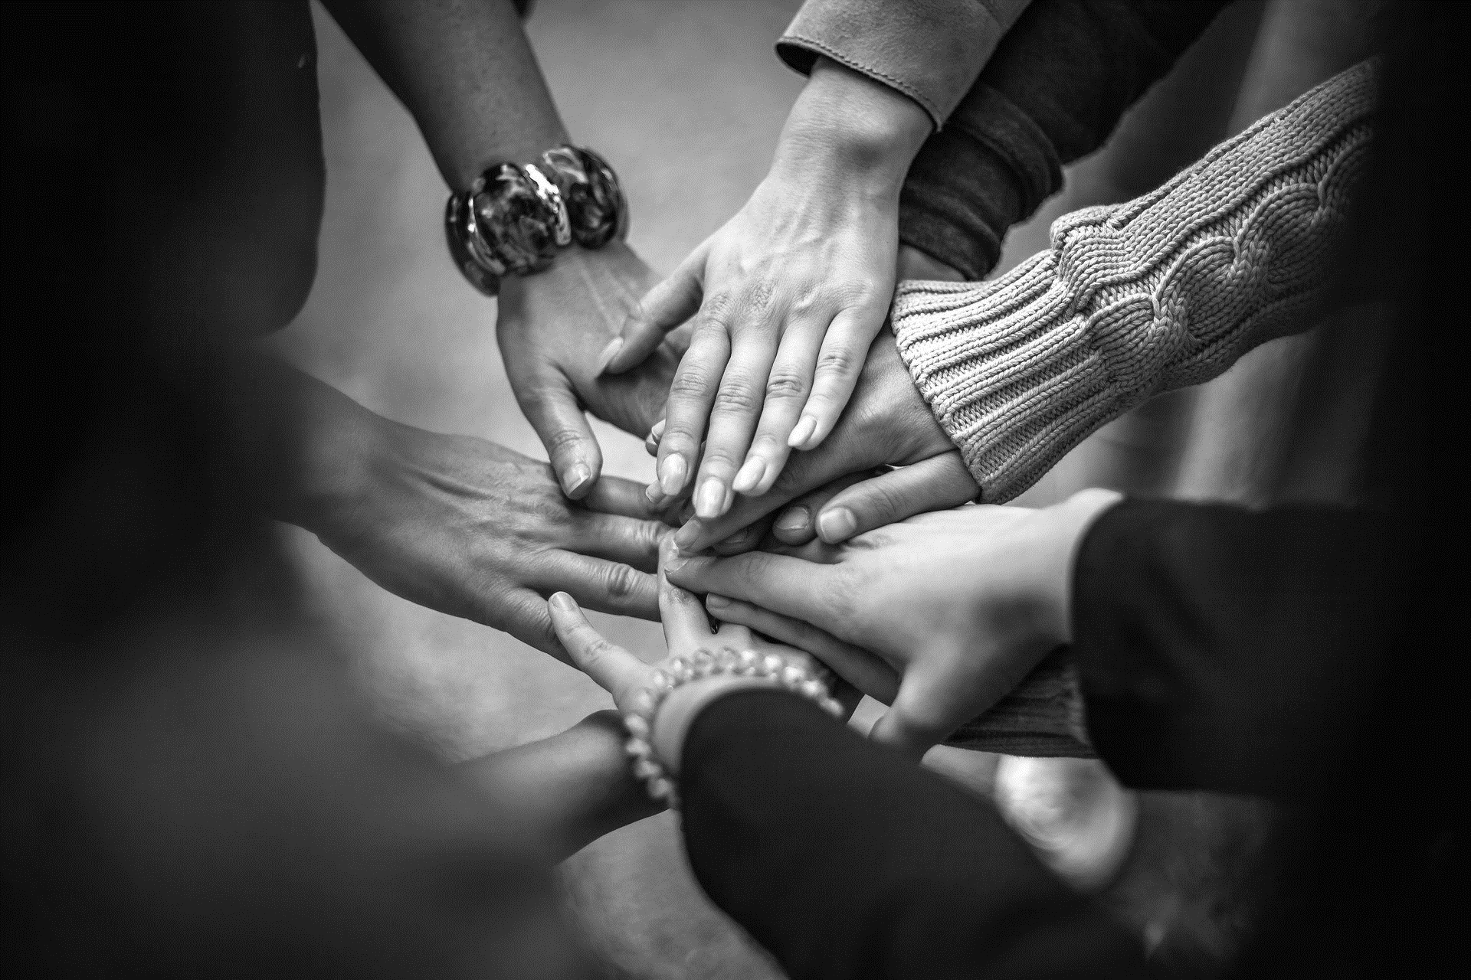
Ways of working
What do you want to get out of the course overall?
How do you want to work together as a group to feel safe and comfortable?
What do you need from the facilitators to feel safe and comfortable?
Recap flipchart outputs.

Slide 11
Buddy catch up

Slide 12
Trainer notes: Buddy catch up
Purpose: To give buddies a chance to catch up and plan their focus for the day
Materials: Handout – Support Plan template (completed in last session), outputs from ‘getting to know you session’
List with names of buddy pairs.
Instructions:
Part 1: Ask people to find their buddies and a space to talk. Encourage the full usage of the room, or to find a spot outside of the room, if they would prefer.
Part 2: Ask people to discuss with their buddy; what they are hoping to get from the day, their reflections from the last session and how they have applied the thinking around supporting transitions
Timings:
Part 1: 1 minute
Part 2: 20 mins (10 minutes each)

Slide 13
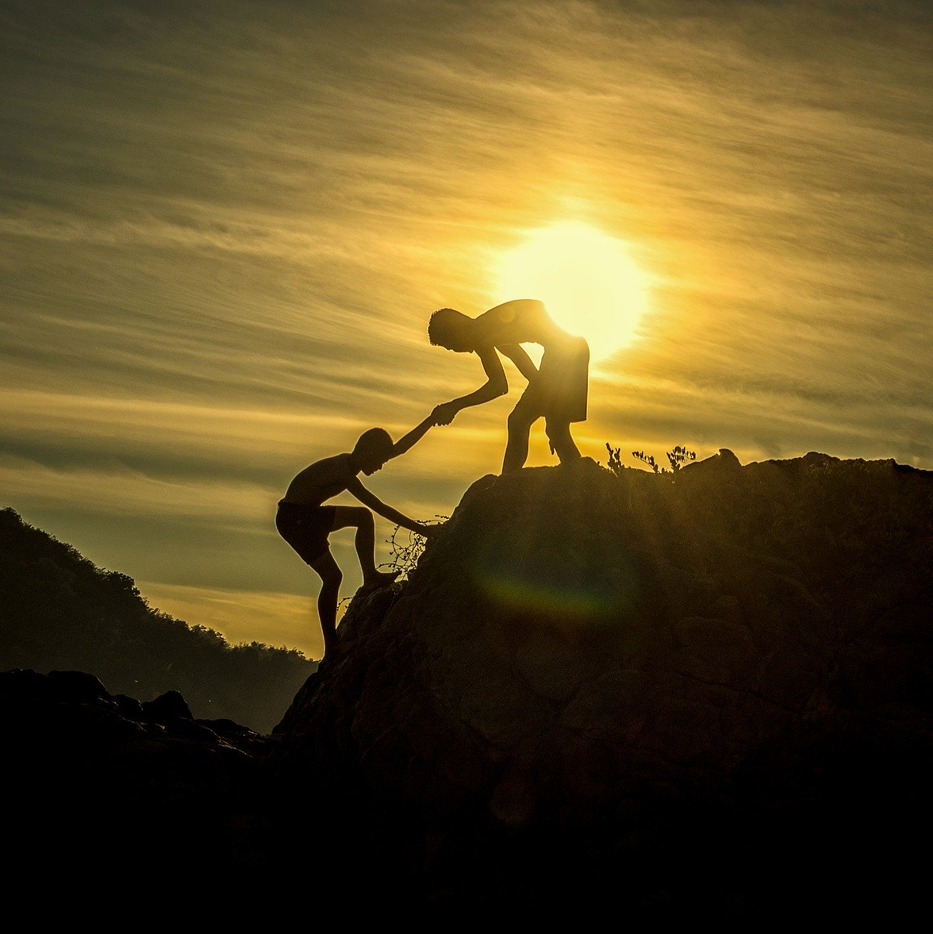
Reminder: The role of your buddy
Support you to identify goals for the training
Support you to manage your wellbeing
Help you plan how to apply your learning between sessions
Check in to see if you’re achieving your goals – and help problem solve
Check in during and between sessions

Slide 14

Buddy catch up
Spend 20 minutes discussing with your buddy, your:
Hopes for today
Reflections on the last session
Any work you’ve done to apply the learning about transitions

Slide 15
Icebreaker

Slide 16
Icebreaker
Purpose: To set the tone for the day, and provide an opportunity to reflect on the purpose of icebreakers
Instructions: explain that, as the day is going to focus on working with groups, you’re going to spend some time working as a group on an activity together. At the end of the activity you will have a chance to reflect on the use of icebreakers and other activities when working with groups, and how to use these activities effectively.
Explain that, as the group has been working together for a while now, and as it’s the last session, it’s time to do a bit of mutual appreciation. Ask everyone to spend a couple of minutes individually thinking about one thing they appreciate about each member of the group (slide 17). Ask people to limit their feedback to a word or a short sentence. Emphasise that this doesn’t have to be a big thing, it just needs to be positive. Once everybody has written their list, take it in turns to work round the group, asking everyone to share their positive thing about the first group member before moving on to the next. For large groups you will need to divide the group into smaller groups for this activity. Exercise instructions are on slide 18.
Debrief by asking people how they feel after that activity.
Share the list on slide 19 showing how icebreakers like this can be used. Ask the group if they have any particular favourites that they like to use when working with groups.
Timings:
Intro and feedback prep: 5 mins
Giving feedback: 15 mins (1-2 mins per person)
Use of icebreakers: 5 mins

Slide 17
Feedback
For each person in your group, write down a word or short sentence to describe something you appreciate or value about them. Consider all of the interactions you’ve had with them over the duration of the course.

Slide 18
Giving feedback
Decide who is going to receive feedback first in your group
All other members of the group give that person their positive feedback
Resist the temptation to disagree with the feedback you are given, if you’re not sure what to say just say thank you!
Repeat the process for each member of the group so that everybody has a chance to hear their positive feedback.

Slide 19

Icebreakers can be used to:
help people get to know each other
get people chatting
boost energy
introduce a topic or theme
build trust and safety
have fun!

Slide 20
The role of the facilitator

Slide 21
Trainer notes: The role of the facilitator
Purpose: to explore the role of the peer when working with groups, and some of the core skills needed to facilitate groups effectively.
Materials:
Instructions: Explain that through the course of the training, the focus has been largely on working with individuals. One of the roles that peers sometimes have to play is facilitating groups of people, either in training or in other contexts. Stress the fact that although these skills might not be relevant to everybody in the group right now, their useful skills to have in your toolkit in case you find yourself working with groups in the future.
Activity: Split participants into small groups and talk through the activity on slide 22. Ask them to discuss the types of groups a peer might be asked to facilitate (based on groups they have facilitated or attended), and what skills might be needed when working with groups. Debrief by asking participants to share their thoughts from their group discussion. Write these up on the flipchart/whiteboard.
Share the definition of facilitation on slide 23. Explain that regardless of the context, the facilitator’s role is literally to “make the process easier”. Reference any of the ideas that came up in the group discussion that might be about making things easier, for example building trust, listening, or supporting learning.
Explain that the facilitator’s role usually includes two key dimensions (slide 24). The first is looking after the “what” of the group’s work, i.e. the content of what they are working on, ensuring that the group stays on track, or gets what they need out of the conversation. The second is the “how” of the session, focusing on how people are working together, how individuals are feeling about the session, and ensuring individual and collective group safety. The facilitator will usually sit somewhere along the spectrum at the bottom of the chart depending on the circumstances. Go back to the list of skills that the group identified in the activity, and point out skills that relate to the “what” and skills that relate to the “how”. Remind the group that both of these are important, but the nature of the session should determine how much focus or emphasis there is on each. Ask the group which of the examples they have come up with might have more of a focus on which of the dimensions. Facilitate a brief conversation about these two aspects of the facilitator’s role in relation to participants’ own experience of facilitating groups.
Timings: Activity 10 mins, Debrief 10 mins, Definition and dimensions 20 mins

Slide 22
The role of the peer with groups
What types of groups might you facilitate as a peer?
What skills are needed when facilitating groups?

Slide 23
Facilitate
“
Make (an action or process) easy or easier.
”
Oxford dictionaries

Slide 24
Dimensions of facilitation
Focus on the “how”
Focus on the “what”
Strong content focus
Strong group focus

Slide 25
Contracting

Slide 26
Trainer notes: Contracting
Purpose: to encourage participants to consider the importance of contracting and ground rules when working with groups
Instructions: ask the group what contracting might mean in this context. Share the definition on slide 27. Explain that in a formal sense contracting is about entering into some form of legally binding agreement. In facilitation of groups we are not entering into a legally binding agreement, however what we do need to do as facilitators is set up the session in such a way that everyone has a very clear agreement of the ways of working, expectations, and roles in order to provide a sense of safety.
Ask the group what a facilitator can do to create this contract with the group. Write up some of their thoughts on the flipchart/whiteboard.
Explain that when you’re working with a group, your contract often starts before the session begins, perhaps before you’ve even met the people you’ll be working with. Show the list of what makes up a contract on slide 28.
Explain that every interaction that you have with the group forms part of your contract. This includes any communication you have in advance of the session, how you set up the room, how you set up the session, and how you interact with the group throughout. It is really important to consider what impression you want to make on the group, and what tone you want to set through all of these channels to ensure that people have a safe and consistent experience.
Activity in small groups ask people to reflect on contracting for today’s session, responding to the questions on slide 29, and considering all of the elements of the contract from the previous slide.
Debrief by hearing back people’s reflections, encouraging people to share what they found helpful and what they might perhaps have done differently to contract today’s session.
Stress the importance of spending enough time at the beginning of each session making people feel comfortable, welcome, and clear on what they can expect from the session. Make sure that some time is spent on ways of working, ideally allowing the group to design their own if there’s enough time, so that people are really clear about what is expected and acceptable during the session.
Timings: Definition and discussion 15 mins, activity 15 mins, debrief 15mins

Slide 27
Contract
“
A binding agreement between two or more persons or parties
”
Merriam-Webster

Slide 28

What forms part of your group contract?
Joining instructions
Pre-course materials
Room set up
Greeting and introductions
Session aims
Ground rules and housekeeping
How the facilitator engages with the group
How the group engages with each other
Icons made by Freepik www.flaticon.com

Slide 29
Our contract
What contracting has happened around today’s session so far?
How has that made you feel about the day?
Why?
What might you learn from this to apply to how you contract with groups?

Slide 30
Group dynamics

Slide 31
Trainer notes: Group dynamics pt.1
Purpose: to explore how different individual or group behaviour can impact on the results you are trying to achieve, and identify strategies to manage these behaviours effectively
Instructions:
Activity 1: divide participants into small groups to discuss the types of challenging behaviour they have seen when working with groups. Emphasise the fact that the focus here is on challenging behaviour, not on labelling individuals as challenging in themselves. Debrief by asking participants to share the examples they have seen that were challenging.
Share the list of challenging behaviours on slide 33, acknowledging where participants have identified the same behaviours, or similar.
Non-participation or withdrawal - while everyone has the right not to participate in a group conversation, it is the facilitator’s responsibility to make sure that all members feel safe and able to contribute should they wish.
Monopolising – there may be times when one person in a group has more to say than other people. This might mean they monopolise the conversation, or at times they may even interrupt other people to get their point across.
Conflict – there may be times where people in the group you are facilitating have disagreements with each other, or indeed with you as the facilitator. These disagreements can potentially become quite heated or personal, particularly when the subject matter is sensitive or emotive.
Distractions – while some distractions are less obvious, and may lead to nonparticipation as mentioned previously, some are more obvious and disruptive. Distractions you might have to manage as a facilitator include participants having lots of side conversations that are related to the topic at hand, or individuals who spend lots of time looking at their phone or taking calls.
Explain that you are now going to have a look at what sits behind some of those behaviours, the impact that they can have, and what the facilitator can do to manage the impact of those behaviours effectively.

Slide 32
Trainer notes: Group dynamics pt.2
Activity 2: Split the group into two or four groups (depending on numbers), and give each group one-two behaviours to look at. Show slide 33 and 34 explaining the task. For each of the behaviours they are being asked to consider what might be driving that behaviour, what the impact of that behaviour might be on the rest of the group and/or the facilitator, and how the facilitator might respond appropriately.
Debrief by asking each group to talk through the behaviours they were asked to look at, and their answers to the questions. Invite the other groups to feeding their experiences or thoughts on each behaviour before moving on to the next.
Summarise any key themes that have come out from these discussions, emphasising that the facilitator’s role is to balance the needs of the individual with the needs of the group. One of the biggest challenges about facilitating groups of people who might be feeling vulnerable is that tension between making sure that everybody feels heard and supported, without letting the needs of one individual override the aims of the group overall. Talk through the top tips on slide 36, highlighting where the group has come up with similar suggestions in the activity. Stress the point that dealing with challenging behaviour is where having an agreed set of ways of working at the beginning of the session can be incredibly helpful, as this can help to reinforce the type of behaviour that everyone within the group agrees is most helpful. If you do have to give feedback on somebody’s behaviour within a group, you can draw on the ways of working that the group themselves agreed were important. Where you can’t respond to an individual’s needs in a group setting, it might be appropriate to offer to speak to an individual separately rather than let their behaviour impact on the rest of the group inappropriately.
Timings:
Activity 1: 10 mins
Debrief: 5 mins
Overview of challenging behaviour: 5 mins
Activity 2: 15 mins
Debrief: 25 mins

Slide 33
Challenging Behaviour
What examples of challenging behaviour have you seen when working in or with a group?
This might be your experiences as a facilitator or as a group member.

Slide 34

Challenging Behaviour
Non-participation or withdrawal
Monopolising
Conflict
Distractions

Slide 35
Dealing with challenging behaviour
For the behaviours you’ve been given:
Why might someone behave like this?
What’s the impact on the group?
What strategies should the facilitator use to respond it?

Slide 36

Top tips
Agree clear ways of working at the beginning, clarifying expectations around participation
Recognise that it might take people time to warm up and get settled into the group
Invest time in building trust between group members and with you as the facilitator
Provide opportunities for people to speak to you separately if there are challenges that are distracting the group
Provide plenty of opportunities for people to speak – but don’t pressure people to share if they don’t feel comfortable

Slide 37
Course review

Slide 38
Trainer notes: Course review/action planning with buddies
Purpose: to look back over all of the content covered throughout the course, and which elements stood out most significantly
Instructions:
Explain that you are going to give participants a, light-hearted/just for fun, quiz to see how much they remember from the previous modules. Emphasise the point that this is just a bit of fun, they are not being tested on their memory! Explained that each module they will be given some pictures that have been used in the session slides. All they have to do is see how much they can remember about those pictures specifically, or the session generally. Bonus points for entertaining anecdotes about the session that don’t relate to the training content!
Activity 1: divide participants into small groups and point them to the pictures in their handouts. Check everybody’s comfortable with the task.
Debrief by going through each of the module slides and asking groups to share their memories of each session.
Activity two: ask participants to make a personal pledge describing what they will do moving forward as a result of everything that they have learnt on this course. Show them the suggested template on slide 48, but encourage them to make this as personal and creative as they would like. They can use pictures words or any other medium they feel comfortable to use.
Debrief by asking people to share a couple of key points from their personal pledge.
Timing:
activity 1:20 minutes, debrief 10 minutes
activity 2:10 minutes, debrief 10 minutes

Slide 39



What do you remember about these pictures?
What do you remember about this day?

Slide 40
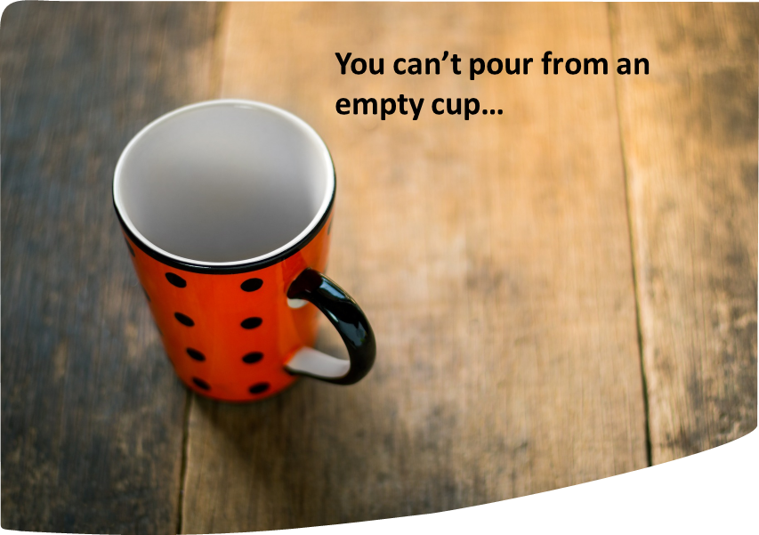
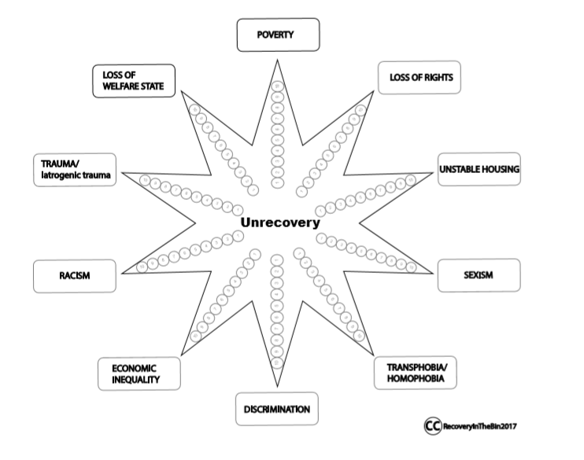
What do you remember about these pictures?
What do you remember about this day?

Slide 41
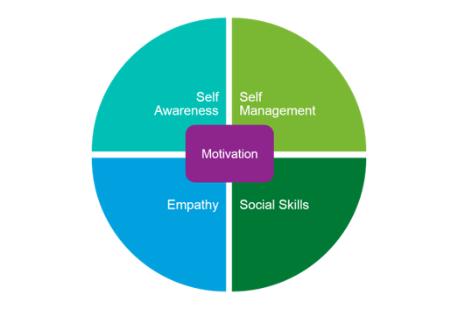
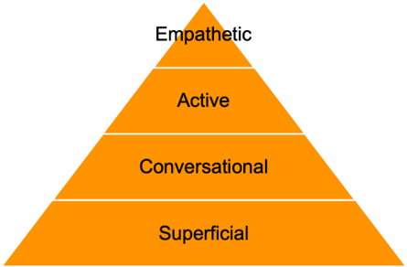
What do you remember about these pictures?
What do you remember about this day?
“…the ability to understand and manage your own emotions, and those of the people around you.”

Slide 42


What do you remember about these pictures?
What do you remember about this day?

Slide 43
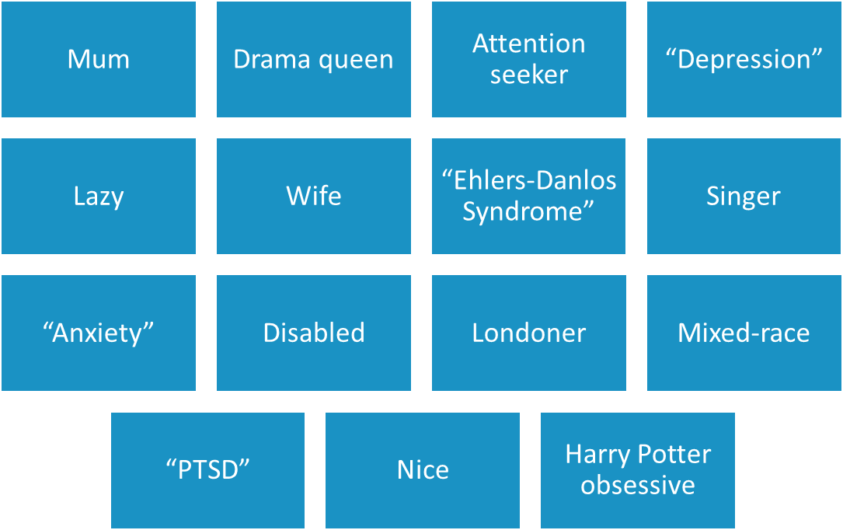
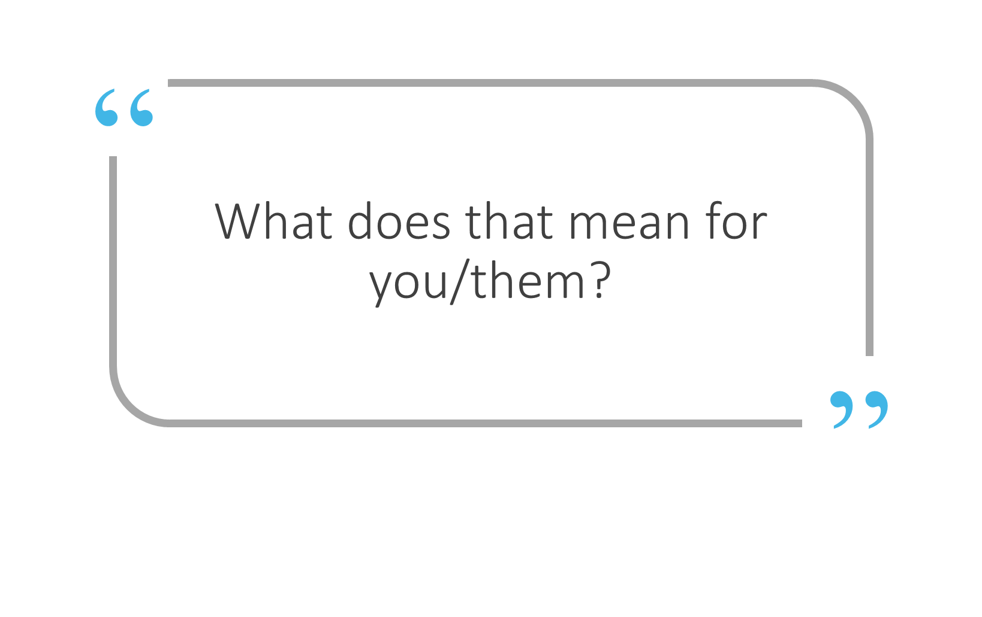
What do you remember about these pictures?
What do you remember about this day?
Listening
Understanding
Responding
Checking

Slide 44
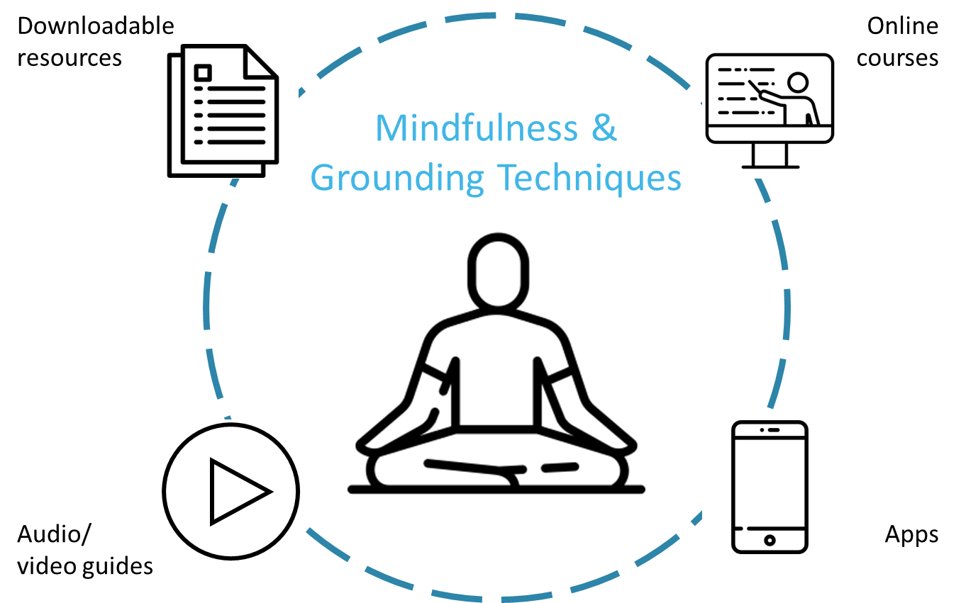
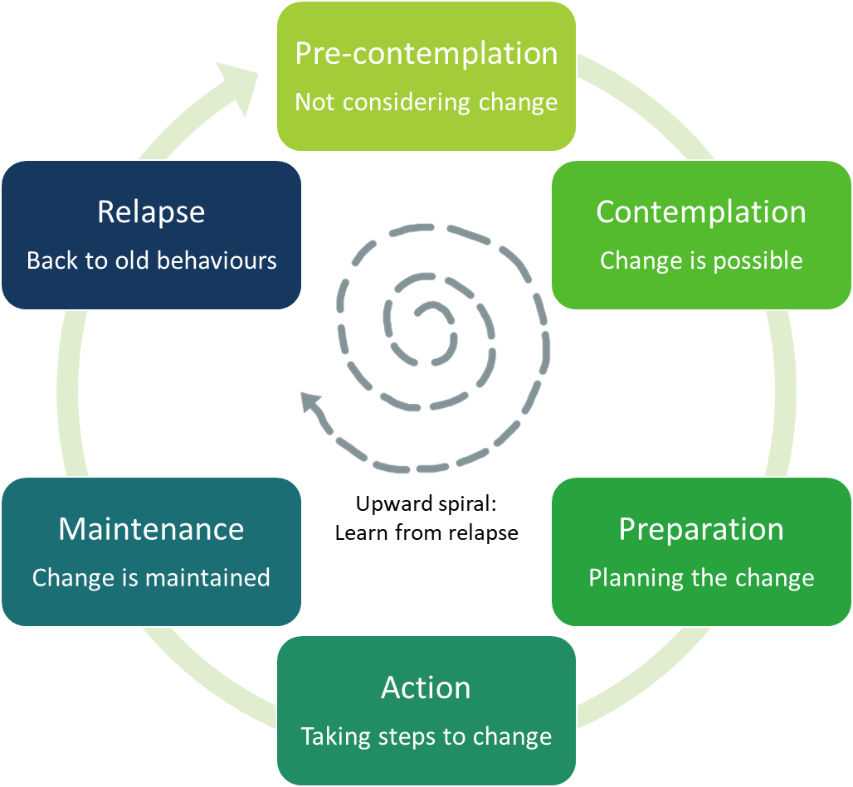
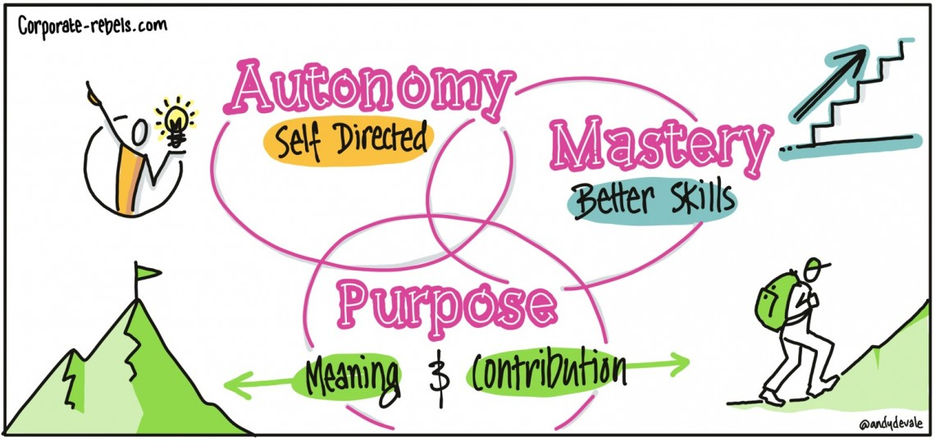
What do you remember about these pictures?
What do you remember about this day?

Slide 45
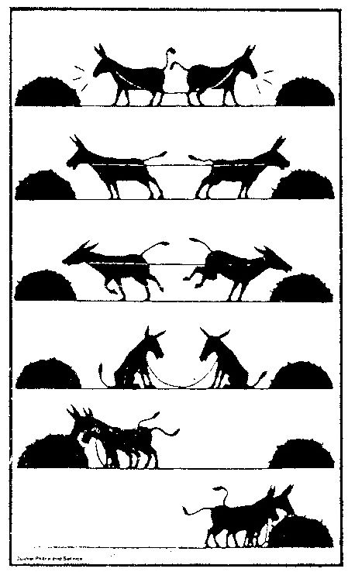
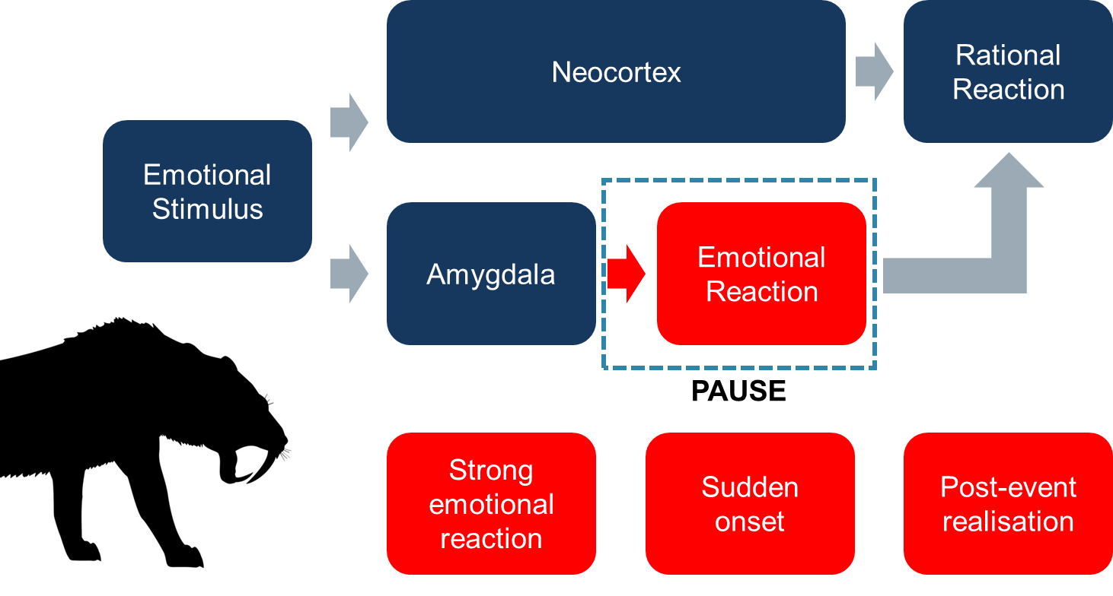
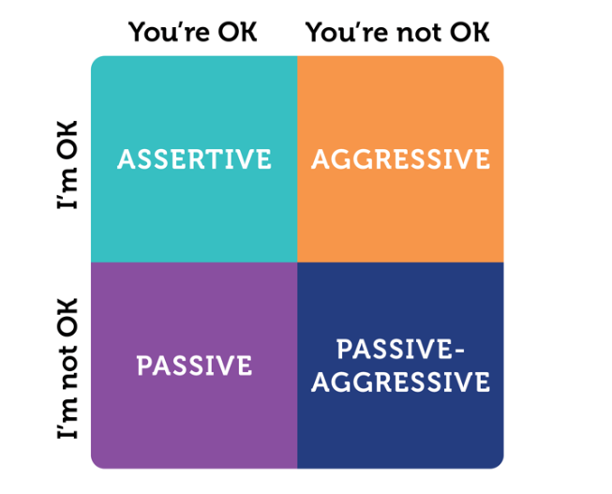
What do you remember about these pictures?
What do you remember about this day?

Slide 46
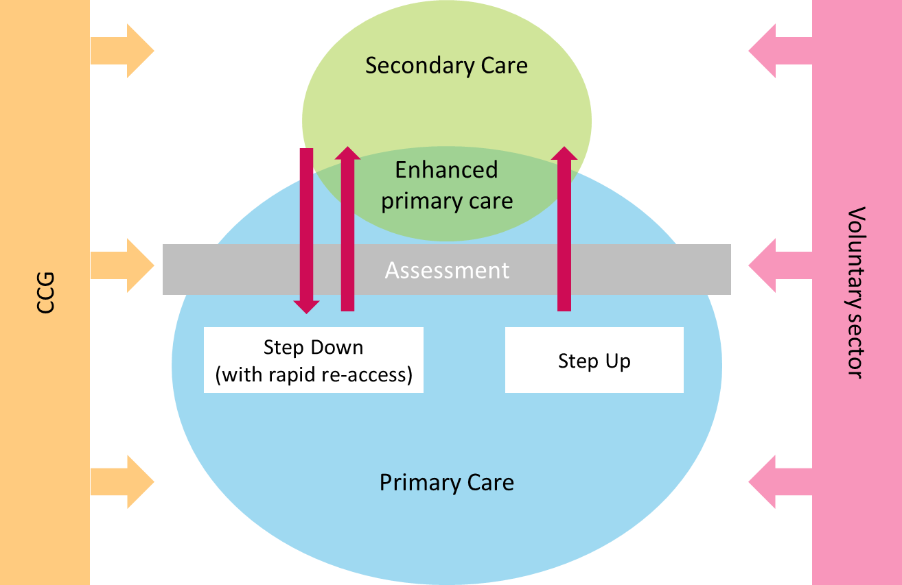
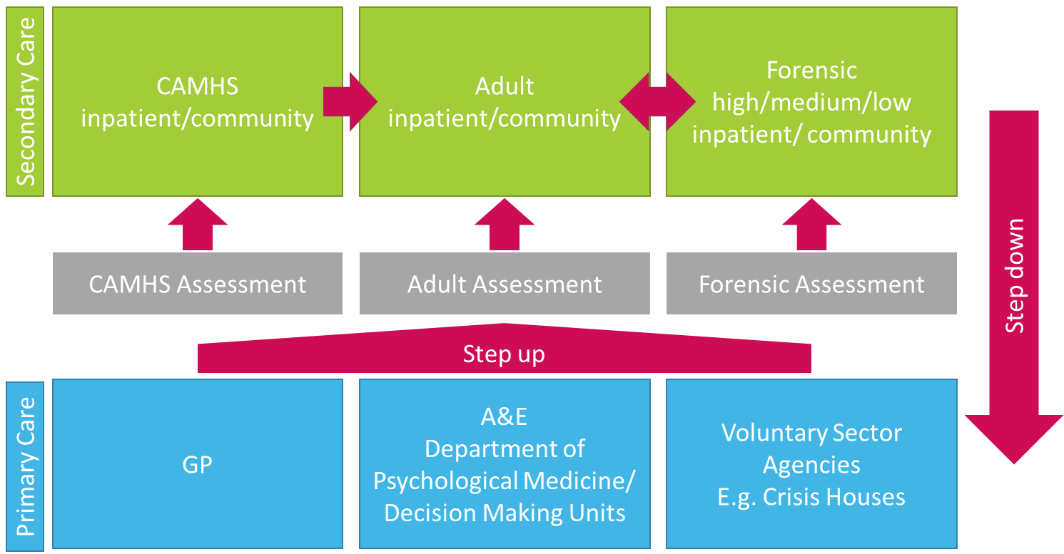
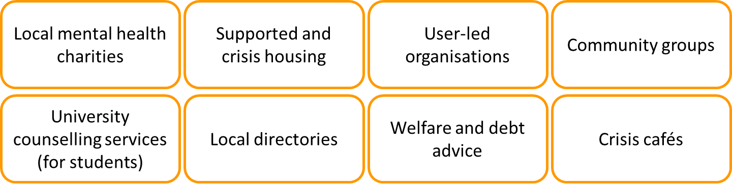
What do you remember about these pictures?
What do you remember about this day?

Slide 47
Shared action planning with buddies

Slide 48
For/about myself
For my work with clients
For my relationships with colleagues
What have I learned?
Reflect on what you have learned from the course through each of these lenses
What will I do?
Think about what action you will take (building on what you’ve done already), and when.

Slide 49
Buddy catch up
Share your action plan with your buddy.
Talk through any potential challenges or barriers to achieving your goals
Identify one key action that you would like to be held accountable for. Discuss how you might hold yourself to account for this action, and what your buddy might be able to do to support you.

Slide 50


