Slide 1
Preventing Cardiovascular Disease
in People with Atrial Fibrillation (AF)

Slide 2
Atrial Fibrillation and Cardiovascular Risk
Atrial fibrillation (AF) leads to a 5-fold increased risk in stroke and is responsible for 20% all strokes.
Anticoagulation reduces the risk of stroke by up to two thirds¹.
If not anticoagulated, 25% of people who experience an AF-related stroke will die and over 50% of people will be left with moderate to severe disability². Each stroke costs the NHS and social care over £45k over 5 years³.
For most people, the benefits of anticoagulation significantly outweigh the risks.
Many people with AF also have high blood pressure, high cholesterol, obesity or smoke. Addressing these factors is central to AF management in order to reduce the risk of heart attack, stroke, peripheral arterial disease, and dementia.
References: 1. Hart et al, 2007; 2. Stroke Association, 2018; 3. Xu et al, 2017;

Slide 3
CVDACTION – The AF Dashboard
CVDACTION is a case finding tool to improve care and outcomes for people who are at high risk of heart attack, stroke and other cardiovascular disease (CVD).
The CVDACTION Atrial Fibrillation (AF) dashboard groups patients into 3 domains – risk assessment and anticoagulation, anticoagulation monitoring, and management of broader CVD risk in people with AF.
Patients are stratified into cohorts to help prioritise, plan where to begin and spread clinical workload over time. For example, priority groups would include people with high-risk AF not on anticoagulants and people with AF and hypertension who also have suboptimally controlled blood pressure, and people with AF and CVD who are on suboptimal lipid lowering therapy.
You can also filter by ethnicity, deprivation, severe mental illness or learning disability to focus on specific populations and target health inequalities.
To deliver best care for patients and maximise capacity, consider two complementary interventions:
Clinical optimisation – delivered by nurse, pharmacist or GP, starting with those at greatest risk or highest priority
Broader, proactive care to optimise support for education, self-management and behaviour change. This can be provided by a member of the wider primary care team such as ARRS* roles (e.g. care coordinators) and healthcare assistants.
The UCLPartners Proactive Care Frameworks offer a wide range of free resources to help team members to deliver these interventions and optimise care.
*Additional Roles Reimbursement Scheme

Slide 4
Atrial Fibrillation:
Data To Inform Pathway Transformation
CVDACTION Atrial Fibrillation domains – Stratify & Prioritise
AF not risk assessed
High risk AF not on anticoagulant
Broader CVD risk management in AF
Clinical Optimisation
(eg pharmacist, nurse)
Holistic Proactive Care
(eg. ARRS* roles)
Optimise clinical management
Review blood results, risk scores & symptoms
Review complications and co-morbidities
Check adherence and adverse effects.
Initiate or optimise therapy
Address wider risk factors eg smoking, obesity
Structured support for:
Education e.g.
What is atrial fibrillation and cardiovascular risk
How to check and reduce cardiovascular risk
Self-management e.g.
Information on AF and anticoagulants
Shared decision making resources
How to check your blood pressure if you have AF
Behaviour Change – brief interventions and signposting
Healthy eating
Smoking cessation
Alcohol
Physical activity
*Additional Roles Reimbursement Scheme

Slide 5
CVDACTION – The AF Indicators
Anticoagulation in high-risk AF | Anticoagulation monitoring | CVD risk management in AF
AF high risk no anticoag: AF with CHA₂DS₂Vasc >1 (Male) or >2 (Female) not on anticoagulants | AF on warfarin | AF & HT(under 80) BP>140/90: AF & HT with latest BP>140/90 or home equivalent (under 80years)
AF no CHA₂DS₂Vasc: AF and not on anticoagulants with no CHA₂DS₂Vasc score last 12months | AF on DOAC no eGFR: AF on DOACS with no eGFR in last 12months | AF &HT (80 plus) BP>150/90: AF & HT with latest BP >150/90 or home equivalent (80years plus)
 |  | AF no BP recorded: AF and no BP recorded in last 12months
 |  | AF & CVD not on statin: AF & CVD not on lipid lowering therapy
 |  | AF & CVD not max statin: AF and CVD on statin but not high dose high intensity
 |  | AF & CVD high non-HDLc: AF & CVD on max statin therapy with non HDL>2.5mmol/L or no non HDL/LDL

Slide 6
Clinical Next Steps
Anticoagulation in AF
If not on anticoagulants, ensure annual CHA₂DS₂Vasc score
Personalise treatment to the individual considering frailty, co-morbidity and polypharmacy
Offer anticoagulation if CHA₂DS₂Vasc ≥1 if male or ≥ 2 if female
BP not treated to target in AF
Optimise therapy: check adherence and consider increasing dose or adding new drug
Personalise treatment to the individual considering frailty, co-morbidity and polypharmacy
Resources to support BP management including treatment pathways, home monitoring
Lipid management in AF– patients with pre-existing CVD
Ensure on high dose high intensity statin (ie atorvastatin 80mg or rosuvastatin 20mg) – or start statin if not already prescribed – and support lifestyle change
If non-HDLc not reduced to target or statin not tolerated, consider ezetimibe, inclisiran, PCSK9i(mab) or bempedoic acid
Resources to support lipid management including treatment pathways, statin intolerance or hesitancy
AF Case finder
The case finder identifies patients not on the AF register whose records suggest they may have uncoded AF: arrange clinical review and 12 lead ECG.
Supporting education, self-management and behaviour change
Resources to support staff helping patients with AF to understand their conditions, to self-manage and to make lifestyle changes

Slide 7
Pathways and Resources
Initiating Direct Oral Anticoagulants (DOACs)
Assessing stroke and bleeding risk
DOACs: Calculating creatinine clearance
DOACs: Dosing in non-valvular atrial fibrillation
DOACs: Reviewing condition management
DOACs: Considerations
Anticoagulation in people taking antiplatelet therapy
Warfarin: Time in therapeutic range (TTR) monitoring
Warfarin to DOAC switching
DOAC to DOAC switching

Slide 8
Initiating Direct Oral Anticoagulants (DOACs)*
Action
Resource
1
Check the patient has Non-Valvular AF (NVAF) and has no other contraindications to therapy
DOAC contraindicated if mechanical prosthetic valve or known moderate to severe mitral stenosis
DOAC contraindicated if pre-existing clotting disorder, such antiphospholipid syndrome (APS) pregnant, breastfeeding or planning pregnancy, mechanical heart valves – seek specialist advice.
For full list of contraindications see SmPCs at www.medicines.org.uk
2
Check CHA₂DS₂VASc
Offer anticoagulation if CHA₂DS₂VASc ≥ 2 (consider if = 1 in men)
3
Check:
Bloods for renal function, LFTs, clotting and FBC
Bodyweight
Creatinine Clearance (CrCl)
Creatinine clearance calculation
Dabigatran contraindicated if CrCl < 30ml/min
Apixaban, Edoxaban, Rivaroxaban, are not recommended if CrCl < 15ml/min
4
Check bleeding risk with HASBLED score or ORBIT score, in line with local guidance
Address modifiable risks identified by HASBLED or ORBIT score to reduce bleeding risk. Review other medication – including antiplatelets and NSAIDs; consider PPIs
5
Shared Decision Making (SDM) - agree which DOAC to initiate. Correct choice of dose
DOAC dosing
6
Counsel patient and agree a plan for follow up including monitoring blood tests
DOAC monitoring
Provide written information, an anticoagulant alert card and point of contact should issues arise
*NICE guidance 2021 recommends DOACs first line. If DOAC is unsuitable, consider warfarin following local pathways for initiation & monitoring

Slide 9
Stroke Risk Assessment
Stroke Risk
CHA₂DS₂VASc
Congestive Heart failure | 1
Hypertension | 1
Age >75 years | 2
Diabetes | 1
Prior stroke/TIA | 2
Vascular disease | 1
Age 65-74 years | 1
Female | 1
CHA₂DS₂VASc Score | Number of AF-related strokes avoided per 1,000 AF patients treated with anticoagulant therapy per year*
1 | 4
2 | 17
3 | 25
4 | 38
5 | 57
Interpretation
Offer anticoagulation to all patients (male or female) with CHA₂DS₂VASc ≥ 2
Consider anticoagulation in all men with CHA₂DS₂VASc = 1
Antiplatelet monotherapy (Aspirin/Clopidogrel) is not recommended for stroke prevention in AF
*Tables adapted from Y Javaid

Slide 10
Bleeding Risk Assessment
Bleeding Risk (HASBLED)
Bleeding Risk - ORBIT
HASBLED Score
Uncontrolled hypertension (systolic >160mmHg) | 1
Abnormal liver function (Bili >2x ULN or AST/ALT/ALP >3x ULN | 1
Abnormal renal function (Creat>200µmol/L, dialysis, transplant) | 1
Prior stroke/TIA | 1
History of major bleed or predisposition (anaemia) | 1
Labile INR (on warfarin (TTR<60%) | 1
Age >65 years | 1
Medication usage predisposing to bleeding (Antiplatelets/ NSAIDS) | 1
Alcohol ( >8units/week) | 1
HASBLED Score | Number of major bleeds caused per 1,000 AF patients treated with anticoagulant therapy per year*
1 | 4
2 | 12
3 | 15
4 | 21
ORBIT Score**
Haemoglobin <13 mg/dL for males and <12 mg/dL for females, or haematocrit <40% for males and <36% for females | 2
Age >74 years | 1
Bleeding history - Any history of GI bleeding, intracranial bleeding, or haemorrhagic stroke | 2
GFR <60 mL/min/1.73 m2 | 1
Treatment with antiplatelet agents | 1
ORBIT Score | Risk level | Number of major bleeds caused per 1,000 AF patients treated with anticoagulant therapy per year
0-2 | Low | 24
3 | Medium | 47
4-7 | High | 81
**NICE 2021 indicated that ORBIT is the best tool for bleeding risk assessment, other tools may need to be used until it is embedded in clinical pathways and electronic systems
Interpretation
HASBLED ≥3 indicates a higher bleeding risk
Address modifiable bleeding risk factors to reduce HASBLED score e.g. lower BP, review concomitant drug therapy, reduce alcohol intake
Consider a proton pump inhibitor to reduce upper GI bleeding
https://www.mdcalc.com/has-bled-score-major-bleeding-risk
Interpretation
Address modifiable bleeding risk factors to reduce bleeding risk e.g. lower BP, review concomitant drug therapy, reduce alcohol intake
Consider a proton pump inhibitor to reduce upper GI bleeding
https://www.mdcalc.com/orbit-bleeding-risk-score-atrial-fibrillation
*Tables adapted from Y Javaid *** European Heart Journal, Volume 36, Issue 46, 7 December 2015, Pages 3258–3264, https://doi.org/10.1093/eurheartj/ehv476

Slide 11
DOACs: Calculating Creatinine Clearance
eGFR should not be used to guide dosing decisions for DOACs¹
Use actual bodyweight (within 1 year) to calculate Creatinine Clearance (CrCl)
If weight < 50kg or > 120kg or if BMI >40 : seek specialist advice
Use renal function checked within last 3 months
Calculate CrCl using Cockcroft Gault equation
Be cautious with calculators integrated into GP IT systems as they may default to ideal bodyweight resulting in underdosing of DOAC
Use MDCalc
Creatinine Clearance | Monitoring interval
>60ml/min | Annually
30-60ml/min | 6-monthly
<30ml/min | 3-monthly
Adjust DOAC dose if necessary
See slide on DOAC dosing in NVAF
1. https://bmjopen.bmj.com/content/3/9/e003343

Slide 12
DOACs: Dosing in Non-Valvular AF
 | Apixaban* | Dabigatran* | Edoxaban* | Rivaroxaban*
Standard dose | 5mg BD | 150mg BD | 60mg OD | 20mg OD
Reduced dose | 2.5mg BD | 110mg BD | 30mg OD | 15mg OD
Criteria for dose reduction | 2 or more of: Age ≥80 Body weight ≤60kg Cr ≥133μmol/L Or CrCl 15-29ml/min | 1. Age≥80 2. On verapamil 3. Consider ↓dose: Reflux/gastritis Age75-80 CrCl 30-50ml/min “Bleed risk” | 1 or more of: CrCl 15-50ml/min Body weight ≤60kg On ciclosporin, dronedarone, erythromycin, ketoconazole | CrCl 15-49ml/min
Contraindicated / Not recommended | CrCl <15ml/min | CrCl <30ml/min | CrCl <15ml/min | CrCl <15ml/min
Check for common drug interactions & possible contraindications | Bleeding risk increased by
Antifungal agents | NSAIDs
Rifampicin | Antiplatelets
Phenytoin and anti-epileptics | Long term oral steroid use
Antiretrovirals | Antidepressants: SSRIs/SNRIs
Chemotherapy
* SmPCs all available at www.medicines.org.uk;

Slide 13
DOACs: Reviewing Management
This review template is designed for review 1 month after initiation and according to the monitoring interval
Eligibility | Monitoring interval | Parameter
All patients on DOAC | Annually | FBC, Renal & Liver function (calculate CrCl, weight)
CrCl 30–60 mL/min | 6 monthly | Renal function
Patients over 75 years and / or frail | 6 monthly | FBC, Renal & Liver function, weight
CrCl 15–30 mL/ml | 3 monthly | Renal function
Other e.g. intercurrent illness that may impact on renal or hepatic function | Individually agreed | Renal & Liver function +/- FBC
Annual clinical review* to include:
Stroke risk assessment using CHA₂DS₂VASc
Review of QRISK and manage CVD risk factors including BP and lipids
Address bleeding risk
Check adherence
Medicines review and check appropriate dosing
Missed/delayed dose advice
Alert card check
Alternatively, NICE CKS recommends that where CrCl < 60ml/min, monitoring frequency should be guided by the CrCl divided by 10. For example, every 3 months if CrCl is 30 mL/minute.
https://cks.nice.org.uk/topics/anticoagulation-oral/management/edoxaban/
* Follow local DOAC clinical review protocols where available

Slide 14
DOACs: Considerations
Consideration | Option | Most suitable DOAC
Frequency of tablets/capsules | One tablet once a day | Edoxaban/rivaroxaban
 | One tablet or capsule twice a day | Apixaban/dabigatran
With or without food | Take with or without food | Apixaban/dabigatran/edoxaban
 | Take with food | Rivaroxaban
Use of a compliance aid (dosette box) | Suitable to go in compliance aid (Cannot use dabigatran in dosette box) | Apixaban/edoxaban/rivaroxaban
Swallowing difficulties or feeding tube | CAN be crushed | Apixaban/edoxaban/rivaroxaban
 | Capsules CANNOT be opened | Dabigatran
Lactose intolerant patient |  | Dabigatran/edoxaban

Slide 15
Anticoagulation in People Taking Antiplatelet Therapy
Antiplatelet therapy is not recommended for stroke prevention in AF; oral anticoagulants should be used.
Some patients with AF are on antiplatelet therapy as treatment for vascular disease. See guidance below
Indication for antiplatelets | Antiplatelet | Action when initiating anticoagulation for AF
Primary prevention of CVD | Antiplatelet monotherapy | Stop antiplatelet therapy (antiplatelet therapy not recommended for primary prevention of CVD)
Secondary prevention of CVD Stroke / Transient Ischaemic Attack (TIA) Stable coronary heart disease (CHD) Peripheral arterial disease (PAD) | Antiplatelet monotherapy or Low dose rivaroxaban with aspirin | Stop antiplatelet therapy Increase DOAC dose (to AF stroke prevention dose) and stop aspirin
Patients within 12 months of an ACS or stent placement (cardiac or vascular) | Aspirin plus clopidogrel, ticagrelor or prasugrel | Seek specialist advice to agree the preferred drug regimen. Triple therapy (dual antiplatelet plus anticoagulant) duration must be clearly defined.
Patients more than 12 months after an ACS or stent placement (cardiac or other vascular) | Antiplatelet monotherapy / dual antiplatelet therapy If discharge summary indicates dual antiplatelet required long-term | Stop antiplatelet therapy, unless otherwise advised by specialist (check discharge summary) Seek specialist advice – do not initiate triple therapy without advice
When using an anticoagulant plus an antiplatelet – add a proton pump inhibitor (PPI)
Adapted from: https://b-s-h.org.uk/guidelines/guidelines/oral-anticoagulation-with-warfarin-4th-edition/ Page 318-319
and https://www.escardio.org/Guidelines/Clinical-Practice-Guidelines/Atrial-Fibrillation-Management Page 61

Slide 16
Warfarin: Time in Therapeutic Range (TTR) monitoring
For effective stroke prevention with warfarin, time in therapeutic range (TTR) should be maintained ≥ 65%
INR should be checked at least 12 weekly in patients with stable INR – target INR in AF is 2.5 (range 2-3)
All patients should have TTR calculated at each INR visit
Reassess anticoagulation if poor control as shown by:
2 INR values > 5 or 1 INR value > 8 within the past 6 months
2 INR values < 1.5 within the past 6 months
TTR less than 65%
If possible, address modifiable factors that may contribute to poor control:
Adherence, illness, interacting drugs, diet and alcohol consumption
NICE guidance recommends that patients prescribed warfarin for stroke prevention in AF should be considered for a swich to DOAC. Switching to a DOAC should be discussed with patients who are stable on warfarin at their next routine review, taking into account their time in therapeutic range.

Slide 17
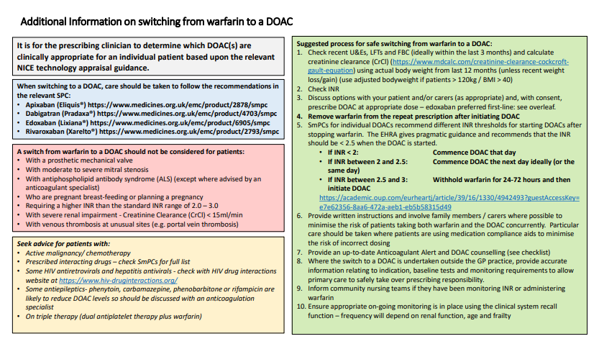
Warfarin to DOAC Switching
1
Confirm the indication for warfarin is stroke prevention in AF
2
Exclude patients with contraindications to DOACs
3
Involve the patient in a shared decision to switch from warfarin to a DOAC
4
Check bodyweight and bloods for INR, renal function, LFTs, and FBC
5
Calculate CrCl using Cockcroft Gault equation
6
Decide which DOAC to use and what dose
7
Advise patient when to stop the warfarin and start the DOAC:
INR should be <2.5 before initiating DOAC
DOAC may need to be withheld or 24-48 hours after stopping warfarin depending on the measured INR
8
Provide written information, an anticoagulant alert card and ensure they have a point of contact should issues arise
https://pccsuk.org/2020/en/page/resources-page

Slide 18
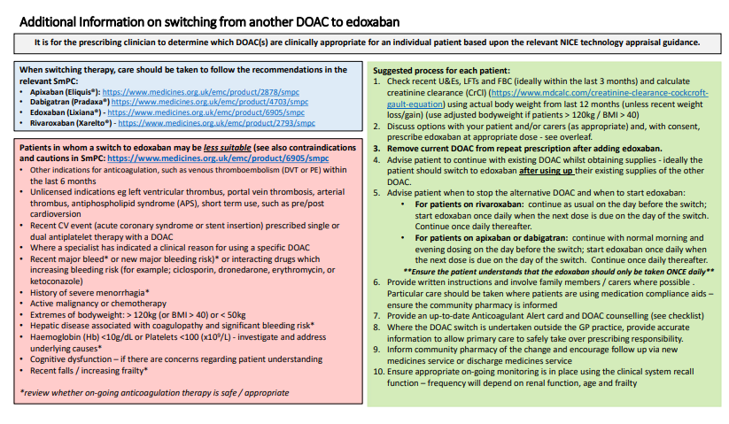
DOAC to DOAC Switching
1
Confirm the indication for DOAC is stroke prevention in AF
2
Identify any reasons why a switch to an alternate DOAC may not be suitable e.g, specific contraindications or cautions etc
3
Involve the patient in a shared decision to switch to an alternative DOAC
4
Check bodyweight and bloods for INR, renal function, LFTs, and FBC
5
Calculate CrCl using Cockcroft Gault equation
6
Decide which DOAC to use and what dose
7
Advise patient when to stop the existing DOAC and to start the alternative DOAC:
Continue existing DOAC as normal on day before the switch
Initiate alternative DOAC when next dose is due on day of switch.
Ensure patient understands if dosing is once or twice daily, depending on DOAC
8
Provide written information, an anticoagulant alert card and ensure they have a point of contact should issues arise
https://pccsuk.org/2020/en/page/resources-page

Slide 19
Management of Broader Cardiovascular Risk in AF: Cholesterol and Hypertension

Slide 20
Lipid Optimisation Pathway for Secondary Prevention¹
Is the patient on high dose, high intensity statin³?
(atorvastatin 80mg daily or rosuvastatin 20mg daily)
Check fasting triglyceride levels & manage according to national guidance.
Lipid lowering therapies should be offered to all patients
with established CVD¹
Yes
No
NICE NG238: Cardiovascular disease: risk assessment and reduction, including lipid modification
Dose may be limited, for example if:
CKD: eGFR<60ml/min – recommended starting dose - atorvastatin 20mg
Drug interactions
Drug intolerance
Older age / frailty / end of life
See statin intensity table.
Use shared-decision making and incorporate patient preference in treatment and care decisions.
NICE Guidance: Evolocumab, Alirocumab
Initiate / increase to high dose high intensity statin^{2,3,4} if possible
and re-enforce lifestyle and diet measures
Review within 2 to 3 months
Is LDL-chol ≤ 2mmol/L or non-HDL ≤ 2.6mmol/L?¹
At any point consider iscosapent ethyl in addition to statins +/- other lipid lowering therapies, if fasting
triglycerides ≥1.7 mmol/L AND LDL > 1.04 mmol/L and ≤2.6 mmol/L
No
Yes
Check adherence to statin and lifestyle¹
Consider intensifying therapy⁴
Consider adding ezetimibe⁴ 10mg daily to maximum tolerated statin to reduce CV risk, even where the lipid target has been achieved.¹
Consider ezetimibe 10mg daily.
Reassess within three months.
Assess eligibility for injectable therapies:
Inclisiran - if LDL-C ≥ 2.6mmol/L
OR
PCSK9i (mAB)⁵ if LDL-C > 4mmol/L (or > 3.5mmol/L if FH or recurrent CV events)
If statin intolerant – offer ezetimibe. Reassess within 2 to 3 months and, if not achieving target, consider bempedoic acid and injectable therapies in line with eligibility criteria.¹
Monitoring statin therapy
Initiation | Full lipid profile, LFTs
Within 3 months | Lipid profile, LFTs
Annually | Full lipid profile , LFTS (first year only)
Review annually, assessing treatment to target, adherence to drugs and offering support for diet and lifestyle measures

Slide 21
Optimisation Pathway for Patients with High Cardiovascular Risk – Primary Prevention^{1,2}
Review and re-enforce lifestyle and diet measures
Primary prevention should be offered to all patients with a QRisk ≥ 10%
after addressing lifestyle modification
(It may also be considered in individuals with QRIsk < 10% )¹
Is patient on high intensity statin? (atorvastatin 20mg or equivalent)
No
Yes
Initiate atorvastatin 20mg/day^{3,4}
Optimal High Intensity Statin for Primary Prevention
Atorvastatin | 20mg
Rosuvastatin | 10mg
After 3 months - has non-HDL-C reduced by 40% or more from baseline?¹
No
Check adherence and lifestyle measures
NICE NG238: Cardiovascular disease: risk assessment and reduction, including lipid modification
High cardiovascular risk:​
QRisk >10% in ten years​
CKD 3-5​
Type 1 Diabetes for >10 years or over age 40
See statin intensity table.
Use shared-decision making and incorporate patient preference in treatment and care decisions.
Consider titrating statin up to atorvastatin 80mg or equivalent taking into account
patient preferences, co-morbidities, polypharmacy, frailty and life expectancy^{3,4}
If statin intolerant – offer ezetimibe. Reassess within three months and, if not achieving target, consider bempedoic acid¹
Yes
If non-HDL cholesterol has not fallen by 40% or more from baseline, consider adding ezetimibe 10mg daily⁴
Review annually, assessing adherence to drugs, diet and lifestyle

Slide 22
Measuring Blood Pressure in People with Atrial Fibrillation
Blood pressure should be checked regularly in people with AF to identify undiagnosed hypertension or suboptimally treated BP. If hypertension is suspected, the diagnosis should be confirmed using ABPM or home BP checks over 7 days.
Single BP readings in people with AF may not be correct. It is recommended to take multiple readings and average. E.g.
Submit 2 BP readings each morning and evening over 4 days. Calculate the average systolic and diastolic values.

Slide 23
Medicines Optimisation: NICE Hypertension Treatment Pathway (NG136)
Hypertension with type 2 diabetes
Hypertension without type 2 diabetes
Use clinical judgement for people with frailty or multimorbidity
Offer lifestyle advice and continue to offer it periodically
Monitoring treatment
Use clinic BP to monitor treatment
Measure standing and sitting BP in people with:
Type 2 diabetes or
Symptoms of postural hypotension or
Aged 80 and over
Advice people who want to self monitor to use HBPM. Provide training and advice
Consider AMPM or HBPM, in addition to clinic BP, for people with white-coat effect or masked hypertension
Age <55 and not of black African or African- Caribbean family origin
Age 55 or over
Black African or African- Caribbean family origin (any age)
Step 1
ACEi or ARB
CCB
ACEi or ARB
+
CCB or thiazide-like diuretic
CCB
+
ACEi or ARB or thiazide-like diuretic
Step 2
BP targets
Reduce and maintain BP to the following targets:
Age <80 years:
Clinic BP <140/90 mmHg
ABPM/HBPM <135/85mmHg
Postural hypotension:
Base target on standing BP
Frailty or multimorbidity:
Use clinical judgement
ACEi or ARB + CCB + thiazide-like diuretic
Step 3
Confirm resistant hypertension: confirm elevated BP with ABPM or HBPM, check for postural hypertension and discuss adherence
Consider seeking expert advice or adding a:
Low-dose spironolactone if blood potassium level is ≤ 4.5 mmol/l
Alpha-blocker or beta-blocker if blood potassium level is >4.5 mmol/l
Seek expert advice if BP is uncontrolled on optimal tolerated doses of 4 drugs
Step 4
Pathway adapted from NICE Guidelines (NG136) Visual Summary https://www.nice.org.uk/guidance/ng136/resources/visual-summary-pdf-6899919517
Abbreviations: ACEi: ACE inhibitor, ARB: Angiotensin II Receptor Blocker, CCB: Calcium Channel Blocker, ABPM: Ambulatory Blood Pressure Monitoring, HBPM: Home Blood Pressure Monitoring

Slide 24
Proactive Care Consultations
Structured support for education, self-management and behaviour change

Slide 25
Proactive Care Consultations
Members of the wider primary care team (e.g. ARRS* roles such as health care assistants and care coordinators) can provide structured support for education, self-management and behaviour change, sharing trusted information from charity and other websites. The UCLPartners Proactive Care Frameworks include education and training resources to support these consultations and educational digital resources to share with patients.
Education e.g.
What is atrial fibrillation
What is cardiovascular risk
Anticoagulant treatment to prevent stroke
Self-management e.g.
How to check your blood pressure if you have AF
How to choose a blood pressure monitor
When to seek advice
Behaviour Change – brief interventions and signposting.
Healthy eating
Physical activity
Smoking cessation
Alcohol
*Additional Roles Reimbursement Scheme

Slide 26
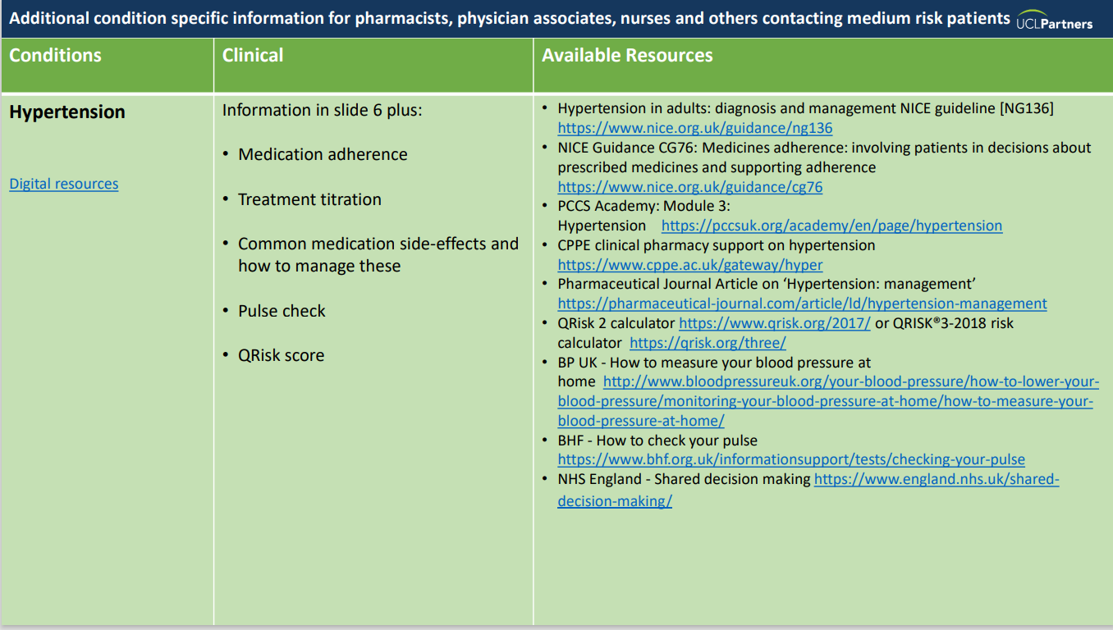
Resources to Support Proactive Care Consultations
Education and training resources:
Recommended training slides
Proactive Care Consultations Guide
Motivational interviewing

Slide 27
Education AF causes, symptoms and treatments What is an arrhythmia Anticoagulant medication videos Starting anticoagulation with Jack video AF Association resources for patients
Self-management How to check your pulse How to check your blood pressure using a blood pressure machine (video) Manage your blood pressure at home How to choose a blood pressure monitor Behaviour Change
Eat well Healthy eating guide Get active Get active indoors Ways to move Quit smoking Drink Less
Resources for Patients

Slide 28
Version tracker
Version | Edition | Changes Made | Date amended | Review due
2 | 2.0 | Updated lipid opimisation pathways | Jan 2024 | Dec 2024
2 | 2.1 | Updated CVD ACTION logo and slide template | March 2025 | March 2026

Slide 29
Thank you
Sign up to our monthly newsletter to receive the latest news, opportunities and events from UCLPartners
UCLPartners.com/newsletter
www.uclpartners.com
@uclpartners
linkedin/company/uclpartners
CVDACTION@uclpartners.com

