Slide 1
Preventing Cardiovascular Disease in People with Diabetes

Slide 2
Diabetes and Cardiovascular Risk
Cardiovascular disease (CVD) is the leading cause of death in people with diabetes.¹
In the UK one in three of adults with diabetes die from a heart or circulatory disease.²
Adults with Diabetes are 2-3 times more likely to develop heart and circulatory disease and nearly twice as likely to die from heart disease or stroke compared to adults without diabetes.^{2,3}
It is estimated 700,000 adults are living in the UK with undiagnosed diabetes.⁴
Optimising BP and lipids as well as blood sugar is very effective at preventing the cardiovascular complications of diabetes
BMJ Best Practice: Diabetic Cardiovascular Disease (2022); https://bestpractice.bmj.com/topics/en-gb/533
The Lancet: Diabetes mellitus, fasting blood glucose concentration, and risk of vascular disease: a collaborative meta-analysis of 102 prospective studies (2010); https://www.thelancet.com/journals/lancet/article/PIIS0140-6736(10)60484-9/fulltext
NHS Digital: National Diabetes Audit - Report 2 Complications and Mortality, 2017-18; https://digital.nhs.uk/data-and-information/publications/statistical/national-diabetes-audit/report-2--complications-and-mortality-2017-18
Diabetes UK: Diabetes Statistics; https://www.diabetes.org.uk/professionals/position-statements-reports/statistics

Slide 3
CVDACTION – The Diabetes Dashboard
CVDACTION is a case finding tool to improve care and outcomes for people who are at high risk of heart attack, stroke and other cardiovascular disease (CVD).
The CVDACTION Diabetes dashboard groups patients into 4 domains – Diabetes treatment to target (blood pressure and HbA1c), broader cardiovascular risk management (lipid lowering therapy and SGLT2 inhibitors), Diabetic Kidney Disease, and Diabetes Care Processes. There is also a case finder for undiagnosed diabetes.
Patients are stratified into cohorts to help prioritise, plan where to begin and spread clinical workload over time. For example, priority groups would include people with the diabetes and high blood pressure or people with Diabetes and CVD but not on lipid lowering therapy.
You can also filter by ethnicity, deprivation, severe mental illness or learning disability to focus on specific populations and target health inequalities.
To deliver best care for patients and maximise capacity, consider two complementary interventions:
Clinical optimisation – delivered by nurse, pharmacist or GP, starting with those at greatest risk or highest priority
Broader, proactive care to optimise support for education, self management and behaviour change. This can be provided by a member of the wider primary care team such as ARRS* roles such as healthcare assistants and care coordinators.
The UCLPartners Proactive Care Frameworks offer a wide range of free resources to help team members to deliver these interventions and optimise care.
*Additional Role Reimbursement Scheme

Slide 4
Diabetes:
Data to inform pathway transformation
CVDACTION Diabetes domains – Stratify & Prioritise
BP not treated
to target
CVD risk reduction: lipids and SGLT2i
HbA1c not treated
to target
Diabetic kidney disease
Clinical Optimisation
(eg pharmacist, nurse)
Holistic Proactive Care
(eg. ARRS roles)
Optimise clinical management
Review blood results, CVD risk & symptoms
Review complications and co-morbidities
Check adherence and adverse effects.
Initiate or optimise therapy
Address wider risk factors eg smoking, obesity
Structured support for:
Education e.g.
Living with diabetes
How to check and reduce cardiovascular risk?
Self-management e.g.
What health checks are needed
How to check your feet, measure your BP
When to seek advice
Behaviour Change – brief interventions and signposting
Healthy eating & Physical activity
Smoking cessation/Alcohol
ARRS = Additional Role Reimbursement Scheme

Slide 5
CVDACTION- The Diabetes Indicators
Diabetes Treatment to target | Diabetes all 8 care Processes | Diabetic Kidney Disease | CVD Risk Management in Diabetes
DM (no Frailty) HBA1c >58: DM without moderate or severe frailty and HbA1c >58 | Diabetes all 8 care processes not complete in last 12 m: DM without all 8 processes of care completed in last 12m | DM no EGFR or ACR: DM with no eGFR or ACR in last 12m | DM and CVD not on statins: DM with CVD not on lipid lowering therapy
DM (Frailty) HBA1c > 75: DM with moderate or severe frailty and HbA1c >75 | Diabetes with no Hba1C in last year: DM and no HbA1c recorded in last year | DM and CKD with 25% fall In EGFR in 12m: DM with CKD with >25% fall in eGFR in 12 months (accelerated progression, dashboard only) | DM and CVD not on high dose high intensity statin: DM with CVD on statin but not high dose high intensity
DM and HT – BP (under 80) >140/90: DM with HT with latest BP>140/90 or Home equivalent (under 80y) |  | DM and ACR >3 not on ACE/ARB: DM with ACR>3 not on an ACE/ARB | T2DM and CVD not on SGLT2i: T2DM with CVD or heart failure and not on SGLT2 inhibitor
DM and HTN – BP (80 plus) 150/90: DM with HT with latest BP >150/90 or Home equivalent (80y or over) |  | DM and last 2 eGFR <60, no CKD code: DM without coded CKD with 2 latest eGFR <60 | T2DM and QRisk >10% or CKD not on high intensity statin: T2DM with QRISK>10% or CKD not on high intensity statin
T1DM and HTN and ACR <3, BP >135: T1DM with hypertension with ACR<3 and BP >=135/85
T1DM and HTN and ACR >3, BP >130: T1DM with hypertension with ACR >=3 and BP >=130/80

Slide 6
Clinical Next Steps
HBA1c, Blood Pressure and ACR not treated to target
Optimise therapy: check adherence and consider increasing dose or adding new drug
Personalise treatment to the individual considering frailty, co-morbidity and polypharmacy
2. CVD risk management in Diabetes – patients with pre-existing CVD
Ensure on high dose high intensity statin (e.g. atorvastatin 80mg or rosuvastatin 20mg) – or start statin if not already prescribed – and support lifestyle change
If non-HDLc not reduced to target or statin not tolerated, consider ezetimibe, Inclisiran, PCSK9i(mab) or Bempedoic acid
If Type 2 diabetes with CVD or heart failure, offer an SGLT2 inhibitor
3. CVD risk management in Diabetes – patients without pre-existing CVD
Record up to date QRisk score and support lifestyle change
If QRisk score ≥10% (or if CKD or T1 diabetes aged 40 plus), ensure on high intensity statin (eg atorvastatin 20mg) or start if lifestyle change alone is not effective
If non-HDLc not reduced to target, (or if statin not tolerated) titrate statin dose and consider ezetimibe or bempedoic acid
Consider SGLT2 if QRisk score ≥10%
4. Diabetic kidney disease
Initiate ACEi/ARB where indicated and titrate to maximal tolerated dose
If CKD and diabetes, consider preferential an SGLT2 inhibitor in addition to ACE/ARB as indicated by ACR level (see CKD Dashboard)
Consider urgent referral if accelerated decline in eGFR (<25% in one year)
CKD Case finder- review and code patients with EGFR <60 (two consecutive). Manage as per CKD in diabetes
5. Diabetes care Processes not complete
Invite for review of care processes
6. Diabetes case finder
The case finder identifies patients not on the diabetes register whose last HbA1c >48. Obtain up to date HbA1c and arrange review
7. Supporting education, self management and behaviour change
Resources to support staff helping patients with diabetes to understand their conditions, to self manage and to make lifestyle changes

Slide 7
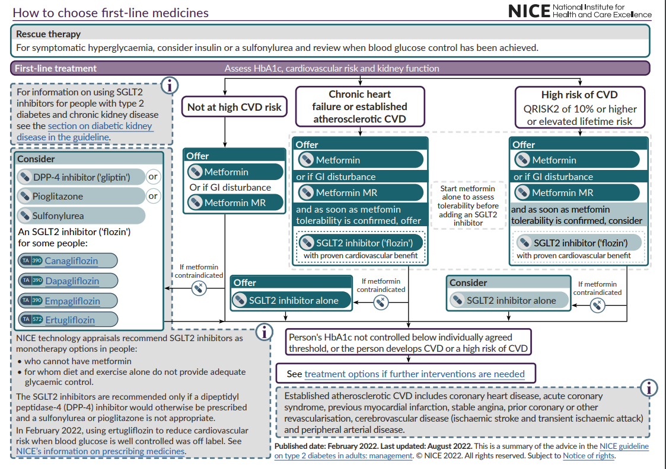

Slide 8
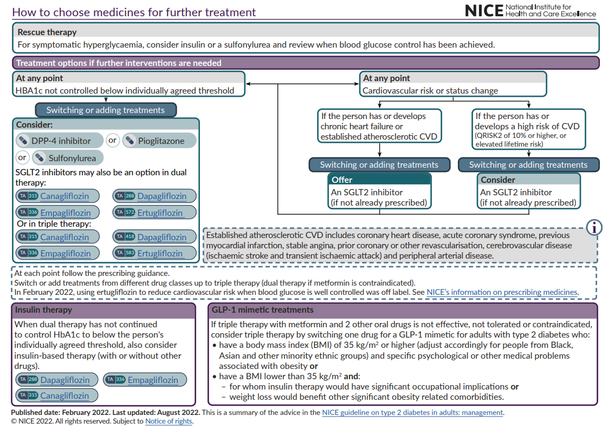

Slide 9
NICE Hypertension Treatment Pathway (NG136)
Hypertension with type 2 diabetes
Hypertension without type 2 diabetes
Use clinical judgement for people with frailty or multimorbidity
Offer lifestyle advice and continue to offer it periodically
Monitoring treatment
Use clinic BP to monitor treatment
Measure standing and sitting BP in people with:
Type 2 diabetes or
Symptoms of postural hypotension or
Aged 80 and over
Advice people who want to self monitor to use HBPM. Provide training and advice
Consider AMPM or HBPM, in addition to clinic BP, for people with white-coat effect or masked hypertension
Age <55 and not of black African or African- Caribbean family origin
Age 55 or over
Black African or African- Caribbean family origin (any age)
Step 1
ACEi or ARB
CCB
ACEi or ARB
+
CCB or thiazide-like diuretic
CCB
+
ACEi or ARB or thiazide-like diuretic
BP targets
Reduce and maintain BP to the following targets:
Age <80 years:
Clinic BP <140/90 mmHg
ABPM/HBPM <135/85mmHg
Postural hypotension:
Base target on standing BP
Frailty or multimorbidity:
Use clinical judgement
Step 2
ACEi or ARB + CCB + thiazide-like diuretic
Step 3
Confirm resistant hypertension: confirm elevated BP with ABPM or HBPM, check for postural hypertension and discuss adherence
Consider seeking expert advice or adding a:
Low-dose spironolactone if blood potassium level is ≤ 4.5 mmol/l
Alpha-blocker or beta-blocker if blood potassium level is >4.5 mmol/l
Seek expert advice if BP is uncontrolled on optimal tolerated doses of 4 drugs
Step 4
Pathway adapted from NICE Guidelines (NG136) Visual Summary https://www.nice.org.uk/guidance/ng136/resources/visual-summary-pdf-6899919517
Abbreviations: ACEi: ACE inhibitor, ARB: Angiotensin II Receptor Blocker, CCB: Calcium Channel Blocker, ABPM: Ambulatory Blood Pressure Monitoring, HBPM: Home Blood Pressure Monitoring

Slide 10
Lipid Optimisation Pathway for Secondary Prevention¹
Is the patient on high dose, high intensity statin³?
(atorvastatin 80mg daily or rosuvastatin 20mg daily)
Check fasting triglyceride levels & manage according to national guidance.
Lipid lowering therapies should be offered to all patients
with established CVD¹
Yes
No
Initiate / increase to high dose high intensity statin^{2,3,4} if possible
and re-enforce lifestyle and diet measures
NICE NG238: Cardiovascular disease: risk assessment and reduction, including lipid modification
Dose may be limited, for example if:
CKD: eGFR<60ml/min – recommended starting dose - atorvastatin 20mg
Drug interactions
Drug intolerance
Older age / frailty / end of life
See statin intensity table.
Use shared-decision making and incorporate patient preference in treatment and care decisions.
NICE Guidance: Evolocumab, Alirocumab
Review within 2 to 3 months
Is LDL-chol ≤ 2mmol/L or non-HDL ≤ 2.6mmol/L?¹
At any point consider iscosapent ethyl in addition to statins +/- other lipid lowering therapies, if fasting
triglycerides ≥1.7 mmol/L AND LDL > 1.04 mmol/L and ≤2.6 mmol/L
No
Yes
Check adherence to statin and lifestyle¹
Consider intensifying therapy⁴
Consider adding ezetimibe⁴ 10mg daily to maximum tolerated statin to reduce CV risk, even where the lipid target has been achieved.¹
Consider ezetimibe 10mg daily.
Reassess within three months.
Assess eligibility for injectable therapies:
Inclisiran - if LDL-C ≥ 2.6mmol/L
OR
PCSK9i (mAB)⁵ if LDL-C > 4mmol/L (or > 3.5mmol/L if FH or recurrent CV events)
If statin intolerant – offer ezetimibe. Reassess within 2 to 3 months and, if not achieving target, consider bempedoic acid and injectable therapies in line with eligibility criteria.¹
Monitoring statin therapy
Initiation | Full lipid profile, LFTs
Within 3 months | Lipid profile, LFTs
Annually | Full lipid profile , LFTS (first year only)
Review annually, assessing treatment to target, adherence to drugs and offering support for diet and lifestyle measures

Slide 11
Optimisation Pathway for Patients with High Cardiovascular Risk – Primary Prevention^{1,2}
Review and re-enforce lifestyle and diet measures
Primary prevention should be offered to all patients with a QRisk ≥ 10%
after addressing lifestyle modification
(It may also be considered in individuals with QRIsk < 10% )¹
Is patient on high intensity statin? (atorvastatin 20mg or equivalent)
No
Yes
Initiate atorvastatin 20mg/day^{3,4}
Optimal High Intensity Statin for Primary Prevention
Atorvastatin | 20mg
Rosuvastatin | 10mg
After 3 months - has non-HDL-C reduced by 40% or more from baseline?¹
No
Check adherence and lifestyle measures
NICE NG238: Cardiovascular disease: risk assessment and reduction, including lipid modification
High cardiovascular risk:​
QRisk >10% in ten years​
CKD 3-5​
Type 1 Diabetes for >10 years or over age 40
See statin intensity table.
Use shared-decision making and incorporate patient preference in treatment and care decisions.
Consider titrating statin up to atorvastatin 80mg or equivalent taking into account
patient preferences, co-morbidities, polypharmacy, frailty and life expectancy^{3,4}
If statin intolerant – offer ezetimibe. Reassess within three months and, if not achieving target, consider bempedoic acid¹
Yes
If non-HDL cholesterol has not fallen by 40% or more from baseline, consider adding ezetimibe 10mg daily⁴
Review annually, assessing adherence to drugs, diet and lifestyle

Slide 12
Proactive Care Consultations
Structured support for education, self-management and behaviour change

Slide 13
Proactive Care Consultations
Members of the wider primary care team (e.g. ARRS* roles such as health care assistants and care coordinators) can provide structured support for education, self-management and behaviour change, sharing trusted information from charity and other websites. The UCLPartners Proactive Care Frameworks include education and training resources to support these consultations and educational digital resources to share with patients.
Education e.g.
Living with diabetes
What is high blood pressure, cholesterol
Self-management e.g.
What health checks are needed
How to check your feet, measure your BP
When to seek advice
Behaviour Change e.g.
Healthy eating
Smoking cessation
Physical Activity
Alcohol
*ARRs: Additional roles reimbursement scheme

Slide 14
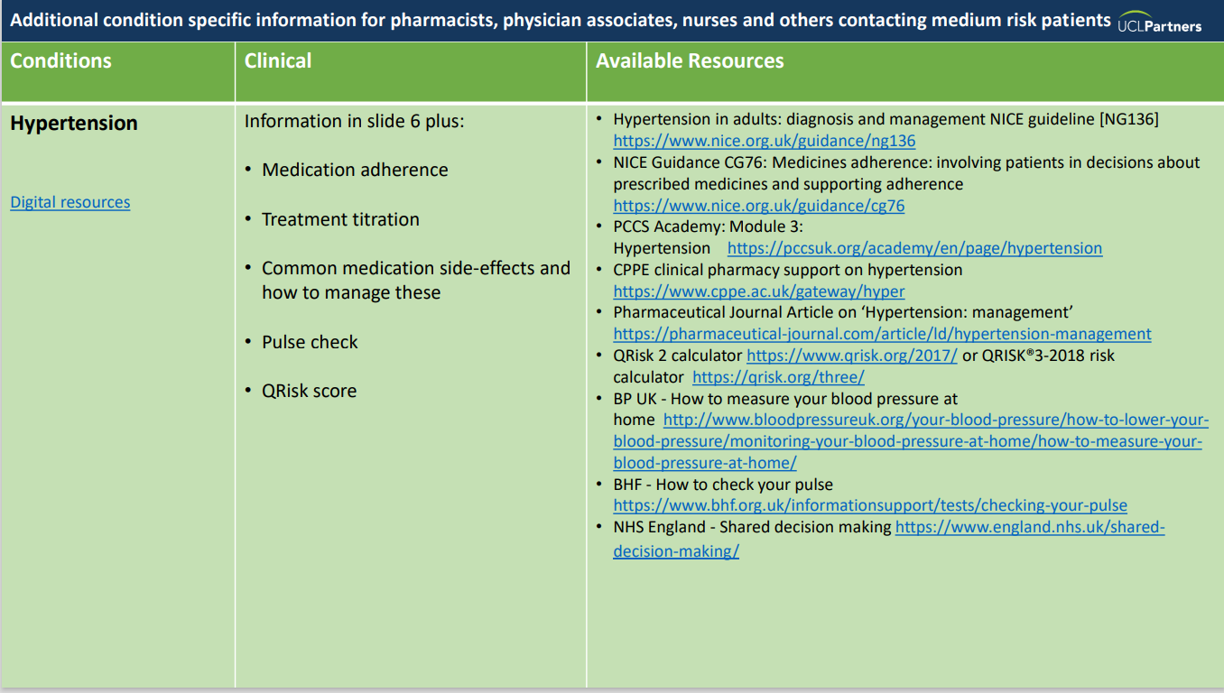
Resources to Support Proactive Care Consultations
Education and training resources:
Recommended training slides
Proactive Care Consultations Guide
Motivational interviewing

Slide 15
Education
Diabetes the basics Diabetes treatments Understanding cholesterol Understanding high blood pressure Risk factors for heart and circulatory disease
Self-management Living with Type 2 Diabetes video What health checks do you need when you have Diabetes Diabetes: Tips for healthy eating Taking care of your feet How to test blood sugar level How to choose a blood pressure monitor How to check your blood pressure (video) Behaviour Change
Eat well Get active Get active indoors Ways to move Quit smoking Drink Less
Resources for Patients

Slide 16
Thank you
Sign up to our monthly newsletter to receive the latest news, opportunities and events from UCLPartners
UCLPartners.com/newsletter
www.uclpartners.com
@uclpartners
linkedin/company/uclpartners
CVDACTION@uclpartners.com

Slide 17
Version tracker
Version | Edition | Changes Made | Date amended | Review due
2 | 2.0 | Lipid Optimisation pathways updated | Jan 2024 | Dec 2024
2 | 2.1 | Updated CVD ACTION logo and slide template | March 2025 | March 2026

