Slide 1
Preventing Cardiovascular Disease
in People with Hypertension

Slide 2
Blood Pressure and Cardiovascular Risk
Hypertension is a leading cause of heart attack, stroke and dementia.
Treatment to lower blood pressure in people with hypertension is highly effective at preventing these devastating cardiovascular events.
In England, around a third of people with hypertension are undiagnosed, and over 40% of people of those diagnosed are not controlled to target.
Prompt intervention makes a difference – delaying blood pressure treatment for more than 6 weeks leads to an increased risk of cardiovascular events
The presence of multiple risk factors magnifies the risk. A majority of patients who have both hypertension and CVD are on suboptimal lipid lowering therapy.
The Size of the Prize shows that prioritising these patients for blood pressure and lipid optimisation will drive a major reduction in heart attacks and strokes over three years.

Slide 3
CVDACTION – The Hypertension Dashboard
CVDACTION is a case finding tool using data extracted from GP records to improve care and outcomes for people who are at high risk of heart attack, stroke and other cardiovascular disease (CVD).
The CVDACTION Hypertension dashboard groups patients into 4 domains – blood pressure not treated to target; lipid lowering for primary and secondary prevention of CVD, pulse checking for atrial fibrillation, and CKD management in hypertension. There is also a case finder for undiagnosed hypertension.
Patients are stratified into cohorts to help prioritise, plan where to begin and spread clinical workload over time. For example, priority groups would include people with the highest blood pressure or people with hypertension and CVD but not on lipid lowering therapy.
You can also filter by ethnicity, deprivation, severe mental illness or learning disability to focus on specific populations and target health inequalities.
To deliver best care for patients and maximise capacity, consider two complementary interventions:
Clinical optimisation – delivered by nurse, pharmacist or GP, starting with those at greatest risk or highest priority
Broader, proactive care to optimise support for education, self management and behaviour change. This can be provided by a member of the wider primary care team such as ARRS* roles such as healthcare assistants and care coordinators.
The UCLPartners Proactive Care Frameworks offer a wide range of free resources to help team members to deliver these interventions and optimise care.
*Additional Roles Reimbursement Scheme

Slide 4
Hypertension:
Data to inform pathway transformation
CVDACTION Hypertension domains – Stratify & Prioritise
BP not treated
to target
Lipid lowering therapy
CKD
management
Clinical Optimisation
(eg pharmacist, nurse)
Holistic Proactive Care
(eg. ARRS roles)
Optimise clinical management
Review blood results, CVD risk & symptoms
Review complications and co-morbidities
Check adherence and adverse effects.
Initiate or optimize therapy
Address wider risk factors eg smoking, obesity
Structured support for:
Education e.g.
What is high blood pressure, cholesterol, risk
How to check and reduce cardiovascular risk?
Self-management e.g.
How to check your blood pressure at home
How to choose a blood pressure monitor
When to seek advice
Behaviour Change – brief interventions & signposting
Healthy eating & Physical activity
Smoking cessation/Alcohol
ARRS = Additional Role Reimbursement Scheme

Slide 5
CVDACTION – Hypertension Indicators
Hypertension Not Treated to Target | CVD Risk Management in Hypertension | AF Detection in Hypertension (over 65) | CKD Management in Hypertension
BP>180/120: BP not at target Group 1 (>180/120 or home equivalent) | HT & CVD NOT on statin: Hypertension and CVD not on Lipid lowering therapy | HT > 65 no pulse check: Hypertension >65years not AF AND no pulse check in 12 months | HT &CKD no eGFR/ACR: Hypertension and CKD with no eGFR or ACR in last 12months
BP 160-179/100-119: BP not at target Group 2 (>160/100-180/120 or home equivalent) | HT & CVD not max statin: Hypertension and CVD on statin but not high dose high intensity statin |  | HT &CKD ACR>30 no RAA: Hypertension and CKD with ACR >30mmol/L not on ACE or ARB
BP(under 80)140-159/90-99: BP not at target Group 3 (less than 80years >140/90-160/100 or home equivalent) | HT & CVD High non-HDLc: Hypertension & CVD on maximal statin therapy with non HDL>2.5mmol/L or no non-HDL/LDL
BP(80 plus)150-159/90-99: BP not at target Group 4 (>80years >150/90-160/100 or home equivalent) | HT & QRisk> 10% no statin: Hypertension with QRisk score ≥10% or CKD OR T1DM >40years not on statin
 | HT (no CVD) no QRisk: Hypertension 40-84years without CVD, not on statin and no QRisk last 5years
Notes:
Extend words

Slide 6
Hypertension – Clinical Next Steps
BP not treated to target
Optimise therapy: check adherence and consider increasing dose or adding new drug
Personalise treatment to the individual considering frailty, co-morbidity and polypharmacy
Lipid management in hypertension – patients with pre-existing CVD
Ensure on high dose high intensity statin (e.g. atorvastatin 80mg or rosuvastatin 20mg) – or start statin if not already prescribed – and support lifestyle change
If non-HDLc not reduced to target or statin not tolerated, consider ezetimibe, Inclisiran, PCSK9i(mab) or Bempedoic acid
Lipid management in hypertension – patients without pre-existing CVD
Record up to date QRisk score and support lifestyle change
If QRisk score ≥10% (or if CKD or T1 diabetes aged 40 plus), ensure on high intensity statin (eg atorvastatin 20mg) or start if lifestyle change alone is not effective
If non-HDLc not reduced to target, (or if statin not tolerated) titrate statin dose and consider ezetimibe or bempedoic acid
Chronic kidney disease in hypertension
Ensure annual eGFR and ACR and consider ACEi/ARB if ACR >30 mmol/l
Atrial fibrillation detection in hypertension
NICE recommends that pulse rhythm is checked before measuring blood pressure to identify atrial fibrillation if present
Hypertension Case finder
The case finder identifies patients not on the hypertension register whose last BP (>3 months ago) was abnormal. Recheck BP and arrange ABPM/HBPM if BP ≥140/90mmHg
Supporting education, self management and behaviour change
Resources to support staff helping patients with hypertension to understand their conditions, to self manage and to make lifestyle changes

Slide 7
Medicines Optimisation: NICE Hypertension Treatment Pathway (NG136)
Hypertension without type 2 diabetes
Use clinical judgement for people with frailty or multimorbidity
Offer lifestyle advice and continue to offer it periodically
Hypertension with type 2 diabetes
Monitoring treatment
Use clinic BP to monitor treatment
Measure standing and sitting BP in people with:
Type 2 diabetes or
Symptoms of postural hypotension or
Aged 80 and over
Advice people who want to self monitor to use HBPM. Provide training and advice
Consider AMPM or HBPM, in addition to clinic BP, for people with white-coat effect or masked hypertension
Age <55 and not of black African or African- Caribbean family origin
Age 55 or over
Black African or African- Caribbean family origin (any age)
Step 1
ACEi or ARB
CCB
ACEi or ARB
+
CCB or thiazide-like diuretic
CCB
+
ACEi or ARB or thiazide-like diuretic
Step 2
BP targets
Reduce and maintain BP to the following targets:
Age <80 years:
Clinic BP <140/90 mmHg
ABPM/HBPM <135/85mmHg
Postural hypotension:
Base target on standing BP
Frailty or multimorbidity:
Use clinical judgement
ACEi or ARB + CCB + thiazide-like diuretic
Step 3
Confirm resistant hypertension: confirm elevated BP with ABPM or HBPM, check for postural hypertension and discuss adherence
Consider seeking expert advice or adding a:
Low-dose spironolactone if blood potassium level is ≤ 4.5 mmol/l
Alpha-blocker or beta-blocker if blood potassium level is >4.5 mmol/l
Seek expert advice if BP is uncontrolled on optimal tolerated doses of 4 drugs
Step 4
Pathway adapted from NICE Guidelines (NG136) Visual Summary https://www.nice.org.uk/guidance/ng136/resources/visual-summary-pdf-6899919517
Abbreviations: ACEi: ACE inhibitor, ARB: Angiotensin II Receptor Blocker, CCB: Calcium Channel Blocker, ABPM: Ambulatory Blood Pressure Monitoring, HBPM: Home Blood Pressure Monitoring

Slide 8
Lifestyle Modifications
Modification | Recommendation | Approximate Systolic Blood Pressure Reduction (mm Hg)ª
Weight loss | Maintain normal body weight | 5–20 per 10-kg weight loss
DASH-type diet* | Consume a diet rich in fruits, vegetables, and low-fat dairy products with reduced saturated and total fat | 8–14
Reduced salt intake | Reduce daily dietary sodium intake | 2–8
Physical activity | Regular aerobic physical activity (at least 30 min/day, most days of the week) | 4–9
Moderation of alcohol intake | Limit consumption to 2 drinks/day in men and 1 drink/day in women and lighter-weight persons | 2–4
*DASH, Dietary Approaches to Stop Hypertension. Effects of implementing these modifications are time and dose dependent and could be greater for some patients.
Vooradi S, Mateti UV. A systemic review on lifestyle interventions to reduce blood pressure. J Health Res Rev [serial online] 2016 [cited 2021 Apr 27];3:1-5. Available from: https://www.jhrr.org/text.asp?2016/3/1/1/173558
In monotherapy, most drugs achieve systolic BP reductions of ~ 10 to 15 mmHg
https://journals.lww.com/md-journal/Fulltext/2016/07260/Treatment_efficacy_of_anti_hypertensive_drugs_in.16.aspx
8

Slide 9
Lipid Optimisation Pathway for Secondary Prevention¹
Is the patient on high dose, high intensity statin³?
(atorvastatin 80mg daily or rosuvastatin 20mg daily)
Check fasting triglyceride levels & manage according to national guidance.
Lipid lowering therapies should be offered to all patients
with established CVD¹
Yes
No
Initiate / increase to high dose high intensity statin^{2,3,4} if possible
and re-enforce lifestyle and diet measures
NICE NG238: Cardiovascular disease: risk assessment and reduction, including lipid modification
Dose may be limited, for example if:
CKD: eGFR<60ml/min – recommended starting dose - atorvastatin 20mg
Drug interactions
Drug intolerance
Older age / frailty / end of life
See statin intensity table.
Use shared-decision making and incorporate patient preference in treatment and care decisions.
NICE Guidance: Evolocumab, Alirocumab
Review within 2 to 3 months
Is LDL-chol ≤ 2mmol/L or non-HDL ≤ 2.6mmol/L?¹
At any point consider iscosapent ethyl in addition to statins +/- other lipid lowering therapies, if fasting
triglycerides ≥1.7 mmol/L AND LDL > 1.04 mmol/L and ≤2.6 mmol/L
No
Yes
Check adherence to statin and lifestyle¹
Consider intensifying therapy⁴
Consider adding ezetimibe⁴ 10mg daily to maximum tolerated statin to reduce CV risk, even where the lipid target has been achieved.¹
Consider ezetimibe 10mg daily.
Reassess within three months.
Assess eligibility for injectable therapies:
Inclisiran - if LDL-C ≥ 2.6mmol/L
OR
PCSK9i (mAB)⁵ if LDL-C > 4mmol/L (or > 3.5mmol/L if FH or recurrent CV events)
If statin intolerant – offer ezetimibe. Reassess within 2 to 3 months and, if not achieving target, consider bempedoic acid and injectable therapies in line with eligibility criteria.¹
Monitoring statin therapy
Initiation | Full lipid profile, LFTs
Within 3 months | Lipid profile, LFTs
Annually | Full lipid profile , LFTS (first year only)
Review annually, assessing treatment to target, adherence to drugs and offering support for diet and lifestyle measures

Slide 10
Optimisation Pathway for Patients with High Cardiovascular Risk – Primary Prevention^{1,2}
Review and re-enforce lifestyle and diet measures
Primary prevention should be offered to all patients with a QRisk ≥ 10%
after addressing lifestyle modification
(It may also be considered in individuals with QRIsk < 10% )¹
Is patient on high intensity statin? (atorvastatin 20mg or equivalent)
No
Yes
Initiate atorvastatin 20mg/day^{3,4}
Optimal High Intensity Statin for Primary Prevention
Atorvastatin | 20mg
Rosuvastatin | 10mg
After 3 months - has non-HDL-C reduced by 40% or more from baseline?¹
No
Check adherence and lifestyle measures
NICE NG238: Cardiovascular disease: risk assessment and reduction, including lipid modification
High cardiovascular risk:​
QRisk >10% in ten years​
CKD 3-5​
Type 1 Diabetes for >10 years or over age 40
See statin intensity table.
Use shared-decision making and incorporate patient preference in treatment and care decisions.
Consider titrating statin up to atorvastatin 80mg or equivalent taking into account
patient preferences, co-morbidities, polypharmacy, frailty and life expectancy^{3,4}
If statin intolerant – offer ezetimibe. Reassess within three months and, if not achieving target, consider bempedoic acid¹
Yes
If non-HDL cholesterol has not fallen by 40% or more from baseline, consider adding ezetimibe 10mg daily⁴
Review annually, assessing adherence to drugs, diet and lifestyle

Slide 11
Proactive Care Consultations
Structured support for education, self-management and behaviour change

Slide 12
Proactive Care Consultations
Members of the wider primary care team (e.g. ARRS* roles such as health care assistants and care coordinators) can provide structured support for education, self-management and behaviour change, sharing trusted information from charity and other websites. The UCLPartners Proactive Care Frameworks include education and training resources to support these consultations and educational digital resources to share with patients.
Education e.g.
What is high blood pressure, cholesterol
How to check and reduce cardiovascular risk?
Self-management e.g.
How to check your blood pressure at home
How to choose a blood pressure monitor
When to seek advice
Behaviour Change – brief interventions and signposting.
Healthy eating & Physical activity
Smoking cessation / Alcohol
*Additional Roles Reimbursement Scheme

Slide 13
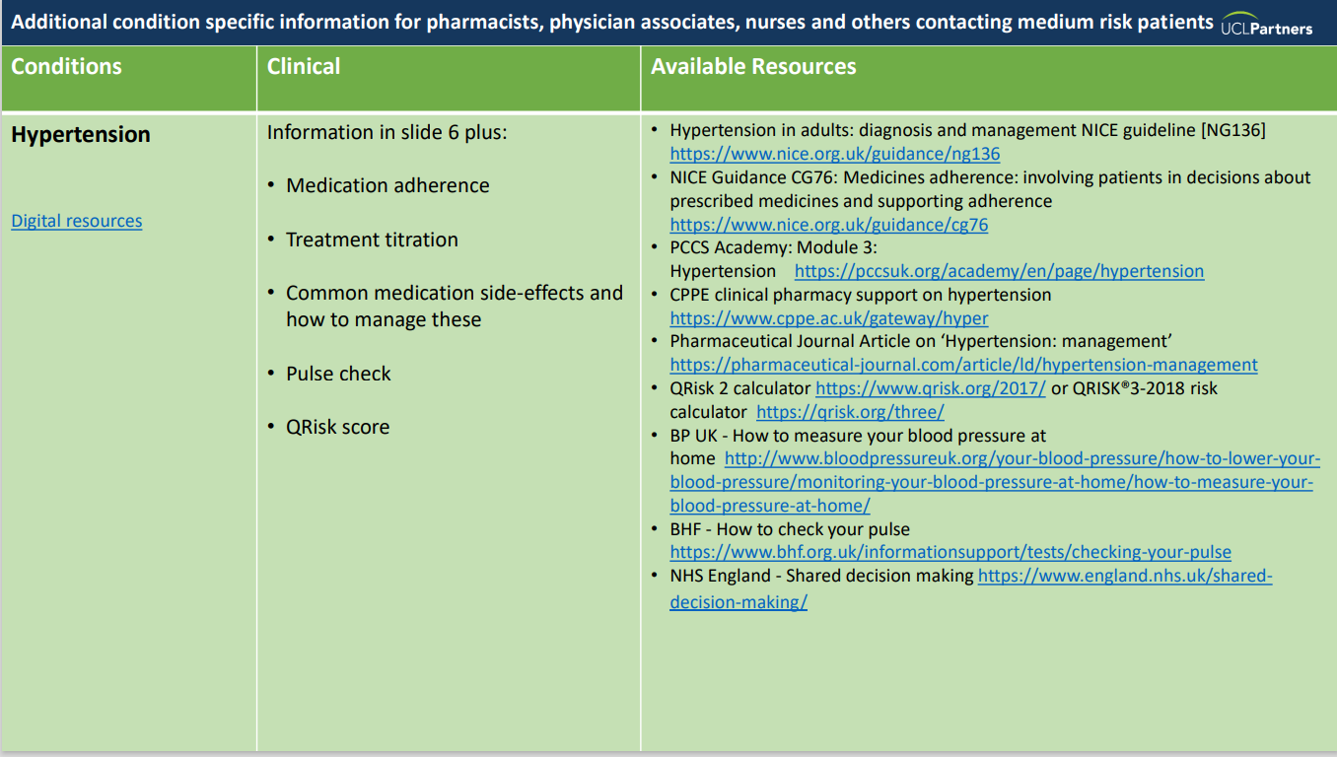
Resources to Support Proactive Care Consultations
Education and training resources:
Recommended training slides
Proactive Care Consultations Guide
Motivational interviewing

Slide 14
Education
Understanding high blood pressure What is high blood pressure? Risk factors for heart and circulatory disease Understanding cholesterol How to lower your cholesterol
Self-management How to reduce your blood pressure: 6 top tips Manage your blood pressure at home Home Blood Pressure Monitoring (video) How to choose a blood pressure monitor How to check your blood pressure (video) Behaviour Change
Eat well Healthy eating guide Get active Get active indoors Ways to move Quit smoking Drink Less
Resources for Patients

Slide 15
Thank you
Sign up to our monthly newsletter to receive the latest news, opportunities and events from UCLPartners
UCLPartners.com/newsletter
www.uclpartners.com
@uclpartners
linkedin/company/uclpartners
CVDACTION@uclpartners.com

Slide 16
Version tracker
Version | Edition | Changes Made | Date amended | Review due
2 | 2.0 | Updated lipid optimisation pathways | Jan 2024 | Dec 2024
2 | 2.1 | Updated CVD ACTION logo and slide template | March 2025 | March 2026

