Slide 1
Summary of UCLP-Primrose e-learning course
Presenter name, position, organisation
Day Month Year

Slide 2
UCLP-Primrose e-learning
Module 1: UCLP-Primrose and behaviour change
Module 2: Engaging patients in conversations about behaviour change
Module 3: Working out which behaviours to change
Module 4: Strategies to support behaviour change

Slide 3
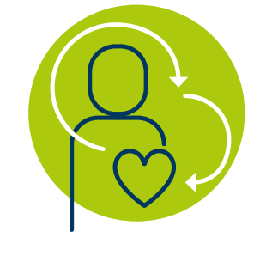
Why UCLP-Primrose matters
General population
10-20 years
Life expectancy
Severe mental illness
Notes:
People living with severe mental illness (SMI) are at risk of dying from cardiovascular disease (CVD) up to 20 years earlier than the general population
UCLP-Primrose aims to transform care for people living with SMI by :
- identifying those at highest risk
- identifying those who are not engaged with care and offering support
- providing behaviour change interventions to support mental health, physical health and wellbeing goals.

Slide 4
The link between severe mental illness and physical health
Notes:
- There are several reasons for this ‘mortality gap’ including:
- how they are treated by health workers,
- an increased likelihood of cardiovascular risk factors such as smoking, diabetes, obesity and alcohol
- and the impact SMI has on motivation
- These reasons can be straightforward to address

Slide 5
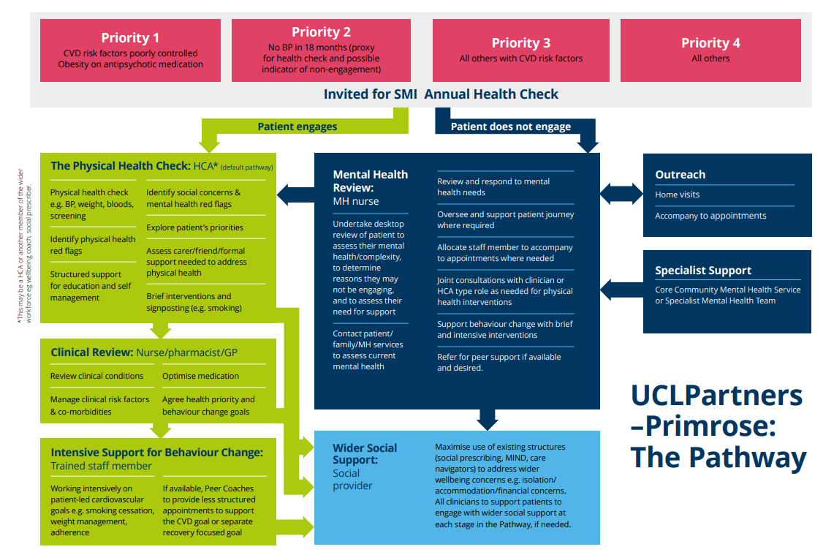
Notes:
- The UCLP-Primrose Pathway is made up of several important stages

Slide 6
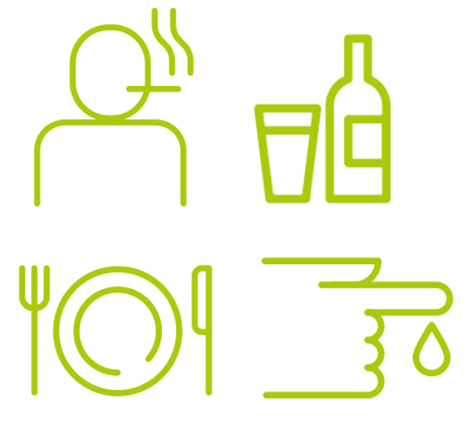
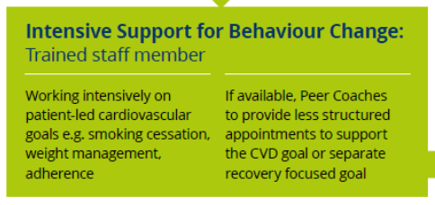
How changing behaviour can help reduce cardiovascular disease
Notes:
- Reducing CVD risk factors usually requires a change in behaviour like stopping smoking, eating more healthily or moving more, but changing these behaviours is hard, especially for people living with SMI, so intensive support for behaviour change is an integral part of the pathway

Slide 7
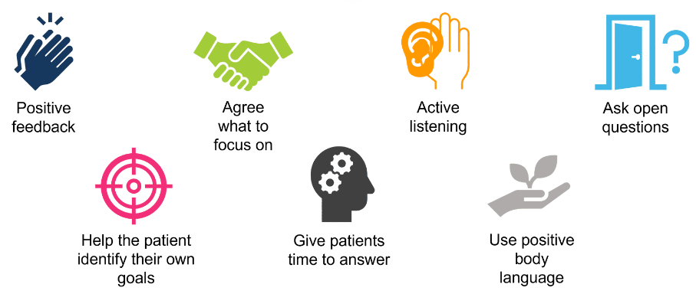
Engaging patients in conversations about behaviour change
Notes:
- Engaging patients in conversations about their health is important but can be challenging with patients living with SMI
- There are a number of communication skills we can use to help us overcome this challenge
- With a little practise, these skills can be incorporated into your everyday conversations with patients
- It can help to ask patients what practical steps might help them to engage more in their health
- There are also a number of practical strategies that help most patients to engage more in their health like
- making sure patients see the same person to build trust
- inviting supportive others if helpful for the patient
- offering flexibility with appointment days, times, length and type e.g., telephone appointments
WE WILL PRACTISE COMMUNICATION SKILLS TODAY

Slide 8
Working out which behaviours to change
1. Establish cardiovascular health status
Notes:
- To help patients set meaningful cardiovascular health goals we first need to:
1) establish their cardiovascular health status (Cardiovascular health status is influenced by cardiovascular, non-cardiovascular, lifestyle and physical factors)
Some behaviours/goals have a bigger impact on improving cardiovascular health than others
Based on this information, the Cardiovascular Health Goals Flow Chart can then be used with the patient to prioritise cardiovascular health goals that will have the greatest impact on their health

Slide 9
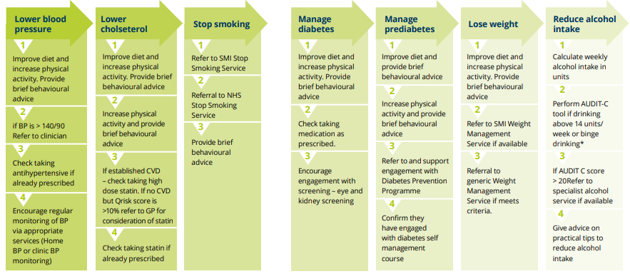
Working out which behaviours to change
2. Use the Cardiovascular Health Goals flow chart to work out which behavioural goals will have the biggest effect
Notes:
2. Use the Cardiovascular Health Goals flow chart to work out which behavioural goals will have the biggest effect.
WE WILL PRACTISE PRIORITISING GOALS TODAY

Slide 10
Strategies to support behaviour change
Set a behavioural goal
Involve supportive others
Action plan
Record behaviour
Review progress
Give positive feedback
Coping with setbacks
Forming habits
Notes:
- People living with SMI can struggle to make changes for their health
- Using behaviour change strategies can help to overcome these barriers
WE WILL PRACTISE BEHAVIOUR CHANGE STRATEGIES TODAY

Slide 11
Any questions?

Slide 12
First name Last name
sample@email.co.uk

