Slide 2
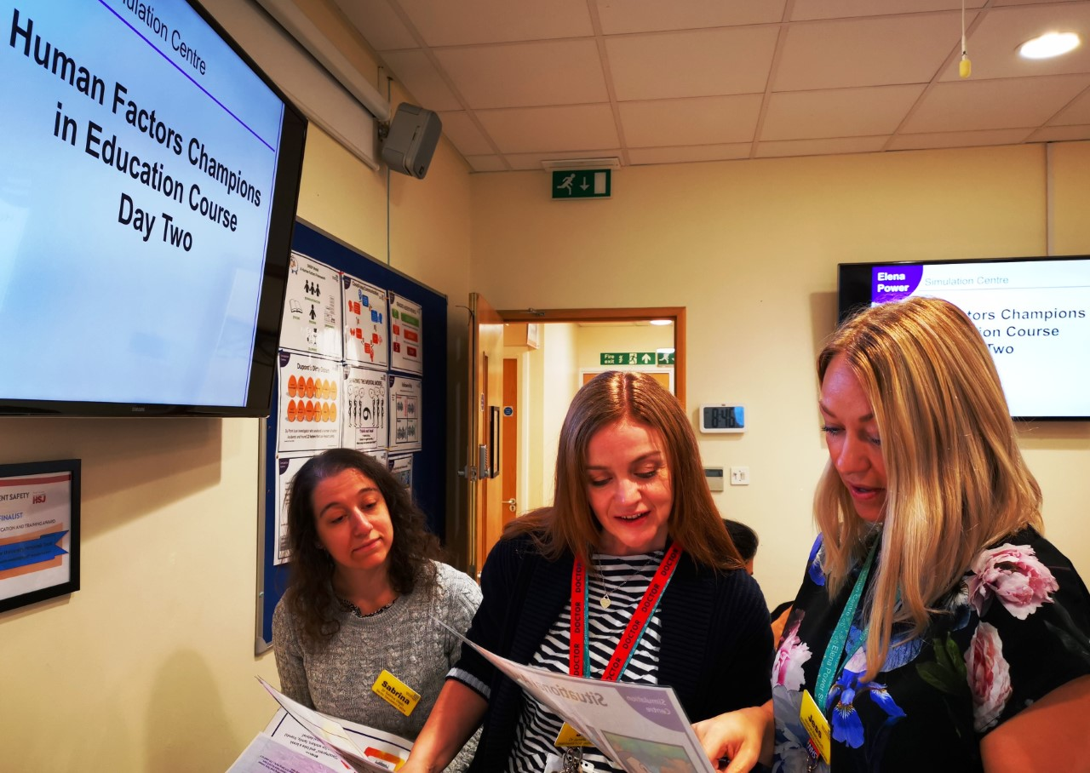
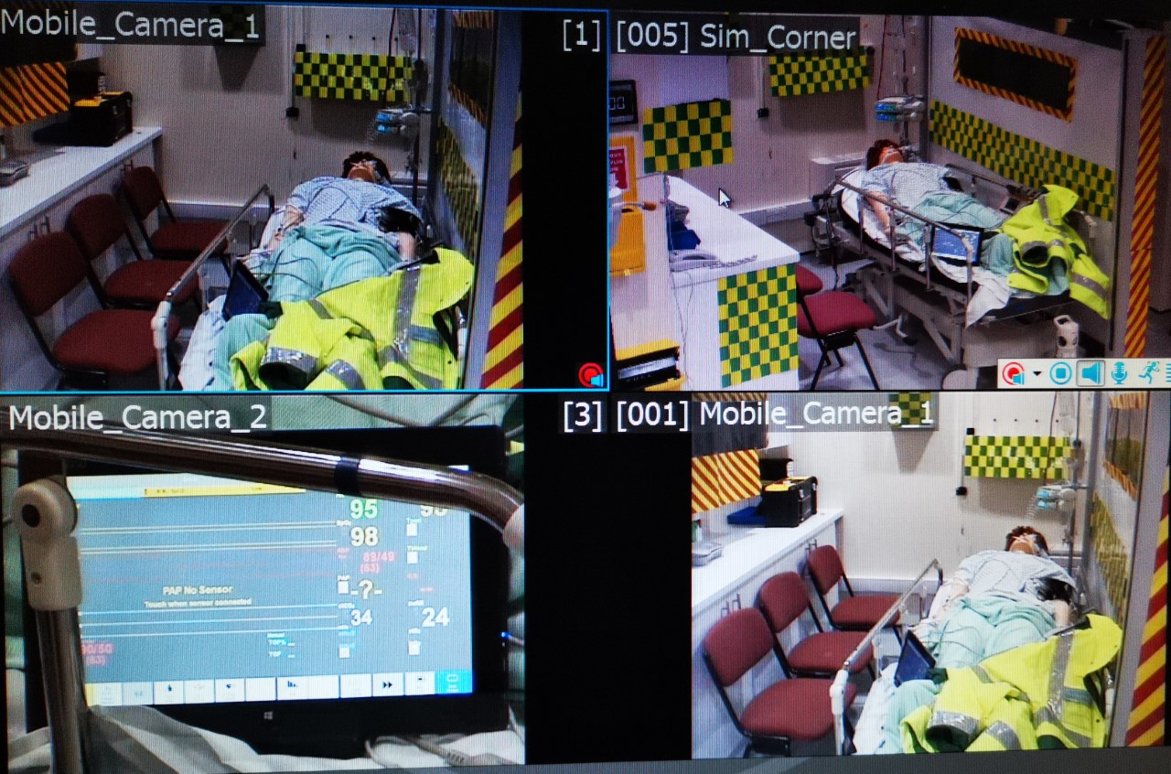
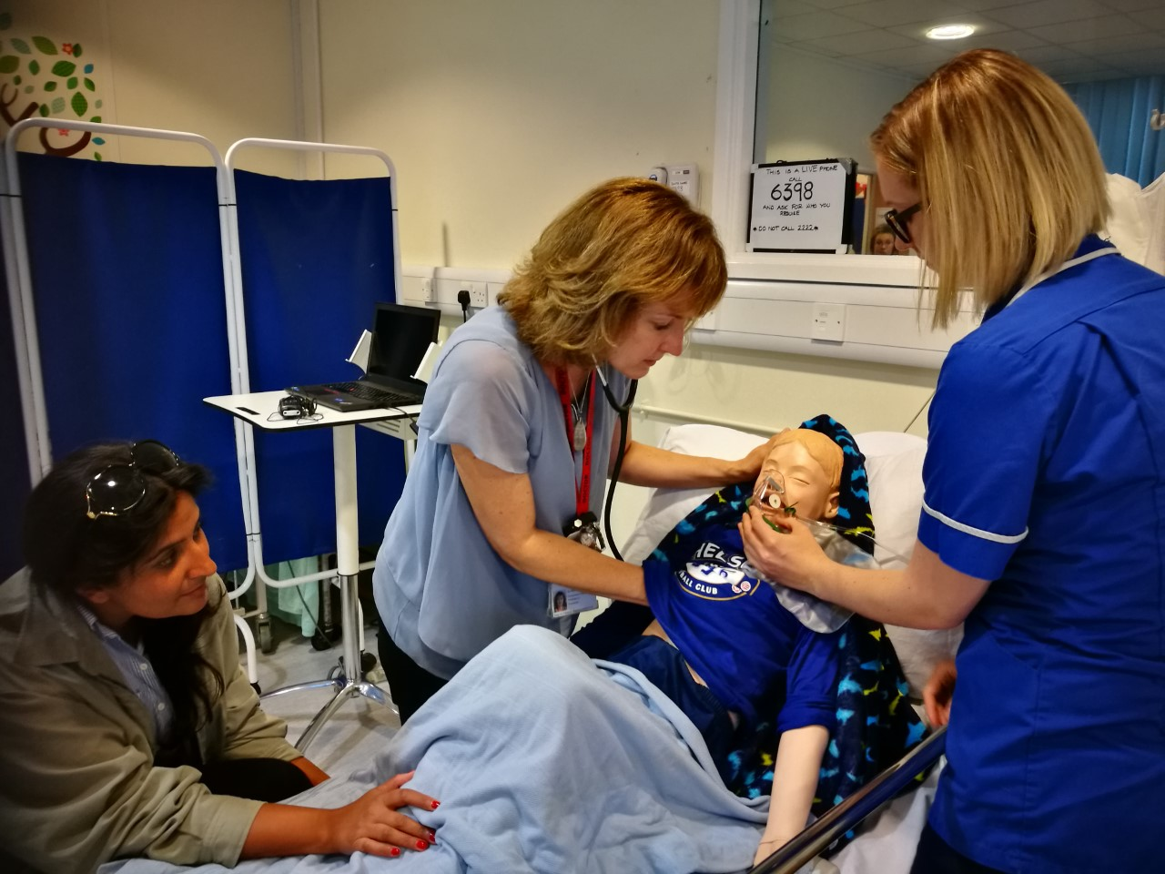
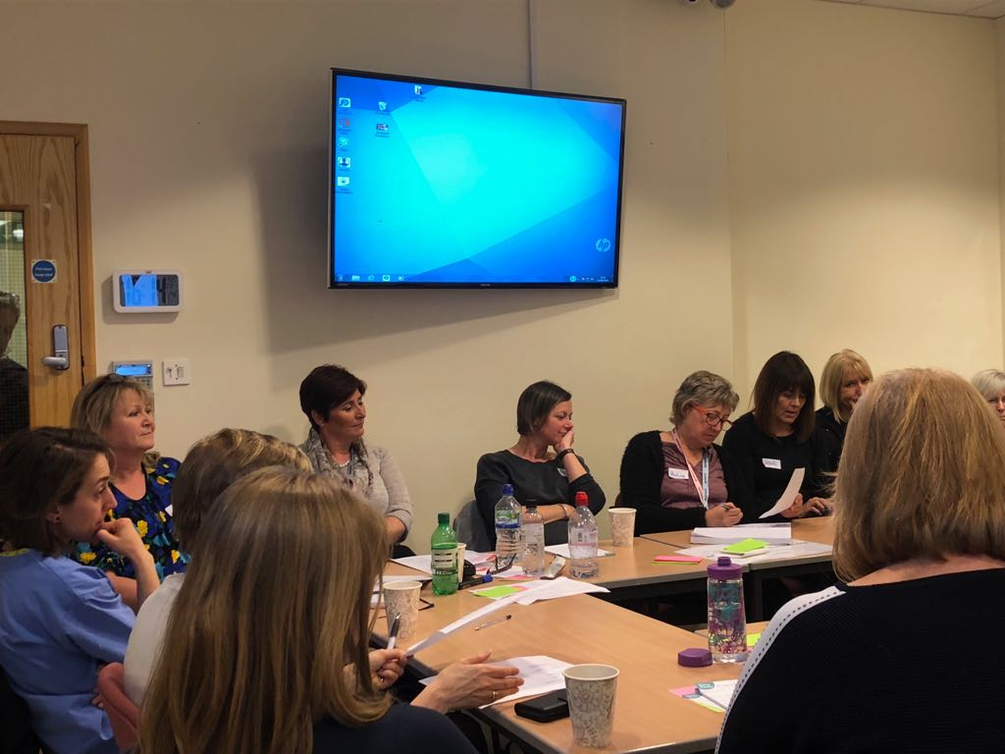
Who we are and what we do!
Mandatory CRISIS courses as core work
Stand-alone Human Factor Courses
SI panel, HF support, HF observations
Senior buy-in
Autonomy: mix of multi-professional substantive staff v student / trainee focus
No OSCE or summative assessment

Slide 3
Safety Synergy - simulation and human factors - hub and spoke model (Sept 2021)
Insight
Incident response (PSIRF)
Themes and areas of learning
Human factors /systems investigation tools
Prospective risk analysis
Safety II & system thinking
Just culture
Implementing safety actions
Transformative simulation
NHS Patient Safety Strategy
Insight Involvement Improvement
Improvement
Quality Practitioner programme
Human factors and QI methodology
In-situ simulation
Transformative simulation
Prospective risk analysis
Safety II & systems thinking
Just culture
Patient experience
Patient safety staff development pathway
Patient safety champions
Simulation & Human Factors Service
Involvement
Patient Safety Syllabus
Medical student simulation
Foundation trainee simulation
Junior doctor HF curriculum
IP human factors simulation
Deteriorating patient simulation CRISIS
CIEHF accredited human factors courses
Advanced human factors courses
Safety II & systems thinking
In-house incident investigation training
Community Simulation
Prospective risk analysis
Transformative simulation
Patient experience
Patient Safety Partners
Based on HEE vison for simulation and immersive technologies (2020)

Slide 4
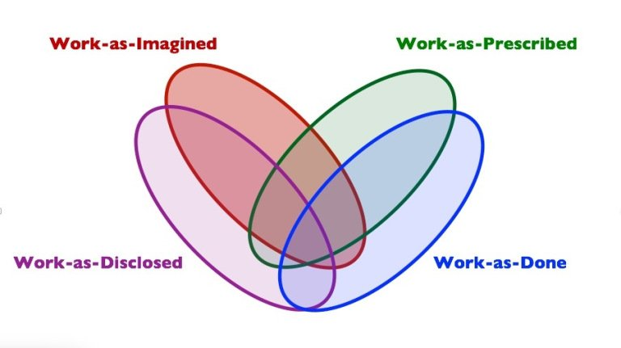
Prospective risk analysis – pilot case study
Incident informed
Defined work system for exploration to look at ‘work as done’

Slide 5
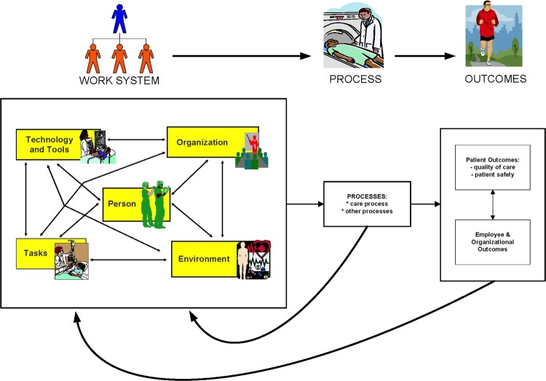
Used systems engineering in patient safety (SEIPS) for observation and walk through
SEIPS & human factors intervention matrix (HFIX) multi-professional workshop

Slide 6
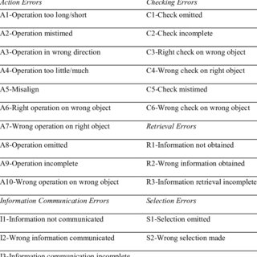
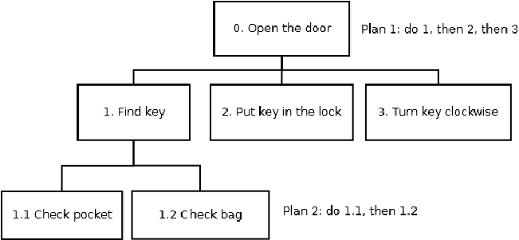
Hierarchical task analysis (HTA)/Systematic human error & risk analysis (SHERA)/performance influencing factors (PIFs)
Potential safety actions developed from multiple data sources
Notes:
Systematic way and look at all ways task could fail, strength of mitigations, PIFs and recommendations (vulnerable areas)

Slide 7
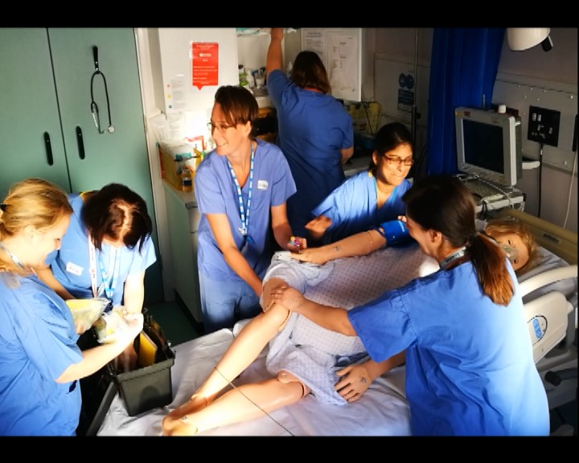
Next Steps
Prioritised safety actions with senior team & allocated ownership FACES
Use SEIPS framework to guide collaborative redesign
Pilot, stress test with simulation and evaluate
Share wider learning across organisation
Develops skills and confidence of those already in safety roles

Slide 8
Organisational wish list
Collaborative business case (simulation/patient safety/quality/patient experience)
More staff and physical resources
Upskill simulation team
Upskill staff in variety of roles and grades
Introduction to human factors
Advanced human factors
QI/HFE blended courses
Investigator training – a safety II approach

