Slide 1
Implementing UCLPartners Familial Hypercholesterolemia Searches and Screening
Dr Deep Shah, Clinical Lead UCL Partners
Dominic Studart, North Thames GMSA Familial Hypercholesterolaemia Project Nurse

Slide 2
Aims
What is FH?
Diagnosing FH
Implementing UCLPartners FH Searches
Practical guide to screening for FH in primary care
Case study

Slide 3
Familial Hypercholesterolemia (FH)
Genetic condition affecting the livers ability to remove excess cholesterol from the blood.
High cholesterol causes cardiovascular disease and accounts for a third of all heart attacks.
Lifetime exposure to raised cholesterol puts individuals with FH at greater risk of cardiovascular disease.
FH is high risk but very treatable. Every 1mmol/l reduction in low-density lipoproteins (LDL) cholesterol reduces risk of a cardiovascular event by 25%. ⁴
Autosomal dominant inheritance pattern. 3 main genes affected: LDLR, APOB, PCSK9
Homozygous inheritance is rare and has a more severe phenotype.
Estimated 1 in 250 people have FH. ~92% are undiagnosed.
The NHS long term plan aims to increase detection to 25% by 2024.
Notes:
Half of men with FH will have a heart attack or stroke before age 50 and a third of women before age 60. Statins are highly effective at reducing this risk.
The average age of diagnosis is 47 years old. Diagnosing at this age shows a missed opportunity of starting medication and positive lifestyle choices to reduce risks.
LDLR 90% More than 2000 known LDLR mutations. 400 have been found in the UK.
APOB 5% – second most common. Single mutation affecting binding to LDLR
PCSK9 2% – gain of function.
APOE 2% – single deletion – mimick FH.

Slide 4
Optimisation Pathway for Patients with High Cardiovascular Risk* – Primary Prevention
Review and re-enforce lifestyle and diet measures as first line
Is patient on high intensity statin?
(atorvastatin 20mg or equivalent)
Optimal High Intensity statin for Primary Prevention (High intensity statins are substantially more effective at preventing cardiovascular events than low/medium intensity statins)
Atorvastatin | 20mg
Rosuvastatin | 10mg
Yes
No
Initiate atorvastatin 20mg/day
After 3 months - has non-HDL-C reduced by 40% or more from baseline?
Yes
No
Check adherence and tolerance**
Consider titrating statin up to atorvastatin 80mg or equivalent if the patient is considered to be at higher risk because of co-morbidities, risk score or using clinical judgment
* High cardiovascular risk:​
QRisk >10% in ten years​
CKD 3-5​
Type 1 Diabetes for >10 years or over age 40
If non-HDL cholesterol has not fallen by 40% or more from baseline,
consider adding ezetimibe 10mg daily
** If statin not tolerated, follow statin intolerance pathway and consider ezetimibe 10mg daily +/- bempedoic acid 180mg daily
Review annually for adherence to drugs, diet and lifestyle

Slide 5
Optimisation Pathway for Secondary Prevention
Is patient on high dose, high intensity statin*?
(atorvastatin 80mg or equivalent)
Optimal High Intensity Statin for secondary prevention (High intensity statins are substantially more effective at preventing cardiovascular events than low/medium intensity statins)
Atorvastatin | 80mg
Rosuvastatin | 20mg
Yes
No
Initiate / increase to high dose high intensity statin ** and re-enforce lifestyle and diet measures
Is non-HDL cholesterol < 2.5mmol/L? ***
No
* Dose may be limited if:
eGFR<30ml/min
Drug interactions
Intolerance
Older age / frailty
** See statin intensity table
*** Current NICE Guidance recommends at least a 40% reduction in non- HDL cholesterol
**** If statin not tolerated, follow statin intolerance pathway and consider ezetimibe 10mg daily +/- bempedoic acid 180mg daily. If non HDL-C remains > 2.5mmol/L despite other lipid lowering therapies consider injectable therapies.
⁺ NICE Guidance: Evolocumab, Alirocumab
Check adherence to statin and lifestyle measures ****
Consider ezetimibe 10mg daily
Reassess after three months. If non-HDL-C remains > 2.5mmol/L; consider injectable therapies arrange a fasting blood test and assess eligibility
Consider injectable therapies
If non-HDL chol > 2.5mmol/L; Arrange fasting blood test to assess eligibility:
Inclisiran - if fasting LDL-C ≥ 2.6mmol/L
OR
Refer for PCSK9i (mAB)⁺ if fasting LDL-C > 4mmol/L (or > 3.5mmol/L if recurrent events)
If eligibility criteria are not met, consider ezetimibe 10mg daily (if not previously considered)
Yes
Review annually for adherence to drugs and support for diet and lifestyle measures
*Tables adapted from Y Javaid

Slide 6
FH Treatment
Primary and Secondary Prevention Treatments
Statins – Atorvastatin, Rosuvastatin
Ezetimibe
Bempedoic acid
Under specialist management
Injectable therapies - PCSK9 inhibitors:
Evolocumab
Alirocumab
Inclisiran
Lipid apheresis
Notes:
Monoclonal antibodies – Evolocumab and alirocumab
siRNA – Inclisiran – blocks production.
Statin intolerance pathways

Slide 7
Overview of Management of FH in Primary Care
Consider referral for genetic testing and cascade testing
Offer a high-intensity statin to all adults with FH - aim for at least a 50% reduction in LDL-C concentration. Increase the dose of statin after 3 months if not achieving a 50% reduction in LDL-C and not already prescribed maximum dose.
Use ezetimibe in patients with FH who have contraindications to, or cannot tolerate, statin therapy and consider adding bempedoic acid
Add ezetimibe to statin therapy in patients who are not achieving a 50% reduction in LDL-C concentration despite maximum dose high intensity statin OR where statin dose is limited by side effects. Consider inclisiran in patients with CVD, who are not achieving an LDL-C<2.6mmol/L despite optimal oral lipid lowering therapy (high intensity statins with or without ezetimibe)
Refer patients to a specialist for consideration of further treatment:
if treatment with the maximum tolerated dose of a high-intensity statin and ezetimibe +/- inclisiran is inadequate
if they are assessed to be at very high risk of a coronary event:
A family history of premature coronary heart disease
Two or more other cardiovascular risk factors (for example, they are male, they smoke, or they have hypertension or diabetes)
If they have established cardiovascular disease
Specialists may initiate PCSK9i (alirocumab or evolocumab), bile acid binders (resins) or fibrates in patients with an inadequate response to first line lipid lowering therapies
PCSK9i are recommended for use in people with FH:
For primary prevention when LDL remains > 5mmol/L despite optimal statin / ezetimibe therapy
For secondary prevention when LDL remains > 3.5mmol/L despite optimal statin / ezetimibe therapy

Slide 8
UCLPartners FH Searches
The UCLPartners FH searches identifies 3 cohorts of patients with the criteria below:
Cohort 1 and 2 are at high risk of having FH – Follow the UCLP FH screening process to exclude and manage any secondary causes of hypercholesterolemia
Cohort 3 are coded FH patients – Follow the UCLP FH desktop review process to identify if they are eligible/require genetic testing for FH.

Slide 9
Implementing the UCLPartners Searches
Download the UCLPartners FH searching tool for EMIS or SytmOne:
https://uclpartners.com/proactive-care/search-and-risk-stratification-tools/
You will need to provide your name, role and organisation details before downloading the FH search tool.
Please select either the EMIS or SystmOne Familial hypercholesterolaemia search tool depending on your practices record system.
Searches currently being updated – expected latest end of September. Current searches available, updated search may increase eligible patient cohort.

Slide 10
Implementing the UCLPartners Searches
Follow the video instructions for running the searches on SystmOne or EMIS:
https://uclpartners.com/proactive-care/search-and-risk-stratification-tools/supporting-resources/

Slide 11
Aim of the UCLPartners FH searches
Identify patients who may have undiagnosed Familial Hypercholesterolaemia
Review treatment management
Refer for genetic test to confirm diagnosis
Cascade test first degree relatives
Identify patients who have Familial Hypercholesterolaemia
Review treatment management
Refer for genetic test to confirm diagnosis
Cascade test first degree relatives
Notes:
May have been lost to follow up during the pandemic.
Opportunity to request monitoring bloods for FH patients who need them.
Escalate therapy accordingly or refer/re refer to a lipid clinic.

Slide 12
Familial Hypercholesterolemia Pathway
1*
Case find under 30 years:
TC >7.5 or LDL-C >4.9 or non-HDL-C >6.0
1*
Case find 30 years or over:
TC >9.0 or LDL-C >6.4 or non-HDL-C >7.5
*Simon Broome Positive Criteria
SB 1+2 = Possible FH
SB 1+3 = Definite FH
HCA
Known/coded FH
1. Family history questionnaire (text or in person)
2. Fasting lipids, LFTs, TFTs, Renal, HbA1c
TG <2.3
TG >2.3
Investigate raised TG
Refer if indicated
2*
Family history premature MI:
1st degree relative MI <60
2nd degree relative MI <50
3*
? Tendon Xanthomata
Negative
Negative
PCN Nurse or pharmacist
Face to face or remote assessment
Nurse/Pharmacist Desktop Review
Nurse/Pharmacist Desktop Review
Unlikely FH: Manage as appropriate for 1º/2º prevention
Aim to reduce non-HDL chol by at least 40%
Support behaviour change, titrate high intensity statins, consider other therapies and manage other CVD risk factors
Confirm diagnosis, refer if indicated for index or family cascade testing
Exclude secondary causes of high TC and refer DNA testing
Not FH
Specialist service
and FH Nurse
Genetic counselling and DNA test
No FH mutation
Treatment in primary care
FH: Aim to reduce LDL by 50% or more
Titrate high intensity statins, consider other therapies, support behaviour change and manage other CVD risk factors
FH mutation
Treatment
Confirmed FH
Cascade testing for family members
Treatment in primary care with specialist support
Notes:
Systematic way of identifying patients using the Simon Broome criteria - Efficient and effective use of resources
For pilot worked with pharmacists – work across PCNs
Utilise HCAs or care co coordinators depending on practice.
Admin support – running searches etc. also invaluable.
Along the way I will try give some practical advice for putting this pathway into practice from my experience on the pilot.

Slide 13
Diagnosing FH
Diagnostic criteria:
Raised cholesterol
Premature CVD
Family history – raised cholesterol or premature CVD
Physical signs of raised cholesterol
Fulfil diagnostic criteria:
Simon Broome Criteria
www.mdcalc.com/simon-broome-diagnostic-criteria-familial-hypercholesterolemia-fh
Dutch Lipid Criteria
www.mdcalc.com/dutch-criteria-familial-hypercholesterolemia-fh
Genetic test – unequivocal diagnosis
Notes:
Genetic test has not always been available.
Negative genetic test – may be other variants we do not know about – council still important to treat/healthy lifestyle and diet if still SB/DLC scoring for FH.
Use pre treatment cholesterol/LDL levels/the highest available.
Simon broome – possible or definite scores for FH
Dutch Lipid – score above 5 makes eligible for genetic testing

Slide 14
Notes:
Should use pre treatment LDL/Total cholesterol levels where possible.
Or highest recorded.
Use slightly different criteria to calculate likelihood of FH
Simon Broome does not take into account personal history of premature CVD
Possible, probable, definite FH
Should try to calculate both scores to assess FH and need to refer for testing.
DLC of 5 or more required for testing.

Slide 15
Diagnosing FH – First exclude secondary causes
Secondary causes of raised cholesterol:
Uncontrolled diabetes mellitus
Obesity – inactivity, diet
Excess alcohol consumption
Untreated hypothyroidism
Medications e.g. thiazide diuretics and ciclosporin
Check – HBA1C, LFT, Renal, TFT, Fasting full lipid profile
Notes:
Need fasting full lipid profile including LDL – assess impact of diet on lipids/TG
Also need LDL to calculate FH diagnosis criteria.

Slide 16
Secondary causes of hypercholesterolemia
Identify and exclude secondary causes of raised cholesterol:
Uncontrolled diabetes mellitus
Obesity – weight/BMI, waist circumference
Excess alcohol consumption
Untreated hypothyroidism
Medications e.g. thiazide diuretics and cyclosporine
Following management of any secondary causes, reassess cholesterol:
Cholesterol remains elevated and meets Simon Broome criteria? – Refer to lipid clinic/genetic testing
Does not meet Simon Broome criteria? – Continue to monitor + primary/secondary prevention
Notes:
May not be a straightforward quick process – may need to review secondary causes and then reassess.
May be complex patient – better for pharmacist/nurse to call.
May already have had recent bloods etc.
diuretics
corticosteroids
immuno-suppressants
anti-retroviral drugs
retinoids
oral oestrogen
beta-blockers
antidepressants
anticonvulsants.

Slide 17
Practical Guide to FH Screening
Each practice may work differently
Different skill sets in the team – resources available to support roles
Adapt the pathway to what suits your practice
Recommend collecting bloods and family history questionnaire at the same patient contact.
Over the phone when booking bloods
Or when they attend for bloods (if done in-house)
Effective documentation and communication
Notes:
PCNs I have been working with – pharmacists as work across sites – encouraged them to lead on the project – enthusiastic – develop their role and service.
Some practices may utilise care co ordinators – others HCAs
We are happy to provide resources to support role – script for telephoning patients – do not expect them to tell patients we think you may have FH – just – cholesterol previously high – want to check – known to cause heart disease – this can run in families – we would like to complete some monitoring bloods and family history questionnaire
Track what bloods/questionnaires have been completed. Keep each other updated.
Trying to avoid inappropriate referrals + excluding individuals unnecessarily
Example of checklist that could be used to aid screening – also use if discussing patients with a specialist – all relevant info in one place.

Slide 18
Familial Hypercholesterolemia Family History Questionnaire
We have reviewed your cholesterol results and would like some information on your family history to help inform your treatment. Please answer the following questions:
Have any of your first-degree blood relatives (mother, father, brother or sister) had a heart attack under the age of 60?
If Yes, which relative (mention how they are related to you) and how old were they when they had the heart attack?
Have any of your second-degree blood relatives (grandparents, aunts, uncles, nephews, nieces and half brothers and half sisters) had a heart attack aged 50 or under?
If Yes, which relative (mention how they are related to you) and how old were they when they had the heart attack?
1
2
Notes:
Advise to get patients to do this when they attend for bloods
Or over the phone when patients are asked to get bloods due to raised cholesterol.

Slide 19
Secondary causes excluded
Fasting triglycerides >2.3 – if not a result of excess alcohol or poor glycaemic control will need referral to lipid clinic. At risk of pancreatitis.
Fasting triglycerides <2.3 – positive family history questionnaire meets Simon Broome Criteria for possible FH
Negative family history – review presence of Tendon Xanthomata to meet Simon Broome Criteria for definite FH
Notes:
Double check bloods are fasted

Slide 20
Practical Guide to FH Screening
Calculate either Simon Broome or Dutch Lipid Criteria for FH
Use the highest/untreated LDL-C
LDL-C estimators are available: https://fhwalescriteria.co.uk/
If there is no reported family history of premature CVD events there are additional factors that can be used in scoring:
Presence of tendon xanthomata
Corneal arcus <45 years
Family history of extremely high cholesterol
Notes:
Prevent inappropriate referrals
e.G patients may have a very strong family history but because of LDL level not score highly
Pre treatment LDL may not be available
May need to take into account when bloods were taken – e.g. When Diabetes was undiagnosed/poorly controlled.
Although unlikely individuals know how high relatives cholesterol is –

Slide 21
Do they meet criteria for Genetic testing?
Identify criteria for Dutch Lipid / Simon Broome scoring:
High cholesterol/Family history of high cholesterol/sudden cardiac death
First degree relative with raised cholesterol/premature CVD/tendon xanthoma or corneal arcus
Clinical history of premature CVD
Physical examinations – tendon xanthomata, corneal arcus <45 years
LDL-Cholesterol levels – highest documented i.e. pre starting treatment if available
Use MdCalc tool:
https://www.mdcalc.com/dutch-criteria-familial-hypercholesterolemia-fh
www.mdcalc.com/simon-broome-diagnostic-criteria-familial-hypercholesterolemia-fh
If unsure – email FH nurse for discussion at Lipid clinic MDT.
Patients meeting Simon Broome or Dutch Lipid Score of 5 or over refer to see FH nurse for Genetic counseling and FH testing.
Notes:
If you have links with lipid specialists – get advice if unsure on a case
Develop links with lipid specialists – ensure appropriate referrals.

Slide 22
Patients meeting Simon Broome / Dutch Lipid Criteria refer to be seen by FH Specialist nurse for Genetic counselling and testing.
Treatment optimization for genetically confirmed FH patients
Cascade testing of first-degree relatives

Slide 23
Genetically confirmed FH – lipid clinic for support with management.
Not FH – continue management in Primary care. Consider specialist referral for further treatment if necessary.
Notes:
Once on stable treatment/cascaded – may discharge back to primary care.
If not FH – treat with primary or secondary prevention
If unable to manage lipids for any reason – i.e. statin intolerace, elevated LDL dispite treatment, or high risk – re refer to lipid specialist.

Slide 24
Familial Hypercholesterolemia Pathway
1*
Case find under 30 years:
TC >7.5 or LDL-C >4.9 or non-HDL-C >6.0
1*
Case find 30 years or over:
TC >9.0 or LDL-C >6.4 or non-HDL-C >7.5
*Simon Broome Positive Criteria
SB 1+2 = Possible FH
SB 1+3 = Definite FH
HCA
Known/coded FH
1. Family history questionnaire (text or in person)
2. Fasting lipids, LFTs, TFTs, Renal, HbA1c
TG <2.3
TG >2.3
Investigate raised TG
Refer if indicated
2*
Family history premature MI:
1st degree relative MI <60
2nd degree relative MI <50
3*
? Tendon Xanthomata
Negative
Negative
PCN Nurse or pharmacist
Face to face or remote assessment
Nurse/Pharmacist Desktop Review
Nurse/Pharmacist Desktop Review
Unlikely FH: Manage as appropriate for 1º/2º prevention
Aim to reduce non-HDL chol by at least 40%
Support behaviour change, titrate high intensity statins, consider other therapies and manage other CVD risk factors
Confirm diagnosis, refer if indicated for index or family cascade testing
Exclude secondary causes of high TC and refer DNA testing
Not FH
Specialist service
and FH Nurse
Genetic counselling and DNA test
No FH mutation
Treatment in primary care
FH: Aim to reduce LDL by 50% or more
Titrate high intensity statins, consider other therapies, support behaviour change and manage other CVD risk factors
FH mutation
Treatment
Confirmed FH
Cascade testing for family members
Treatment in primary care with specialist support
Notes:
Efficient and effective use of resources
For pilot worked with pharmacists – work across PCNs
Utilise HCAs or care co ordinators depending on practice.
Admin support – running searches etc. also invaluable.

Slide 25
Desktop Review for People with Coded FH
Identify patients coded as Familial Hypercholesterolemia
Review notes and medications
Have they had a genetic test to confirm diagnosis?
Yes
No
Are they under regular lipid clinic review?
Calculate probability of FH using Dutch lipid / Simon Broome criteria and refer to specialist lipid clinic if meets criteria
No
Yes
Continue management as per specialist team
Consider referral to lipid clinic if appropriate

Slide 26
Practical Guide to FH Screening
Incorrect coding
Investigate why they were coded with FH
May need to assess secondary causes and family history
Notes:
Follow the ?FH high risk pathway

Slide 27
Desktop Review on EMIS – FH Coded patients
Notes:
Screening SNOMED coded FH patients
Where to find relevant information for desktop review to fulfil Dutch lipid criteria.

Slide 28
Desktop Reviews of Coded FH
Referrals – Are they under a lipid clinic or cardiac/metabolic/endocrine/diabetes clinic?
Documents – Clinic letters from Lipid/Metabolic clinic – do they have a genetic diagnosis?
Problems – When were they coded FH? Do they have any other relevant medical history: diabetes, obesity, hypothyroidism, CVD?
Consultations – Why were they coded FH? Any family history?
Medication – Are they on an appropriate cholesterol lowering agent?
Investigations – Are lipids well controlled? Do lipid bloods need repeating? Escalate therapy or refer to lipid clinic?
Notes:
Some FH coded patients may not be under a lipid clinic or discharged back to primary care.
May have other problems? High risk of CVD?
May have been coded FH inappropriately.
May need to investigate further.
Problems – may have just been coded as FH beacase TC was >9 – but actually had diabetes etc.
Correct clinic/treatment/test

Slide 29
Outcome of Coded FH Desktop Review
Do they have FH? Have they been tested? Has cascade testing been offered?
Do they meet criteria for FH testing?
Cholesterol and treatment review.
Do they need referring to a lipid clinic?

Slide 30
Case study
55 year old male
Highest total cholesterol 9.8
Highest LDL-C 6.5
Current LDL-C 3.8
Triglycerides 0.8
Corneal arcus
Angina
Atorvastatin 40mg – unable to tolerate higher dose
Uncle had MI aged 47
HBA1C 41
BMI 27
Liver, renal and thyroid function normal
https://www.mdcalc.com/dutch-criteria-familial-hypercholesterolemia-fh
www.mdcalc.com/simon-broome-diagnostic-criteria-familial-hypercholesterolemia-fh

Slide 31
Case study review
Bloods: fasting lipids, renal, liver function, thyroid function, HBA1C
Family history questionnaire
Fulfil Simon Broome/Dutch Lipid Criteria
Treatment review:
Modifiable risk factors: lifestyle, diet, exercise, smoking & alcohol
Statin intolerance pathway
Consider starting ezetimibe +/- bempedoic acid
Angina – interventional cardiology referral?
Refer for FH testing
Notes:
Highlight – opportunity to review treatment – escalate and refer as needed.

Slide 32
Results of pilot so far
Number of individuals identified by UCLPartners searches at each of the Pilot PCNs including the number of individuals already with genetically confirmed FH
Notes:
Hopefully not overwhelming numbers of patients to review – review effectively and refer appropriate patients.

Slide 33
Digital Resources to Support Self-Management: Cholesterol
Heart UK resources: Healthy Eating, blood fats explained, understanding cholesterol, and Familial Hypercholesterolemia
British Heart Foundation resources: Understanding Cholesterol
Diethttps://www.heartuk.org.uk/downloads/health-professionals/publications/blood-fats-explained.pdf
Providing information and recipes for easy ways to eat better from the ‘One You’ website
NHS advice on lowering cholesterol levels
Smoking cessation: NHS support, stop smoking aids, tools and practical tips
Exercise
NHS ‘One You’
iPrescribe app offers a tailored exercise plan by creating a 12-week exercise plan based on health information entered by the user
Getting active around the home: tips, advice and guidance on how to keep or get active in and around the home from Sport England
Dance to health: Online dance programme especially tailored to people over 55 years old
Alcohol
Heart UK alcohol guidance
NHS Drink Less guidance
Mental Health :Tips and suggestions for looking after your mental health
Peer support:Communities of people living with high cholesterol

Slide 34
References and Further Information
Collins et al Lancet 2016; 388: 2532–61
NHS England statin intolerance pathway
NHS England summary of lipid management national guidance
NICE cardiovascular disease clinical guidance
NICE secondary prevention clinical guidance
European Heart Journal, Volume 37, Issue 29, 1 August 2016, Pages 2315–2381
Summary of National Guidance for Lipid Management for Primary and Secondary Prevention of CVD – AAC Subgroup March 2020

Slide 35
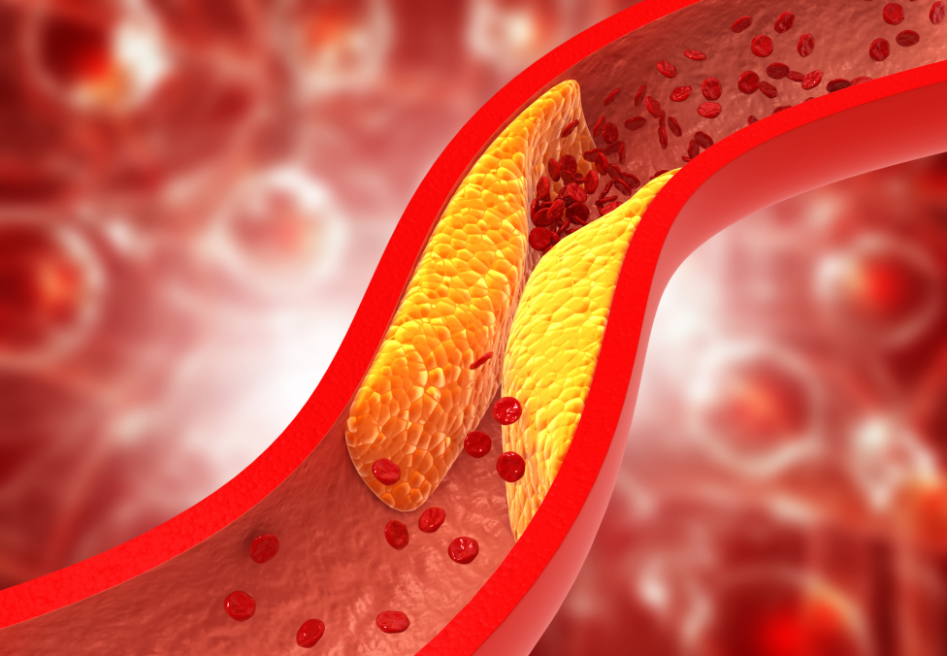
FH Screening training for Primary Care
RCGP FH training available:
https://elearning.rcgp.org.uk/course/info.php?id=487
Module 1 provides GPs and other Health Care Professionals with information about the causes and consequences of FH, how they can identify those in their practice most likely to have FH, and how these patients and their relatives should be managed.
Module 2 covers the genetic causes of FH in more detail, the ongoing study into identifying FH in infants, and describes novel lipid-lowering agents.

Slide 36
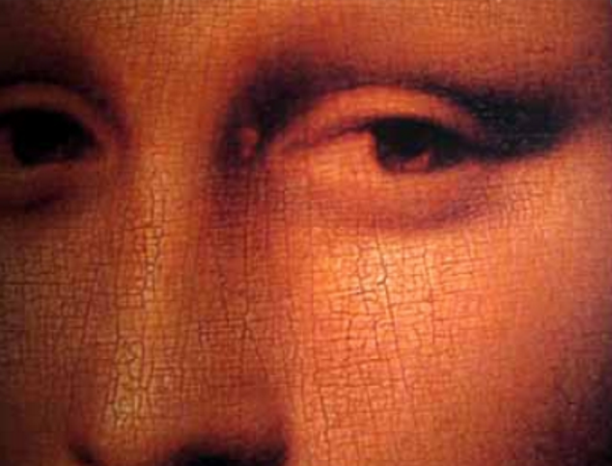
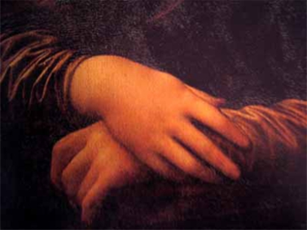
Did Mona Lisa have FH?
Died aged 37 of unknown causes
Portrait painted in 1506 may be the the first evidence of FH
Was not formally described until 1852 by Addison and Gall

Slide 37
Thank you

