Slide 1
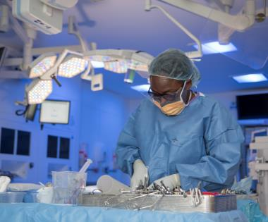
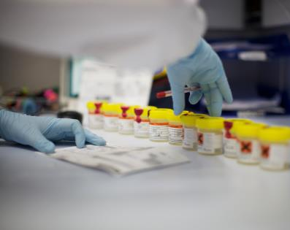
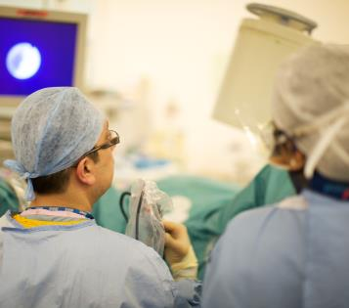
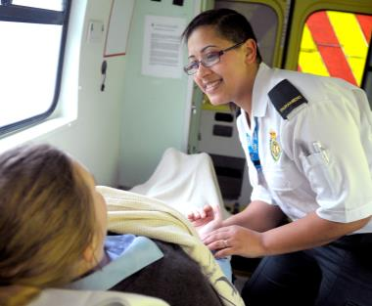
Patient Safety Education London Symposium

Slide 2
Aim
To provide a forum to connect educators and patient safety specialists
To understand the potential opportunities to integrate patient safety science into education and improvement activity

Slide 3
Patient Safety Syllabus
The syllabus developed by the Academy of Medical Royal Collages will be delivered across 5 levels, each level targeted towards a specific audience and topic.
Levels 1 and 2 will be delivered via a 20 to 30 minute e-learning sessions utilizing animation, case studies,
Knowledge checks and interactive delivery to convey the relevant syllabus knowledge.
Level 1 will be split across 2 courses; session 1 will be specific to the whole workforce and sessions 2
Specific only to board members
Level 2 will be delivered via 2 sessions within one course and will focus on the key themes of the systems
Approach, proactive and reactive approaches to risk, human factors and safety culture
Access to the board specific content and the level 2 content will not be granted until session 1 is complete
Levels 3 to 5 will be delivered by HEIs or another such organizations with accreditation
The Levels 1 and 2 will go live end of October 2021
Syllabus overview available: https://www.hee.nhs.uk/our-work/patient-safety

