Slide 1

TRANSABDOMINAL CERVICAL CERCLAGE
UCLH PTBC Team
9/6/2022
NORTH CENTRAL LONDON PRETERM BIRTH NETWORK

Slide 2
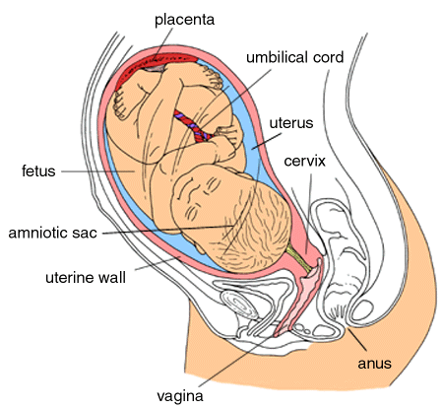
Causes of preterm birth
Infection
Cervix weakness/trauma
Multiple pregnancy
Increasing maternal age
Placental insufficiency
Fetal anomaly
Uterine anomaly
Smoking
Low progesterone
Immune response
Maternal disease
Excess amniotic fluid
Domestic violence

Slide 3
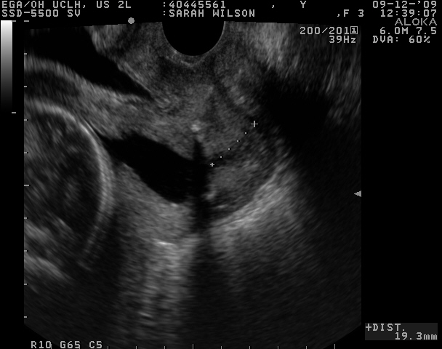


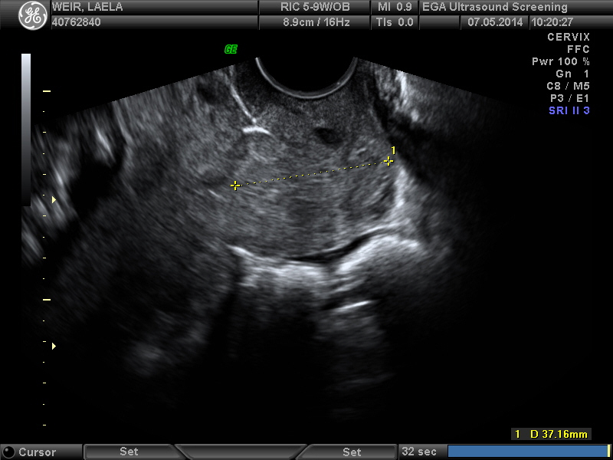
MacDonald
Shirodkar
Abdominal
Abdominal

Slide 4
A patient: Mrs LA
26 year old Afro-Caribbean, Non-Smoker
1st pregnancy miscarriage at 15 weeks
2nd pregnancy 22 week PPROM
3rd pregnancy Macdonald cerclage at 16 weeks when Cx shortened
Miscarriage at 18 weeks
What is my risk of preterm birth?
Management?

Slide 5
Recurrent risk for preterm delivery in a 3rd birth
McManemy J, Cooke E, Amon E, Leet T.
AmJOG 2007;196:576-576.

Slide 6
MAVRIC trial Women with a previous PTB or PPROM <28 weeks

Slide 7
MAVRIC trial Women with a previous PTB or PPROM <28 weeks
129 patients randomised 1:1:1
Shennan et al AJOG 2020

Slide 8
MAVRIC trial Women with a previous PTB or PPROM <28 weeks
Shennan et al AJOG 2020

Slide 9


Slide 10
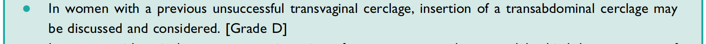
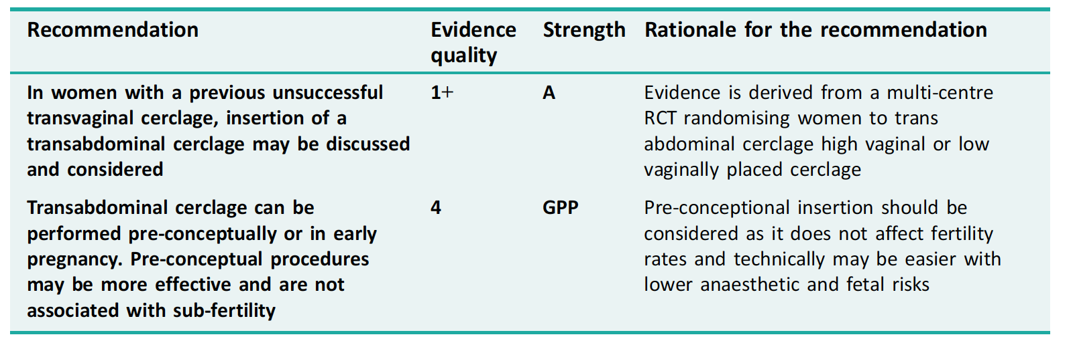
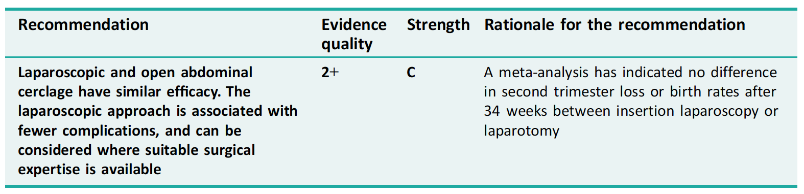

Slide 11

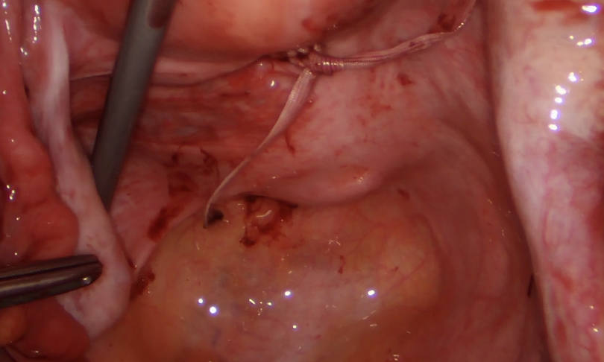

Interval laparoscopic cervical cerclage for the prevention of midtrimester pregnancy loss and preterm birth:
a single centre experience
Mr Ertan Saridogan, Mr Oliver O’Donovan

Slide 12
Results
N= 54
4 lost to follow up
4 ongoing pregnancies
16 not pregnant (5<1yr since surgery, 1 not trying) - 83% fertility rate after 1 year
2 women had 2 babies each
All day cases except one lady had concurrent laparoscopic myomectomy
No complications

Slide 13
Results comparison
 | UCLH (%) | Huang (%) | Moawad (%)
Fertility | 83 | 82 | 78
Del >37/40 | 72 | 76 | ?
Del >34/40 | 81 | ? | 83
Livebirth | 91 | 96 | 96
Neonatal survival | 88 | 96 | 90
Complication rate | 0 | 1 | 1
i.e. supports previous studies
good outcomes
low complication rates

Slide 14
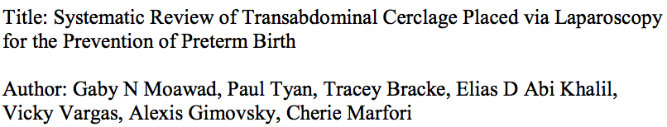
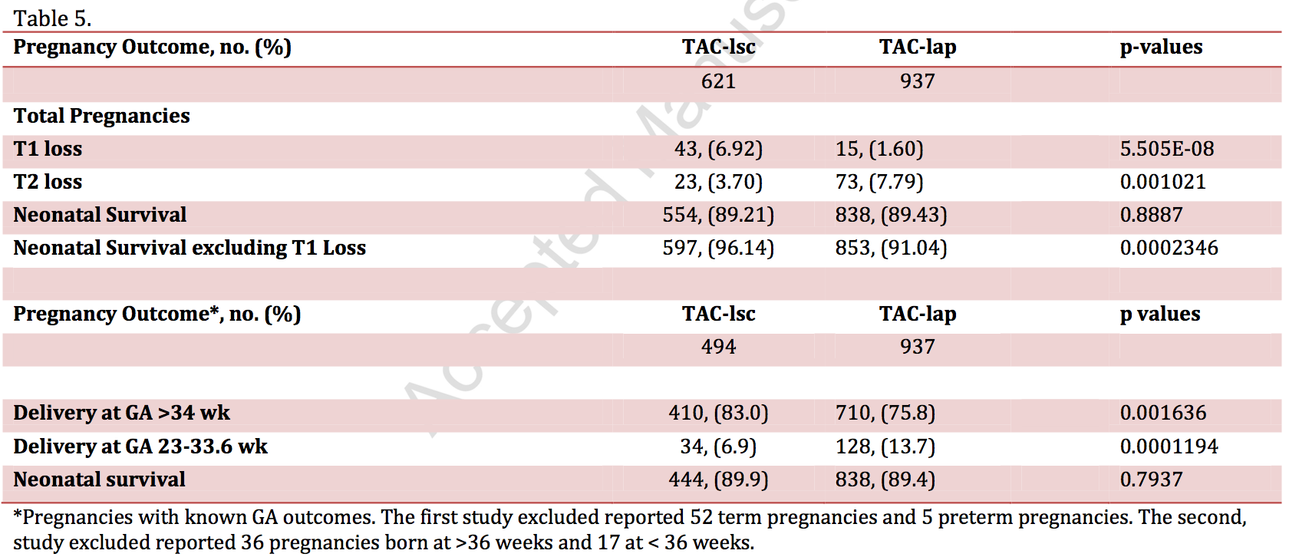

Systematic review of open vs laparoscopic
Open 26 studies, laparoscopic 15
Moawad et al J. Minimally Invasive Gynaecology 2017

Slide 15
A patient: Mrs LA
26 year old Afro-Caribbean, Non-Smoker
1st pregnancy miscarriage at 15 weeks
2nd pregnancy 22 week PPROM
3rd pregnancy Macdonald cerclage at 16 weeks when Cx shortened
Miscarriage at 18 weeks
Management?
Laparoscopic pre-pregnancy cervical cerclage
Caesarean section at 37+3 weeks

Slide 16
CASE 1 - OM
38 yrs
White British, BMI 22, non-smoker
PMHx: nil, cervical smears –normal.
DHx: pregnancy vitamins
Obs Hx: G6 P3 + 2
2012 40 wks EMCS at 8cm for fetal distress
2013 Early miscarriage – surgical management
2014 38 wks FD, OASI 3b perineal tear (no cervical tear)
2016 20 wks Late miscarriage: large bleed and subchorionic haematoma in the 1st trimester; increased PV discharge and PPROM at 20w; ?IOL; no PM exam

Slide 17
2017 under UCLH PTBC
PTBC 17w CL 31 mm
UTI at booking – treated by GP
PTBC 19w1d CL 37mm
Vaginal swabs - NAD
UTI E Coli - treated (negative TOC)
Anomaly scan 21w0d CL 15mm
PTBC 21w1d CL 15 mm
Funnelling, fFN 15ng/mL, urine negative
emergency cervical cerclage (McDonald) and progesterone treatment
PTBC 24w1d CL 28mm
cervix closed below and above the cerclage

Slide 18
PTBC 27w1d CL 24mm, fFN 58ng/mL
QUiPP – probability of SPTB:
< 30 weeks 8.1% within 1 week 2.5%
< 34 weeks 24.2% within 2 weeks 5.4%
< 37 weeks 38% within 4 weeks 12.2%
MFAU 29w0d abdominal pain and PV discharge CL 11mm, fFN 354ng/mL
Normal fetal growth, Dopplers and AFI
Admitted to LW, steroids given.
LW 29w1d PPROM, cervical cerclage was removed. Vaginal delivery of baby boy 1300g. Currently well.
Completed 5 days of iv abx E Coli (cervical cerclage grew E coli)
Histology (placenta): acute chorioamnionitis and funisitis

Slide 19
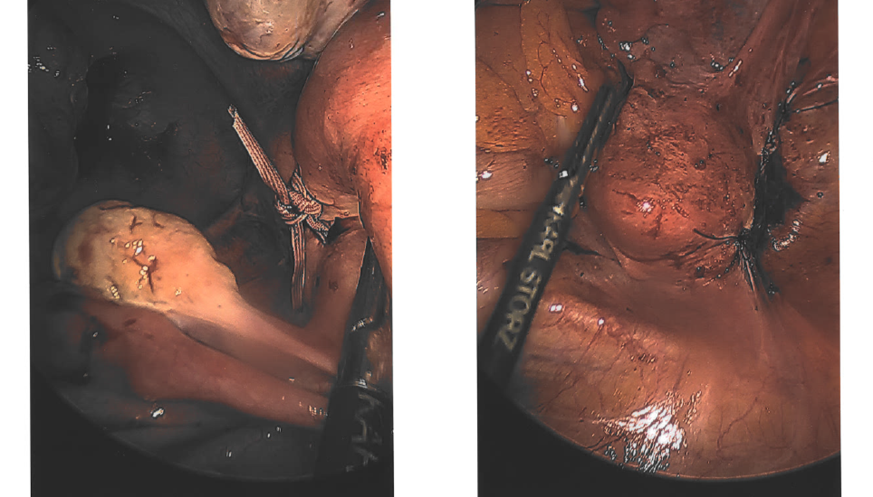
PN debrief and future pregnancies counselling – elective McDonald vs TAC and results of MAVRIC trial discussed
Referred to RMU
2021 Laparoscopic TAC

Slide 20
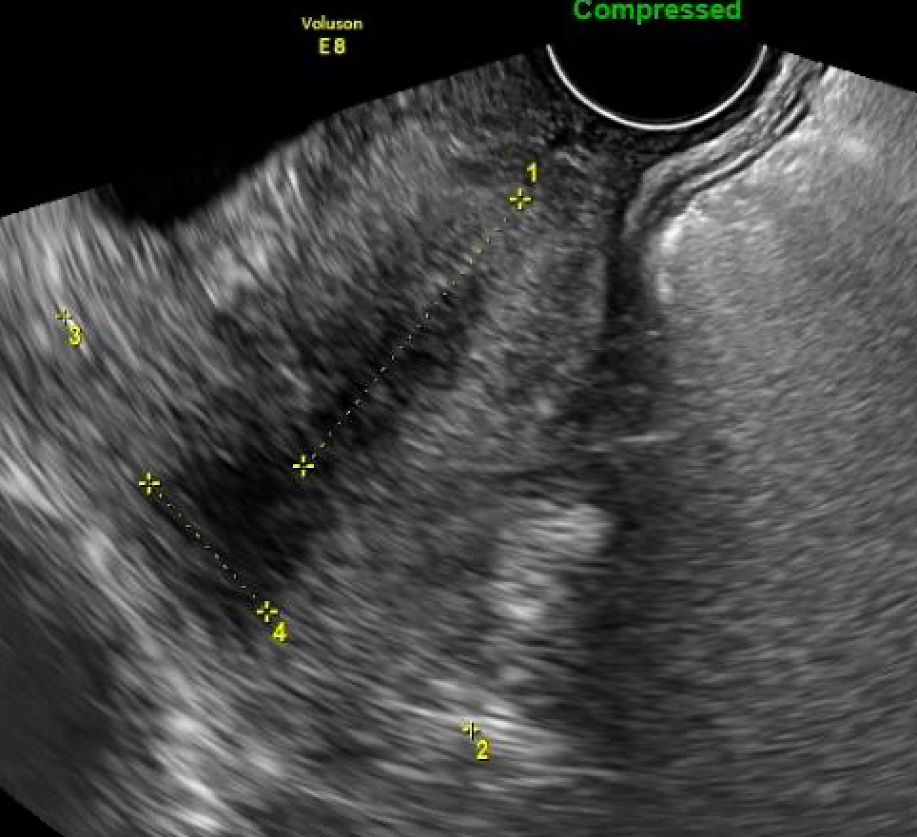
2022 under UCLH
Nuchal scan 12w5d CL 29mm
PTBC 14w6d CL 40mm
Urine and vaginal swabs NAD
Progesterone 200mg OD started
PTBC 16w6d CL 37mm
PTBC 18w6d CL 38mm, fFN 1ng/mL
Anomaly scan 20w6d CL 45mm
PTBC 22w6d CL 42mm, fFN 1ng/mL
Borderline AFI 25 → OGTT N
PTBC 25w6d CL 40mm

Slide 21
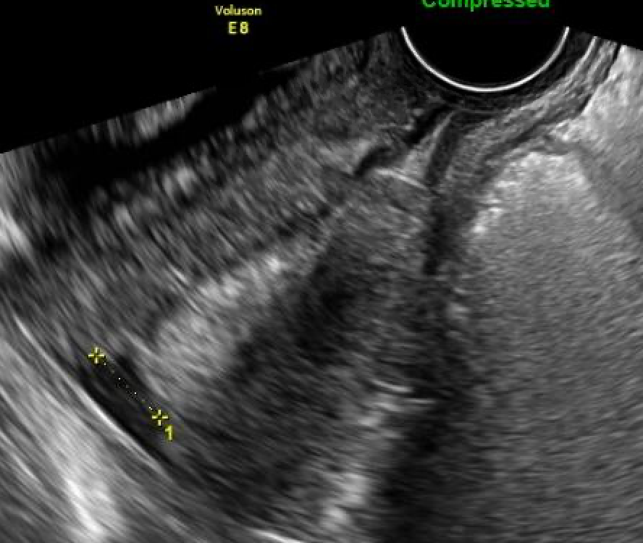
PTBC 28w6d CL 47mm
Normal fetal growth and Dopplers
Plan for ELCS at 37w
MFAU 36w6d Presented with brown pv discharge
CL 37 mm, Funnelling through the TAC around 2cm which extends 2cm into the internal os
Plan to expedite delivery within the next 1-2 days
Cat 3 EMCS 37w1d EBL 1000mL baby boy 3030g well

Slide 22
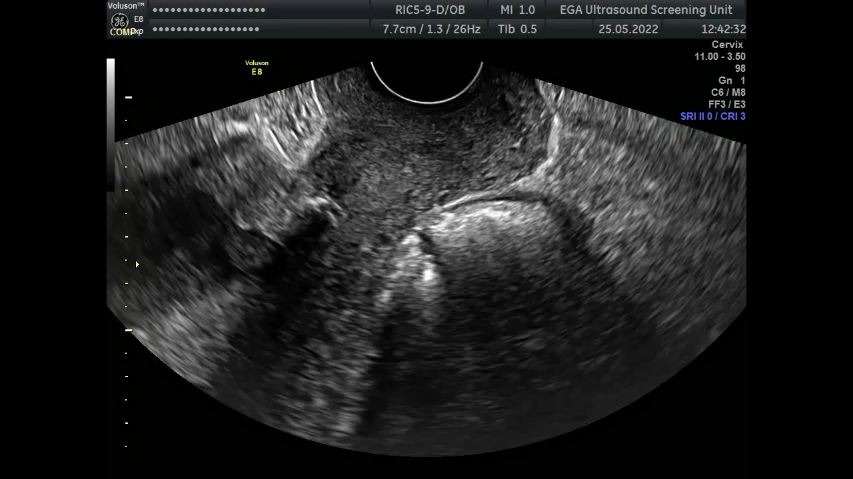
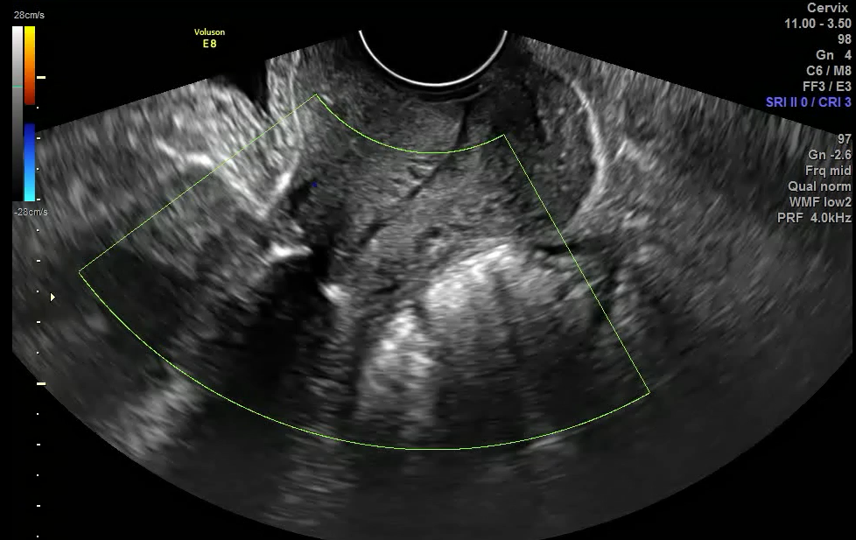
TVUS examination of the cervix/TAC during 2nd trimester of pregnancy

Slide 23
CASE 2 - AS
32 yrs
White European, BMI 21, non-smoker
PMHx: IBS
DHx: pregnancy vitamins
Obs Hx:
1st pregnancy - Late miscarriage at 20wks with rescue cerclage
2nd pregnancy - SVD at 23wks SVD with elective vaginal cerclage, NND after 2 weeks.
Referred for pre-conception abdominal cerclage.
2019 - Laparoscopic abdominal cerclage at UCLH. Uncomplicated procedure.

Slide 24
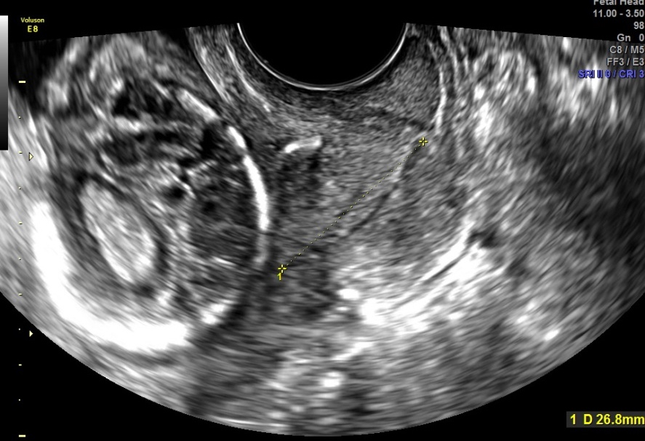
3rd pregnancy – UCLH PTB clinic
EPU 11w – Presented with pv bleeding. Scan – normal. Started on progesterone.
Nuchal Scan 12w4d CL 28mm
PTBC 14w6, 16w6d, 18w5d CL 26 - 28 mm. Abdominal cerclage was visible and the cervix was closed below it. Progesterone continued. Urine and Vaginal swabs – NAD.
Anomaly Scan 20w4d CL 26
CL at 16 wks

Slide 25
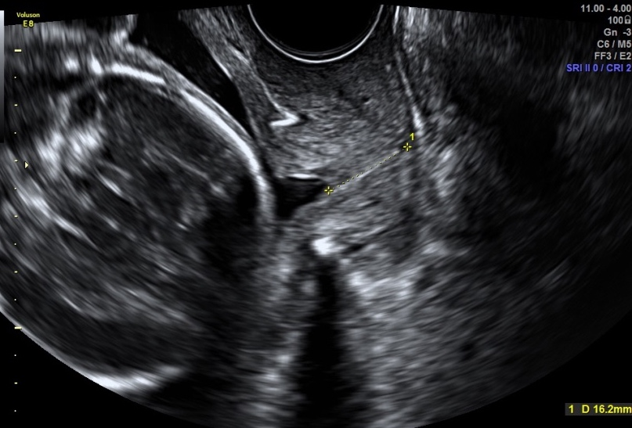
PTBC 22w6d
TVUS
Total closed CL 17mm. Mild funnelling noted through top of abdominal cerclage. FFN 34ng/ml. Patient generally asymptomatic. Occasional abdominal discomfort.
Urine Culture – NAD
Plan: Continue Progesterone PTBC in 3 weeks
QUiPP – probability of SPTB:
within 1 week 1.3%
within 2 weeks 2.9%
within 4 weeks 7.8%
< 30 weeks 20.6%
< 34 weeks 44.3%
< 37 weeks 62.1%

Slide 26
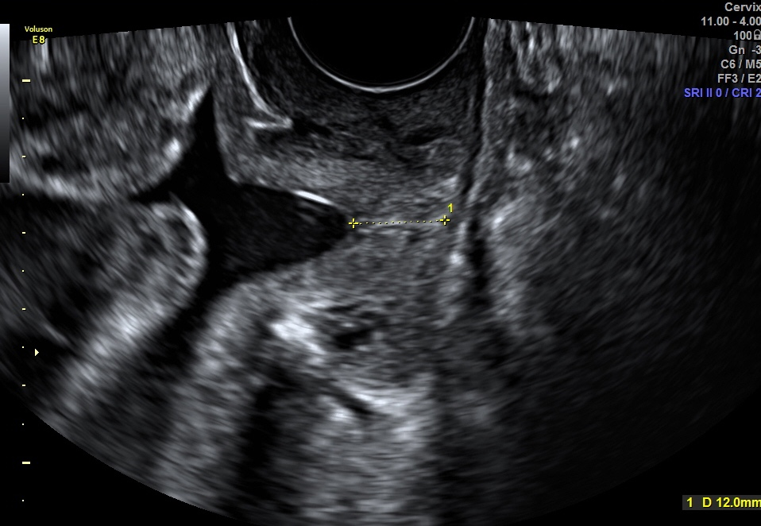
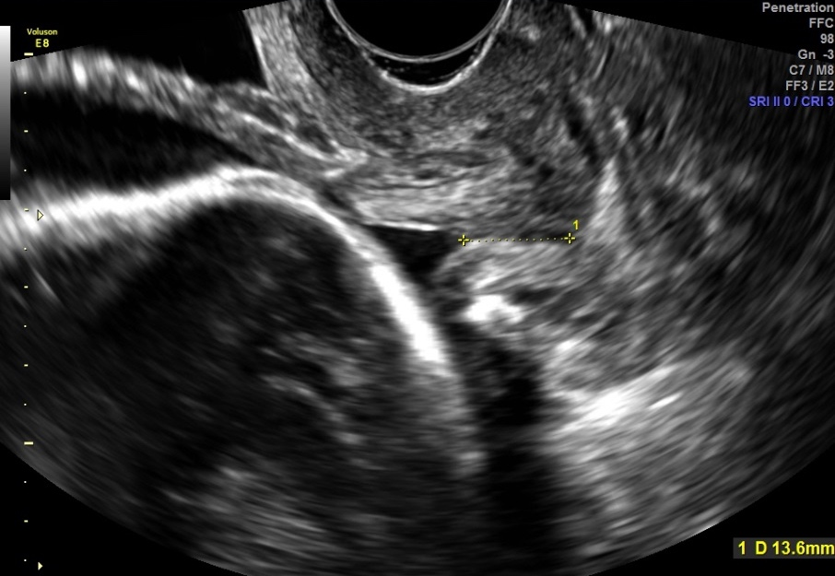
TVUS
MFAU 24w5d – Presented with crampy lower abdominal pain. Admitted with suspected TPTL. FFN 128 ng/ml. TVUS CL 15mm, mild funnelling noted.
Pain relief, Steroids, Tocolysis ( Nifedipine)
Developed loose stools – suspected gastroenteritis
Stool, urine culture – NAD. HVS – BV ( Metronidazole)
PTBC 25w6d- Patient asymptomatic. TVUS - funnelling of the cervix through the abdominal cerclage. No pressure effect. Closed total CL 12mm. Discharged home.
PTBC 27+6 - CL 14mm, funnelling noted as previously. Situation stable.
Plan:
Continue progesterone until 36-37 weeks
ElCS 39 weeks scheduled
25w6d
27w6d

Slide 27
MFAU 35w6d – Admitted for 2 days with irregular abdominal crampy pain and RFM. Discharged as symptoms settled. Urine and Vaginal swabs – NAD.
MFAU 38w1d – Presented with mild abdominal cramps and RFM. US – Normal Dopplers and amniotic fluid.
LW 38w5d – Uncomplicated ElCS. EBL 650mls

