Slide 1
London Simulation Network 15th July 2022
EDI in debrief: tackling inequity in and through simulation

Slide 2
Session Schedule
Orientation 5 minutes
Introductions & Mastermind 5 minutes
EDI in debrief
Before 5 minutes
During 20 minutes
In action 10 minutes
After - don’t forget
Question and answer session 15 minutes

Slide 3
Housekeeping
Environment
Check your background (no blurring)
People living with you may need to know you are in a training session
please protect this space as you would do in a training centre
Comfort
Toilets, fire escape…
Feel free to bring a drink
Session recording
consent
Confidentiality
Psychological safety

Slide 4
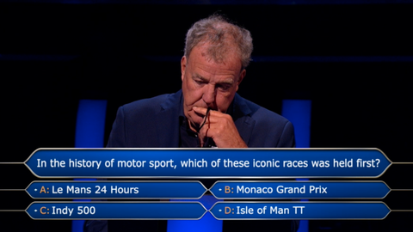
EDI: scale of the problem
Do you wish to put your knowledge on this to the ultimate test?
A: Yes
B: Yes
C: Yes
D: Yes

Slide 5
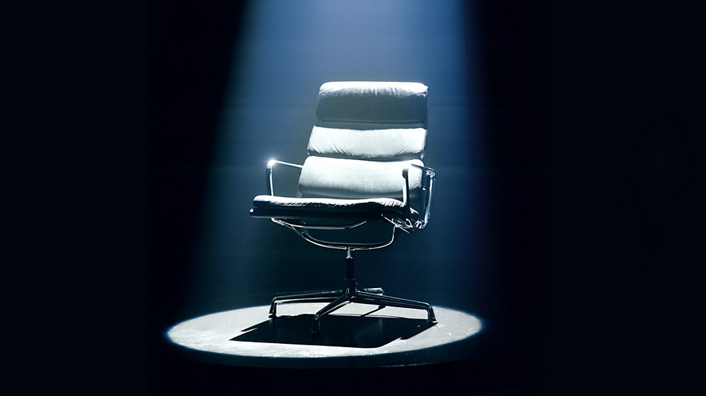
Maudsley Mastermind: specialist topic EDI
Notes:
Pole answers?

Slide 6
Maudsley Mastermind: specialist topic EDI
1. Relative likelihood of white NHS applicants being appointed from shortlisting compared to BME in 2021?
A: 1.1
B: 1.61
C: 2.3
D: 1.45
2. Percentage of white staff experiencing discrimination from colleagues in NHS in 2021?
A: 6.2
B: 8.3
C: 2.9
D: 4.5
3. Percentage of BME staff experiencing discrimination from colleagues in NHS in 2021?
A: 12.4
B: 16.7
C: 8.8
D: 7.5
4. Relative likelihood od white staff getting access to non-mandatory training and CPD compared to BME?
A: 1.14
B: 1.09
C: 2.3
D: 1.73
Notes:
Pole answers?

Slide 7
Maudsley Mastermind: specialist topic EDI
Adjusting for geographical, socio-economic and pre-existing health factors, which group was at higher risk of COVID-19 mortality
than white group, in the second wave?
A: Black African
B:. Indian
C: Pakistani
D: Chinese
Percentage of LGBTQ+ individuals who had a negative experience when accessing public health services because of their gender
identity?
A: 14%
B: 28.1%
C: 42%
D: 38%
How much more likely was a person of mixed ethnicity likely to be restrained in mental health services in 2019, compared to their
white counterparts?
A: 1.7
B: 1.4
C: 2.0
D: 3.0
Notes:
Pole answers?
- only 12.6% of board members were from BME backgrounds even though

Slide 8
The thought of bringing up EDI during a debrief makes me feel....
Because....
Notes:
Pole answers?

Slide 9
Stage 1: Preparedness
The faculty
Make up
Current knowledge
The psychological space
Icebreaker type
Ground rules
Statement
Role modelling, avoiding re-enactment
Timing
SLaM are committed to tackling inequality, eliminating discrimination and harassment, promoting equality of opportunity for all and fostering good relations.
https://www.slam.nhs.uk/about-us/equality/public-sector-equality-duty/
Notes:
co-facilitation from diverse background
- icebreaker type: fvaourite place – often connect on cultural level, provide safe place for them to escape to in imagination
- ground rules to include: agreement that
I statements
lean into difficult conversations
There may not be closure for some topics
Use own experiences
- microaggresions will be dealt with

Slide 10
Sneak preview of reading list
NHS Race and Health Observatory https://www.nhsrho.org/
Vara S., Dahlen B., et al. (2021), Recommendations and Guidelines for the Use of Simulation to Address Structural Racism and Implicit Bias, Simulation in Healthcare 1;16(4):275-284.doi 10.1097/SIH.0000000000000591. PMID: 34398114.
Reni E-L, (2017) Why I’m No Longer Talking to White People About Race, Bloombsbury Circus
Braincast, About Race: ethnic inequalities in mental health, maudsleylearning.com/webinars-podcasts/braincast-webinar/about-race-ethnic-inequalities-in-mental-health
NHS Workforce Race Equality Standard 2021 data analysis report for NHS trusts (2022) https://www.england.nhs.uk/wp-content/uploads/2022/04/Workforce-Race-Equality-Standard-report-2021-.pdf

Slide 11
Stage 2: Raise
The direct approach
Perspective taking
“ I noticed that.... I wonder what...”
Watchful waiting of a carefully constructed scenario
“ What might the patient/carer be thinking or feeling?”
De-personalising, owning things as a group
The ‘side door’ (start with the easier ‘isms’)
The carefully loaded question
“ Do we think things would have been different if....”
“ were there any protected characteristics which may have...
Notes:
Pole answers?

Slide 12
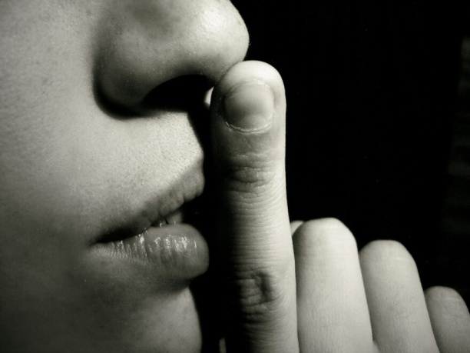
Stage 3A: Response - participants
TRYING TO USE LOGIC AND VERBAL REASON TO JUSTIFY SOMETHING UNACCEPTABLE
TRIES OVERLY HARD IN OPPOSITE DIRECTION
SILENCE
Denying lived experience
FOCUSED ONLY ON THE COGNITIVE ASPECTS, AVOIDS EMOTIONS
“ I do not see colour”
DISPUTING THE EXISTANCE OF A PROBLEM
OVERLY CRITICAL OF SOMEONE/SOMETHING ELSE UNRELATED
DEFLECTING THE CONVERSATION, AVOIDING THE MAIN ISSUE
Reframing as being to do with economy
ACCUSES SOMEONE ELSE OF WHAT THEY ARE DEMONSTRATING
Dodging specific words by using others e.g. “inner city youth”
COMFORT EATING
SHOUTING, INTERRUPTING & NOT LISTENING
Notes:
Pole answers?

Slide 13
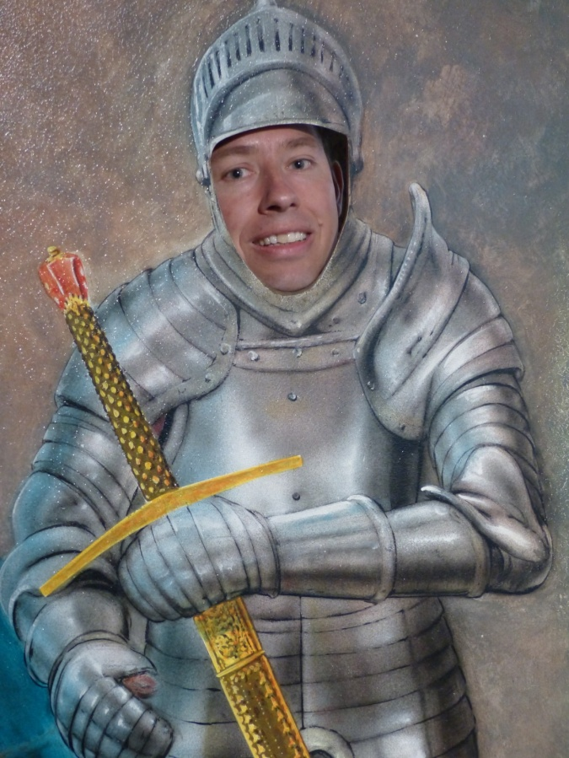
Stage 3A: Response – defense mechanisms
Unconscious psychological strategies activated within a person, in difficult emotional and/or cognitive situations, in order to help resolve the inner conflict
They distort reality to defend us against unacceptable feelings or impulses, and maintain our one schemas about ourselves
....not all defense mechanisms are considered equal
Notes:
Pole answers?

Slide 14
Stage 3A: Response - participants
TRYING TO USE LOGIC AND VERBAL REASON TO JUSTIFY SOMETHING UNACCEPTABLE
SILENCE
RATIONALISATION
DENIAL
TRIES OVERLY HARD
DISPUTING THE EXISTANCE OF A PROBLEM
FOCUSED ONLY ON THE COGNITIVE ASPECTS, AVOIDS EMOTIONS
REACTION FORMATION
INTELLECTUALISATION
DEFLECTING THE CONVERSATION
REPRESSION
OVERLY CRITICAL OF SOMEONE/SOMETHING ELSE UNRELATED
PROJECTION
ACCUSES SOMEONE ELSE OF WHAT THEY ARE DEMONSTRATING
SHOUTING & NOT LISTENING
REGRESSION
DISPLACEMENT
COMFORT EATING
Notes:
Pole answers?

Slide 15
Stage 3A: Response - FACILITATORS
TRYING TO USE LOGIC AND VERBAL REASON TO JUSTIFY SOMETHING UNACCEPTABLE
SILENCE
RATIONALISATION
DENIAL
TRIES OVERLY HARD
DISPUTING THE EXISTANCE OF A PROBLEM
FOCUSED ONLY ON THE COGNITIVE ASPECTS, AVOIDS EMOTIONS
REACTION FORMATION
INTELLECTUALISATION
DEFLECTING THE CONVERSATION
REPRESSION
OVERLY CRITICAL OF SOMEONE/SOMETHING ELSE UNRELATED
PROJECTION
ACCUSES SOMEONE ELSE OF WHAT THEY ARE DEMONSTRATING
SHOUTING & NOT LISTENING
REGRESSION
DISPLACEMENT
COMFORT EATING
Notes:
Pole answers?

Slide 16
Ways
Redirect back, refocusing on experiences and not generalities
Name the problem
Name the defense mechanism
Facilitate other group members to counteract
“Ouch”
Clarifications e.g. “what do you mean by ‘inner city youths’?”
If you were someone of colour, who would you experience hearing someone say they don’t see colour?

Slide 17
In action
Notes:
Pole answers?

Slide 18
Q&A and discussion

Slide 19
More
Ahmed T., Drummond R., Bosworth M, (2022) Updating ethnic contrasts in deaths involving the coronavirus (COVID-19), Engladn: 10 January 2022 to 16 February 2022, Office for National Statistics, www.ons.gov.uk
Raleigh V., Deaths from Covid-19 (coronvirus): how are they counted and what do they show? The King’s Fund, www.kingsfund.org.uk

